Slide 1
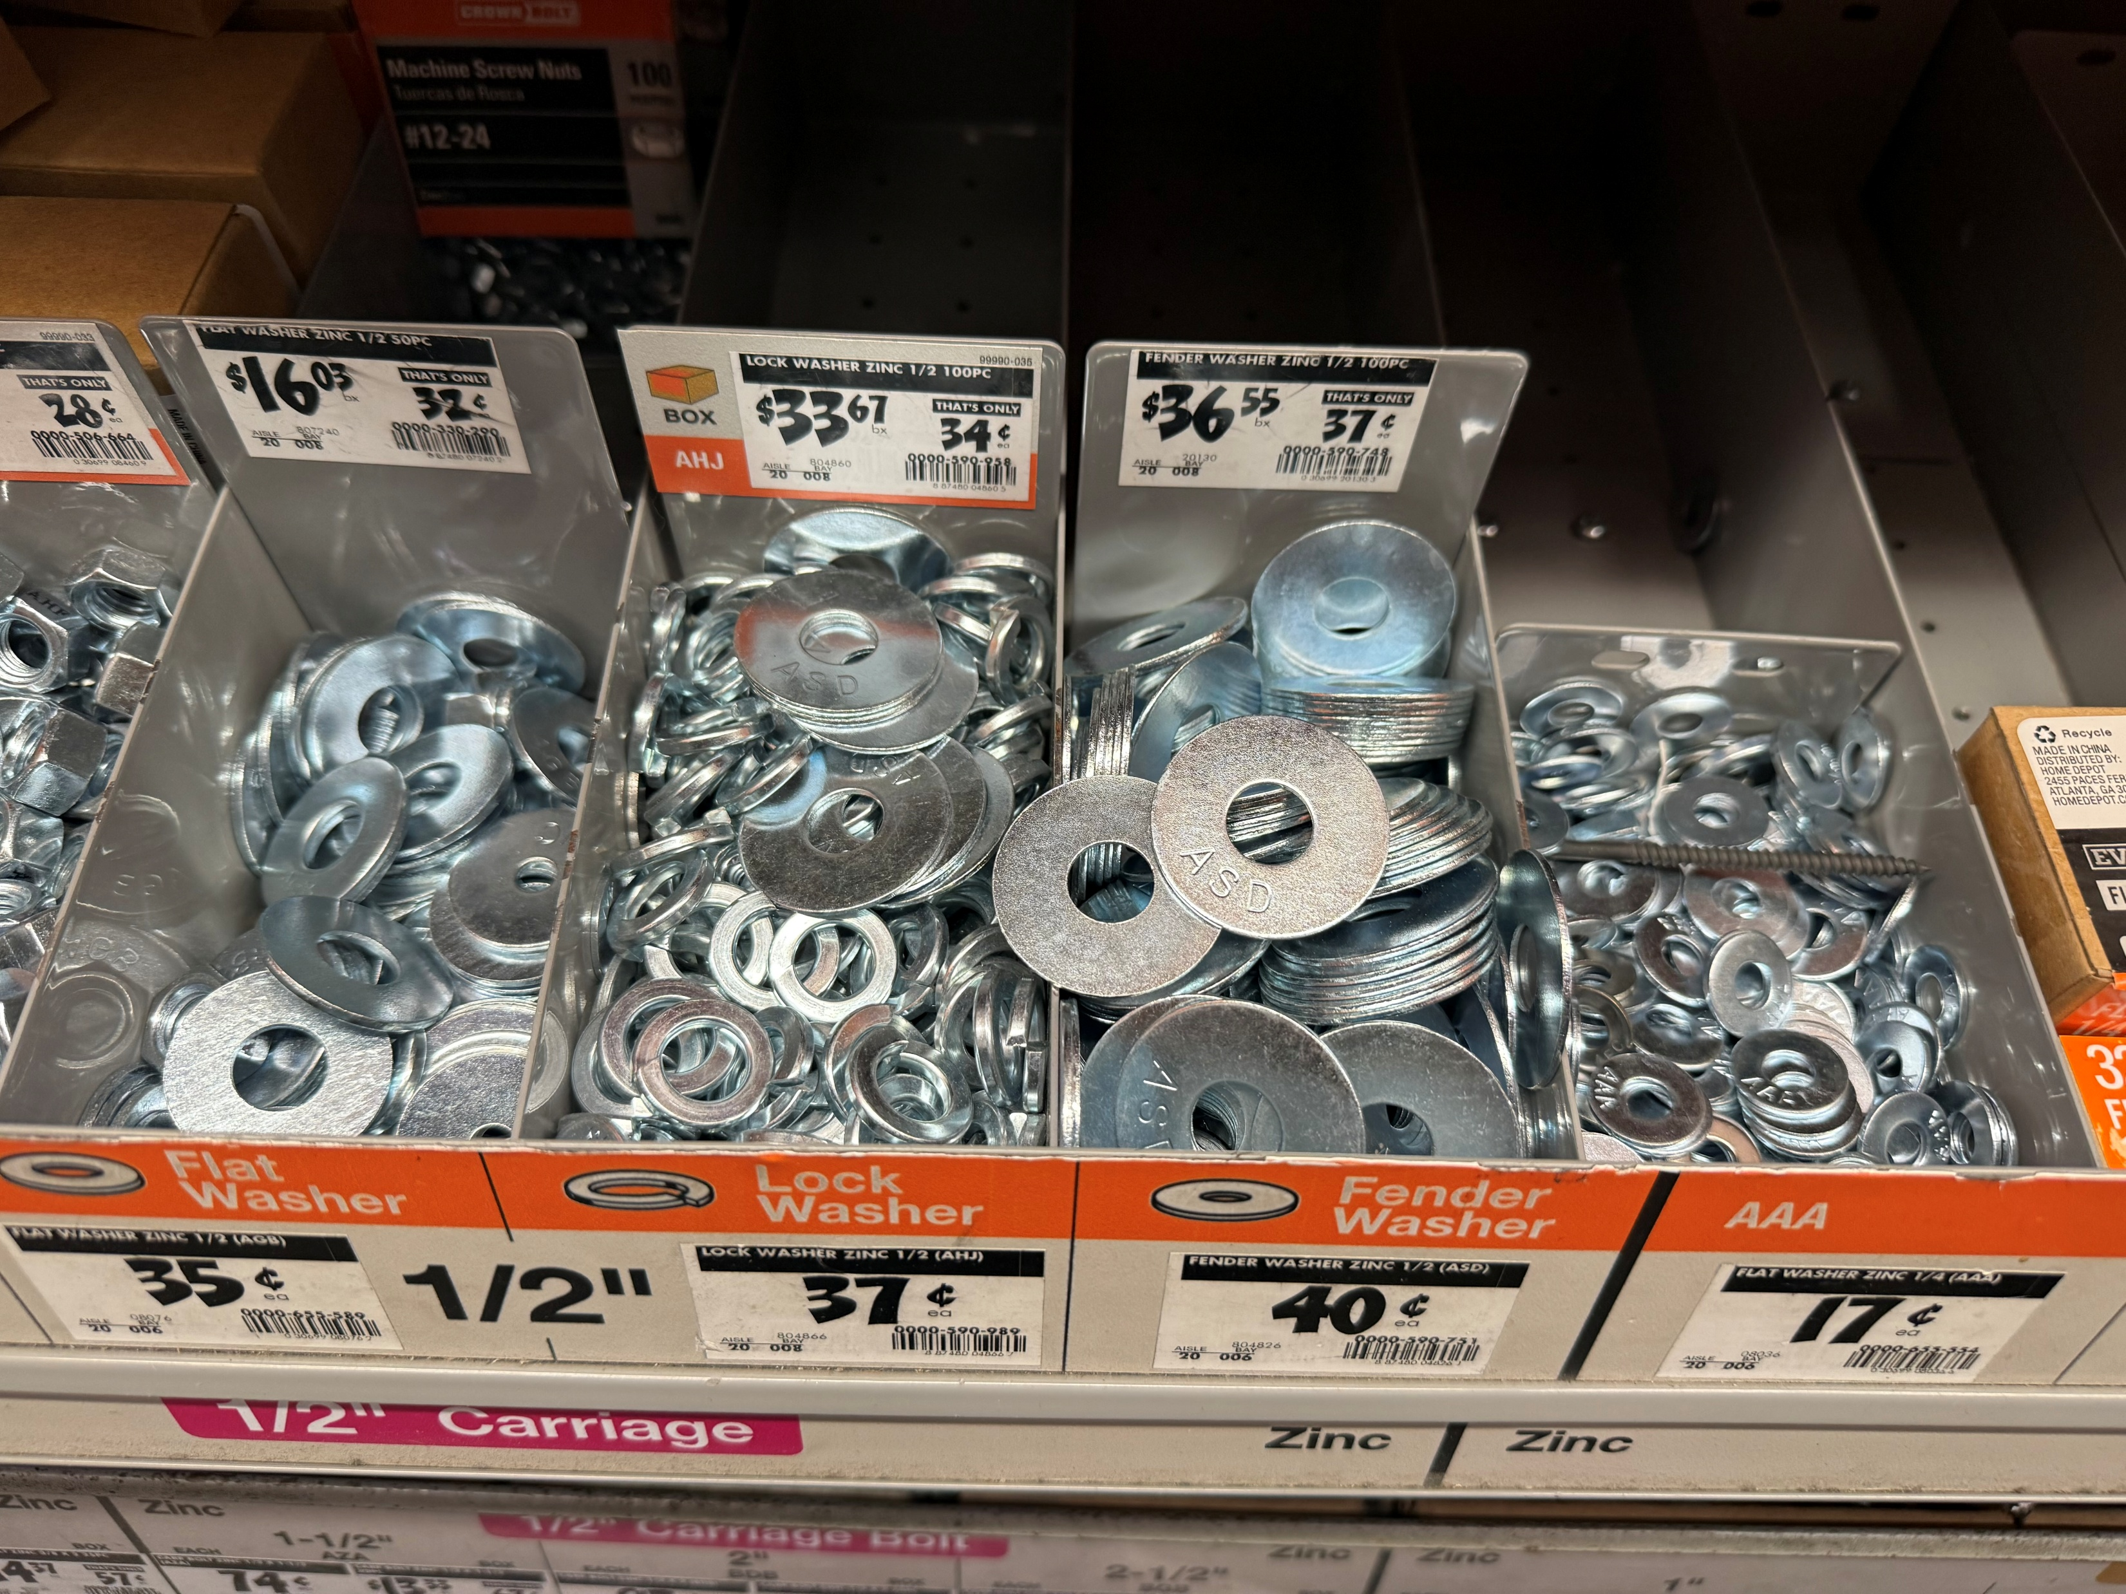
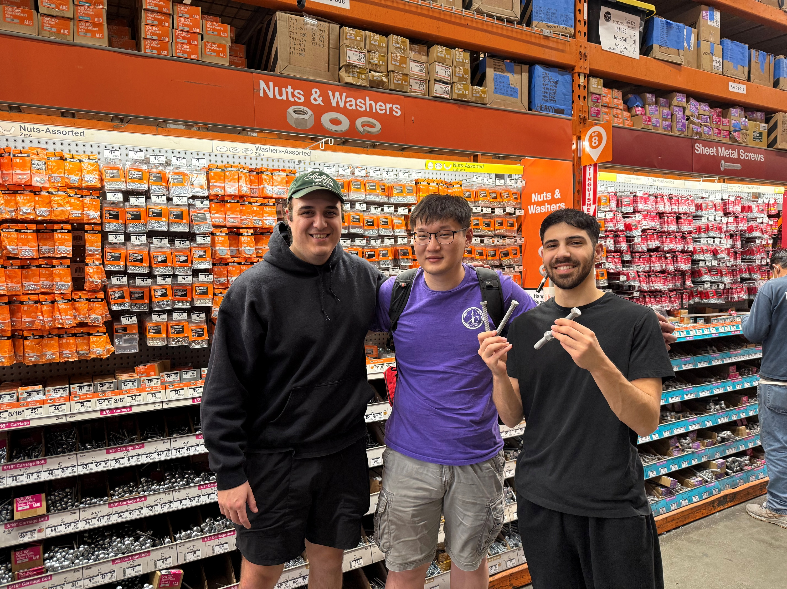
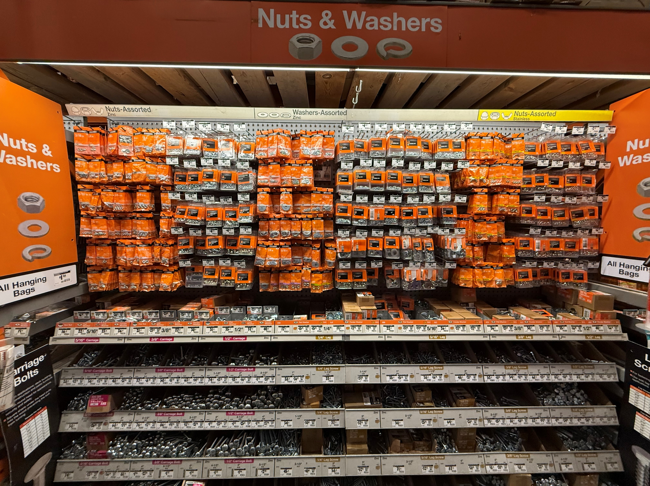
Question 1
Imperial Fasteners (USA)
  Imperial expressed by thread count
    Thread count of 20 would represent 20 threads per inch
  Imperial thread starts with W*N
    Pitch of the inch screw indicates number of threads per inch.
    ¼”-20x3 (Diameter – Thread count x Length)
Group Photo
British Fasteners (Metric)
  Metric expressed by thread pitch
    Distance between the threads
    1.5 pitch = 1.5 mm between threads
  Metric thread starts with letter “M”
    Followed by outer diameter of the thread “M8”

Slide 2
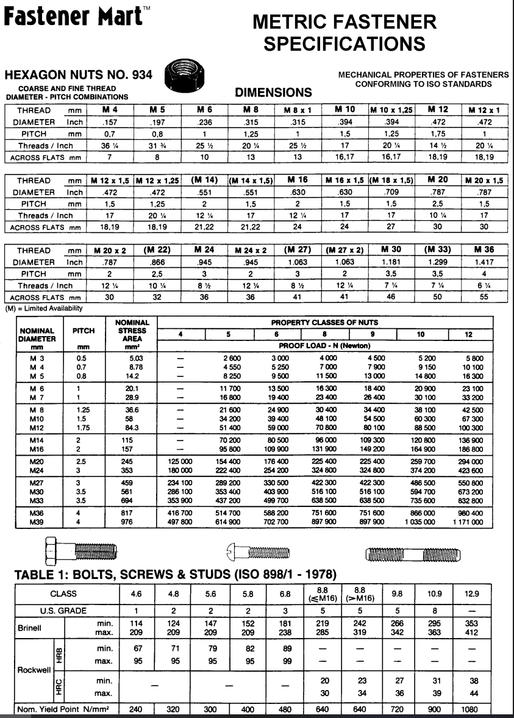
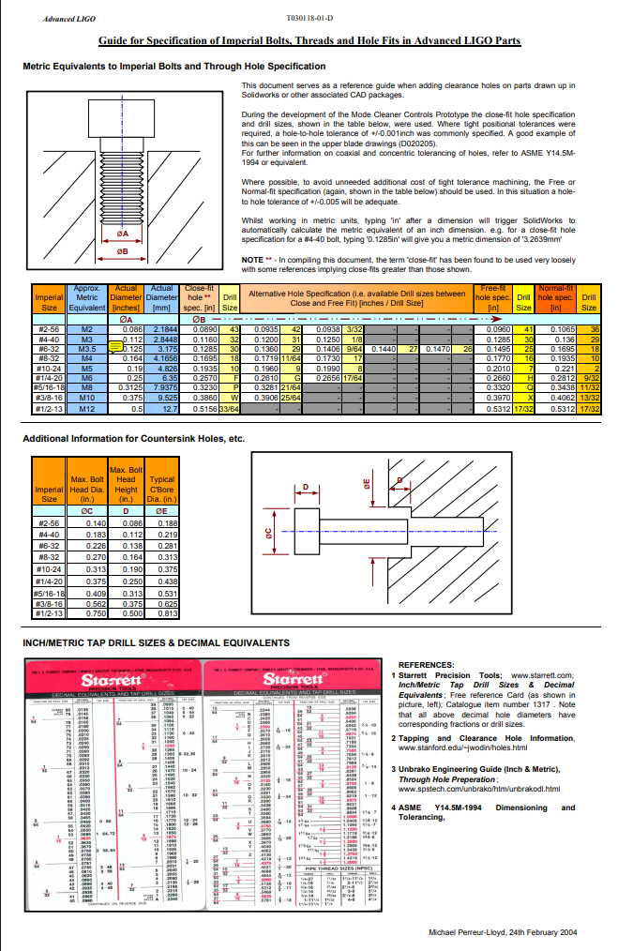
Question 1 Cont.
Metric Fasteners (British)
https://www.fastenal.com/content/feds/pdf/Article%20-%20Metric%20System%20&%20Specifications.pdf
https://www.fastenermart.com/files/metric_fastener_specs.pdf
https://www.nickelalloysonline.co.in/metric-bolt-sizes-and-dimensions.pdf
Imperial Fasteners (USA)
https://dcc.ligo.org/public/0027/T030118/001/T030118-01.pdf
https://www.aimsindustrial.com.au/blog/fastener-reference-guide-metric-imperial
https://www.mudgefasteners.com/imperial-vs-metric-chart

Slide 3
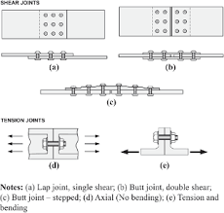
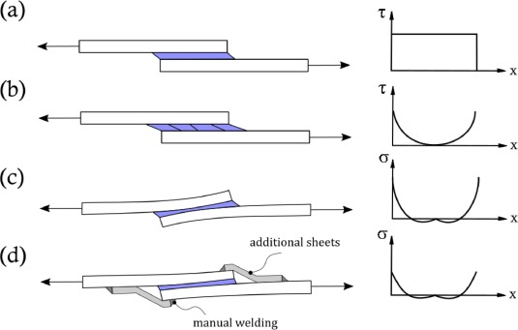
Question 2
Depending on application, fasteners can be more useful than bonded joints
  Field assembly
  Disassembly – Can be removed and reused (bonded joints are permanent)
  Maintenance – reversable process, easy to maintain and monitor
  Adjustments
  Quick - Fasteners provide immediate mechanical strength when tightened, no need to wait for a cure
  Very predictable – bonded joints can vary in performance based on surface prep, curing, how it was applied
    Fasteners are predictable – easy to calculate clamping force, tension, loads….
  Bonded joints better for weight savings, permanent solutions, sealed joints, aerodynamics
    Good for vibration dampening and load distribution
https://www.sciencedirect.com/science/article/pii/S2666330922000279
https://www.emerald.com/insight/content/doi/10.1108/aeat-10-2012-0184/full/html

Slide 4
Question 3
40 lessons learned, Handbook ORD 5700 (https://www.parker.com/content/dam/Parker-com/Literature/O-Ring-Division-Literature/ORD-5700.pdf)
An O-ring is a doughnut-shaped (torus) ring, usually made from elastomers, though some are made from PTFE, thermoplastics, or metals. Their primary function is sealing, but they can also serve as light-duty mechanical drive belts.
An O-ring seal is used to prevent the loss of fluid or gas. The seal assembly consist of an elastomer O-ring and a gland. The gland is usually cut into metal or another ridged material which contains and supports the O-ring
O-ring failure is usually gradual and easy to identify
Cost effective
Elastomer O-rings can be made leak proof for fluid pressures up to 5000 psi
O-rings with smaller cross-section diameters are less stable than larger cross-sections, tending to twist in the groove when reciprocating motion occurs. This leads to early O-ring spiral failure and leakage
Spiral failure – O-ring gets twisted, and a spiral cut occurs around the circumference
  Caused by lack of lubrication, Speed of stroke, temperature
Extrusion of seal material – caused by high pressure, seal hardness, strength, or clearance
Squeeze – too much squeeze will cause excessive friction, wear, or spiral failure
Extrusion and Nibbling – O-ring material gets pushed into gaps and torn or nibbled away
  Occurs when clearness are too large or under high pressure
Blow out – seal failure caused by the action of the pressure in the system on the side of the O-ring, forcing it out of the groove into some other par of the system
  Occurs when differential pressures are above 5.5 bar (80 psi)
Compression Set – O-ring doesn’t return to its initial shape
  Caused by prolonged compression, temperature, or material selection
Explosive decompression – Caused by high pressure gas trapped within the internal structure of the elastomeric seal element
Abrasion – Found in mostly dynamic seals subject either to reciprocating, oscillating, or rotary motion
  Caused by improper finish of the surface in dynamic contact with the O-ring, improper lubrication, excessive temperatures, or contamination od the system fluid with abrasive particles

Slide 5
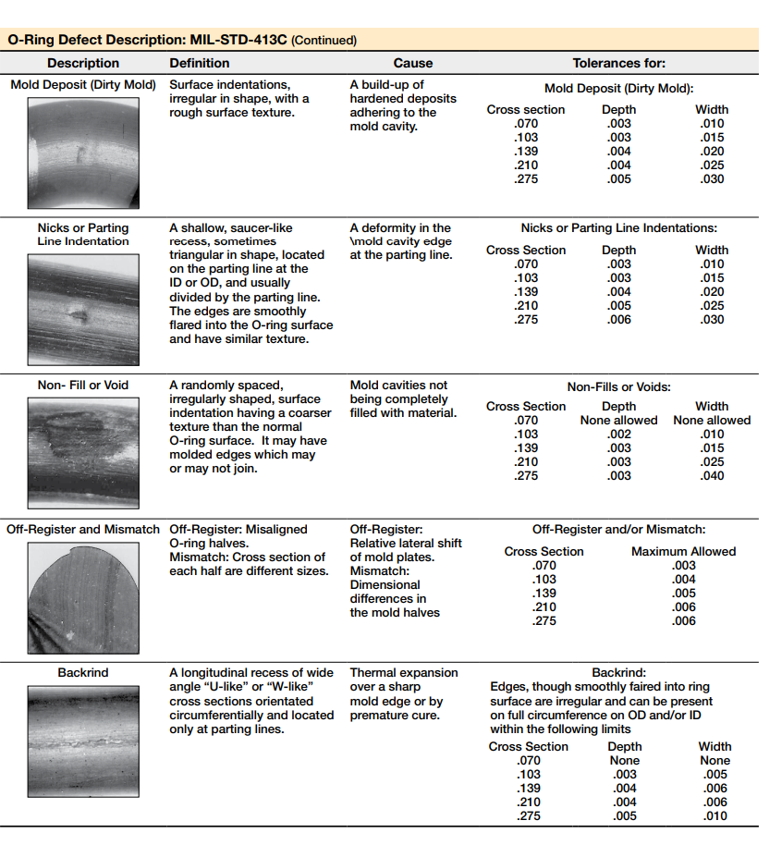
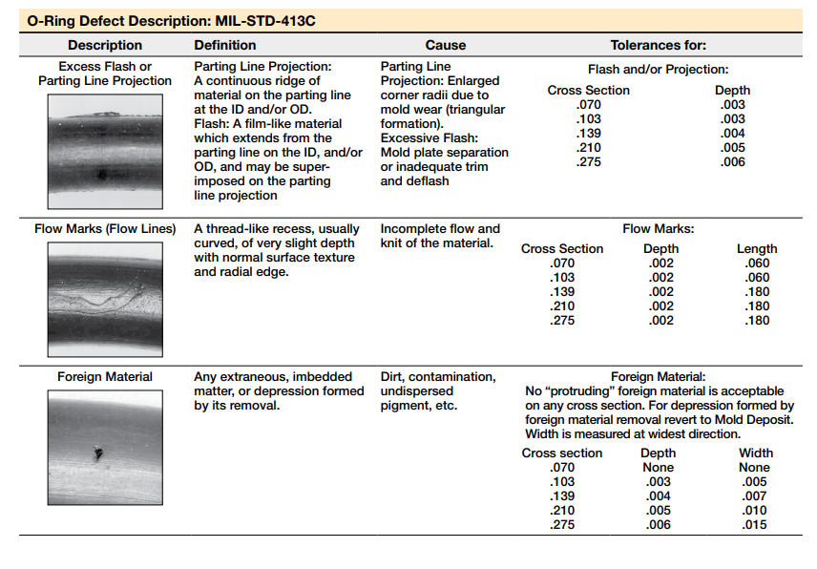
Question 3 Cont.
40 lessons learned, Handbook ORD 5700
Installation damage – improper installation
  Caused by insufficient lead-in chamfer, bling grooves, oversized O-ring, undersized O-ring, O-ring twist/pinch, improper lubrication, contaminated O-ring
Weather and Ozone degradation
Heat aging and oxidization
Loss of plasticizer(s)
Example Data sheet – Visual references for slandered visual defect tolerances

Slide 6
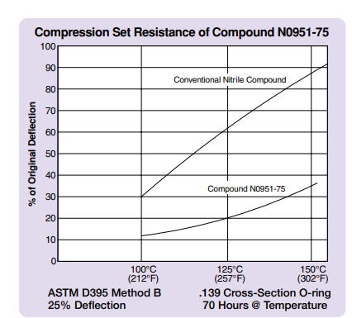
Question 3 Cont.
40 lessons learned, Handbook ORD 5700
Back-up rings precent extrusion in high pressure systems and compensate for loose fitting parts
Avoid gaps larger than the extrusion resistance of the material
Friction, either break-out, running, or both, can be troublesome in some applications
Use proper stretch guidelines
Choose a material rated for the temperature range
Account for thermal expansion
Cross-reference chemical compatibility charts
  Test for exact chemical, make sure fluid won't degrade seals
Inspect compatibility of mating hardware for scoring or rough finishes – surface finishes are very important for life of O-ring seals
Place the O-ring groove on the side opposite the direction of system pressure and friction to reduce the risk of extrusion
Butyl rubber is preferred for vacuum applications due to its extremely low gas permeability, low outgassing, and good sealing properties
When an O-ring contacts certain plastics, especially polycarbonates like Lexan, it can cause fine surface cracks known as “crazing,” which weaken the plastic over time
The gas leak rate through an O-ring can be estimated using the elastomer's known gas permeability at the operating temperature
  Uses the “Leak Rate Approximation” method
Fluorocarbons are the most useful for high temperature sealing applications
Silicone (S1224-70) and fluorosilicone (L1120-70) should be selected for low temperature applications
Nitrile compound N0951-75 is recommended for dynamic applications involving petroleum fluids, offering strong abrasion resistance, good low-temperature flexibility, and the best high-temperature performance in its class
Nitrile compound compression set resistance

Slide 7
Question 3 Cont.
40 lessons learned, Handbook ORD 5700
Gland fill—the percentage of the gland volume occupied by the O-ring
  should typically be between 60% and 85%, with an ideal target of 75%, to accommodate tolerance variations, swelling, and thermal expansion while ensuring at least a 10% void remains
Cleanliness is very important to assure proper sealing action and long O-ring life
  Maintaining clean fluids is also important to prevent excessive seal wear
Tooling is very important to reduce installation error, time, and to make everything easy – Extraction tools, O-ring sizing cone, O-ring kits
PTFE coatings of O-rings are an ideal low-friction coating that is used when operational flexibility is a major concern/consideration
In many cases an O-ring can be reused, an advantage over non-elastic flat seals and crush-type gaskets
A reciprocating seal involves back and forth axial motion between inner and outer elements, causing the O-ring or sealing surface to slide or roll

Slide 8
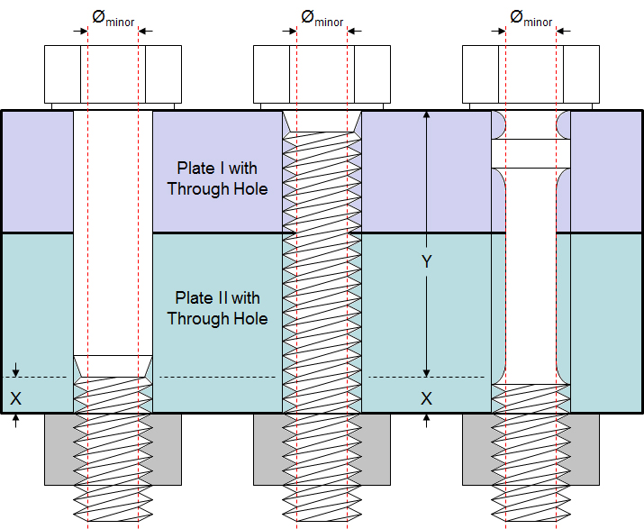
Question 4
Fasteners that lead to better fatigue performance
Fasteners fail in fatigue for 3 reasons
  Design issues
  Instillation/handling issues
  Loosening over time (dynamic loading, vibrations, etc..)
    Can be a combination of all three
Aluminum alloy fasteners processed by the electromagnetic cold expansion method have a 1.77 times greater fatigue life
  https://www.sciencedirect.com/science/article/abs/pii/S0142112322002584
Modify the geometry of the fastener so that any stretching that occurs is forced to act in a specific region where stress concentrations can be distributed uniformly
Use Tap bolts – Entire bolt length is threaded so they have a uniform cross-sectional area
Increase the length of the fastener = increasing the grip range of the fastener = longer fatigue life
Polish the area, surface conditions such as dents can increase stress concentrations
  This removes areas where a fatigue crack could initiate
Thread considerations
  Rolled threads have smoother thread surfaces and have greater strength (work hardened)
  Unified national rounded (UNR) root radius threads can be combined with being rolled which improves fatigue life by reducing stress concentrations
    UNJ and MJ – metric and imperial threads that have larger thread root radius than normal fasteners
Compatibility with thread material – stripping, relaxation, and embedment can all occur if clamp load is not maintained due to material deficiency
Maintaining clamp load and proper clamp load
  Follow spec sheets and torque guidelines
Corrosion resistant materials
Maintenance and replacement
https://www.fastenal.com/fast/services-and-solutions/engineering/fatigue

Slide 9
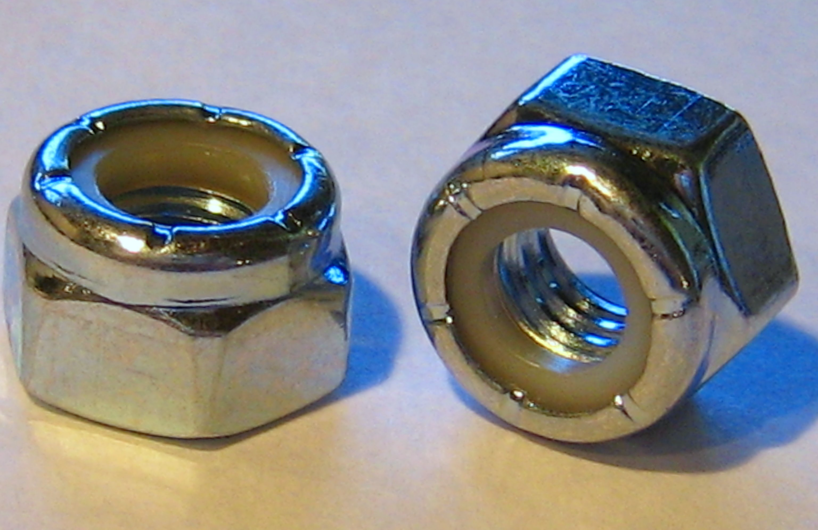
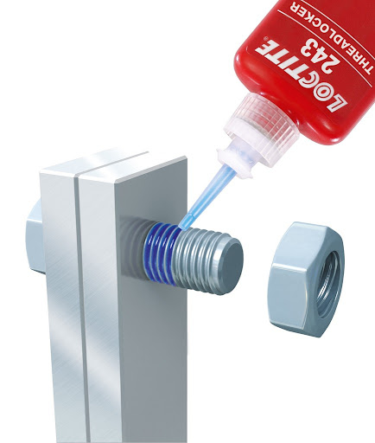
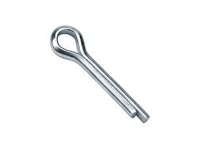
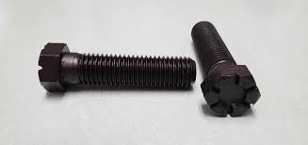
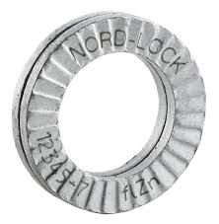
Question 5
Locking Features
Prevent fasteners from loosening due to vibration, dynamic loads, mechanical loads, or thermal cycling
Maintains structural integrity and is a safety precaution (redundancy)
Safety wire – used to prevent loosening
Lock nuts – Contain nylon inserts or deformed threads to resist loosening
Locking washers – exert a spring tension that keeps fastener from vibrating loose
Cotter pins – passes through the nut and bolt to hold it
Thread-locking adhesives – adhesive that fills the space between the threads to provide resistance to loosening
Self-locking bolts – has a locking mechanism, designed to keep the bolt tight without needing a separate lock nut or washer
Multiple nut method – Thin nut is placed on the bolt first and typically tightened 25% to 50% of overall tightening torque. Second nut is then placed on the bolt. The thin nut prevents rotation, and the thick nut is tightened to full torque specs.
Images
  Locknuts
  Cotter pins
  Locking washer
Thread-locking adhesives
Self-locking bolts

Slide 10
Question 6 and Question 7
10 Fasteners required how many should you include?
  Common procedure is a 20%-30% margin to the number of fasteners
  I would suggest if design allows to use 13 fasteners for redundancy
  Factor of Safety should also be applied to the number of fasteners
    Fasteners rarely share load equally; some carry more loads than others
  Literature specifically says, NOT to design with the minimum number of fasteners required to meet loading conditions
    Instead, it recommends adding extra fasteners to account for uneven load distribution, manufacturing tolerances, or unpredicted loading environments/events
  https://web.mae.ufl.edu/designlab/Lab%20Assignments/Fastener%20Design%20Manual%20(NASA).pdf
Understanding Threads
  Do not assume all threads are equally engaged or equally carry load in a threaded fastener design
  Majority of the time, the first thread closest to the head carries the majority of the load
  Other threads take on progressively less load due to deformation
    Occurs due to elastic deformation of the bolt and internal threads
  Need to test fasteners to understand strength properties
  Thread engagement length is important
  https://web.mae.ufl.edu/designlab/Lab%20Assignments/Fastener%20Design%20Manual%20(NASA).pdf
  https://quicksearch.dla.mil/qsDocDetails.aspx?ident_number=53876 (Ch. 8)
  https://www.associatedfastening.com/blog/what-is-thread-engagement/

