Slide 1
AME 486
Project 5 – Backup
Henry Glover
2/24/2025

Slide 2
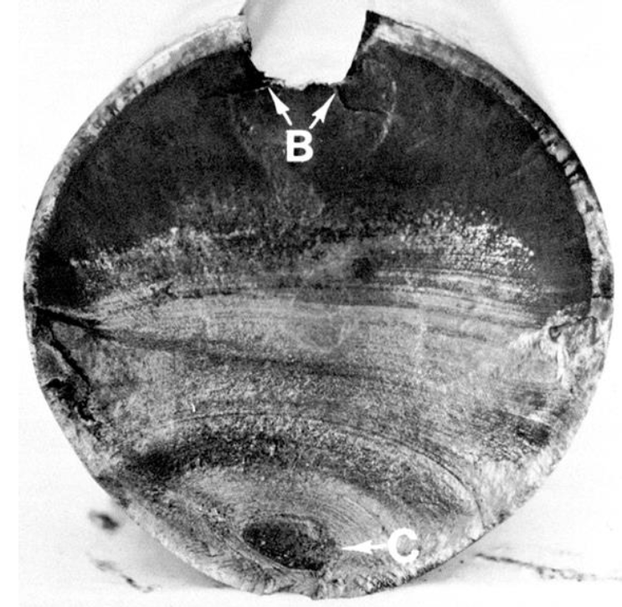
#1
Visual Inspection
  Site B – Crack initiation at stress concentration in keyway
    Smooth region, notice the small notch/defect at the outer edge
  Site C – Final brittle failure
    This is a rougher region
    The crack has grown, causing complete failure
Analysis
  Smooth concentric patterns suggest a fatigue crack propagation zone
    This indicates cyclical loading
  The final fracture at site C indicates an overload failure ( sudden failure )
  The initial crack zone at site B introduced a sever stress concentration
    The failure was fatigue related (cyclical, bending, or torsional loading)
  The notch at site B suggests a defect or stress concentration
    Combined with the concentric rings suggesting cyclical loading, the part at Site C failed catastrophically
Source: Lecture

Slide 3
#2
High cycle fatigue
  Occurs when materials are repeatedly stressed below there yield strength
    Repeated elastic deformation = crack growth
    Sufferers a sudden catastrophic failure
  Crack initiation starts at the surface because of (stress concentrations)
  For high cycle fatigue, a higher scatter factor of 10x is recommended
  HCF typically involves cycles counts between 10^4 and 10^6 cycles
Very high cycle fatigue
  Occurs beyond 10^ - 10^10 cycles and is important for components with billions of loading cycles
  Traditional fatigue models don’t characterize this (materials can survive infinitely beyond 10^6 cycles
    Ultra high cycle fatigue testing shows that under constant amplitude loading failures can still occur
    Stress levels are much lower in UHCF and crack initiation can shift to the interior of the material because surface defects become less dominant

Slide 4
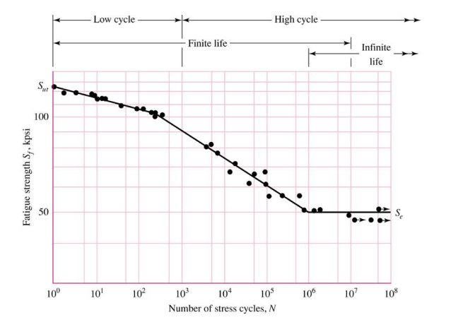
#3
Endurance limit: Test vs. Real Life
  Endurance limit test – materials are tested for there ability to withstand repeated cyclical loading
  This is shown on an S-N diagram
    S-N diagram
      Number of cycles to failure at varying stress levels is plotted on log-log scale
      Strength corresponding to the knee is called endurance limit
      Some materials have infinite life – for Al and Cu alloys there is no endurance limit
      Between 10^3 and 10^6 cycles, finite life is predicted
      Repetitive loading occurs below 10^3 cycles (known as low cycle)
      S-N diagram is a controlled tests created for a lab specimen that is smooth, circular, and has ideal conditions
  For real life you need to make endurance limit adjustments – Marin factors
    Surface conditions
    Size modification
    Load modification
    Temperature modification
    Readability factor
    Miscellaneous-effects modification
  Marin factors are modifying factors that adjust the theoretical endurance limit of a material to account for real-world conditions
Source: Lecture - SN diagram

Slide 5
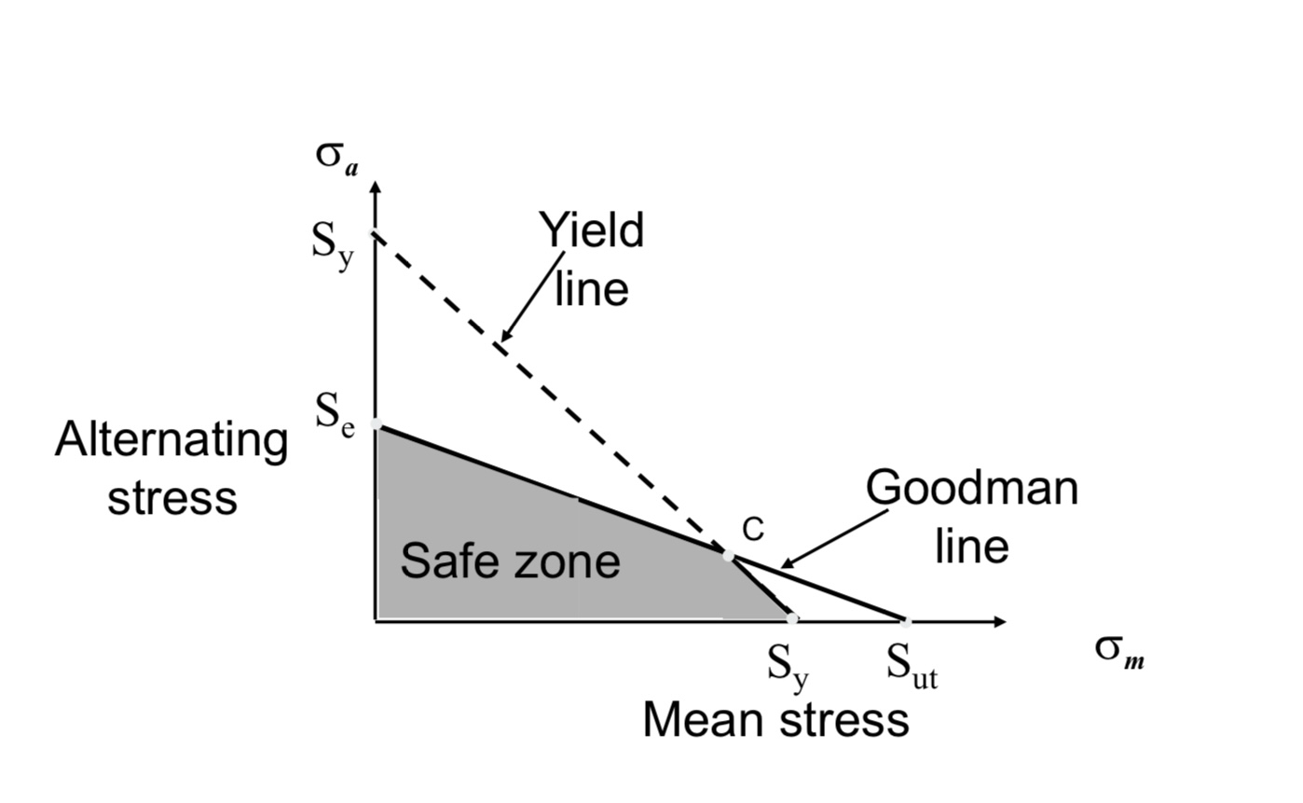
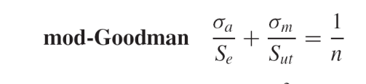
#4
Goodman Diagram
  Used to assess fatigue failure
  Shows whether a component is operating within a safe zone or at risk of failure
  Based on the mean stress and alternating stress
  The goodman line is a failure criterion that shows how fatigue life decreases as mean stress increases
  The yield line is a boundary where plastic deformation occurs
Safe zone
  The goodman equation is used to see if a component is at risk of failure
  If the equation proves to be true where ≤ 1, then the design is safe
    If it exceed, then the component will fail due to cyclical loading
  If the operating stress point is in the zone and holds true in the equation, then the component is safe
Source: Lecture

Slide 6
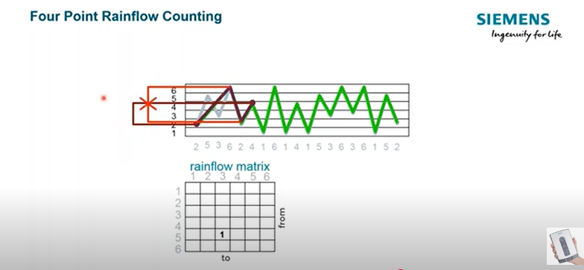
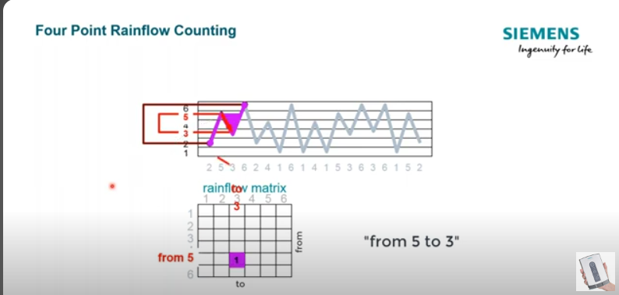
#5
Rain flow cycle count
  Used for countingg cycles and determining the load history on real life data
  Can use it to compare two load histories
  4 step method – first 3 steps are used to simplify and reduce the trace
    Hysteresis filtering – removes non-damaging small fluctuations in the stress time history
    Peak-Valley filtering – only keep data points that are direction changes to simplify the stress sequence – removing redundant points
    Discretization – “binning” converts filtered stress values into discrete stress levels by rounding stress ranges
    Four point counting method – actual cycle counting where a stress cycle is identified when the inner stress range is bounded by the outer points
      This is the Rainflow counting
      You count the stress ranges from the peaks and valleys of the trace
      Added up the Rainflows to get a stress cycle at a stress range
      Shown on the image to the right
Inner points are not bound by outer values, this cycle is not counted
Source: https://www.youtube.com/watch?v=kOjahdZHL5g
Inner points are bound, 1 cycle, 1 count

Slide 7
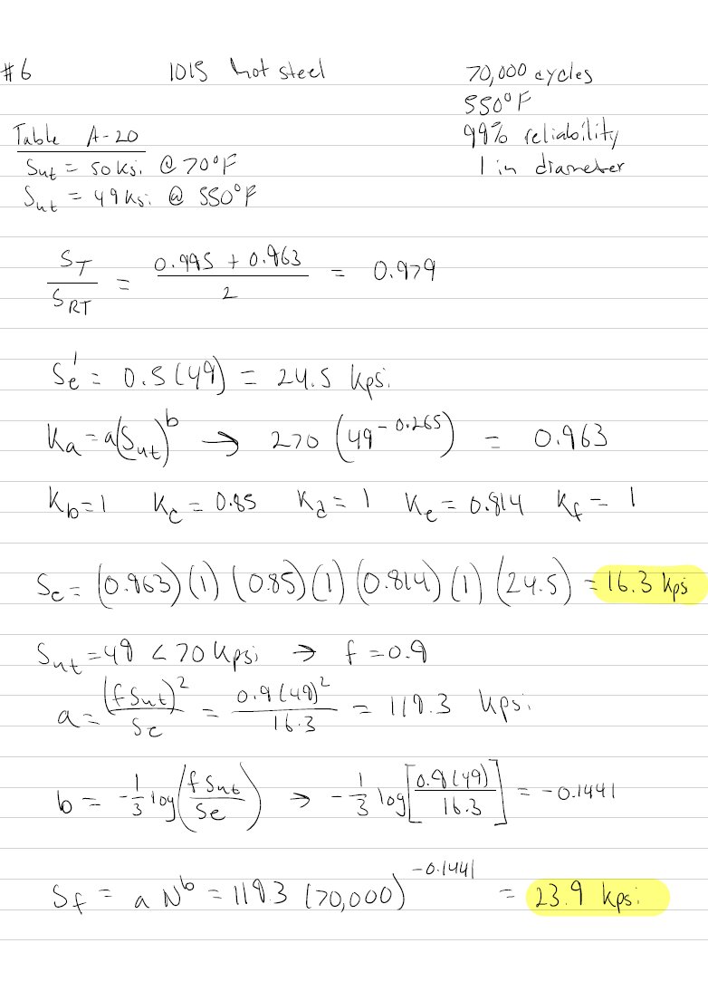
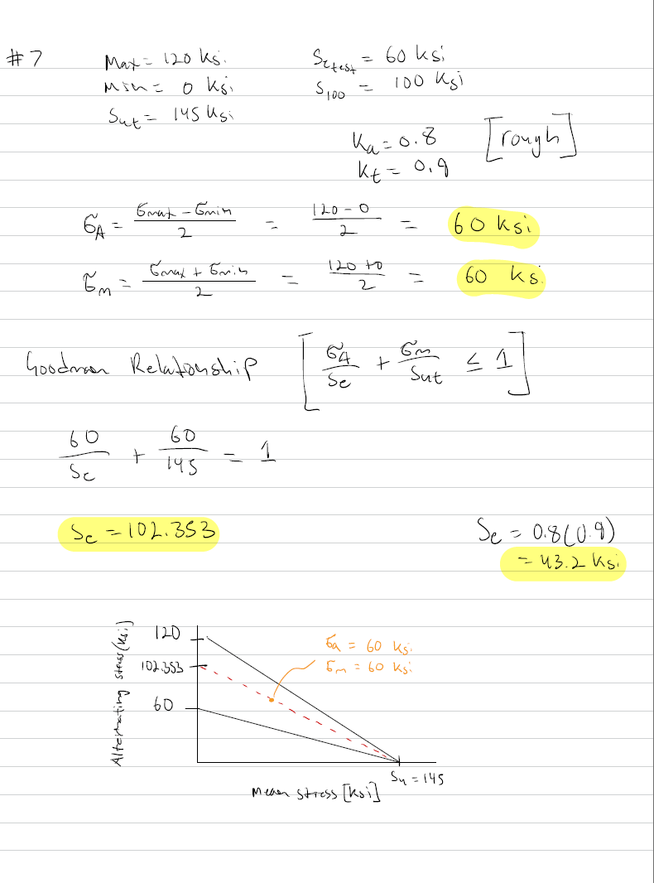
#6 and 7

Slide 8
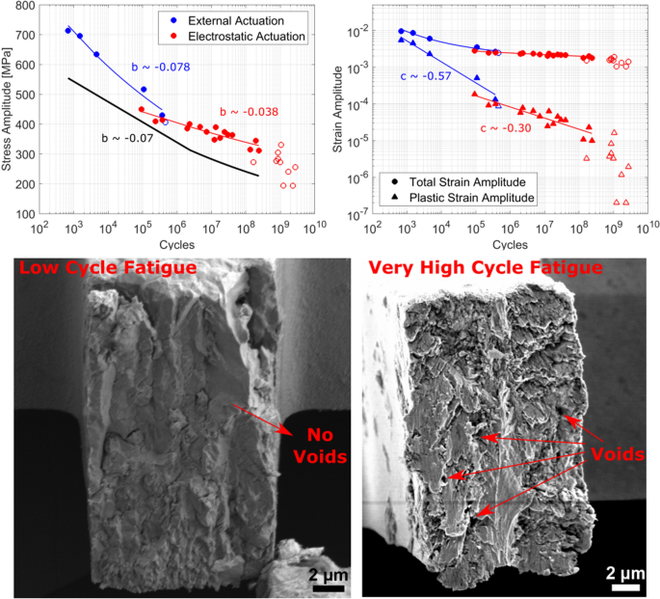
#8
High cycle fatigue
  Occurs when materials are repeatedly stressed below there yield strength
    Repeated elastic deformation = crack growth
    Sufferers a sudden catastrophic failure
  Crack initiation starts at the surface because of (stress concentrations)
  For high cycle fatigue, a higher scatter factor of 10x is recommended
  HCF typically involves cycles counts between 10^4 and 10^6 cycles
Low cycle fatigue
  Involves cycle counts below 10^3
    Repetitive yielding usually occurs here
  Occurs under high stress
  Involves significant plastic deformation
    Typically causes a much quicker failure
Source: https://link.springer.com/article/10.1557/s43578-020-00097-y

Slide 9
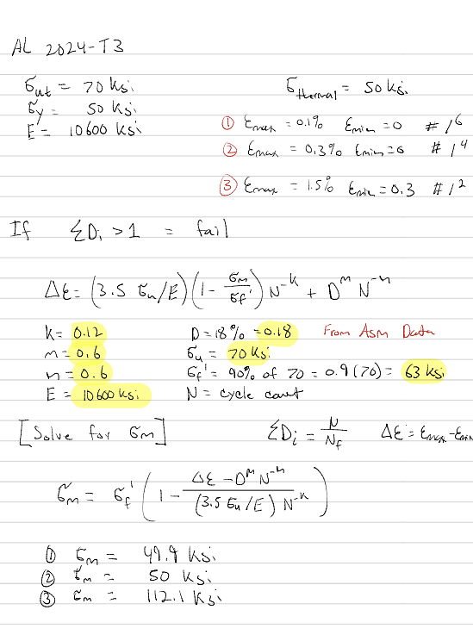
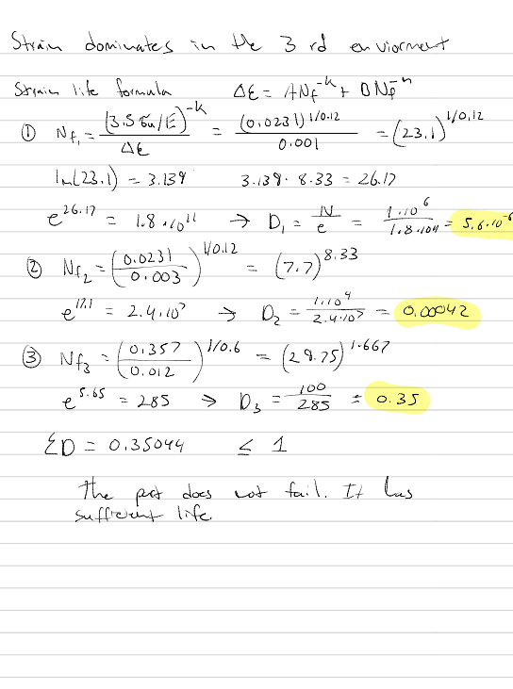
#9

Slide 10
#10
Given Parameters
  Loading
    Far field stress = 30e3 Psi
    In tension
  Material Properties
    Aluminum 7075-T6
    Elastic
      E = 10e6 Psi
      V = 0.3
    Plastic
      Yield Strength
        50e3 Psi
        Strain = 0
      Ultimate Strength
        80e3 Psi
        Strain = 0.05
  Dimensions
    40 x 40 in plate
    1 in diameter = 0.5 radius
Hand Calculations
  d/w = 1/40 = 0.025​
  Kt = 2.9​
  σ = 30 * 2.9 = 87e3 Psi

Slide 11
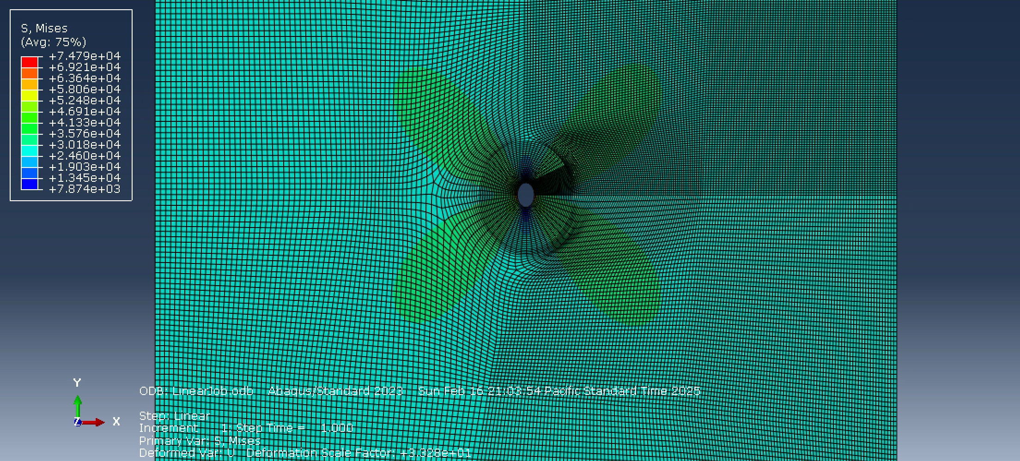
#10
Results (Linear)
  No plastic properties in the linear results
  Left edge was constrained with x-symmetry
  Left corner constrained with y-constraints
  Max stress observed = 74790 Psi
  Compared to hand calculation:
  %error = [(87000-74790)/74790]*100 = 16.32%
  Conclusion
    My error is quite high and not acceptable
    Looking for a 10-15% margin
    The hand calc is close, but not as much as I would like to be

Slide 12
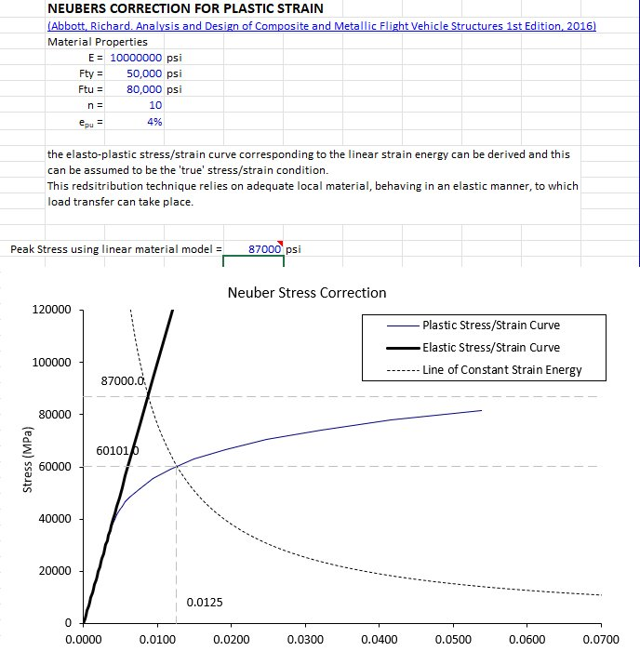
#10
Results(Nonlinear)
  Using the chart on excel we get a peak stress of
    60.1 Ksi

Slide 13
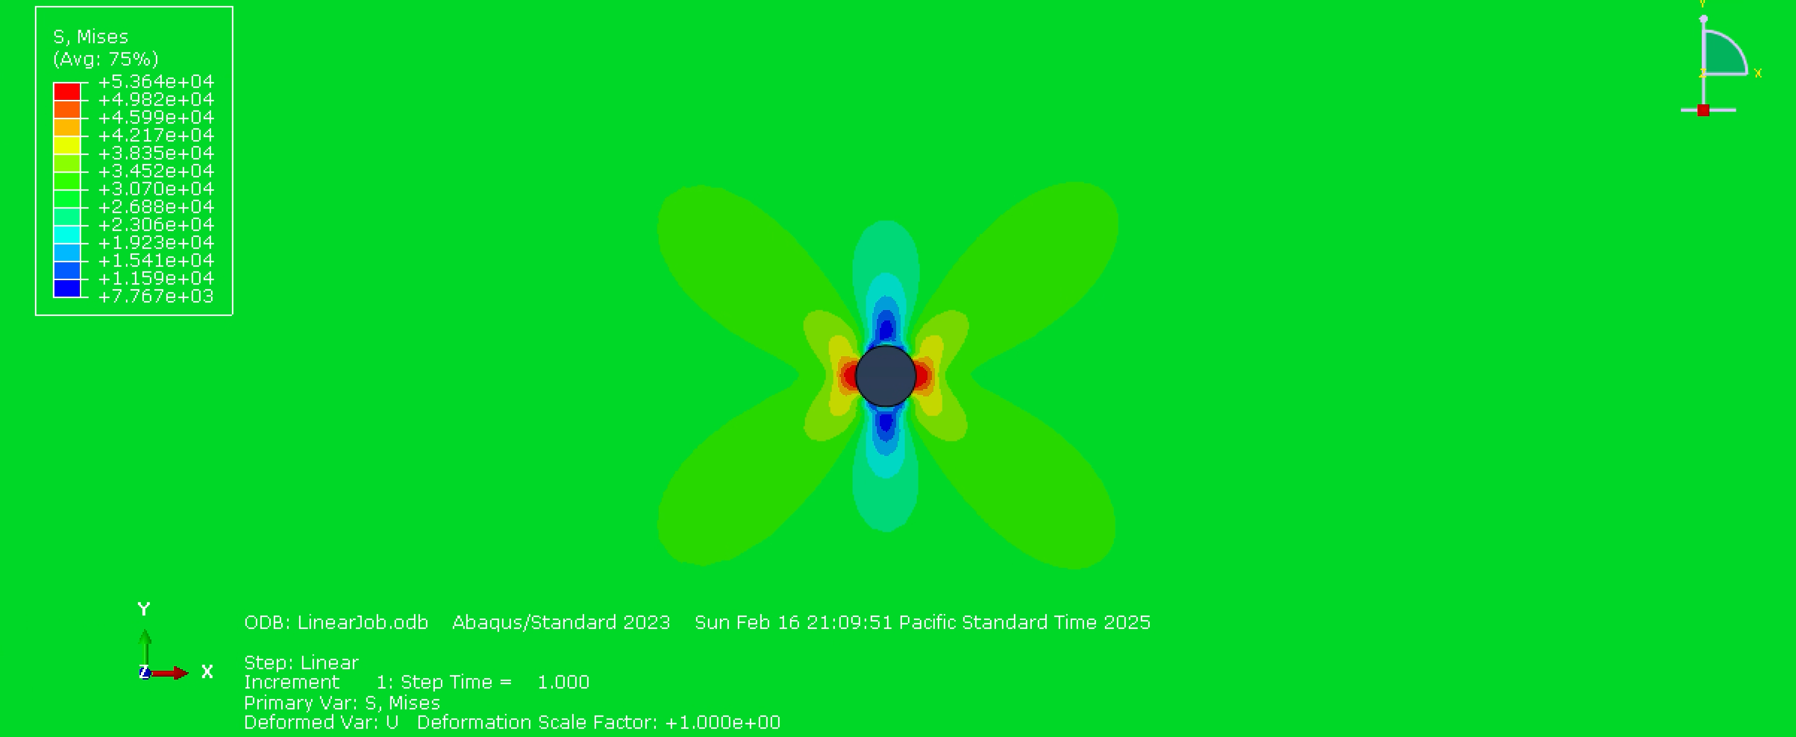
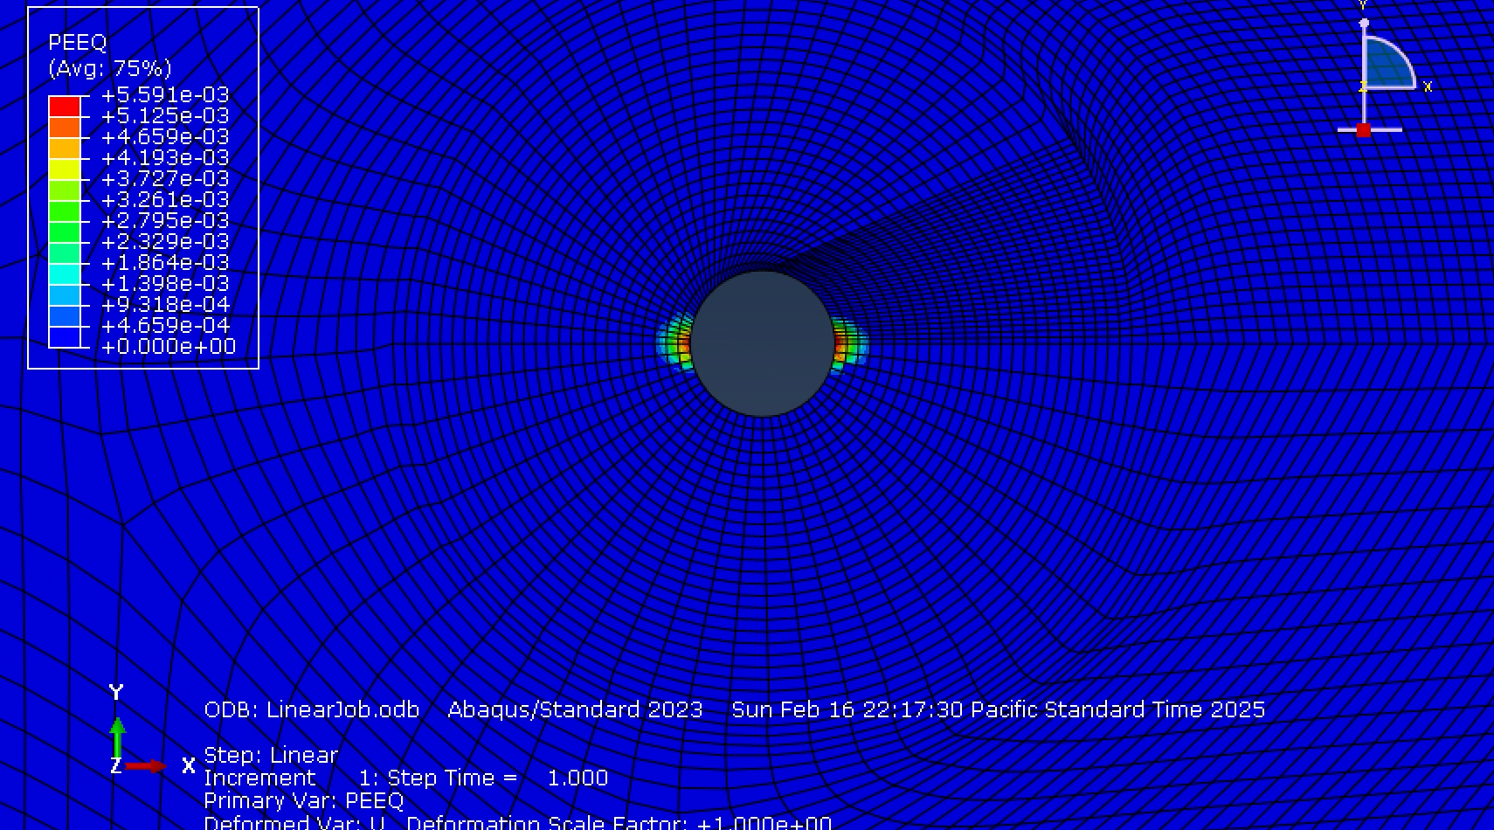
#10
Results(Nonlinear)
  Plastic properties were included, and nonlinear effects were added (Ngleom)
  Max observed stress = 53640 Psi
  Mas plastic strain = 5.59e-3
  Compared to hand calculations
    [(60100-53640)/53640]*100 = 12.04%
  The hand calculation for the nonlinear results is much better than for the linear results
  This is within the 10-15% range of overestimation from Neuber’s method

Slide 14
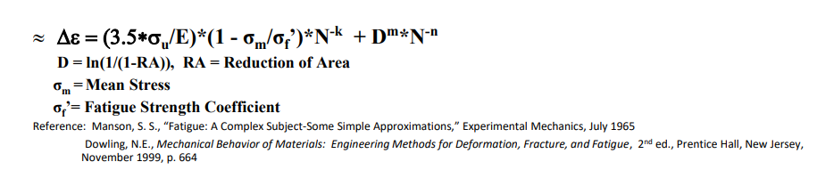
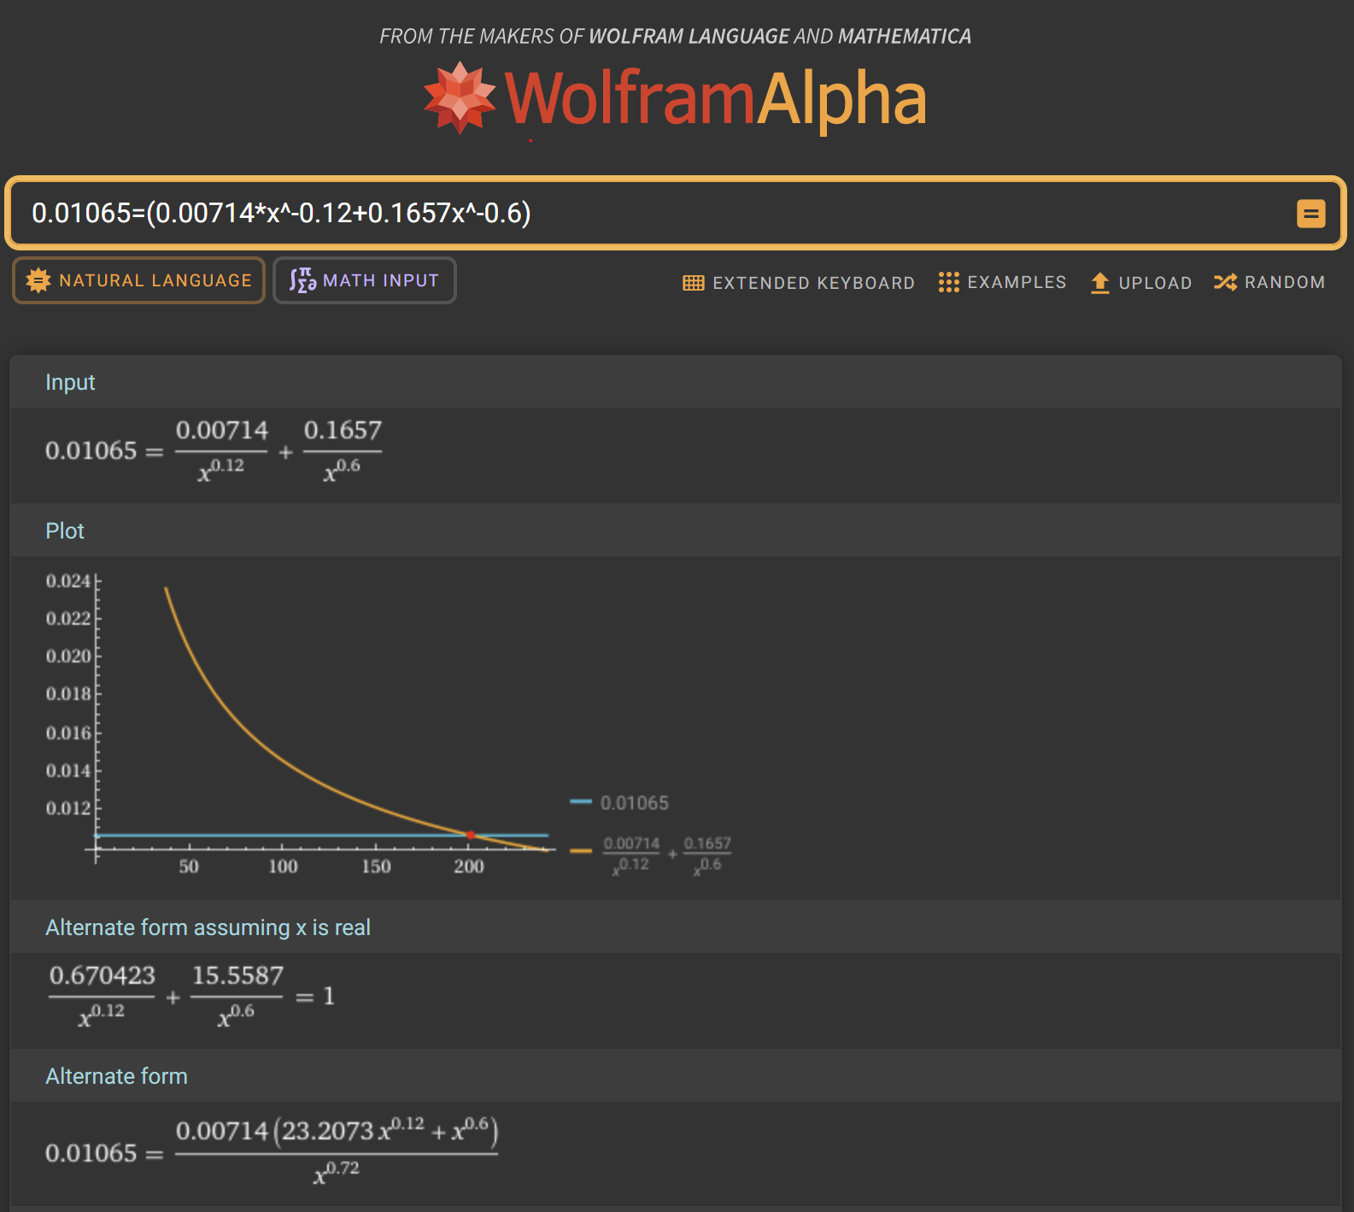
#10
Fatigue Analysis
  Max observed stress = 53640 Psi
  Mas plastic strain = 5.59e-3
  Max total strain = 0.01065
Material Properties
  E = 10000 ksi
  Ultimate strength = 80 ksi
  Fatigue strength = 72 ksi
  Elongation to fail = 0.05
Constants
  n = 0.06
  m = 0.06
  k = 0.12

Slide 15
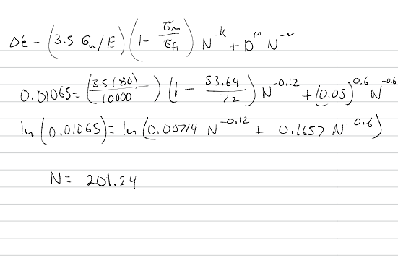
#10
Hand calculation analysis
  Equation was plugged into numeric solver
  The data was taken from PRJ4 question 3
  Part fails at 201.24 cycles

