Slide 1
Project 4 – Backup
Henry Glover
2/16/2025

Slide 2
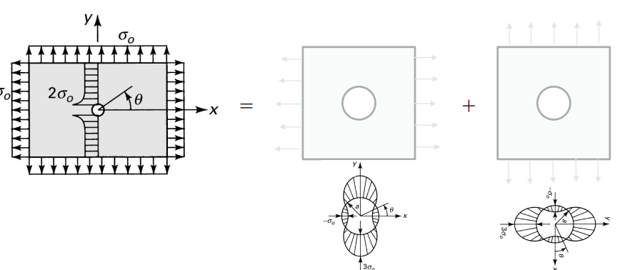
Question 1
Given Parameters
  Hoop stress
    PR/t = 11089.8 psi
  Axial stress
    PR/2t = 5544.9 psi
  Given properties
    Hole diameter = 0.5 in
    Distance between hole centers = 2 in
    Pressure differential
      From 37000 - 5000 ft = 9.09 psi
    Radius of skin = 122 in
    Thickness = 0.1 in
  Material properties
    Aluminum 7075-T6
      E = 10400e3 Psi
      V = 0.33
Source: From homework

Slide 3
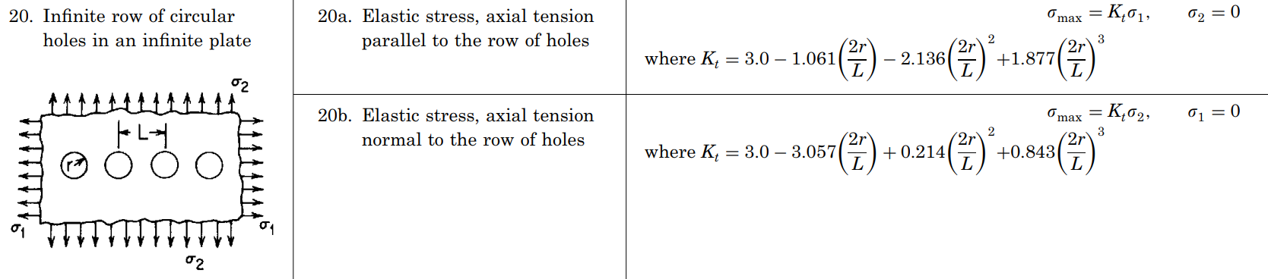

Question 1
Hand Calculations
  Hand calculations
  Axial = 2.63 * 5545 = 14586 Psi
  Hoop = 2.26 * 11090 = 25088 Psi
  Expected Von Misses Stress = $\sqrt{σ12+σ22}=$ 29020
$$Kt_{\text{σ}\text{1}}=3−1.061\left(\frac{2∗0.25}{2}\right)−2.136\left(\frac{2∗0.25}{2}\right)2+1.877\left(\frac{2∗0.25}{2}\right)3=2.63$$
$$Kt_{\text{σ}\text{2}}=3−3.057\left(\frac{2∗0.25}{2}\right)+0.214\left(\frac{2∗0.25}{2}\right)2+0.843\left(\frac{2∗0.25}{2}\right)3=2.26$$
Source: From homework

Slide 4
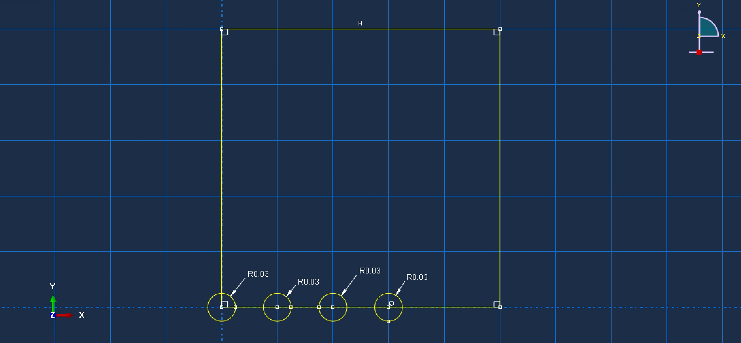
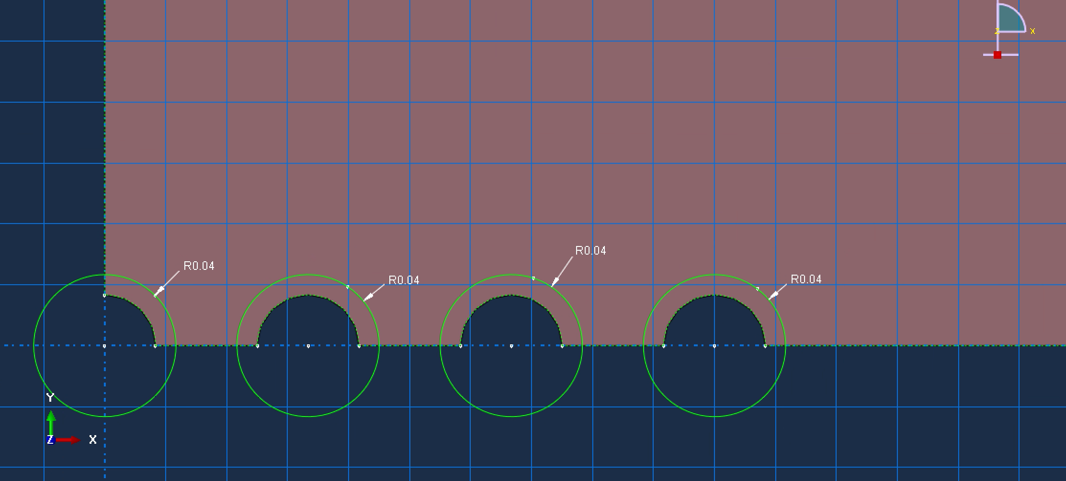
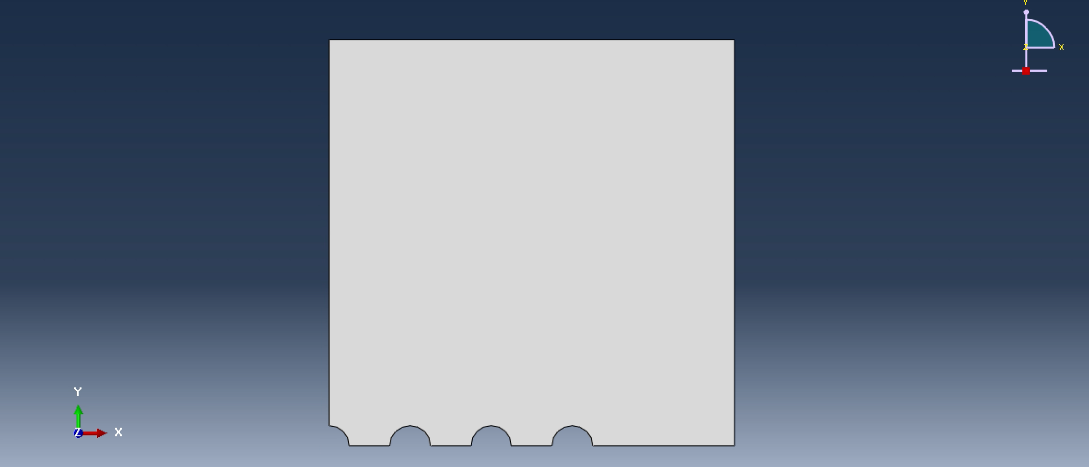
Question 1
Inputs
  Geometry is defined and setup
  Radius for the circles are made and trimmed
  Partition is made to make mesh definable
    All steps follow the given properties

Slide 5
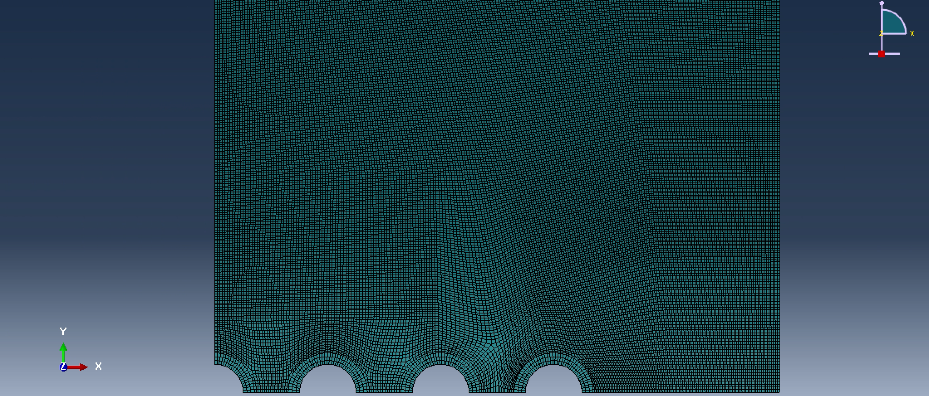
Question 1
Inputs
  Mesh is set to 0.0125
  Characterization and discretization is good
    For inside the half circle at the edge, mesh is set to 20
    For the rest of the 4 holes, mesh is set to 40
      Moving forward with this mesh

Slide 6
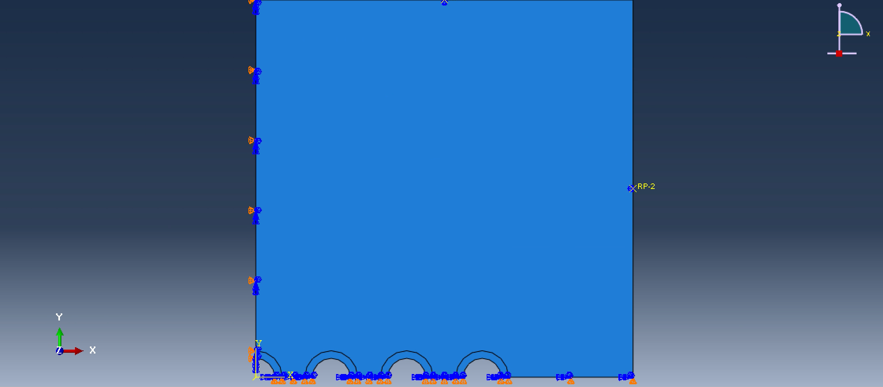
Question 1
Inputs
  Boundary conditions are set

Slide 7
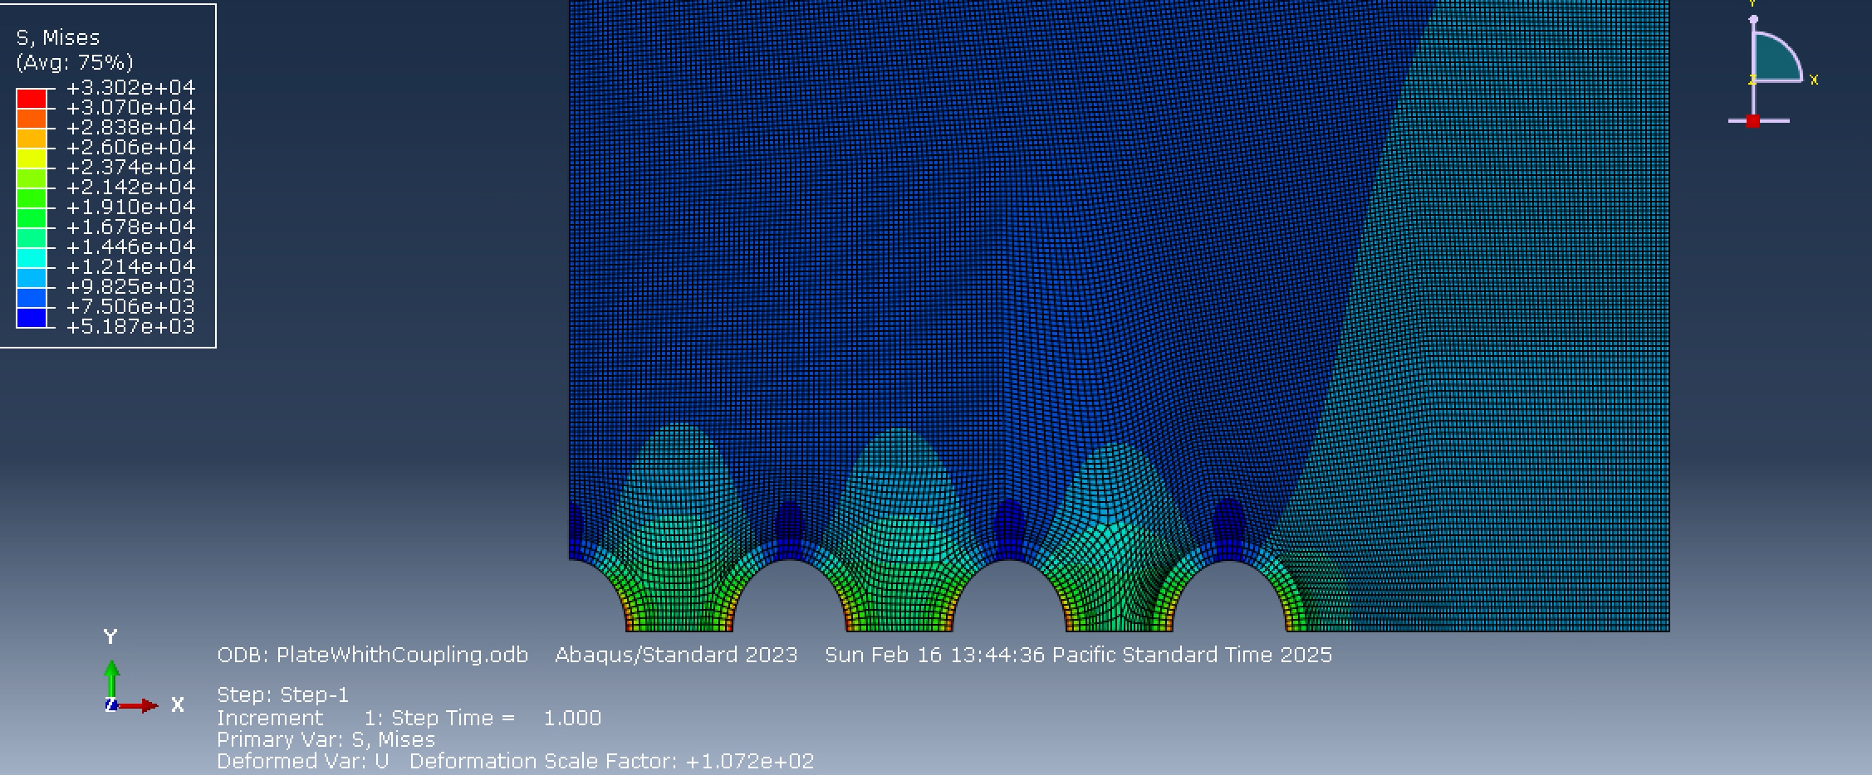
Question 1
Results
  Hand calculations say we are supposed to get 29020 Psi
  Our results differ slightly
    We get a max stress of 33020 Psi
    This is a 12.11% error
      Margin of safety = 1.5
    The margin of safety calculates to 0.37
  Conclusion
    The error is quite high but still adequate for this design
    The margin of safety is positive but not as good as my other groupmates

Slide 8
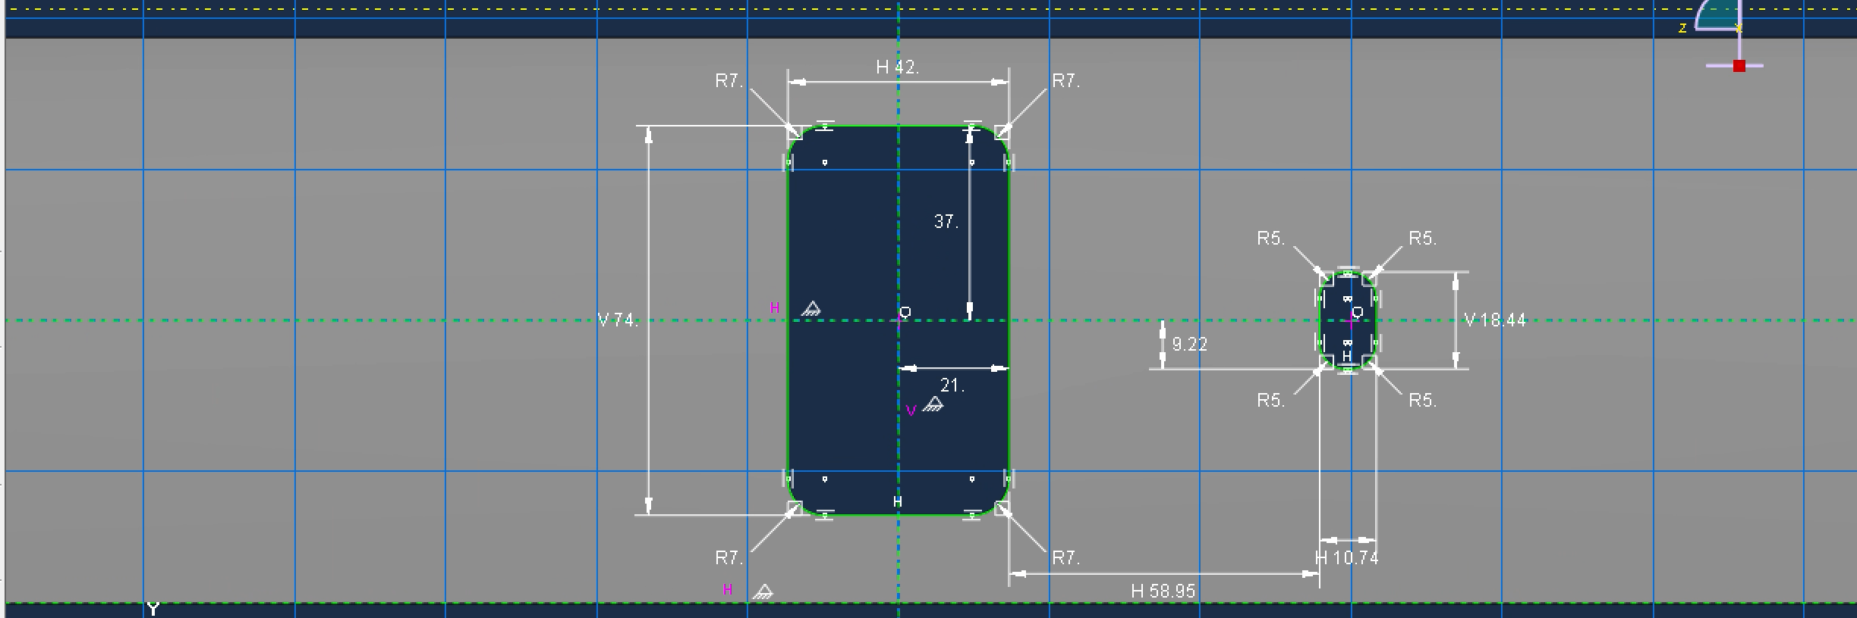
Question 2
Given Parameters
  500 x 500 plate
  Thickness = 0.1 in
  Pressure = 9.09
  Radius = 215/2 = 107.5 in
  Hoop load = Pr/t = 9771.75 Psi
  Axial load = Pr/2t = 4885.88 Psi
  Door
    Height = 74 in
    Width = 42 in
    Corner Radius = 7 in
  Window
    Height = 18.74 in
    Width = 10.74
    Corner Radius = 5 in

Slide 9
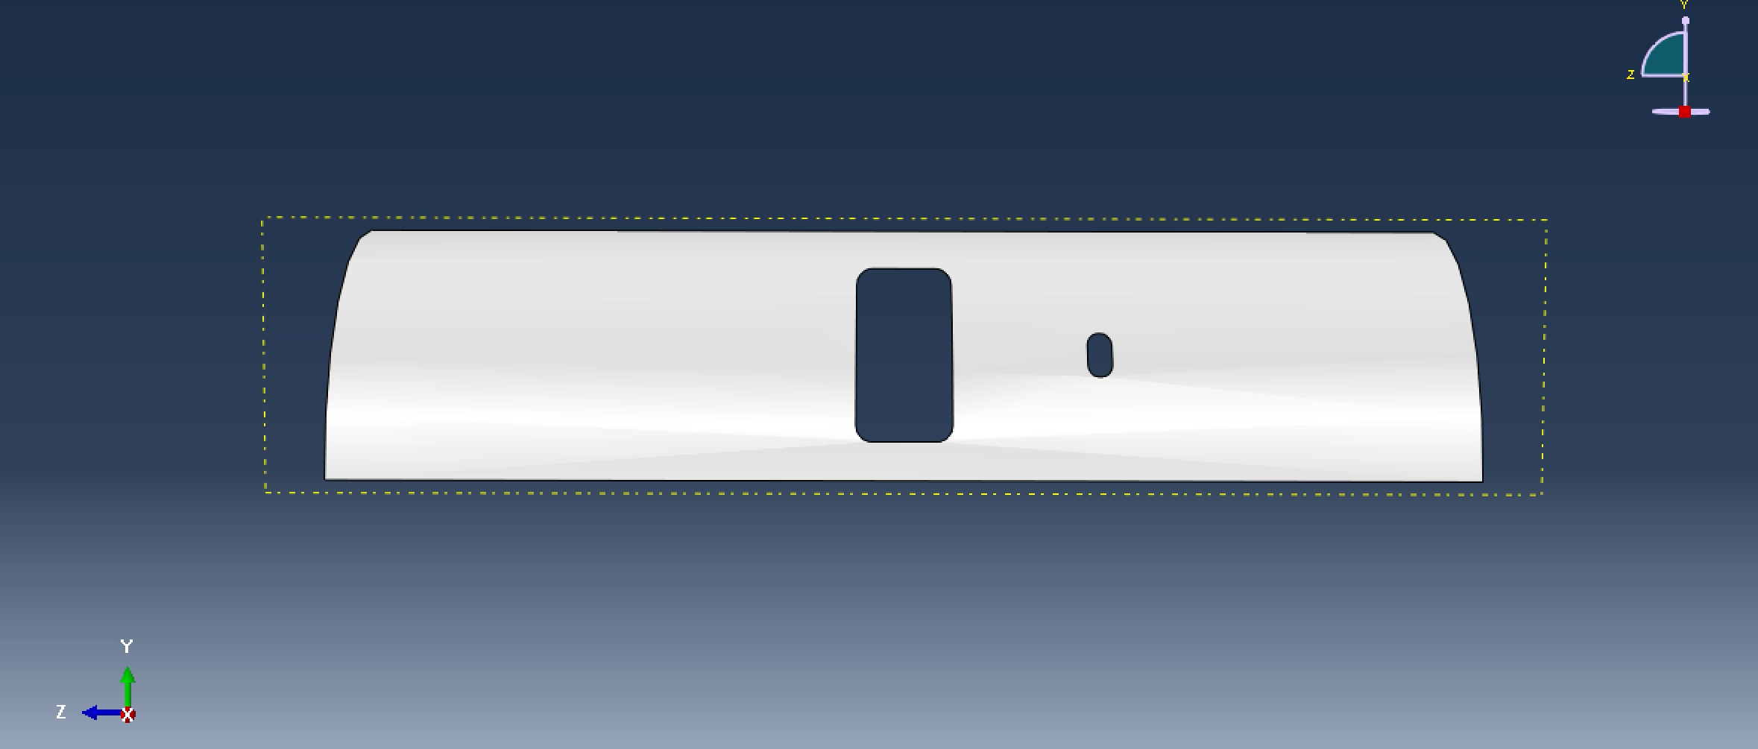
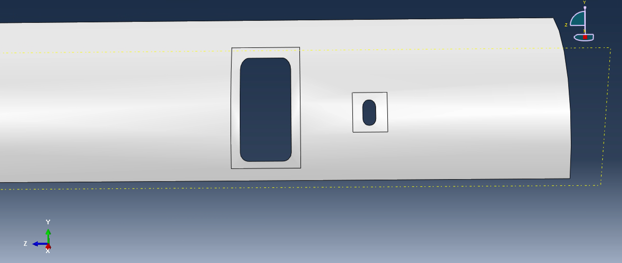
Question 2
Model
  The extruded cut is shown to the right
  Partitions were made around the door and window to discretize the mesh

Slide 10
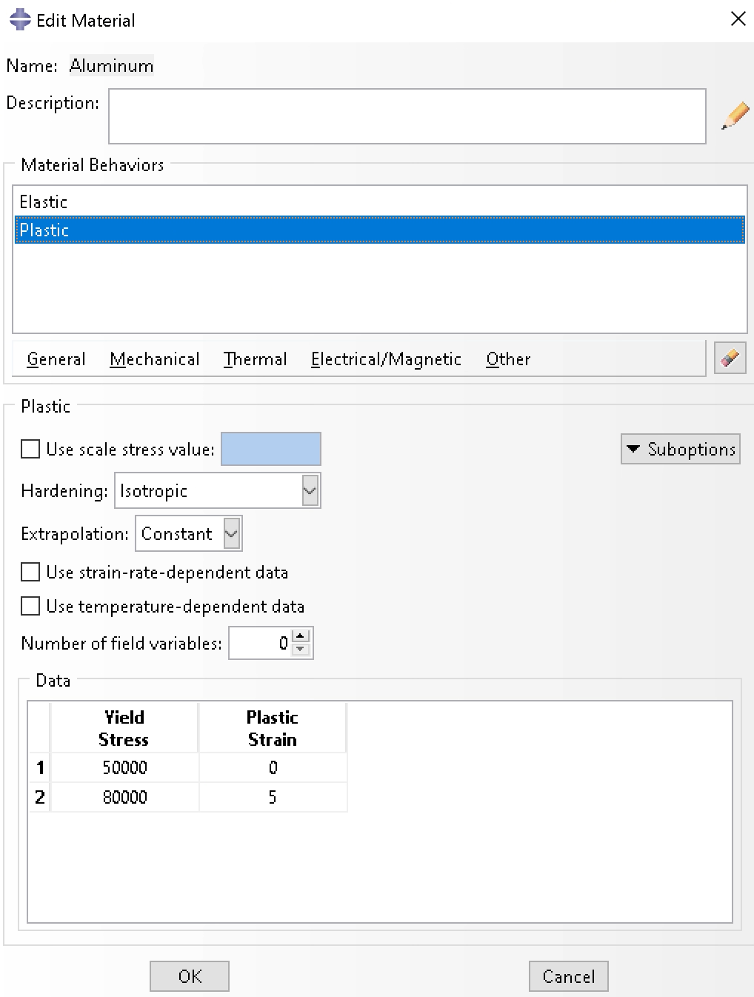
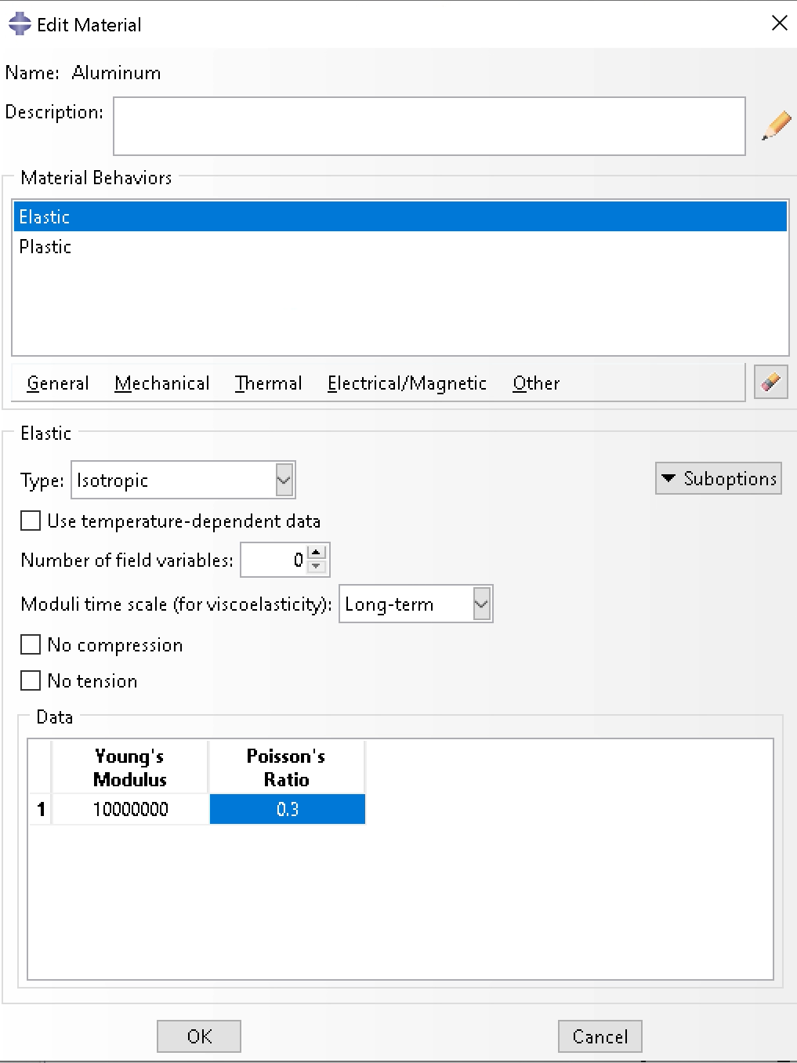
Question 2
Material settings
  Elastic and plastic settings are inputted from given parameters
  For linear run
    No plastic settings
  For nonlinear run
    Both plastic and elastic settings were used

Slide 11
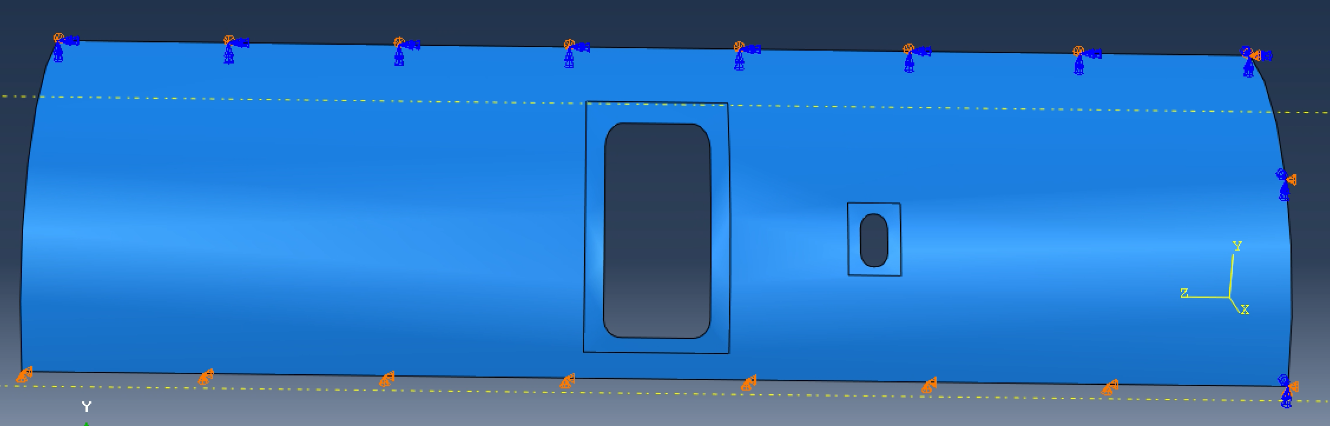
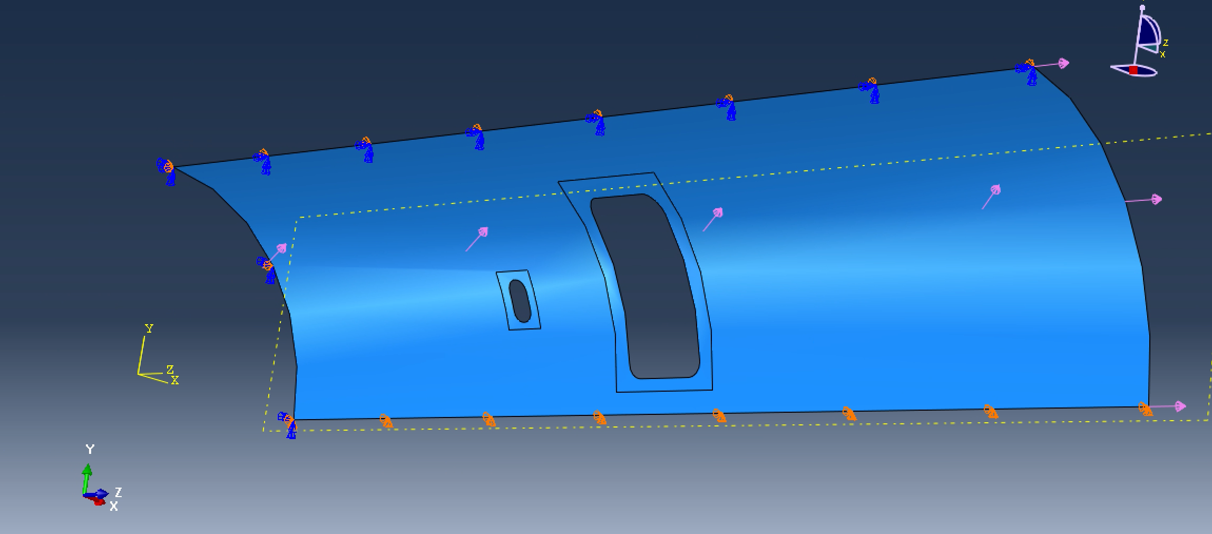
Question 2
Given Parameters
  Boundary conditions on the top, bottom, and right edge
  For linear run there was no pressure in the fuselage
  For the nonlinear run both pressure and edge loading were inputted
  Edge loading
    Set to 4885.88 * 0.1 = 488.85 Psi
  Pressure loading
    9.09 Psi from given data

Slide 12
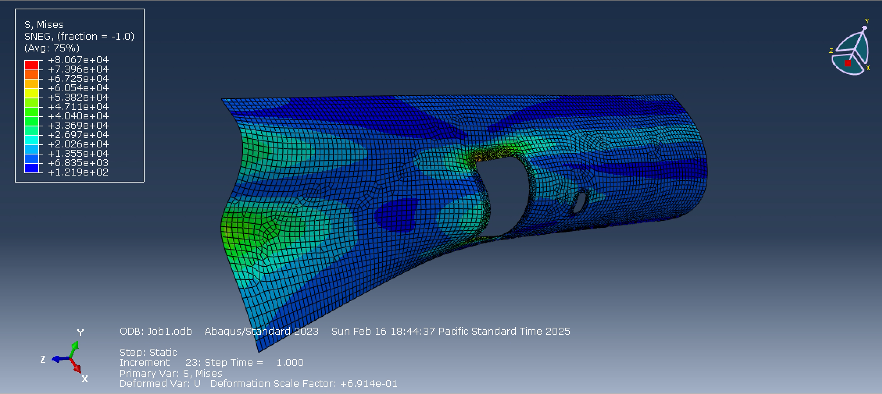
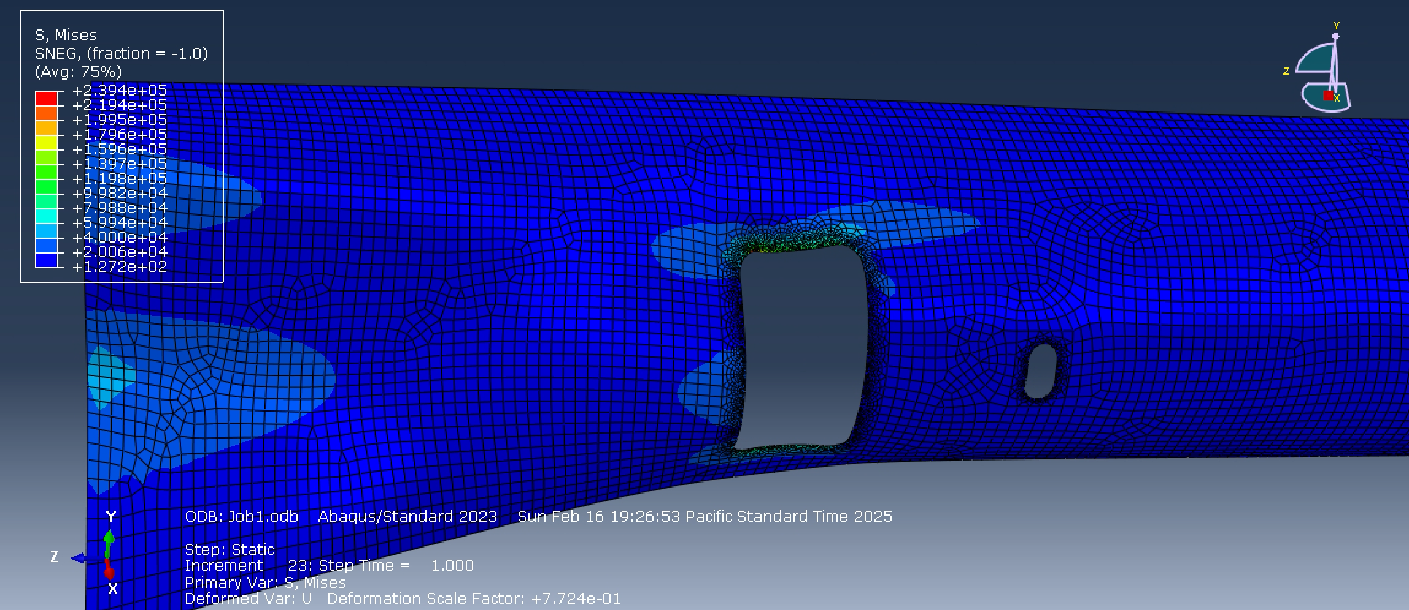
Question 2
Results (Linear)
  The top figure
    This is the linear run with the plastic material property included
    This was not needed and not required just used to make sure the model was working properly
  The bottom figure (No plastic)
    The max stress was 239400 Psi
    This trial was run with no plastic material property
    Stress is expected to be higher compared to a flat plate
      Nonlinear trial is need to see if this occurs

Slide 13
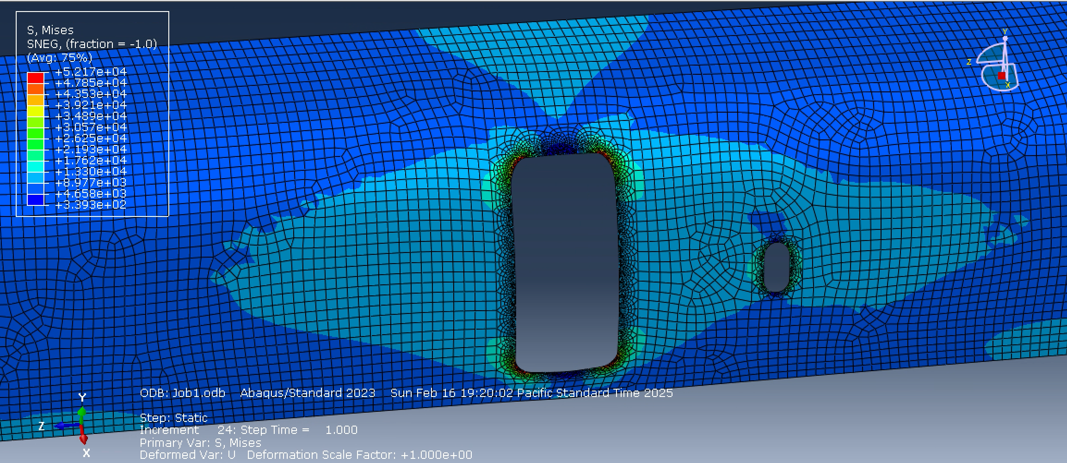
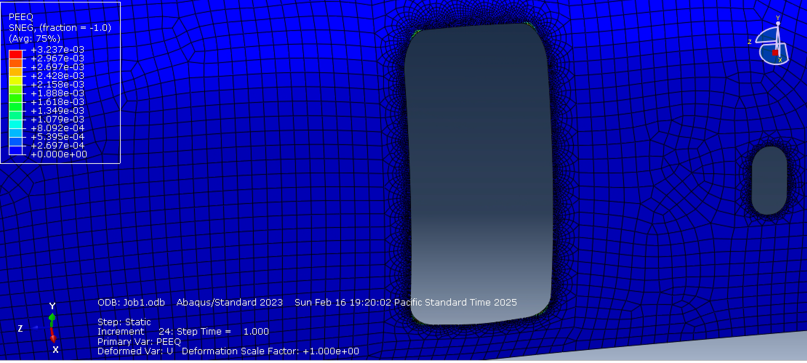
Question 2
Results (Nonlinear)
  Pressure and edge loading parameters were applied
  Ngleom was turned on for nonlinear affects
    Boundary conditions and axial load stay the same
  Incrementation was changed to 1e08
  Max stress = 52170 Psi
  Max plastic deformation = 0.003237
    This can be seen at the corners of the fuselage door
  Conclusion
    Overtime the axial loading can be determinantal to the fuselage, introducing unwanted stress concentrations
    This is shown in the bottom figure
    Conical shell stress concentrations need a large F.S. and high margin
    The addition of internal stress pushing against the fuselage shows a reduction in stress

Slide 14
Question 3
Given Parameters
  Loading
    Far field stress = 30e3 Psi
    In tension
  Material Properties
    Aluminum 7075-T6
    Elastic
      E = 10e6 Psi
      V = 0.3
    Plastic
      Yield Strength
        50e3 Psi
        Strain = 0
      Ultimate Strength
        80e3 Psi
        Strain = 0.05
  Dimensions
    40 x 40 in plate
    1 in diameter = 0.5 radius
Hand Calculations
  d/w = 1/40 = 0.025​
  Kt = 2.9​
  σ = 30 * 2.9 = 87e3 Psi

Slide 15
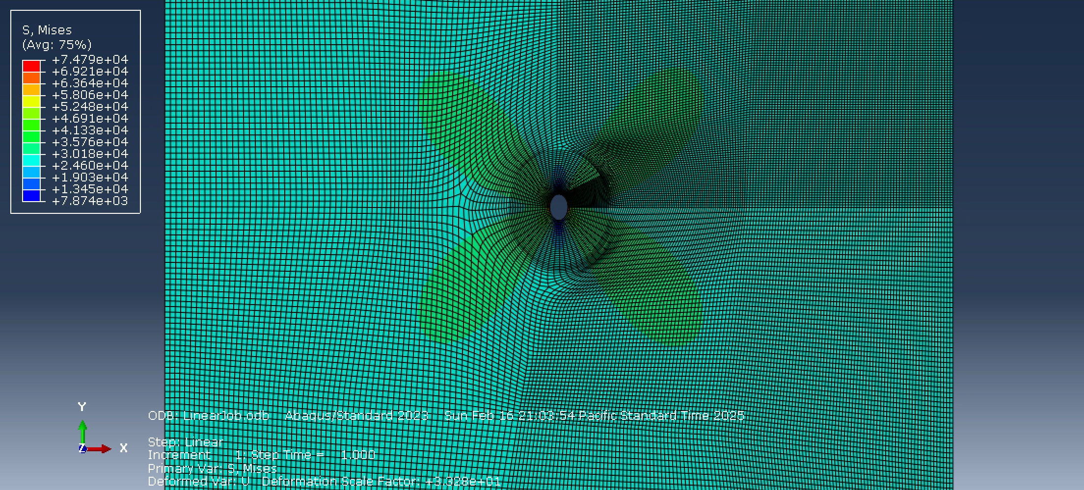
Question 3
Results (Linear)
  No plastic properties in the linear results
  Left edge was constrained with x-symmetry
  Left corner constrained with y-constraints
  Max stress observed = 74790 Psi
  Compared to hand calculation:
    %error
    [(87000-74790)/74790]*100 = 16.32%
  Conclusion
    My error is quite high and not acceptable
    Looking for a 10-15% margin
    The hand calc is close, but not as much as I would like to be

Slide 16
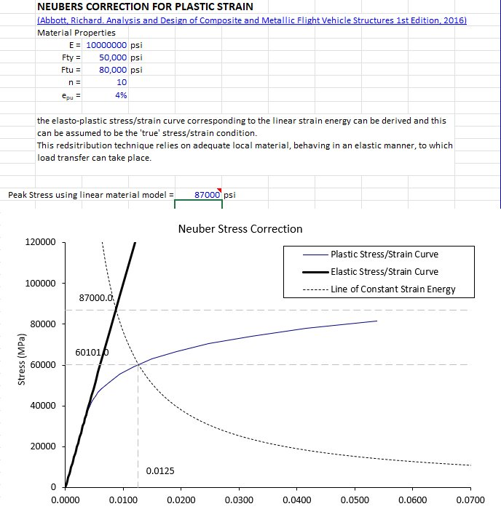
Question 3
Results(Nonlinear)
  Using the chart on excel we get a peak stress of
    60.1 Ksi
  This will be compared to my nonlinear results

Slide 17
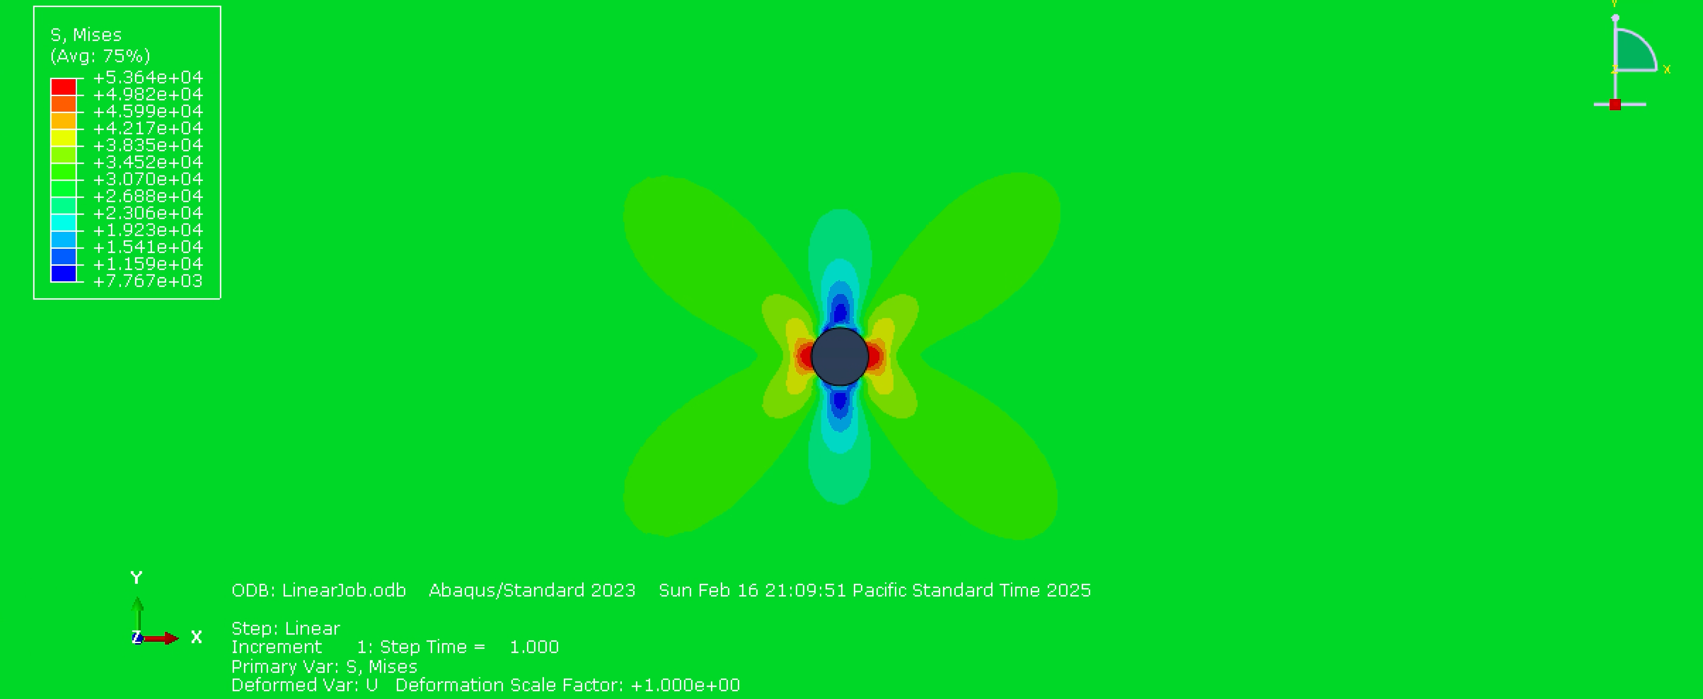
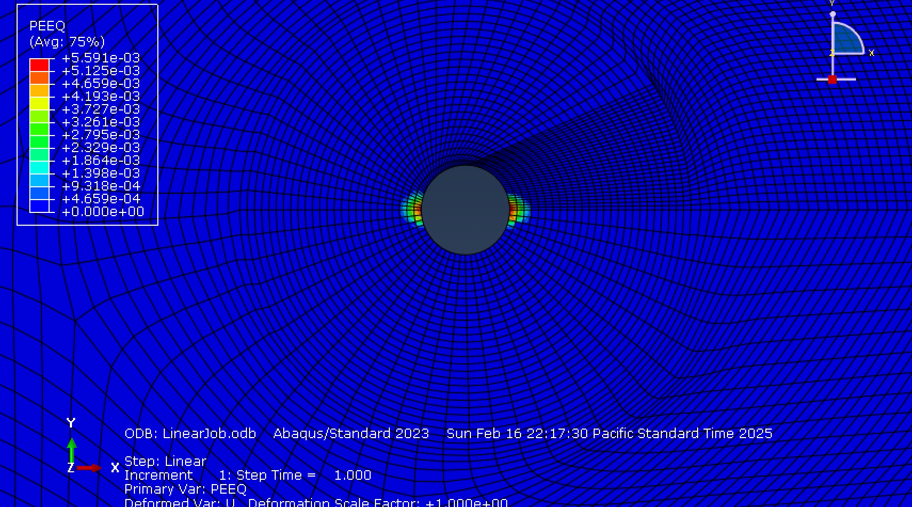
Question 3
Results(Nonlinear)
  Plastic properties were included, and nonlinear effects were added (Ngleom)
  Max observed stress = 53640 Psi
  Mas plastic strain = 5.59e-3
  Compared to hand calculations
    [(60100-53640)/53640]*100 = 12.04%
  The hand calculation for the nonlinear results is much better than for the linear results
  This is within the 10-15% range of overestimation from Neuber’s method

