Slide 1
AME 585
Project 3
Henry Glover
1/28/2025

Slide 2
#1
Buckling – “A structural failure due to excessive displacement – loss of structural stiffness due to imposed loads”
  A failure mode that occurs when a structural component deforms suddenly due to compressive loads exceeding a critical threshold
  Process
    Structure is subject to loads
    Structure cannot withstand loads with original geometry
    Structure changes shape to find new equilibrium configuration
  Possible outcomes
    Structure displaces considerably
    Large deflections may induce plastically or fail
    Structure may or may not fail catastrophically
Important to note – local buckling is admissible if it is safe and below the yield limit
This happens more often than you think on aircraft, it is just not reported
The buckling of complex structures could be a combination of two types
  Global buckling
    The axis of the structural members changes
    The cross section of the member can remain constant
    Usually leads to failure of the structure
  Local buckling
    The axis of the structure member does not change a lot
    The cross section of the member changes
    Can cause failure of structure, but can be acceptable in certain cases
Stability can be determined by observing the global response

Slide 3
#2
Shells are very sensitive to imperfections
  Dents
  Variation in manufacturing
  Dents can be characterized like “small waves”
In analytical solutions
  Theoretical buckling strength of shells is rarely achieved in actual design due to geometric imperfections
  Linear buckling load is higher than experimental buckling load due to geometric imperfection
Now, dents have similar shapes to waves, making it easy to buckle
  Buckling solutions need to overestimate the real buckling capability of thin cylinders
    This is because analysis assumes a perfect shell producing a linear load response

Slide 4
#3
Lessons learned
  Buckling verification approach occasionally used is the “test only” buckling verification option that requires little to no relance on analytical modeling for predicting behavior
  Knockdown factors (KF) are used to correct for imperfections but can be overly conservative
  High fidelity FEA model incorporate stiffeners, weld lands, and imperfections to improve accuracy
  Nonlinear finite element analysis is necessary for refined structural stability predications
  Linear analysis – uses closed form solutions but assumes a perfect structure and requires knockdown factors
    Nonlinear analysis – includes geometric imperfections and load variations but it more accurately predicts real-world buckling loads
  Analytical model need to be verified and validated, could lead to unreliable predictions
  There are various challenges - physical testing is unreliable and expensive, imperfections need to be accounted for accurately, local and global buckling modes need to be distinguished
  4 case studies
    Buckling failure due to improper test configuration \
    Importance of considering manufacturing imperfections
    Interactions with temperature, pressure, and surrounding structures
    Wind-induced buckling in LV require consideration of multiple loading factors
Notes:
https://arc.aiaa.org/doi/10.2514/6.2021-0206

Slide 5
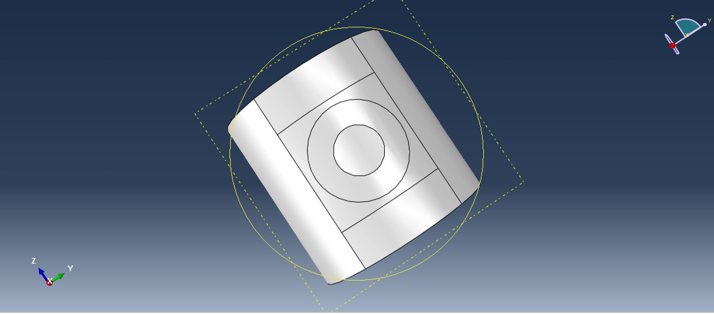

#4
Geometry Parameters:
  Radius = 20 in.
  Height = 40 in.
  Access Window Diameter = 10 in.
  Mesh = S4 shell elements
Material Properties
  $E_{11}=12 Msi$, $E_{22}=12 Msi$
  $G_{12}=0.7 Msi$, $G_{13}=0.5 Msi$, $G_{23}=0.5 Msi$
  $v_{12}=0.5$
  Ply Thickness = 0.008 in.
  Laminate [90/+30/-30/0/0/+30/-30/90]
Boundary Conditions
  Clamped-clamped: both ends are fully fixed in rotation
  Axial movement on one end
Units
  Inches, lb.'s, psi, seconds

Slide 6
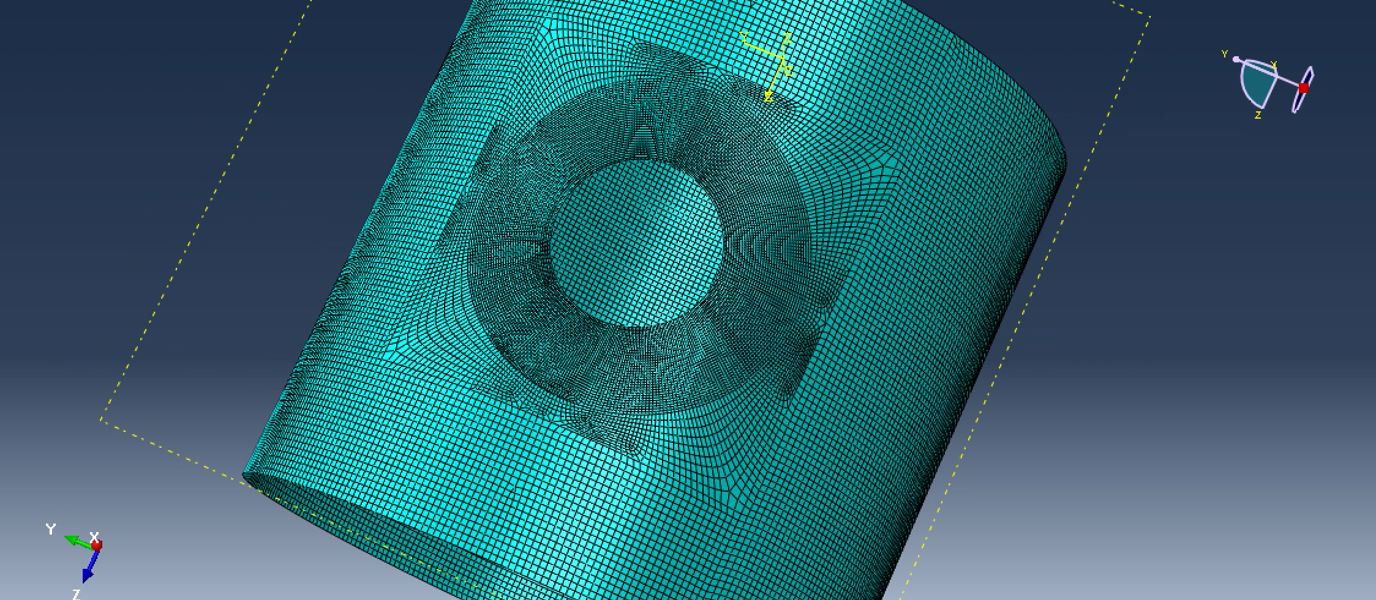
#4
The mesh is set and separated into 3 different sections
  This was done to help characterize the circular opening on the surface of the thin shell

Slide 7
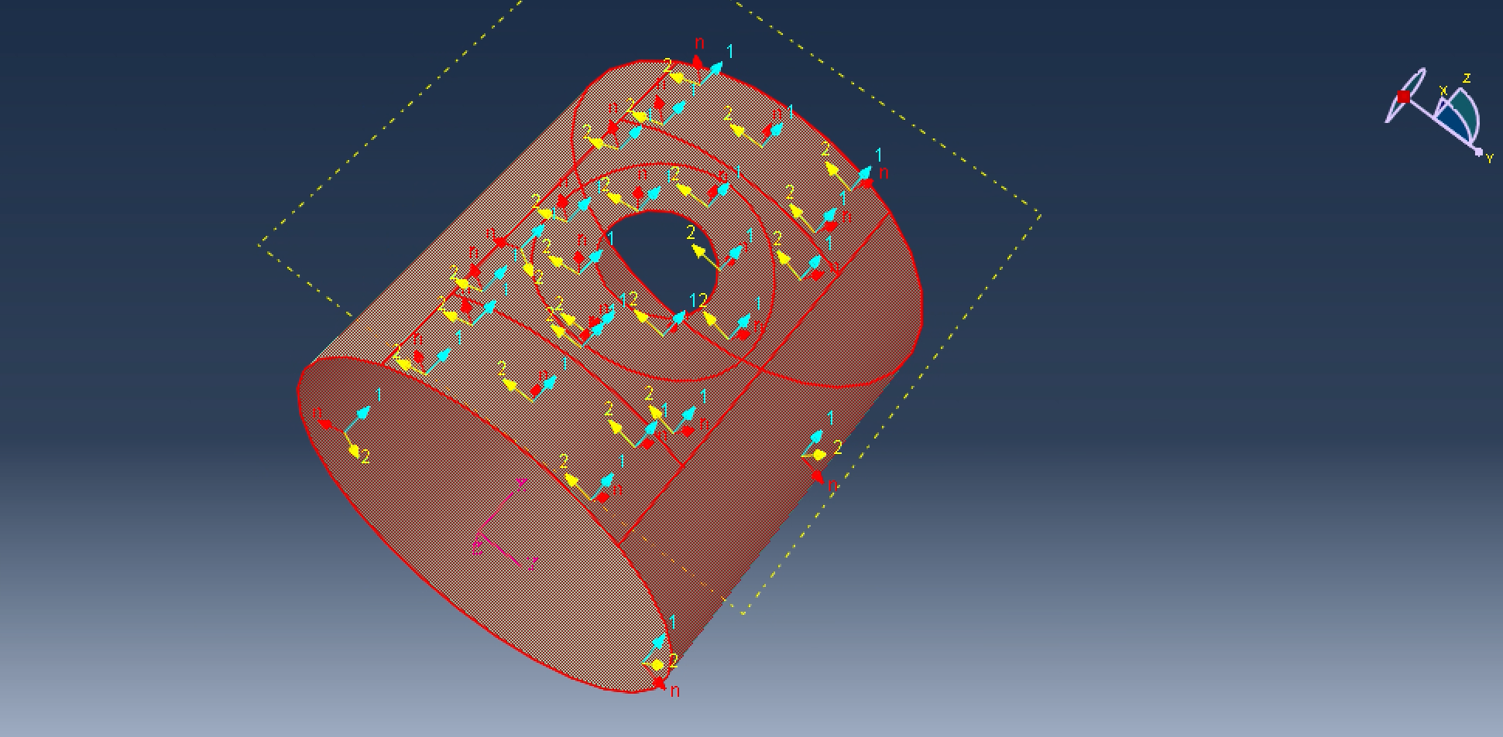
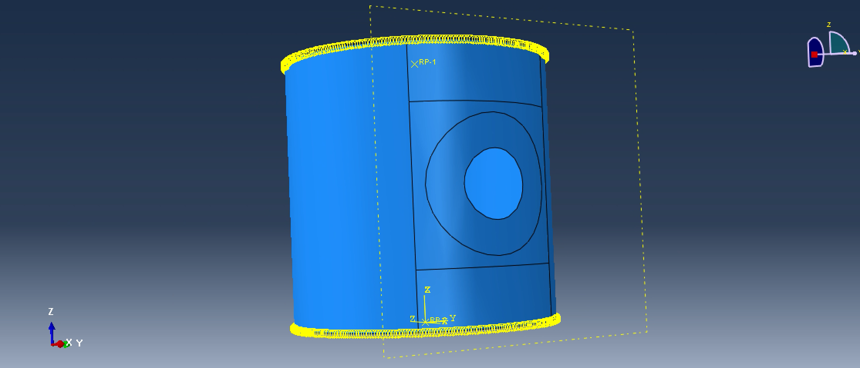
#4
The top and bottom of the shell are rigid bodies
  The bottom is completely fixed
  The bottom only allows axial movement the other axes are locked
The compressive load is set at the top using the first reference point, which equals -1

Slide 8
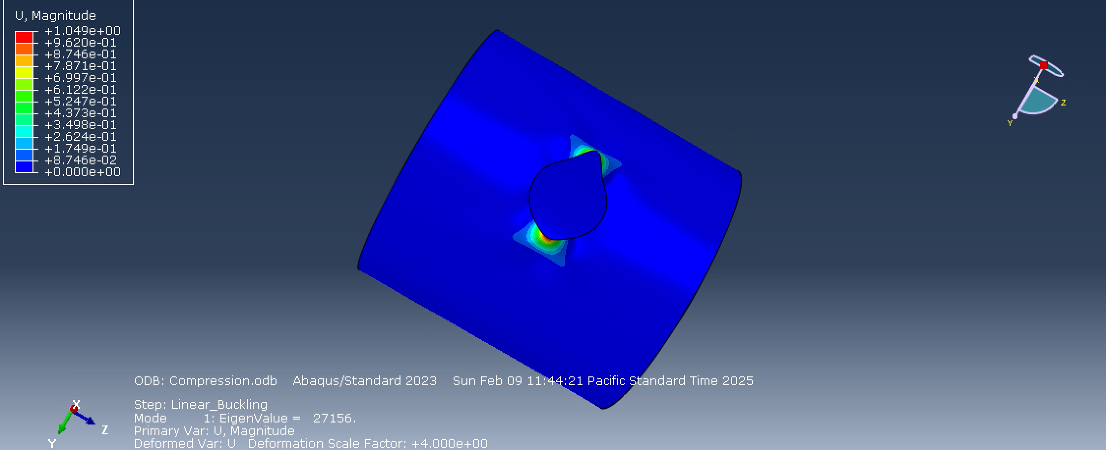
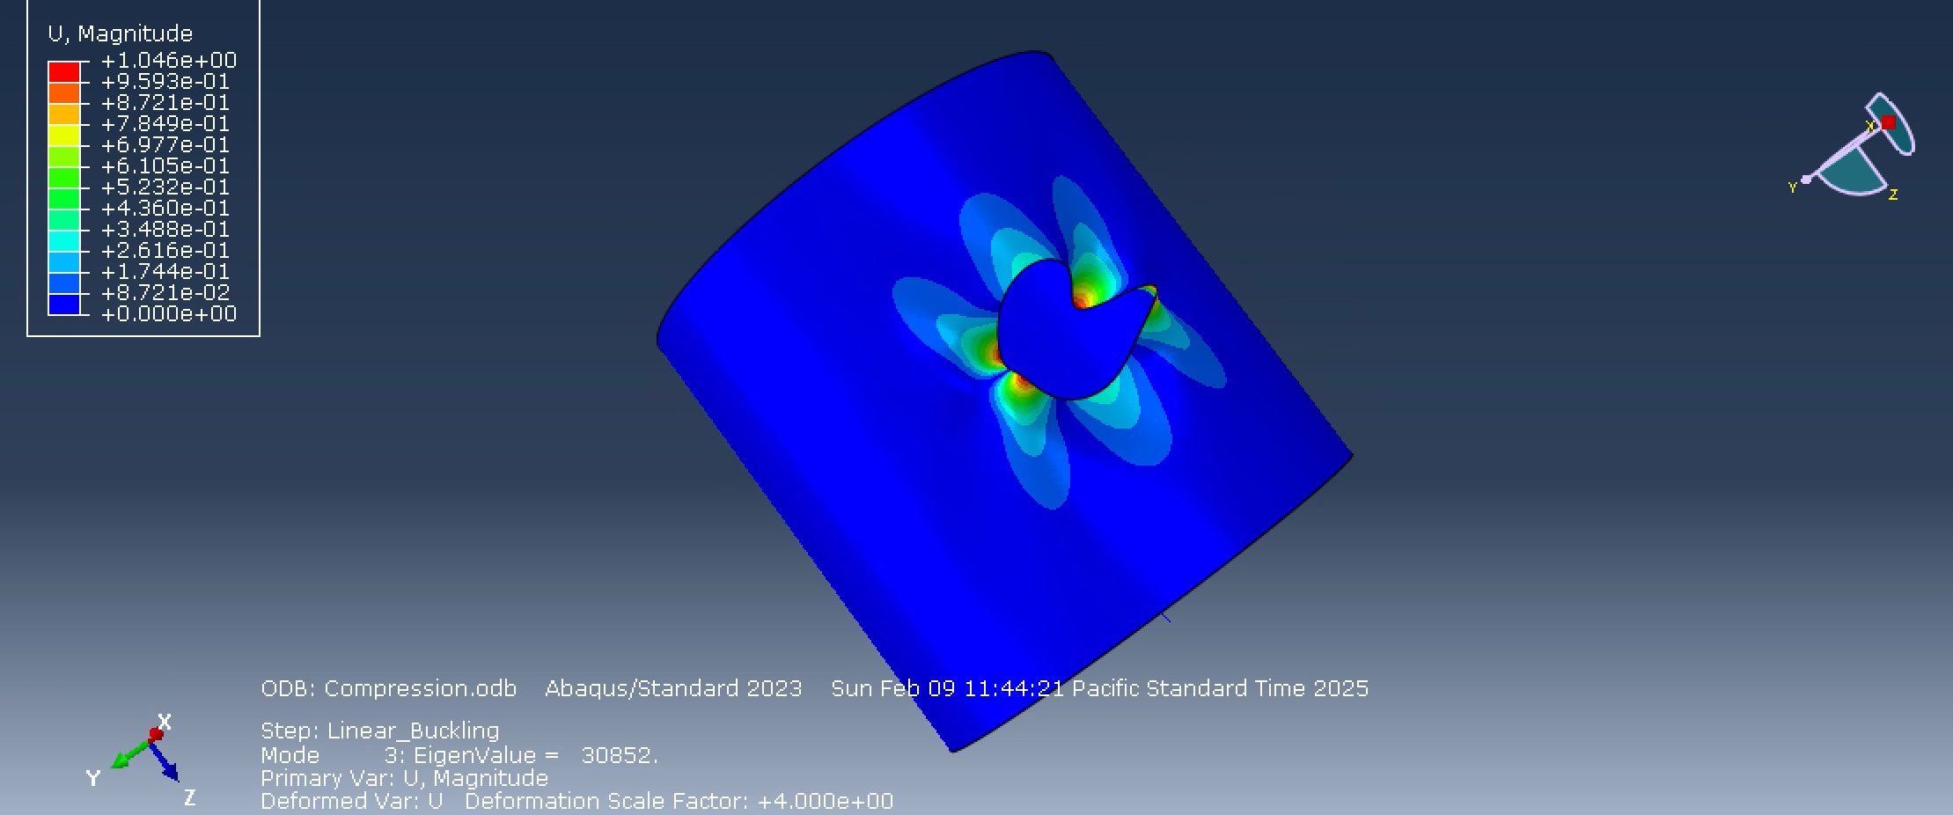
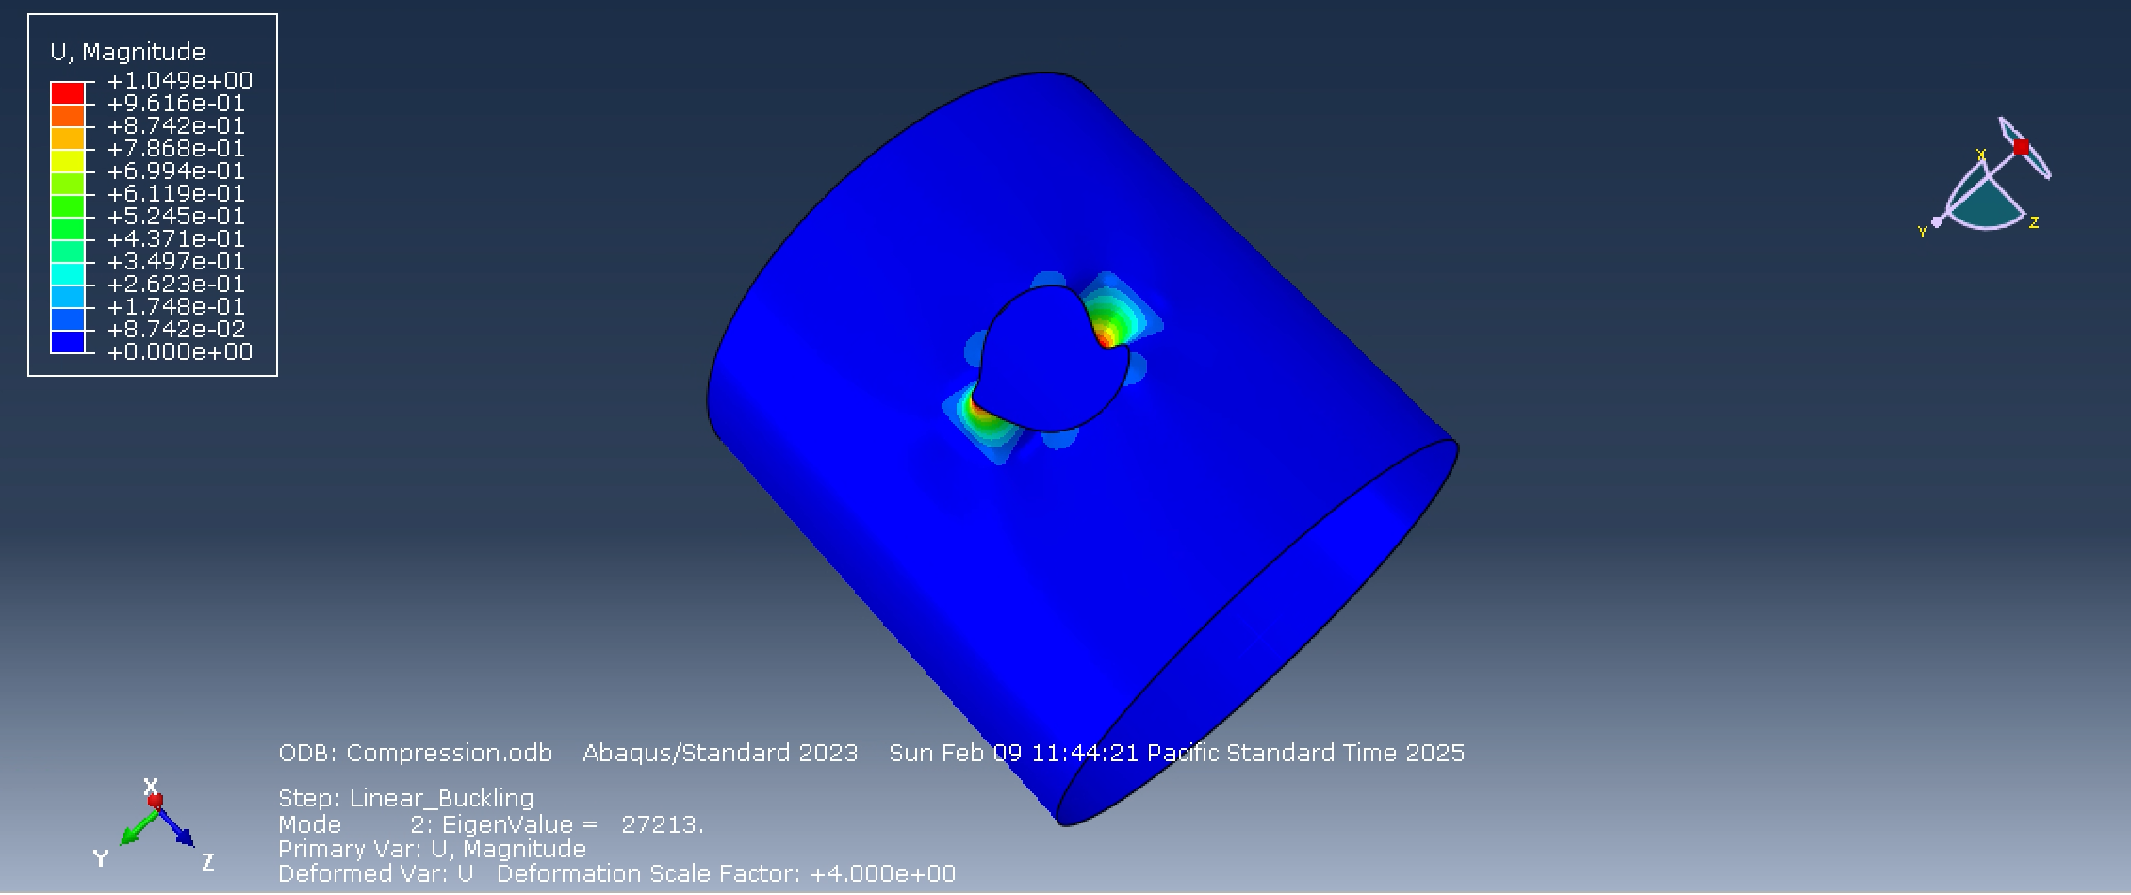
#4
The linear model results give us three eigenvalues
  27156, 27213, 30852
The observed minimum buckling load = 27156 lb
The design load allowable = 0.5 * 27156 = 13578
Design load allowable = 13578 lb

Slide 9
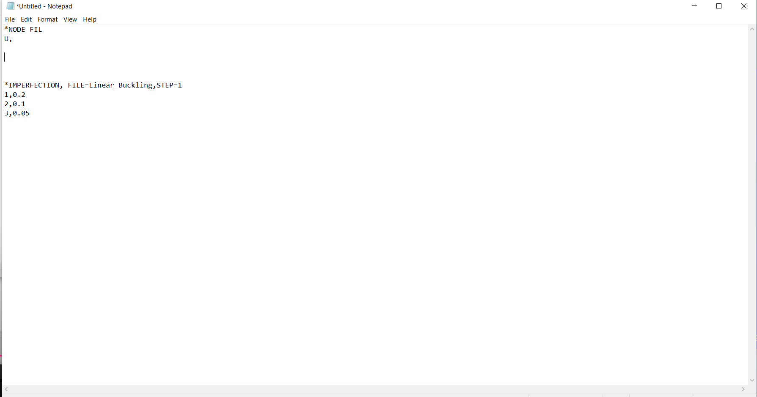
#4
Non-linear analysis required changes
  Suppress the linear step
  Add a nonlinear step
    We selected Riks static step
    Nonlinear effects were turned on
Compressive load of 30,000 lb was selected based on linear analysis eigenvalues
Imperfections were added by editing keywords in the model script
  1, 0.05
  2,0.025
  3,0.0125
The top of the notepad shows what is needed for the linear analysis file
The bottom of the notepad shows how to add imperfections

Slide 10
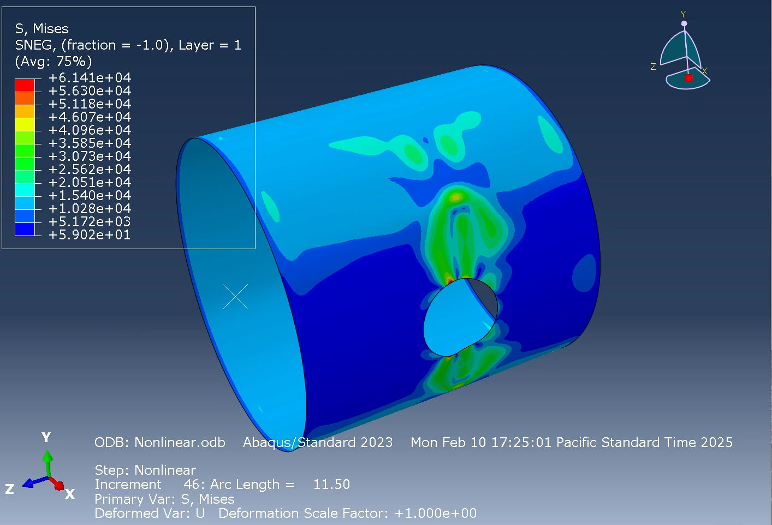
#4
Result from the nonlinear analysis
We can see were the first instance of deformation occurred
  This is crucial for helping us plot the displacement / LPF plot

Slide 11
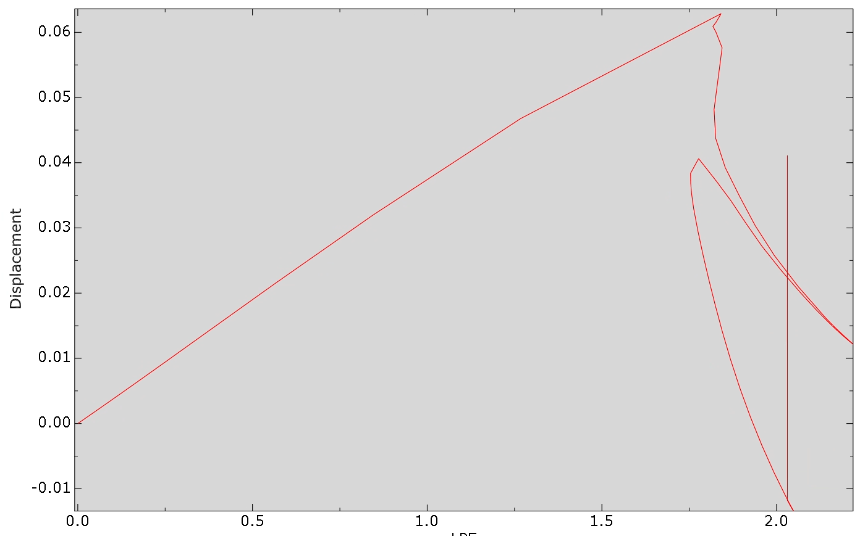
#4
Pully from my results
  LPF at knuckling is roughly 1.8
  This was done with an applied force of 30,000 lb
  The nonlinear buckling load = 1.8*30000
    54000 lb
However, this is quite high
  There is a slight slope change at 1.3 which indicates that this was roughly the first instance where the same or less loading caused deformation
  With an adjust LPF of 1.3 the nonlinear loading becomes 39000 lb
Buckling of composites is dominated by nonlinear effects

Slide 12
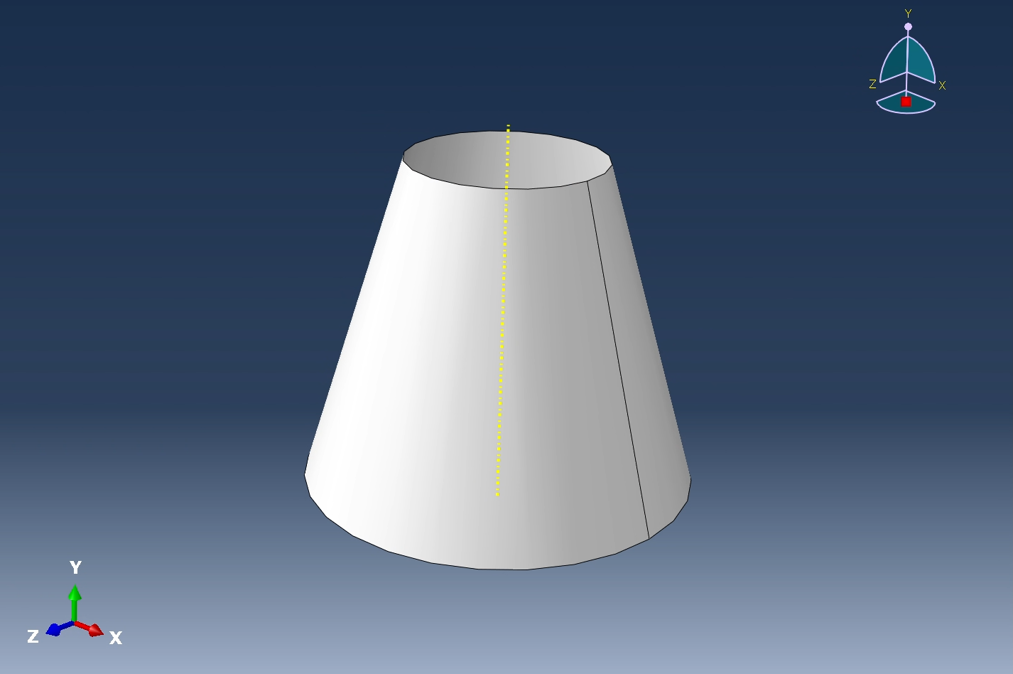
#5
Given Parameters –
Length = 25 ft
Small_top diameter = 15ft
Big_bottom diameter = 30 ft
Materials -
Aluminum AL6061-T6
  E = 1.439e9 lb/ft²
  Poisson’s ratio = 0.33
Load -
Compressive load = 1.5e6 lb
Units -
Length = ft
Mass = lb
Load = lb
Initial Thickness = 0.1 ft
Vary the thickness to conform to specific requirements

Slide 13
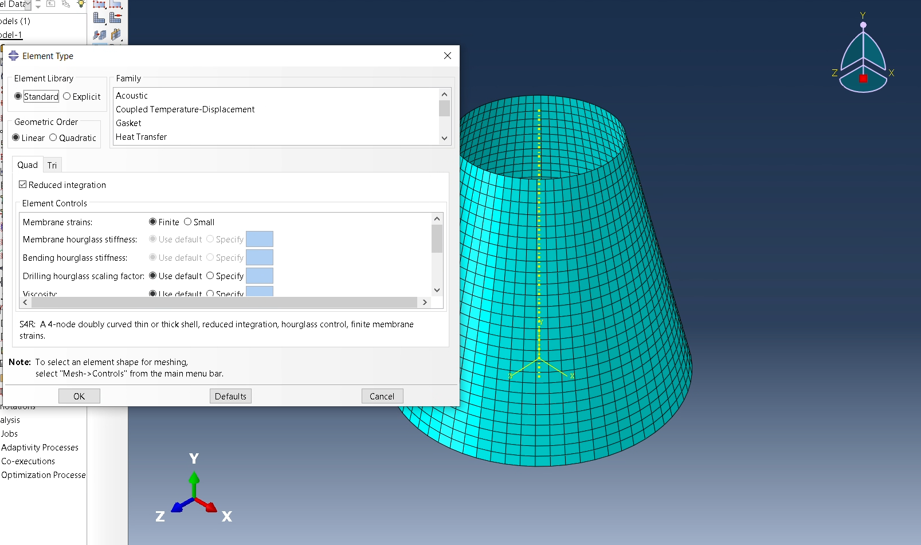
#5
The mesh was defined for the part
  Settings were checked to make sure S4R

Slide 14
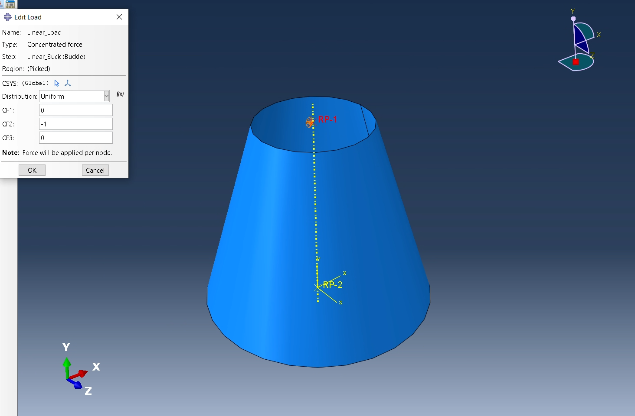
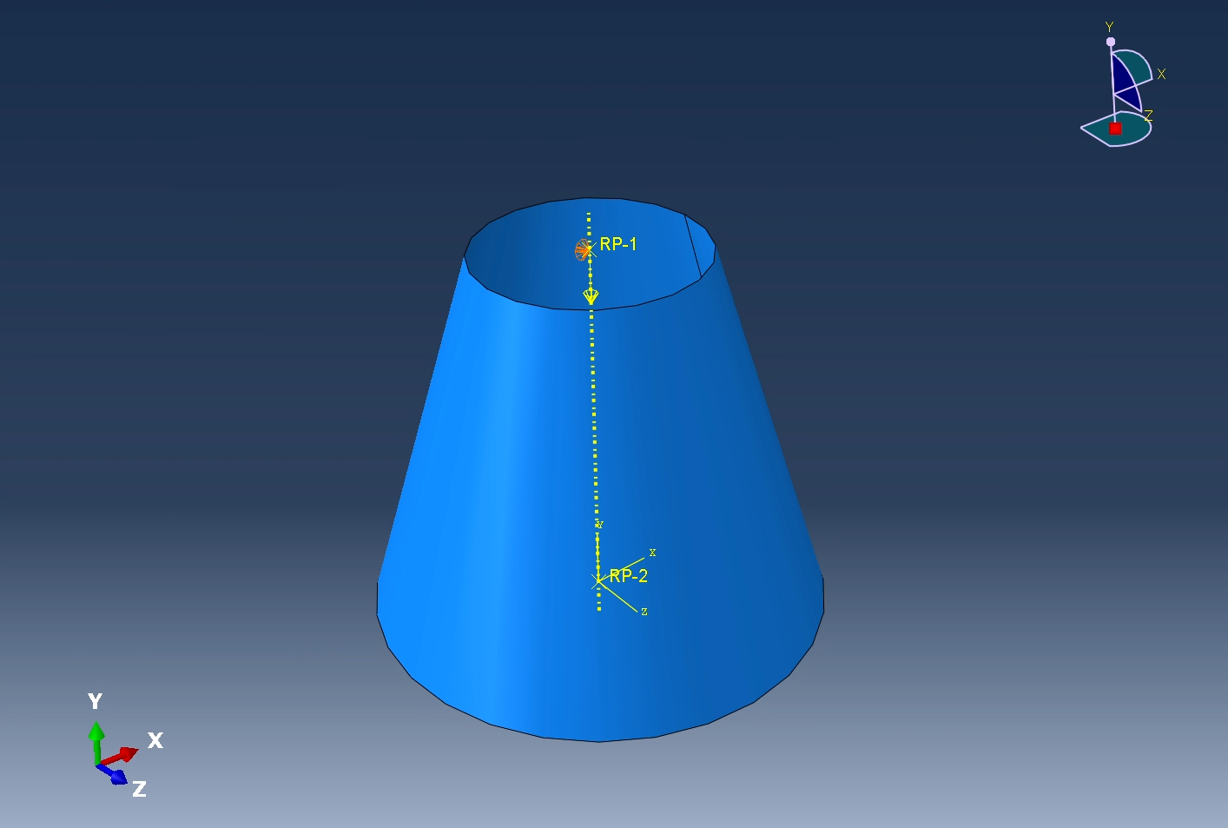
#5
The reference points were implemented into the model
  Datum plane was placed, the Y-axis is the loading axis
    For a compressive load it will be negative (-)

Slide 15
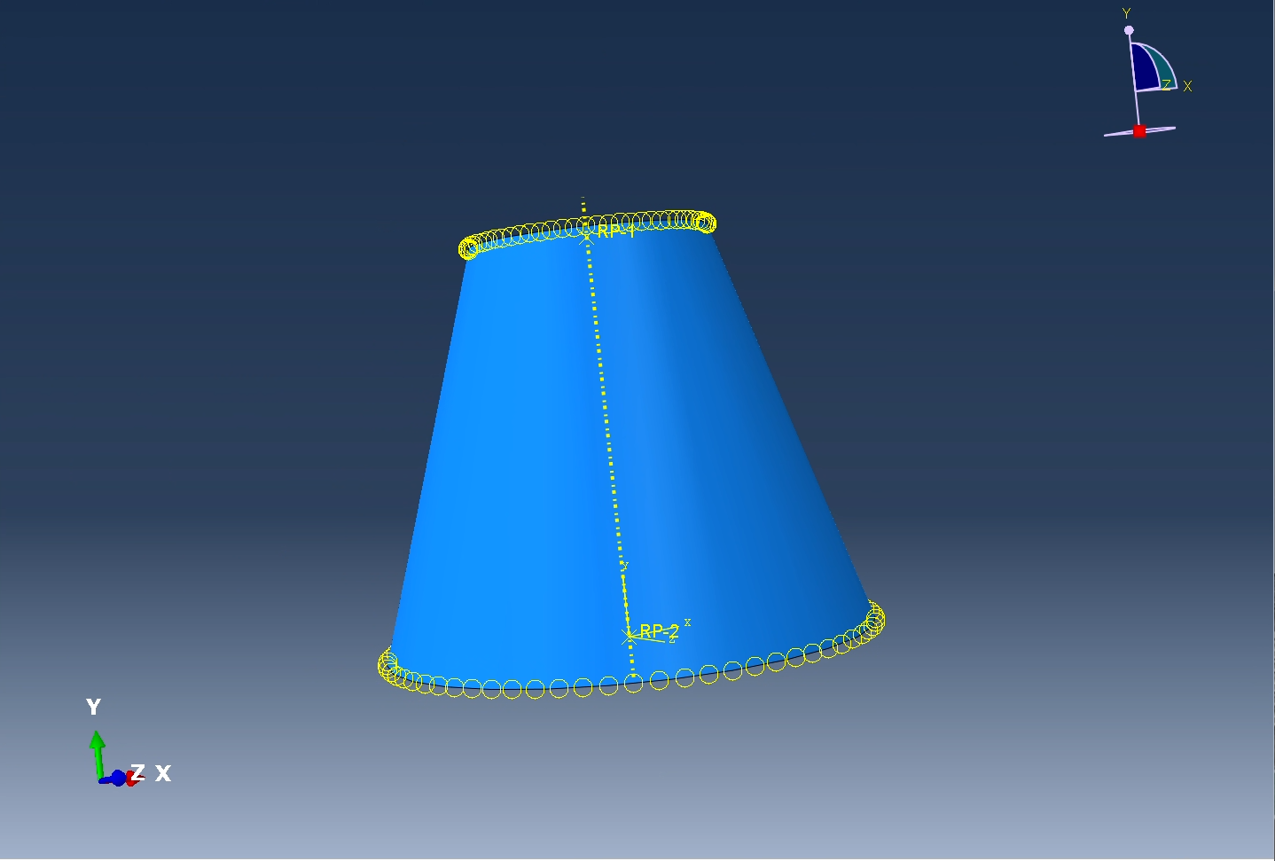
#5
The boundary conditions were applied to the model
  Top and bottom were fixed
    Clamped-clamped assumption

Slide 16
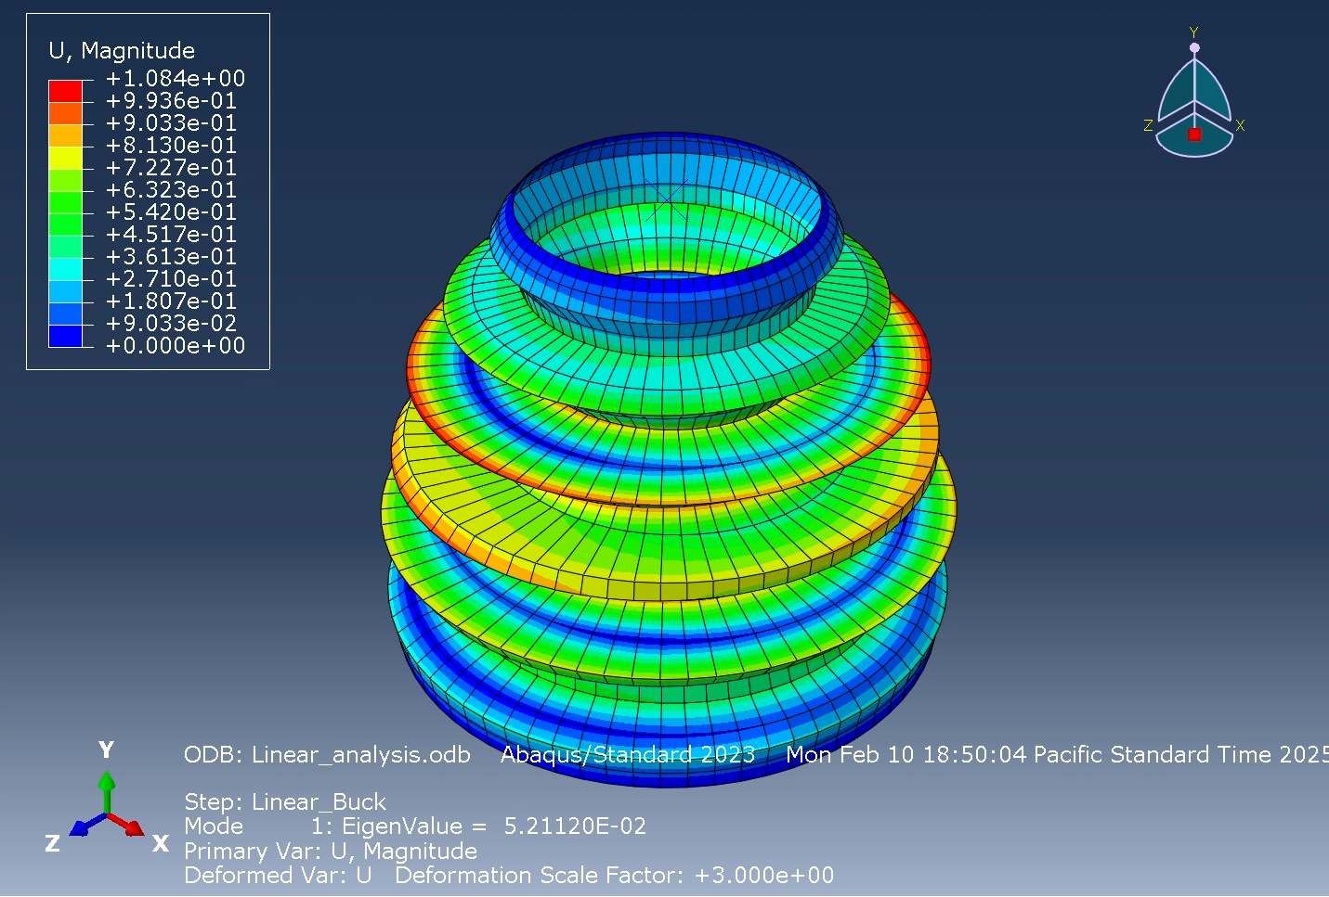
#5
Run 1
  0.1 ft thickness
  Eigenvalue = 5.211 e7 lb
  Roughly 5x the required buckling load
With given parameters
  1.5 e6
  KF = 0.3
  F.S. = 2
    To pass the requirements
      1.5(2)/0.3 = 1.0 e7

Slide 17
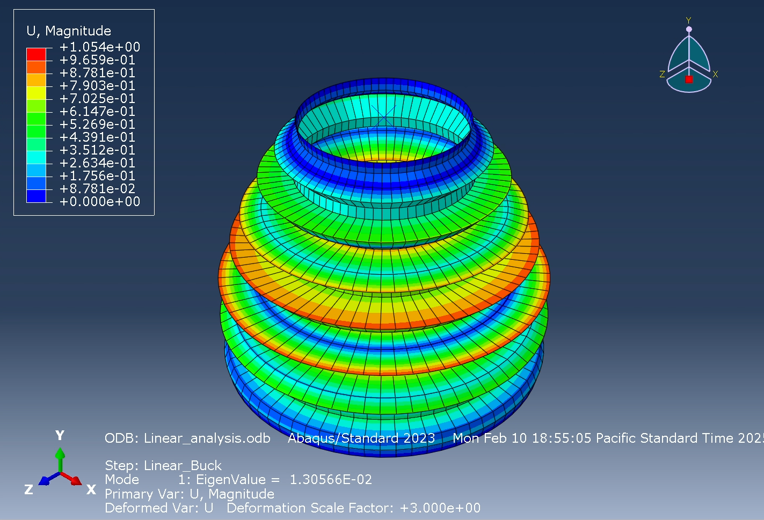
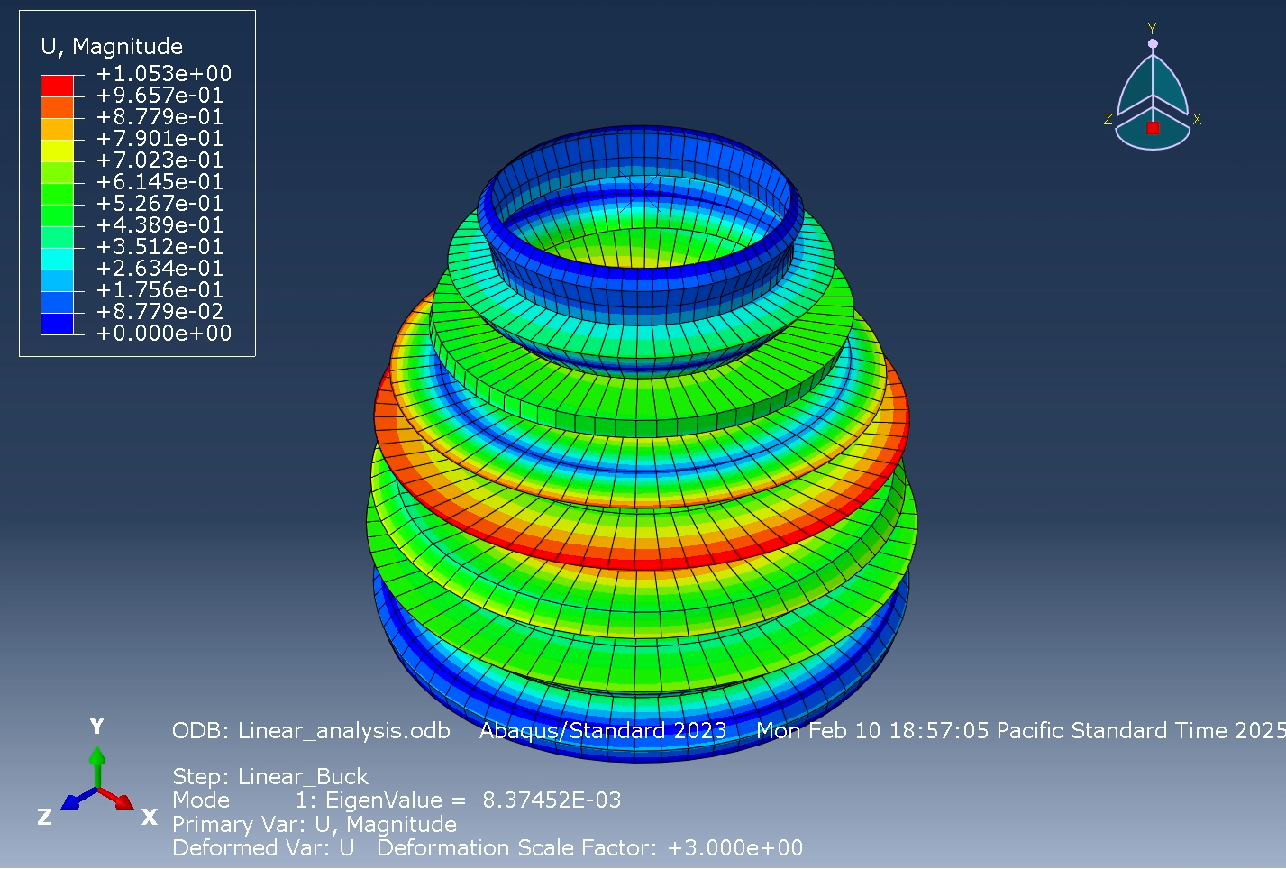
#5
Run 2
  0.05 ft thickness
  Eigenvalue = 1.30 e7 lb
    Still to much, we can take more thickness off
Run 3
  0.04 ft thickness
  Eigenvalue = 8.37 e6
    Took off too much thickness, need to add more

Slide 18
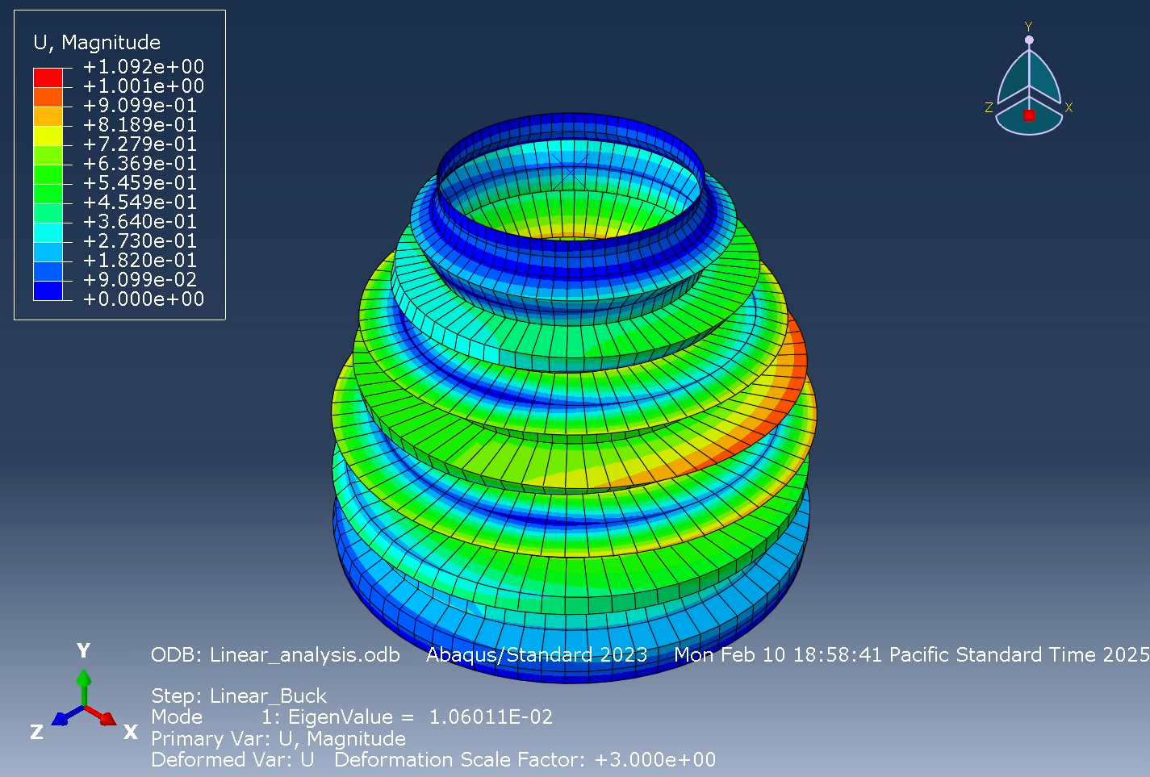
#5
Run 4
  0.045 ft thickness
  Eigenvalue of 1.06 e7
  There is still room to remove more thickness, but I would have to go to 1/1000 of an inch
  The group concluded this does not make sense

Slide 19
#5
Hand calculations were done for comparison
This was found in the lecture slides
  The hand calculation was fairly accurate and was within 27% of what I calculated in Abaqus
  There is probably more room to reduce thickness, but it doesn’t make sense

