Slide 1
AME 585
Project 2
Henry Glover
1/28/2025

Slide 2
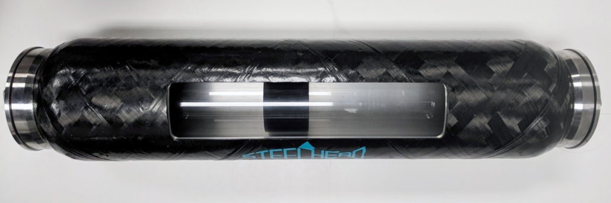
#1
Composite overwrapped Pressure Vessels (COPV) are lightweight, high-strength composites that are wrapped over a liner and used to store pressurized gasses or liquids
  Metallic linear – provides a permeation barrier to prevent leaks (typically a ductile material – soft aluminum)
  Composites Overwraps – matrix of continuous fibers contained within a resin (typically made from carbon fiber, kevlar, fiberglass)
  The ribbon of the fiber and resin is wound on top of the metallic linear
#2
Cylindrical body
Filling port
Metallic linear
Composite overwrap – CFRP

Slide 3
#3
Over pressurization burst – typically mitigated by using a stronger material or getting material certification
Metallic linear fatigue failure – mitigated with inspection and testing (NDI techniques)
Burst from metallic linear or composite damage – any slight damage to a COPV (tool falling and hitting the structure) could be catastrophic. Issue is mitigating by protecting the composites from damage and performing damage tolerant tests
Stress rupture of composite overwrap – degradation of the composites overtime results in sudden structural failure
Buckling of liner – debonding of the liner and composite can result in a buckle. The compressive forces from the overwrap will cause this
Leak before burst (LBB) – Surface cracks in the linear caused by cyclical loads, this is a preferred failure mode over a sudden rupture or burst. Crack stability in the liner is maintained to prevent sudden rupture
#4
Autofrettage is a way to improve structural performance on a COPV, it is a process where a COPV is over pressured. The COPV is pressurized above its rated strength - above the liner yield strength, causing the liner to plastically deform and expand. This results in a small amount of liner growth, which results in liner compression.
  This process can be either elastic or elastic-plastic
  The compressive residual strain on the liner from the overwrap results in improved life cycle performance, increasing the durability and life of the structure
Notes:
https://www.nasa.gov/centers-and-facilities/nesc/advances-in-understanding-copv-structural-life/

Slide 4
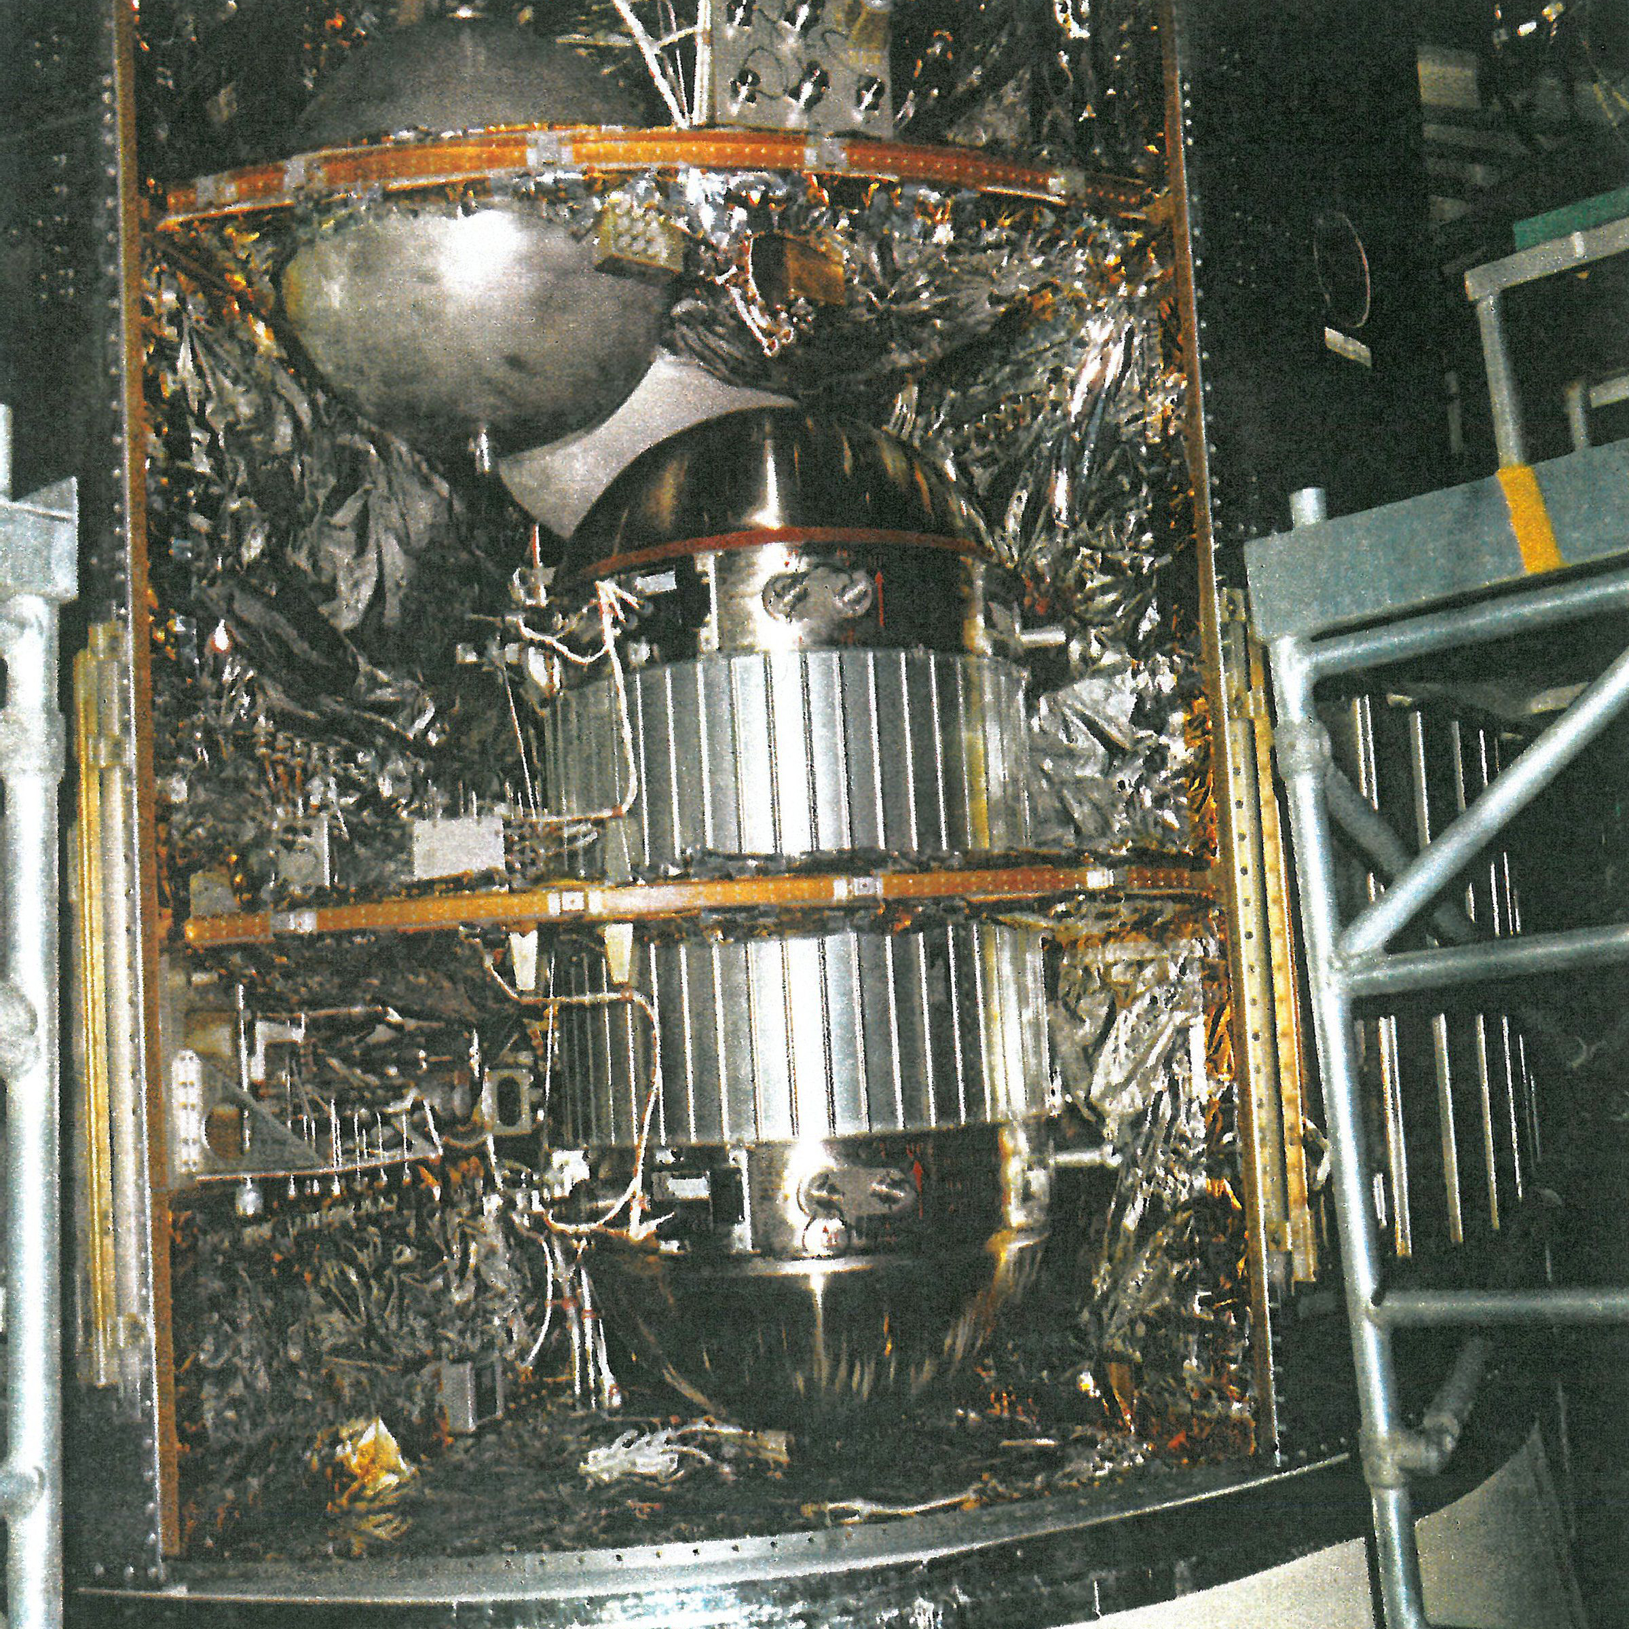
#5
During the Apollo missions, all-metal pressure vessels were being developed where 19 failures occurred. 3 failures occurred while the COPV was installed on the spacecraft. One of them unfortunately ruptured on Apollo 13, where oxygen tank no. 2 in the service module ruptured.
In 2016, a SpaceX Falcon 9 rocket exploded on the launch pad during a fueling test. The explosion was caused by the rupture of a Composite Overwrapped Pressure Vessel (COPV) helium tank located in the 2nd stage. The launch vehicle (LV) was holding densified propellant, meaning the liquid oxygen (LOX) was chilled close to its freezing point, increasing the fuel density. This provided better performance, extended range, and more propellant storage. However, this approach had a downside- while the rocket remained on the launch pad, the surrounding atmosphere warmed the tank over time. Inside the LOX tank, helium was stored in COPV’s at high pressure and low temperature to maximize density. However, as the temperature fluctuated, the COPV experienced a rapid pressure increase, causing its structure to buckle inward slightly. The extremely cold LOX surrounding the tank solidified within the voids of the COPV during this buckling situation. During refueling, the rising pressure led to a failure in the COPV, ultimately triggering the explosion.
In 2015, a Flacon 9 rocket during the CRS-7 Dragon mission exploded. Investigation found, a strut
In the 2nd stage LOX tank broke, releasing a COPV and causing a pressurization rupture. The strut impacted with the surroundings of the tank causing the explosion.
Apollo 13 - COPV
Notes:
https://appel.nasa.gov/2017/10/26/human-spaceflight-knowledge-sharing-mitigating-the-high-risk-of-copvs/
https://nssdc.gsfc.nasa.gov/planetary/lunar/ap13acc.html
https://sma.nasa.gov/SignificantIncidents/assets/spacex-falcon-9-failure-investigation-focuses-on-copv-struts--nasaspaceflight.com.pdf
https://www.youtube.com/watch?v=mBcoTqhAM_g
https://sma.nasa.gov/SignificantIncidents/assets/spacex-falcon-9-failure-investigation-focuses-on-copv-struts--nasaspaceflight.com.pdf

Slide 5
#6
A leak before burst (LBB) is a preferred failure mode for COPV’s to mitigate and prevent cataphoric explosions/ruptures.
  Overtime, cracks may form over pressure cycles in the composite overwrap or the liner due to cyclical loading, fatigue, impact damage, and/or material degradation
  Crack formation should allow a small detectable amount of pressurized gas to escape in a controlled manner
    The COPV should developed a detectable leak before undergoing sudden rupture
      Allows for the prevention of a rupture and provides an early warning to allow engineers to detect and address the issues before reaching a critical failure mode
#7
“A study of residual burst strength of composite over wrapped pressure vessel due to low velocity impact”
  Low velocity impact (LVI) can lead to cataphoric failures on COPV’s
    Experience a reduction in burst strength due to internal delamination, fiber breakage, and matrix cracking
    Non-visible impact damage is also significantly compromising to the COPV’s performance
  Failure mechanisms
    Microcracking in the composite overwrap weakens structural integrity
    Delamination between layers – reduces allowable pressure loads
    Liner deformation – introduce stress concentrations
  Study’s approach
    Drop weight impact testing to simulate LVI
    FEA for stress concentrations, distributions and failure prorogation \
  Conclusions
    Higher impact energy led to greater strength degradation
    Emphasized need for better protective coatings, better composite materials, frequent inspections
Notes:
https://journals.sagepub.com/doi/full/10.1177/15589250221088895
https://www.sciencedirect.com/science/article/abs/pii/S0308016121002064#:~:text=These%20impact%20loads%20can%20cause,strength%20after%20impact%20of%20COPV.
https://www.sciencedirect.com/science/article/abs/pii/S2452213922001838#:~:text=The%20composite%20overwrapped%20pressure%20vessel,sensor%20array%20in%20real%2Dtime.

Slide 6
#7 CONT.
“ Low velocity impact damages of filament-wound composite overwrapped pressure vessel (COPV)”
  Impact force-time curve for COPV’s has phases
    Linear increase in force
    Plateau – where there is repeated oscillation, increasing with greater impact energy
    Rapid force reduction
      Greater impact energy increases the Plateau phase – indicates greater internal damage
  Test focused on filament-wound, composite laminated plate, and filament-wound composite plates
    Filament-wound COPV had the best impact resistance, followed by composite laminated plate, and filament-wound composite plate
  Impact damage mechanisms
    Delamination – occurred between layers in the COPV tube section
    Matrix cracking – fiber breakage was concentrated in the fiber-overlapping area of the spiral wound layer
  Conclusions
    At low impact energies, delamination and matrix cracking occurred with no visible fiber breakage
    At high impact energies about the threshold, fiber breakage initiated, leading to a significant loss of structural integrity
    Maximum impact force on COPV’s is lower than laminated/composite plates
      COPV’s absorbed less energy – it better distributed the impact energy compared to plates
Notes:
https://journals.sagepub.com/doi/full/10.1177/15589250221088895
https://www.sciencedirect.com/science/article/abs/pii/S0308016121002064#:~:text=These%20impact%20loads%20can%20cause,strength%20after%20impact%20of%20COPV.
https://www.sciencedirect.com/science/article/abs/pii/S2452213922001838#:~:text=The%20composite%20overwrapped%20pressure%20vessel,sensor%20array%20in%20real%2Dtime.

Slide 7
#8
Key Qualification and Acceptance Requirements
Tests | AIAA | ISO | DOT
Burst pressure | 2.5-4x max operating pressure | 3-4x working pressure | 3x service pressure
Cycle life | 50,000 cycles for space use | 10,000 cycles at operating pressure | 10,000 cycles minimum
Leak before burst | Required for spaceflight safety | Recommended for high pressure | Not required
Stress rupture | Long term cyclical tests | Long term cyclical tests required | Not required
Environmental | Vibration, radiation, temperature extremes | Extreme temperatures, UV, infrared, chemicals | Temperature and chemical exposure
Flaw tolerance | Artificial flaws and impact testing | Damage and impact resistance | Drop and impact testing
Non-destructive inspection (NDI) | X-ray, ultrasonic, acoustics | Ultrasonic and radiology | Required before service life

Slide 8
#9
Micro Meteoroid and Orbital Debris
(MMOD) Micro-merteroid and orbital debris pose significant risk to COPV’s and can cause catastrophic tank failure
    Lead to loss of spacecraft or even human missions
    Perforation on a COPV could damage integral systems of the spacecraft
  Cryogenic temperature-controlled tests, with high velocity and low velocity impacts lead to further understanding
    Helps with selecting tank materials to avoid such failure
    Most spacecraft have at least one pressurized vessel on board (either liquid propellant tank for robotic spacecraft or in some satellites a fuel tank)
Protection to put in place for COPV
  Changing or adding spacecraft MMOD shields
  Adding blankets
  Changing the configuration of the spacecraft
    EX. COPV is located on the front of a spacecrafts orbiting or ram direction – higher probability to get damaged
      Can change the configuration of the spacecraft
      Can lower the orbit of the spacecraft to avoid as much MMOD
Notes:
https://appel.nasa.gov/2021/04/27/critical-knowledge-insight-mitigation-of-micrometeoroids-and-orbital-debris-risk/
https://ntrs.nasa.gov/api/citations/20230012105/downloads/8-16-23%2020230012105.pdf

Slide 9
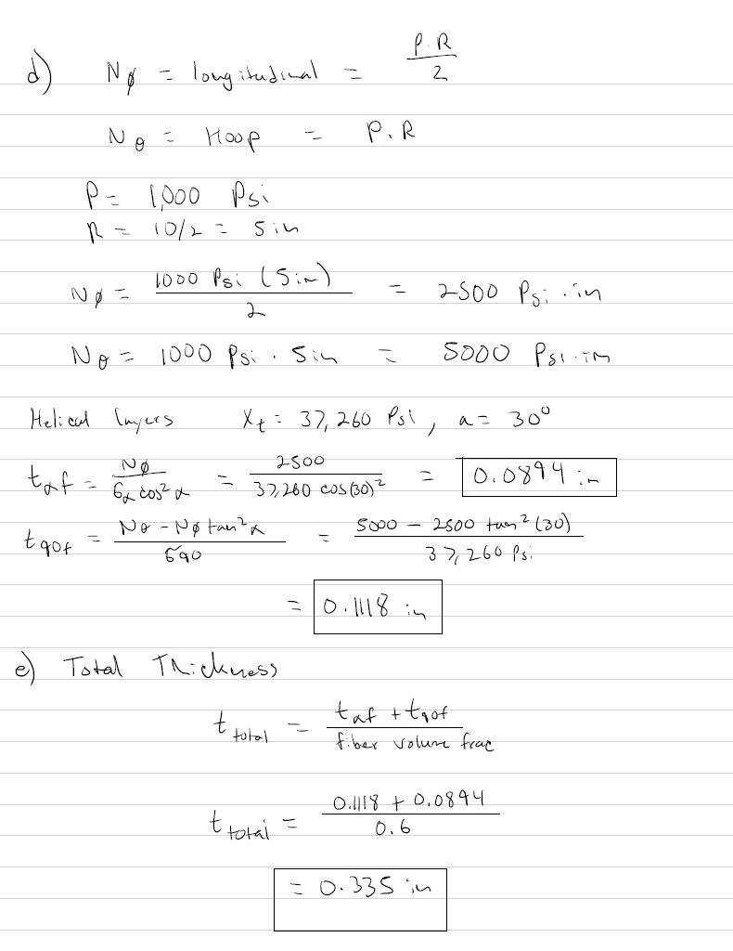
#10
Design Problem
These are PDF links, write click and click open

Slide 10
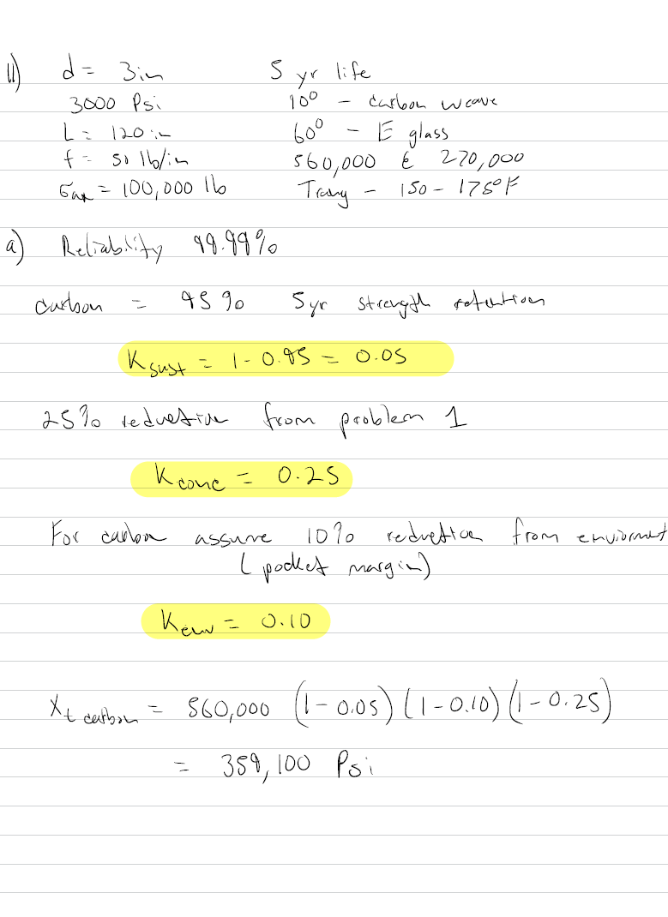
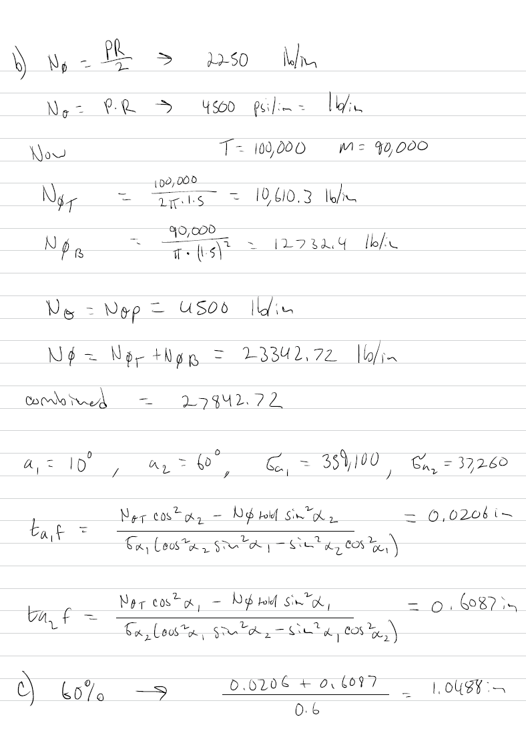
#11
Design Problem
These are PDF links, write click and click open

Slide 11
#12
Design Problem
These are PDF links, write click and click open

Slide 12
#13
Design Problem
These are PDF links, write click and click open

Slide 13
#14
10 Lessons learned
COPV structures exhibit a non-uniform distribution of stresses and deformation due to liner geometry, its interaction with the overwrap winding pattern, the relative stiffness of the liner, and the presence of incompatible curve changes.
The polar boss areas (filling ports) of the liner are thickened and more rigid to support the fixtures
Overwrap complexity is based on manufacturing phases with winding parameters, consolidation, and curing schedules
The presence of load-sharing liners significantly influences the stress distributions in the COPV
Predictions from manufactures sometimes overestimate fiber stress at burst, indicating a need for qualification and testing to ensure reliability. The need for testing is obvious.
Manufacturing COPV’s is intricate and requires careful attention to detail. Applying stress rupture life data from one vessel to another, especially with dissimilar designs should be accounted for.
Liner influences can have a significant impact on stress concentrations and deformations in the composite overwrap
Stress ratios are used to make life cycle predictions on a vessel
Time dependent factors such as creep and material degradation were of concern and can alter the stress distribution over the vessel's lifespan
The interaction between the composite overwrap and the liner results in residual stresses after proof testing due to the elastic-plastic behavior of the liner and the elastic unloading of the composite. The COPV is under compression even at zero pressure.

Slide 14
#15
3 Lessons Learned Each
Video 1
  Lorie Grimes-Ledesma working on COPV for 18 years
  COPV’s have disadvantages – needs to be carefully used and a lot of oversight
  COPV’s reduce the mass to store fluid/gases, you can save up to 50% over an all-metal pressure vessel
Video 2
  Metallic liner overwrapped with a composite material functioning together to contain the gas/propellant
  Relative loads on the liner vs. the overwrap, must function together
  Failure modes for both metallic and composite materials needs to be understood, they interact with each other
Video 3
  Liner failure modes – have been fracture control related - sustain load crack load, cyclic fatigue crack growth, incompatibility with fluid stored, buckling
  Composite failure modes – hard to model – impact damage, stress rupture failure
  All metal pressurized vessel were used on the shuttle, and they experienced several failures – stress corrosion cracking, weld cracks, weld pours, cyclic fatigue.
Video 4
  Mitigation for COPV failure – adequate and careful design as well as qualification, what are the contribution of the liner and the overwrap, what are the loading environment, what are the loads
  Qualification and testing is extremely important to mitigate risk
  Understanding the manufacturing steps of the COPV’s needs to be understood and even incorporated into the design if there are any variations
  Impact damage is a significant risk – in manufacturing, during transportation, or while its being incorporated into the flight system
    This is all process control but sometimes you can test a specific impact damage range and understand how the COPV will burst

Slide 15
#15
3 Lessons Learned Each
Video 5
  Factors of safety are used to prevent any overpressure or strength failure
  These failure are rare because the design is put through FEA and a robust qualification system
  COPV’s are inspected using radiography to establish if there are any fatigue cracks and if they are found then tests are conduct to understand whether the liner/design is robust to cracks
Video 6
  The most important failure modes for COPV’s for extended stays in space are liner fatigue crack growth or crack propagation mechanisms, impact damage, and stress rupture mechanisms
  Detail oriented work during the design and qualification phases are of most importance
  Lessons learned from the past include looking at the “small stuff”. Small details are very significant and COPV’s are suspectable to failure from oversight.
Video 7
  Lower weight = better thrust to weight ratio
  COPV’s are complex – they are integrated now and will be for the future of the program
  Used for oxygen, propulsion, life support systems – integrated in all vehicles (NASA)
  Aging of the overwrap material alone is not an issues, stress rupture (fatigue life of overwrap at pressure overtime) is the highest risk
  Transportation of COPV is important especially from foreign programs (other countries)
  Minimizing risk is of utmost importance – test programs for reliability and life is very important to understand
    Highest risk is on ground when pressure in the vessel is highest
  Prevent risk by using damage control plans - fatigue crack growth in the liner, making sure there is no corrosive environments, no overstress on the vessel, no mechanical damage.
  To that point, even stress rupture was hard to characterize its effects the life of the vessels

Slide 16
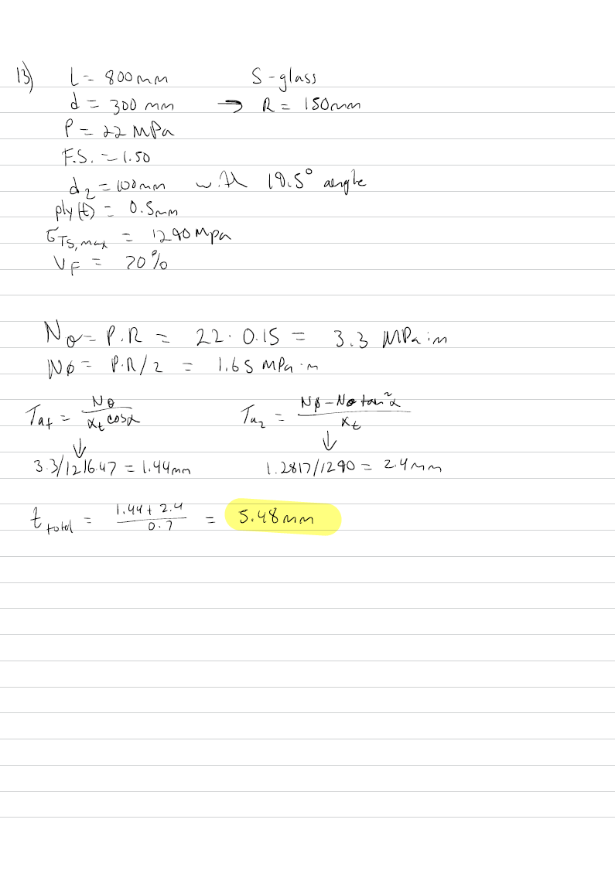
#16 – doing number 13
Abaqus
Ply thickness (t) = 0.0005 m
Length = 0.8 m
Radius = 0.15 m
Pressure = 22 MPa
Estimation was 5.48mm thickness

Slide 17
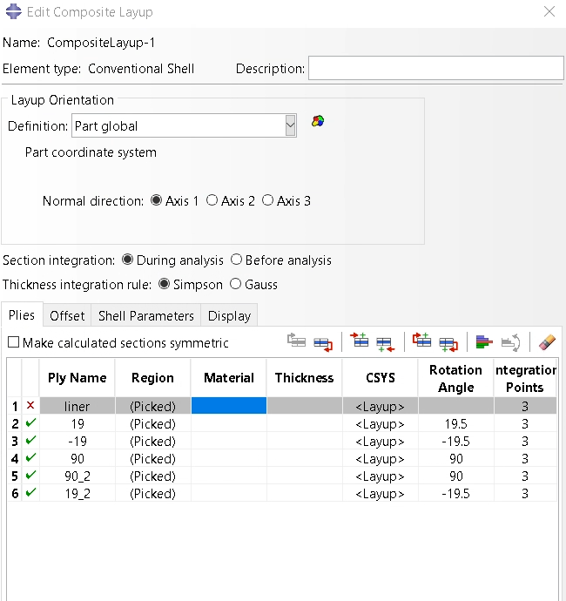
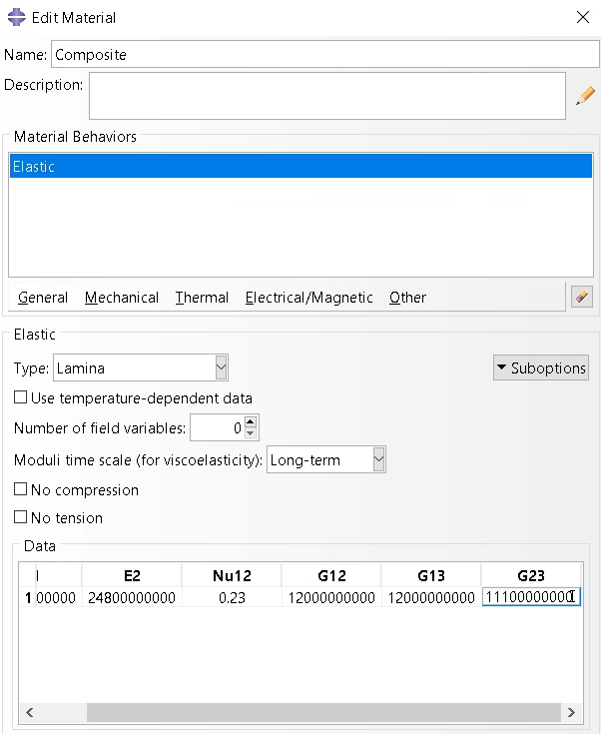
#16
Abaqus – Ply and Layup settings
Composite material Properties

Slide 18
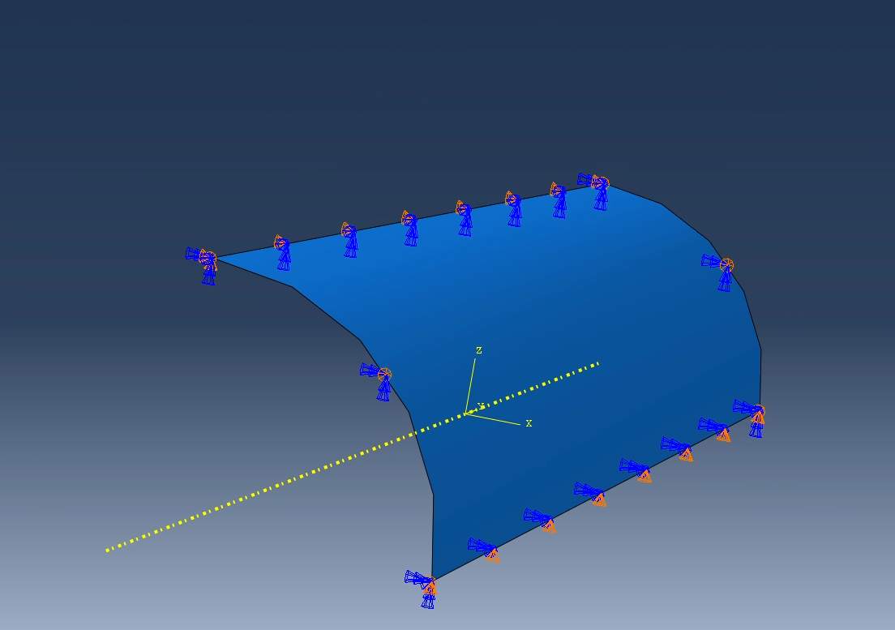
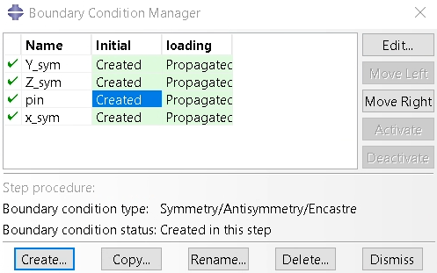
#16
Abaqus – Boundary Conditions

Slide 19
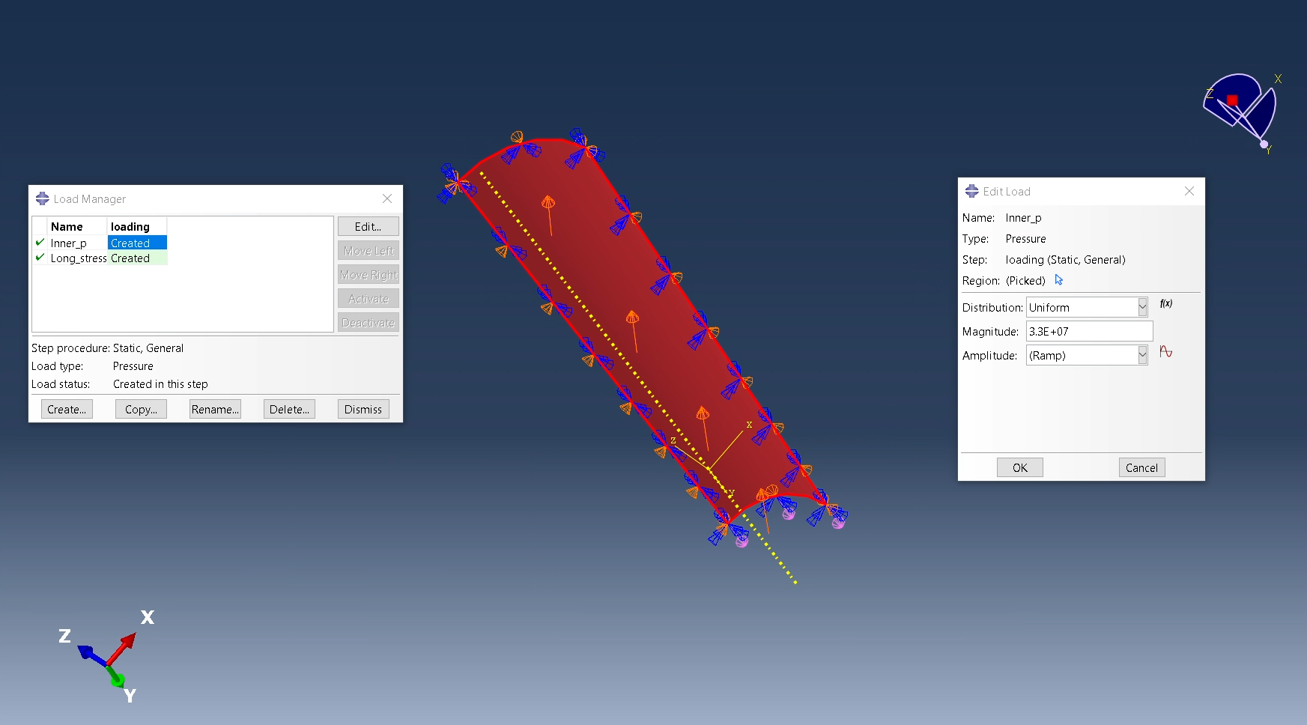
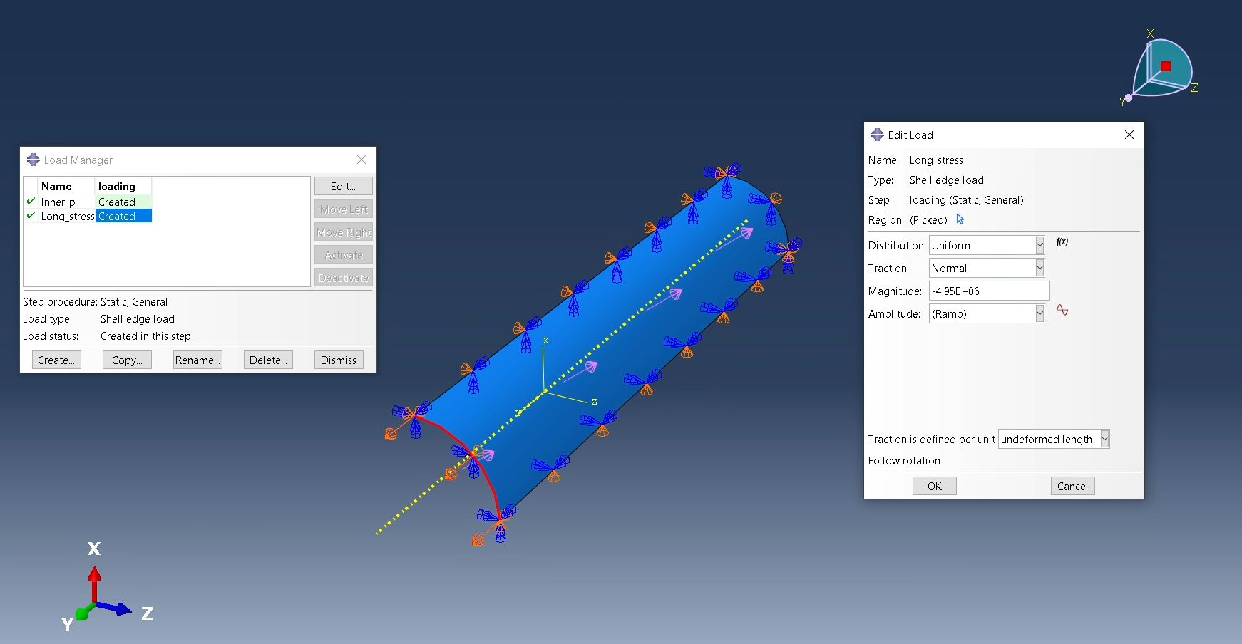
#16
Abaqus – Loading Conditions
Pressure = 22 MPa
Input pressure = 3.3e7 Pa (Introduced F.S.)
Shell edge loading = 4.95e6

Slide 20
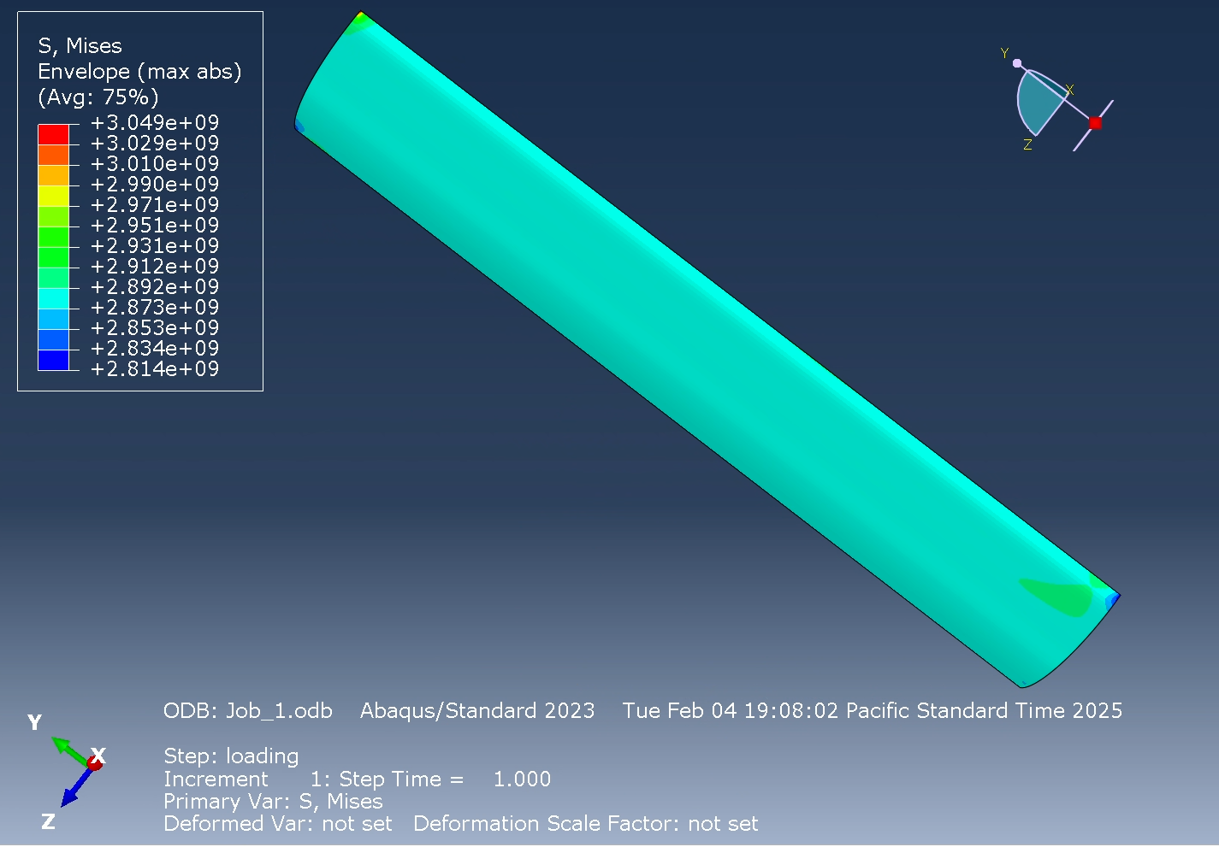
#16
Abaqus
Mesh was set to 0.005
Problem statement = 1290 MPa
Results showed –
  2.9 Pa max for 1 ply
  2.9/1.29 Pa = 2.24
Need 2.24 more sets
3 total sets, 15 total layers

Slide 21
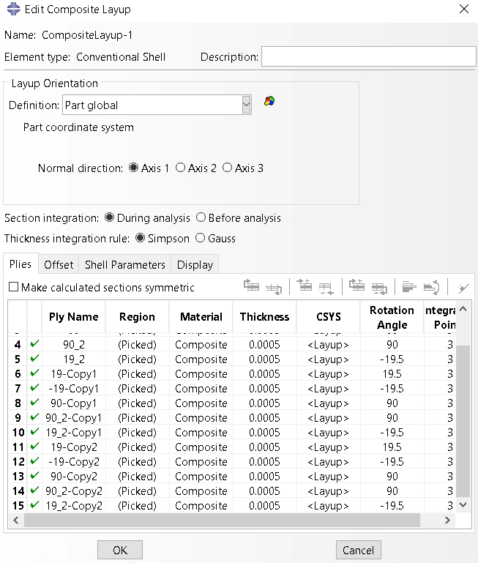
#16
Abaqus
3 total sets, 15 total layers

Slide 22
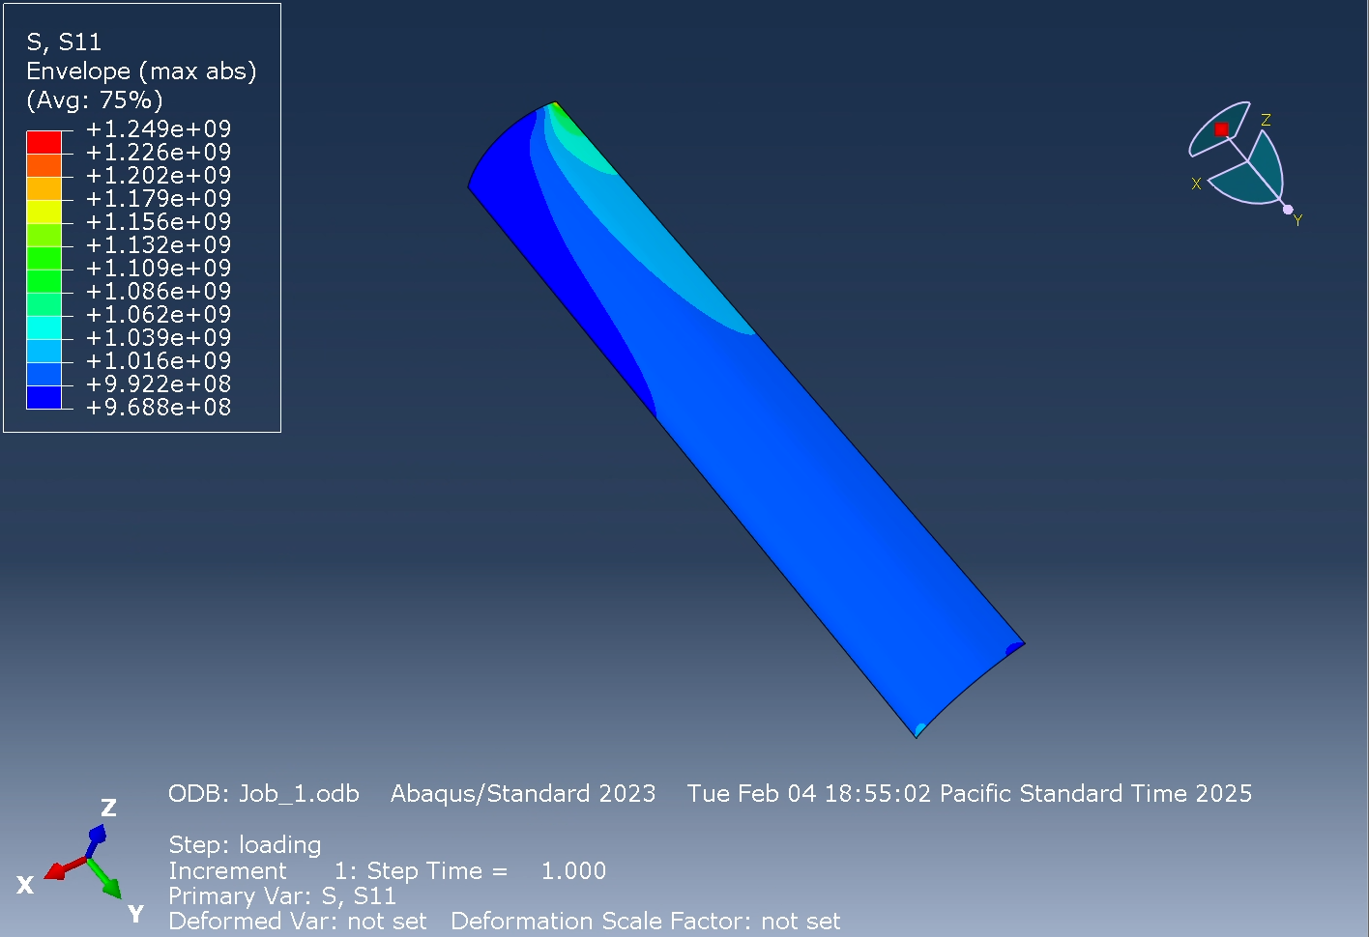
#16
Abaqus
15 total layers
  1016 MPa total S11 with 3 sets
  This passes the criteria of 1290 MPa

Slide 23
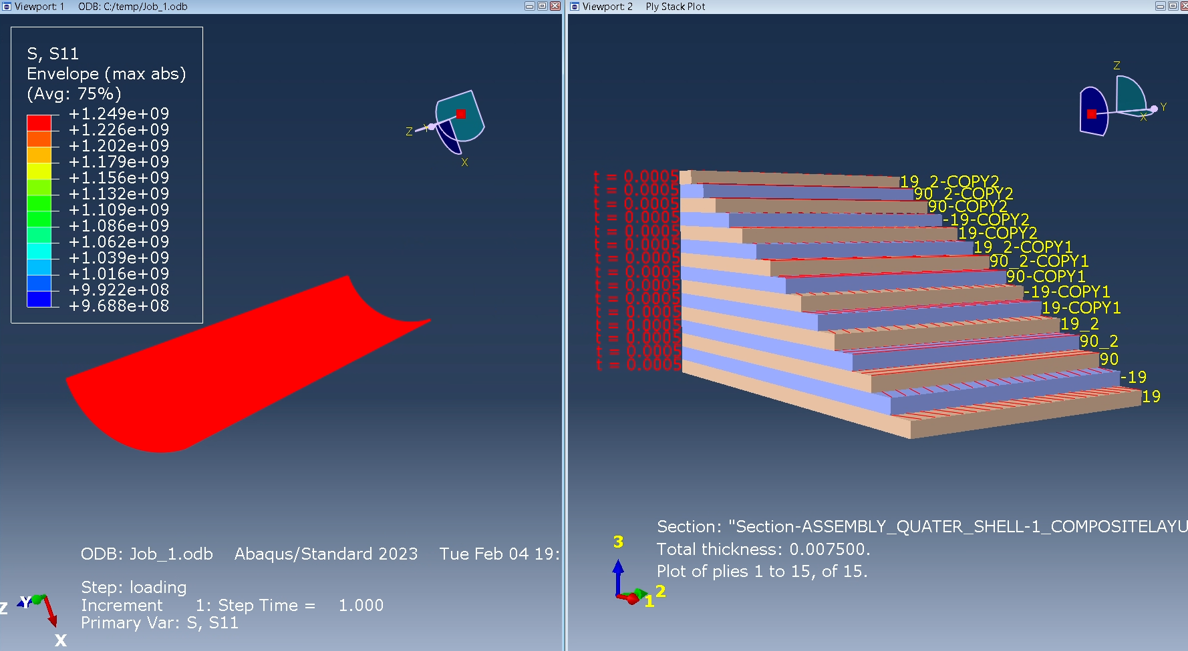
#16
Abaqus
Rough estimate from hand calculations said 5.5 mm thickness
We have thickness of 7.5 mm
Our S11 is 274 MPa lower than max strength

