Slide 1
AME 585 – Composites
Project 1
Henry Glover
1/19/2025

Slide 2
#1
Why Heat Transfer Analysis is Important
Heat transfer analysis is relevant within aerospace structures.
  Launch vehicles
    Engines (combustion, performance, thrust-to-weight ratio)
    Launch conditions and environment
      Thermal resistance, temperature control, thermal protection
      Reentry conditions, how the structure handles/insulates from the environment
    Insulating the payload, electronics/avions, protecting key elements of the launch vehicle
    Surviving drastic temperature fluctuations during ascent, descent, and orbit
  Aircraft
    Engine performance and reliability – heat transfer directly associated with how efficient the aircraft performs
      Coolant systems and blade design must operate withing a threshold
    Heat dissipation/preventing thermal stress and fatigue
    Cyclical thermal loading
  Spacecraft
    Thermal protection during reentry, extreme temperatures and durations
    Radiation protection from space
    Understanding solar heating
    No convection/conduction in space, cold environment could require heating up critical components
    Understanding mission requirements and goals
  https://ntrs.nasa.gov/api/citations/20230003714/downloads/Thermal%20Design%20for%20Spaceflight.pptx.pdf

Slide 3
#2
Types of materials (Thermal Protection Systems)
  Aircraft (Commercial)
    Ceramic Thermal insulation blankets – used to protect engine nacelles
    Aluminum alloys – used on wing leading edges
    Titanium alloys – for engine compartments
    Thermal paint coatings – reflect solar radiation on the fuselage structure
    Carbon composites – for leading edges
    MA-25S – Filled elastomeric silicone, used in engine compartments (<1200F)
  Military (supersonic)
    Titanium, carbon composites, ceramics
  Aircraft (Hypersonic)
    Inconel – high temperature resistance
    Rene 41 – high temp alloy
    Carbon silicon carbide – leading edges
    Zirconium and Hafnium diborides – leading edges, extreme temperature, reentry/ascent

Slide 4
#2
Types of materials (Thermal Protection Systems)
  Launch Vehicles
    High temperature ceramics – have good rigidity, durability, and high melting point
      Borides, carbides, nitrides such as hafnium, zirconium, tantalum, titanium
    Coatings
      RCG dense glass coating used on the outer layer of the space shuttle tiles
      TUFI – High impact resistance coating
    Ablators
      SLA-220 – Lockheed martin silica filled elastomeric silicone composite (<1500 F)
      MA-25S – Filled elastomeric silicone (<1200F)
      UHTC – high temperature capability and high thermal conductivity for leading edges
        Made from zirconium Diboride (ZrB₂) and Hafnium Diboride (HfB₂) composites
    https://ntrs.nasa.gov/api/citations/20120002684/downloads/20120002684.pdf
    https://lockheedmartin.com/content/dam/lockheed-martin/space/documents/thermal/SLA-220%20product%20sheet.pdf
    https://lockheedmartin.com/content/dam/lockheed-martin/space/documents/thermal/MA-25S%20product%20sheet.pdf

Slide 5
#2
Types of materials (Thermal Protection Systems)
  Spacecraft
    Coatings – Tapes, films, paints
      Vapor deposited gold or aluminum for smaller components
    Multi Layer Insulation (MLI) – lightweight insulation blankets for large components
      Made from alternating layers of Dacron/Nylon Mesh and Vapor Deposited Aluminum (VDA). Outterlayer is made from Kapton/Black Kapton/Germanium Black Kapton/Stamet
    Single Layer Insulation – for smaller parts to protect from radiation
      Has a low emissivity coating of VDA
    Interface materials (I/F) – materials between components that can help with heat transfer/flow
      NuSil – Thermal paste, only good thermally
      ChoSeal – Thermal paste but in sheet form and is good thermally and eclectically
      CHoTherm – Thermal paste in sheet form and is good only thermally
      eGraf – Not reusable thermal sheet with okay electrical properties
    Heat Straps
      Copper or aluminum laminate of thin foils which have a high conductivity
      Acts as a thermal path, or used as a connection material between coolers and detectors
    APG – Annealed pyrolytic graphite – graphite sheets that improve thermal conductivity
https://ntrs.nasa.gov/api/citations/20230003714/downloads/Thermal%20Design%20for%20Spaceflight.pptx.pdf

Slide 6
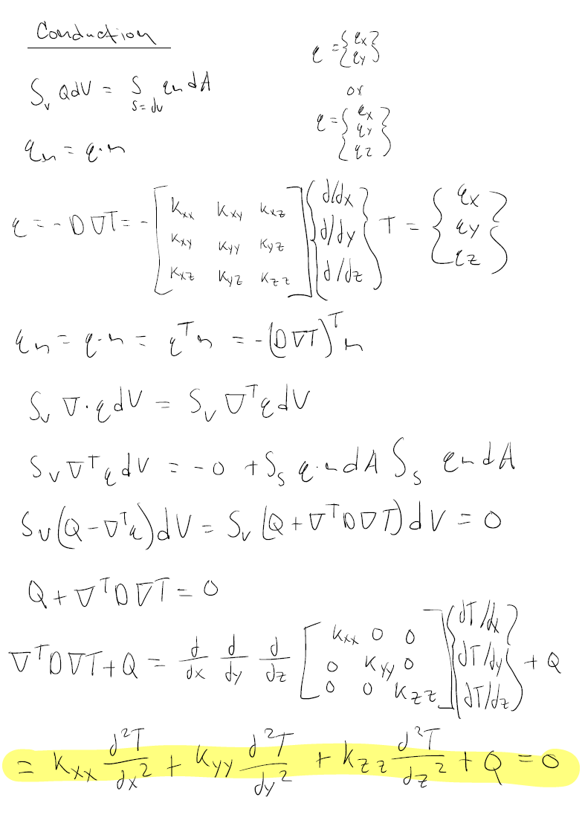
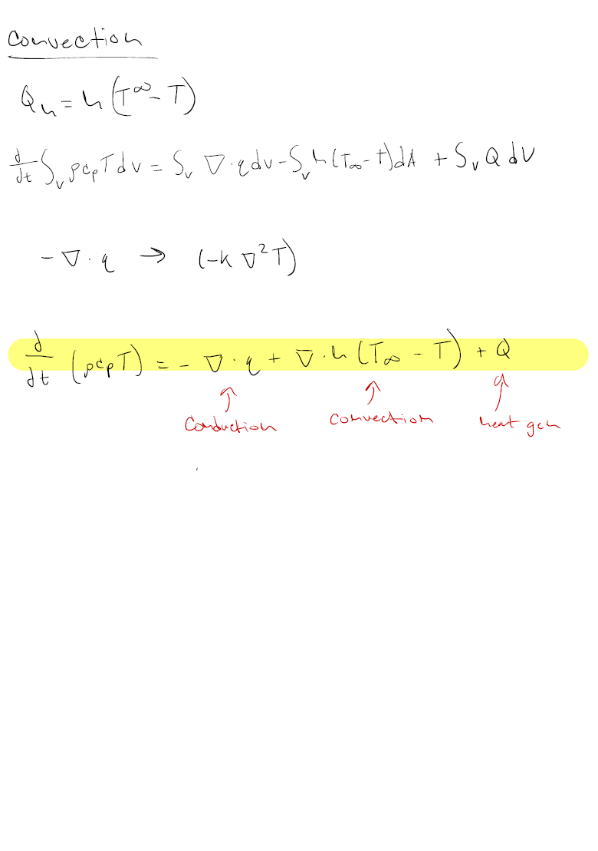
#3
Rederive

Slide 7

#4
How to measure and emissivity and conductivity
  Emissivity (€) = the fraction of energy emitted by a surface based on its thermo-optical properties compared to a perfect absorber or emitter (known as a black body were € = 1)
  Direct temperature method
    Measure actual temperature of the material using a sensor (thermocouple, resistance temperature detector, IR sensor)
    Measure the object temperature
    Adjust emissivity until measure temperature of the material equals the actual temperature
  Heat Flux Method = Calorimetric method
    Heat object to specific temperature
    Measure the heat flux radiated using a sensor
    Solve for emissivity using Stefan-Boltzmann law
      Calorimetric method
        Perform energy balance of radiative heat losses by measuring the sample in vacuum
          This eliminates conduction and convection
          Use Stefan-Boltzmann
  Absorption/Reflectometric method
    Measure Resistance of object surface
    Compute emissivity
Notes:
https://ntrs.nasa.gov/api/citations/20230003714/downloads/Thermal%20Design%20for%20Spaceflight.pptx.pdf
https://themacs-engineering.com/wp-content/uploads/2020/05/Emissivity-measurement.pdf

Slide 8
#4
How to measure and emissivity and conductivity
  Absolute
    Guarded hot plate
      Uses two material blocks around an insulated hot plate emitting heat
      Temperature is measured with thermocouples
      Temp is regulated by surrounding the samples with two controlled plates
    Guarded bar
      Like the hot plate method but using rod-shaped samples to measure the temperature gradient
    Flowmetry method
      Measure thermal conductivity by applying a temperature difference across a sample and measuring heat flow
  Transient
    Laser flash
      Laser pulse is flashed on one side of the surface of the object
      The temperature response is recorded on the other side of the surface
      The thermal diffusivity is calculated = calculation of thermal conductivity
    Hot wire
      Thin wire contact the material
      Electric current is passes
      The temp of the wire is recorded as a function of time
      Thermal conductivity is calculated from temp rise and material properties
    Hot disk method
      A probe is placed between two sample plates, a current heats the probe, and the samples thermal conductivity dissipates the heat
      Detects temperature change through variations in the probe’s electrical resistance
Notes:
https://www.calnesis.com/en/measurements/thermal-conductivity/#:~:text=The%20flowmeter%20method%20involves%20determining,thermal%20conductivity%20using%20Fourier's%20law.

Slide 9
#5
What is FEM
  The finite element method is an approximation method for partial differential equations that discretize shape into simple polyhedral elements (mesh of smaller elements). For each polyhedral element a set of governing equations is applied to individually calculate the mechanics for a given area. The elements then combine and get a discrete set of equilibrium equations allowing for an approximation of mechanical behavior.
  We use the FEM method because it is extremely efficient and allows for the accurate analysis of complex real-world structures.
  How it works
    Problem statement
    Adjust for the physical phenomenon (Solid mechanics, Fluid mechanics, Thermal conduction…etc)
    Model for boundary conditions and initial conditions
    Discretize the shape
    Governing equations and Boundary conditions are approximated
    FEM is calculated using the governing equations
    Solution
  For Heat transfer
    Problem statement
    Discretize and Apply material properties
    Model, apply boundary conditions, apply loads
    Solution and post processing
Notes:
Lecture

Slide 10
#6
TPS
  TPS – Thermal protection device (To protect spacecraft from extreme heat during reentry and orbit/space)
  How it works
    Balance between ablation and insulation performance
  Several processes
    Thermal insulation
    Ablation – heat shield material vaporizes, forming a insulating layer by removing heat
    Radiation coolingg in space
    Retribution of heat
  Components
    Heat shields – Protection of leading edges
    Ceramic tiles and blankets
    Insulating coatings and filler
    Ablators
      Hot gases in the boundary layer convectively heat the surface
      Radiation flux from shock layer heat surface
      Ablative material redirects heat by re-radiating out or conducting into the surface
        If conducted into surface, decomposition takes heat away from surface
        Each layer acts as an insulating boundary
  Physics
    During reentry, surface material will heat up and reject heat
      Re-radiation from the surface
      Convective cooling
Notes:
Lecture

Slide 11
#6
TPS – Columbia Disaster
  During ascent, foam debris was seen hitting the space shuttle wing during launch that came from TPS insulation.
  At the time, NASA engineers examined the footage and claimed it didn’t cause any damage to the structure of the wing.
  The TPS is brittle and has soft properties, an impact like this caused significant damage.
  During reentry, the left wing was compromised, and plasma began to breach through the heat shield
  The shuttle was pulling to the left, so the engines tried to correct the pulling. This was due to the added drag on the left wing caused by the puncture in the wing structure.
  NASA knew that the heat shield could have been damaged and didn’t do enough to prevent its failures.
  Challenger was a consequence of bad decisions and oversight
Notes:
Lecture

Slide 12
#7
Parameters
Structure Definitions
Cork | 0.36 (in) | 0.03 (ft)
Face-sheet (1) | 0.1 (in) | 0.008333 (ft)
Core | 1 (in) | 0.008333 (ft)
Face-sheet (2) | 0.1 (in) | 0.008333 (ft)
Composite | 1.2 (in) | 0.1 (ft)
Total | 1.56 (in) | 0.13(ft)
Material Properties
Material | Al 6061 (face-sheet) | Core | Cork
Density | 168.48 | 16.917 | 13.772
Specific Heat (C) | 0.214 | 0.1756 | 0.5
Conductivity (K) | 0.02685 | 0.00269 | 0.0000116
Notes:
Lecture

Slide 13
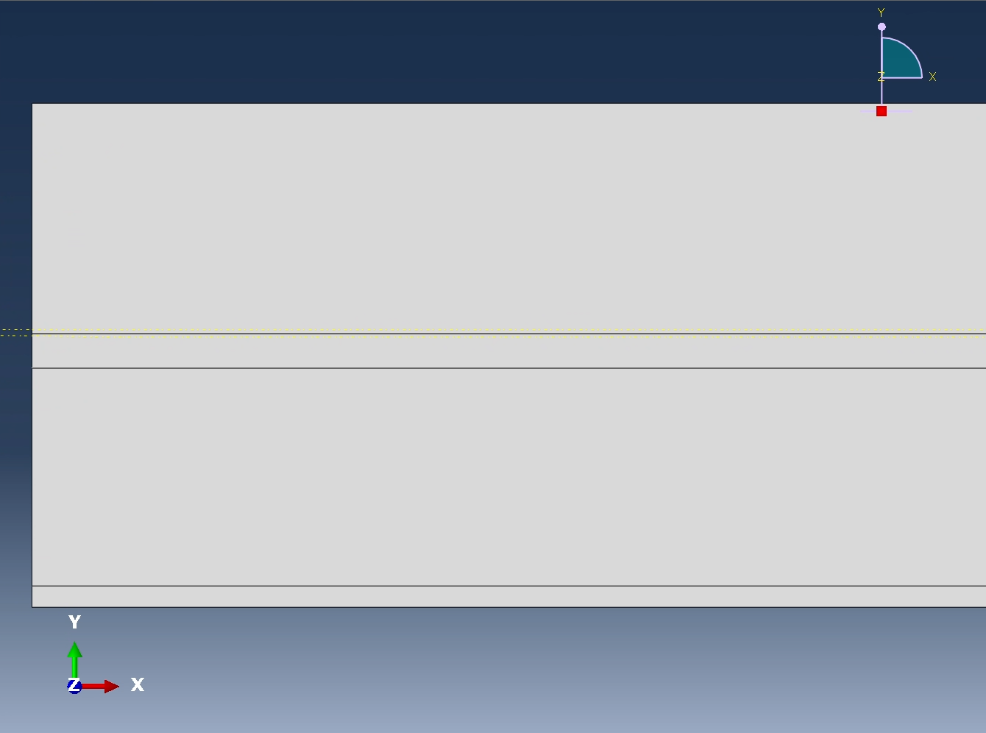
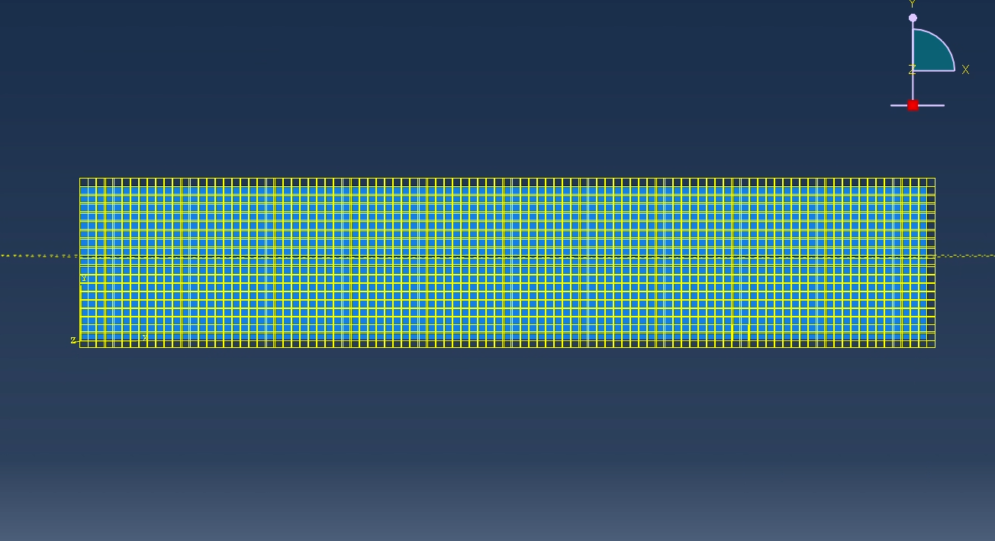
#7
Model
Discretized mesh at 0.001 nodes and applied initial temperature condition to whole body.
Created 3 partitions - facesheet (1) and fachseet (2), core, and cork.
Notes:
Lecture

Slide 14
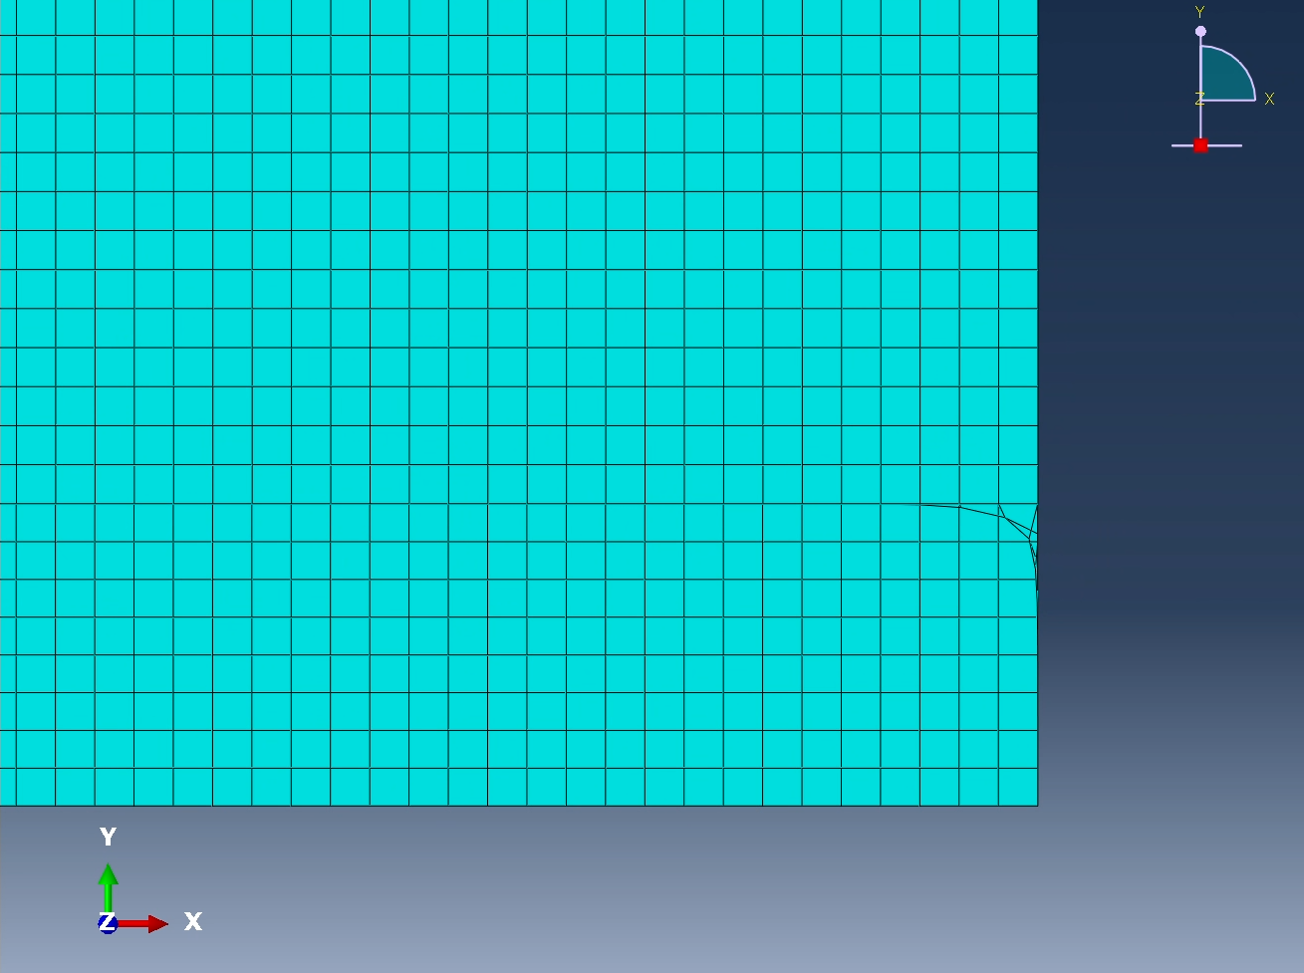
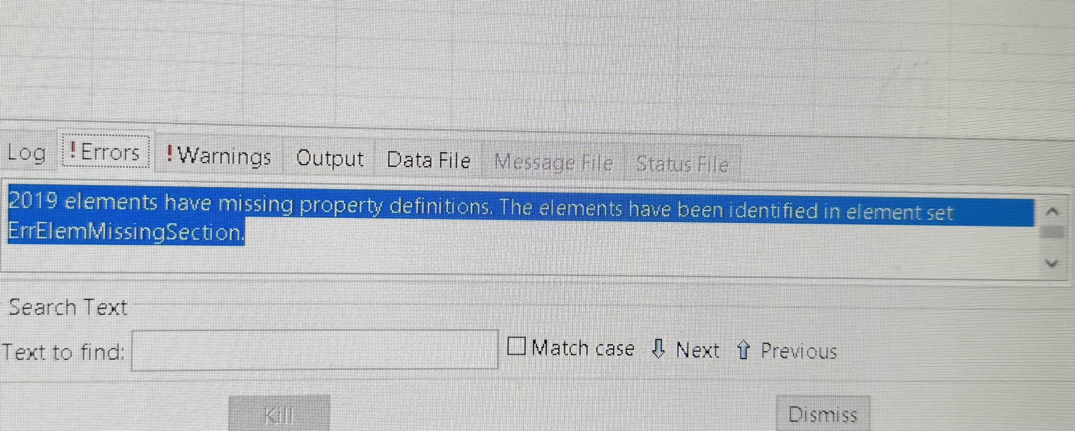
#7
Simulation – Error
The mesh criteria is failing the FEA, a portion of the mesh is corrupted and missing definitions.
Notes:
Lecture

Slide 15
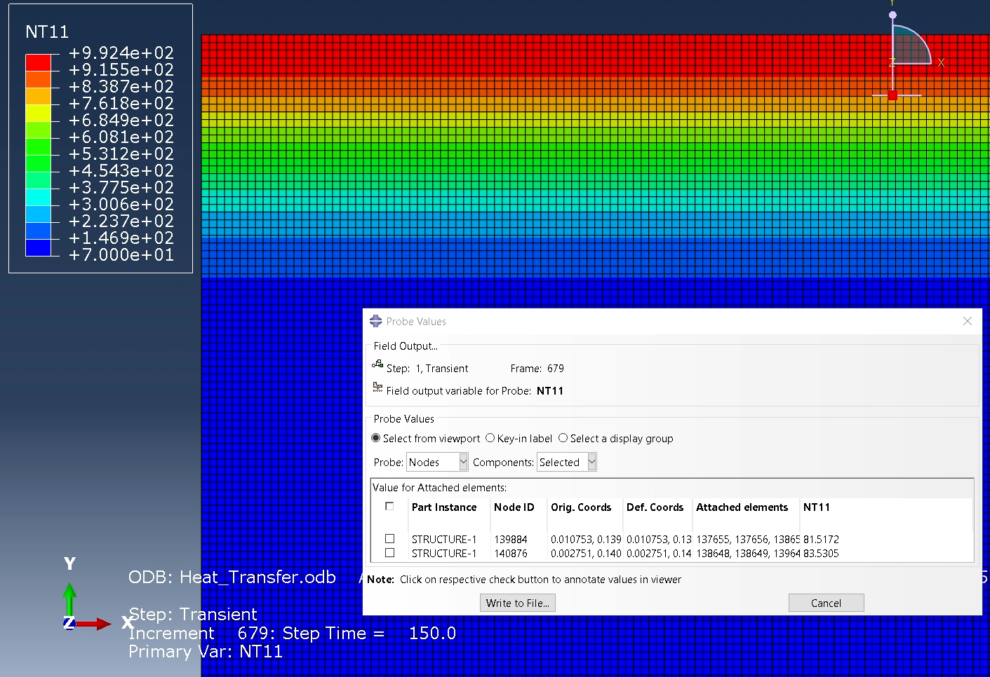
#7
Simulation – Error
Fixed errors – Results
Notes:
Lecture

Slide 16
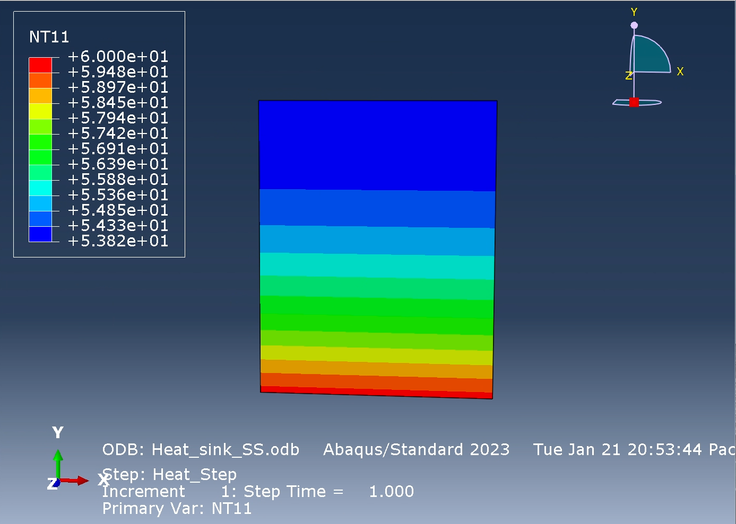
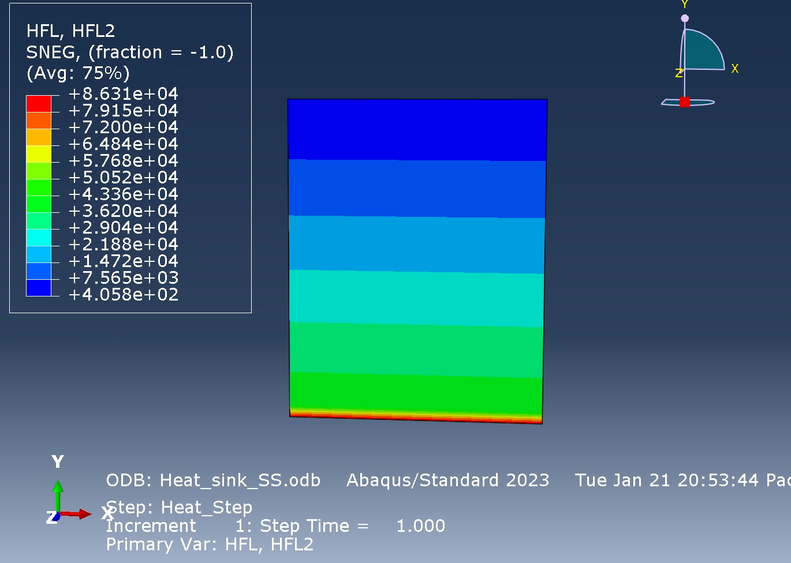
#8
  Steady State
Notes:
Lecture

Slide 17
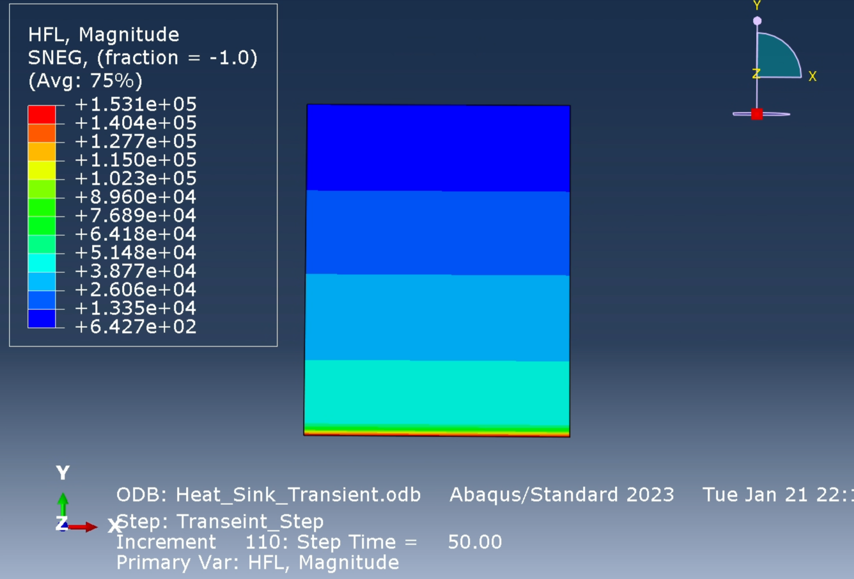
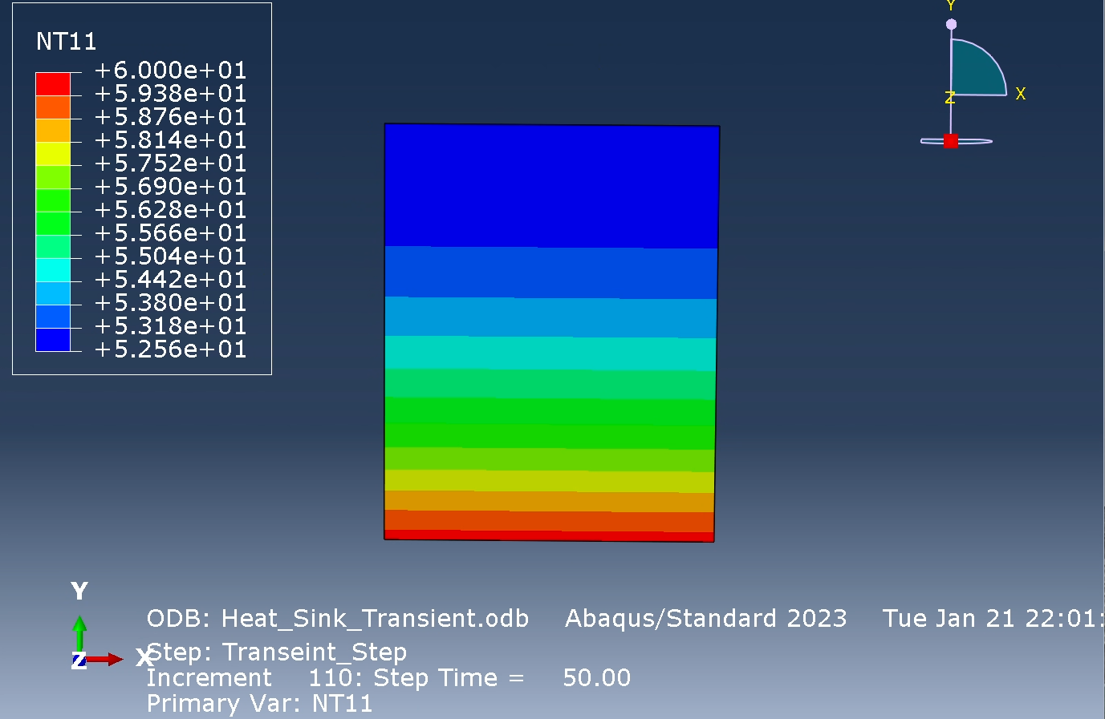
#8
  Transient
Notes:
Lecture

Slide 18
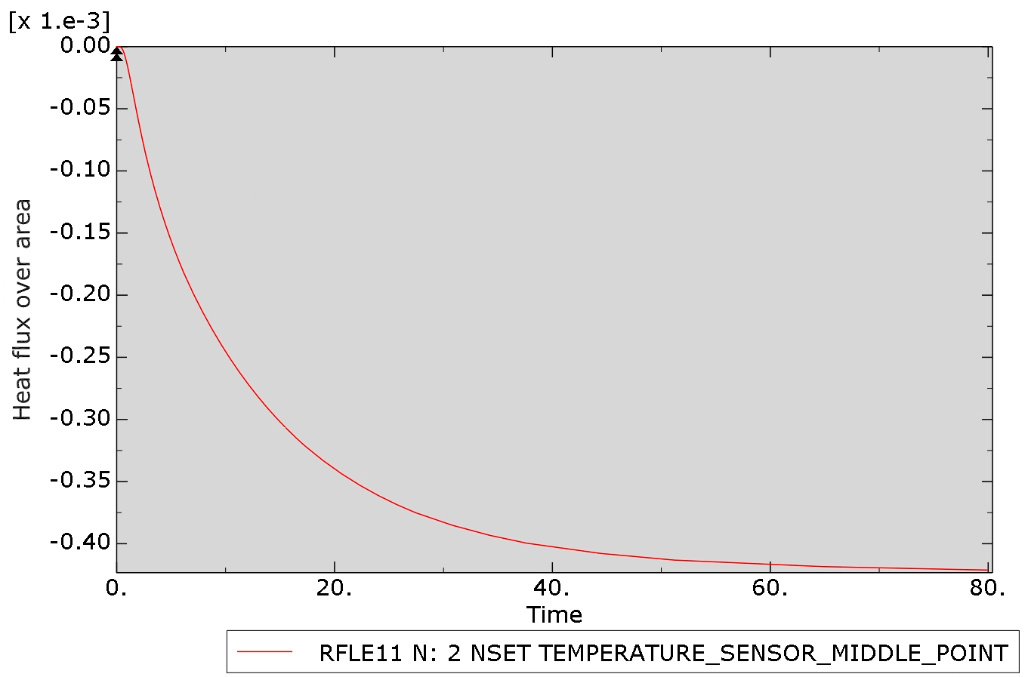
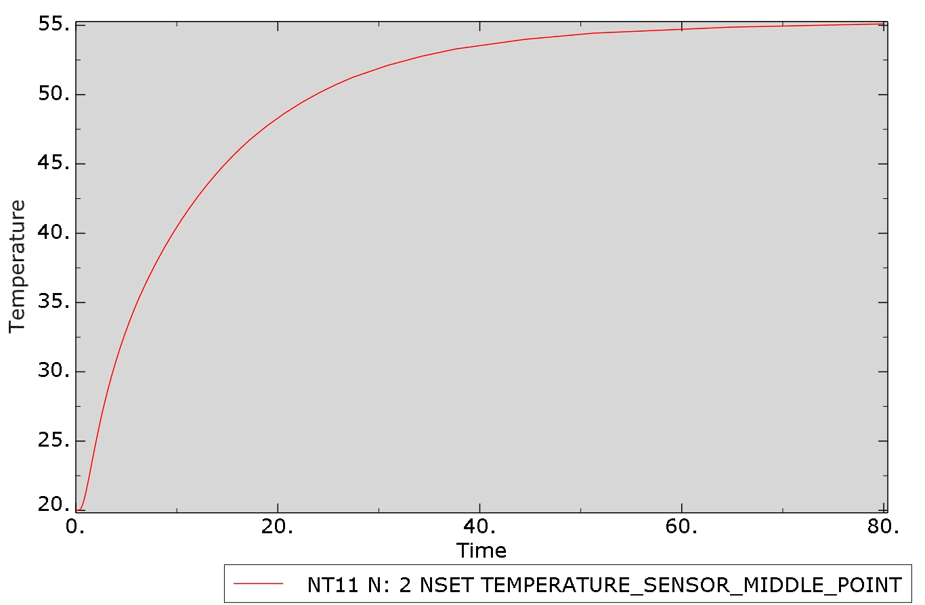
#8
  Heat Flux vs. Time
  Temp vs. Time
Notes:
Lecture

