Slide 1
Dynamics Project 11 – Backup
Henry Glover

Slide 2
Question 1
What is modal analysis
  Free-vibration problem/eigenvalue problem
  Used to determine the natural frequencies and normal modes (mode shapes)
  It is very important for determining whether a structure will reach or approach its natural frequency (resonance) and understanding how it will affect the structure
  Natural frequencies (eigen frequency)
    The frequency at which a system tends to oscillate in the absence of any driving or damping force
    Mass and stiffness determine this value
  Mode shapes
    The motion patterns of a system oscillating at its natural frequency
    Pattern of deformation the structure has when subject to a particular natural frequency during vibration
    Each natural frequency has its own mode shape
Determining the dynamic characteristics of the system
  Dynamic characteristics are defined by eigenmodes and eigen frequencies
  Helps with determining failure
  Predicts if a system or structure will experience resonance during certain loading conditions
  Helps improve design to avoid failure
  Under dynamic loads Engineers need to make sure the system/structure is safe, reliable, and durable

Slide 3
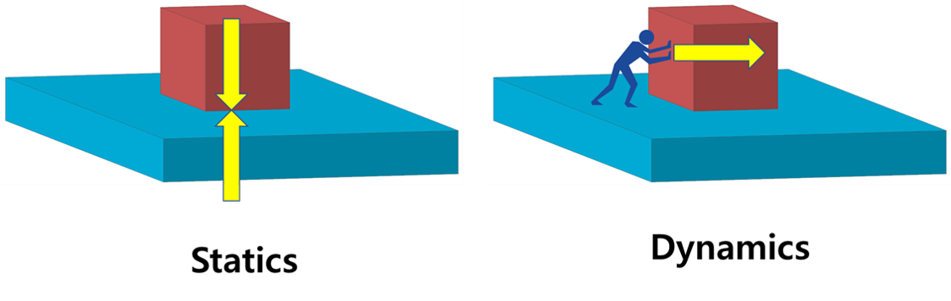
Question 2
Statically vs. Dynamics
  Static assumptions is sometimes efficient when:
    Quasi static loads are due to dynamic phenomena but remain constant for long periods of time (loads remain constant)
    Damping forces are negligible compared to the applied loads
    Structural system can be subject to loads that vary over time
      Need to look at the characteristic time to determine if the load is static or dynamic
    Ex. of when to use static (budlings or bridges)
  Why dynamics:
    A structure that is undergoing dynamic loading responds differently then a system undergoing static loading (loads change)
    Forces and damping affect response of structure
    Helps with quantifying the dynamic characteristics of structures and enables prediction of responses of structures to dynamic environments
    Resonance of time-dependent behaviors affect the structure
    Need to analyze and understand excessive vibration
https://functionbay.com/en/technical-tip/single/259

Slide 4
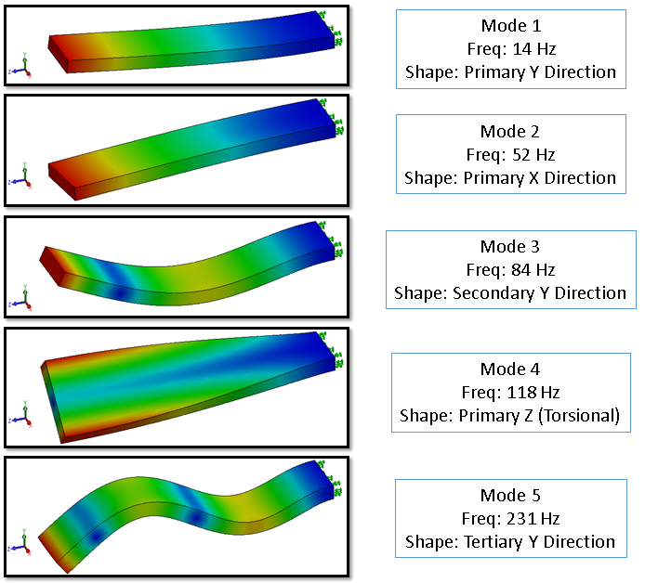
Question 3
What is the role of modal analysis
  Used to determine the natural frequencies and normal modes (mode shapes)
  To assess dynamic interactions with another structural component (acoustics, vibrations, and shock in system)
  To verify stiffness requirements
  Design change evaluations
  To ensure the frequency of the structure does not operate near resonance
    Excessive vibration can cause structural failure due to high dynamic stresses (ex. Turbine blades)
  To detect damage
https://www.mechead.com/ansys-modal-analysis/

Slide 5
Question 4
Dynamic transient direct time integration
  Modal dynamic transient analysis is the response of linear structures to loads that vary as a function over time
  Discretized the spatial domain using finite elements, and integrated equation of motions directlyy from loading time history
  Solves nodal displacements, velocities, stresses…. As functions over time
  Pros:
    Predict structural behavior due to time-varying excitation
    Transient load excitations explicitly defined in the time domain
    Allows definitions of applied force and/or enforced motions
    Can model nonlinear behavior
  Cons:
    Expensive
    Takes a long time, for a linear system may need to solve problem using modal dynamics
Modal Transient solution
  Uses modal shapes to determine the response of the system – shapes define dynamic characteristics of the system
  Mode shapes are found from frequency analysis
  Overcomes pitfalls of dynamic transient direct time integration
    Faster
    Less expensive
    Simpler
  May be convenient to use less modes in linear transient dynamic formulation
  Calculates system response as a linear combination of these modes
  3 simplifications:
    Only a selected number of modes (based on natural frequency and environment) are used to speed up analysis
      High frequency modes can be ignored if they don’t affect the expected service range
    Use the Newmark-beta method to reduce number of equations that need to be solved
    Mapping resonance as linear combination of system of modes

Slide 6
Question 5
Forced vibration response
  Mechanical vibration is the motion of a particle or body which oscillates about a position of equilibrium.
  Time interval full cycle of motion = period of the vibration
  Maximum displacement of the system from equilibrium = amplitude of vibration
  Forced vibrations occur when a system is subjected to a periodic force or a periodic displacement of a support
    Ex. Sinusoidal load
  Caused by changing force
  Response is split into initial transient + steady state response
Role of steady state dynamic analysis
  Used to predict how system will respond to continuous oscillating forces at various frequencies
  Calculates steady-state amplitude of displacements, velocity, and stress under loading without solving full time interval
  Helps:
    Identify vibrations across frequencies
    Find where and if resonance occurs under operating conditions
    With design to avoid excessive vibration/fatigue failures

Slide 7
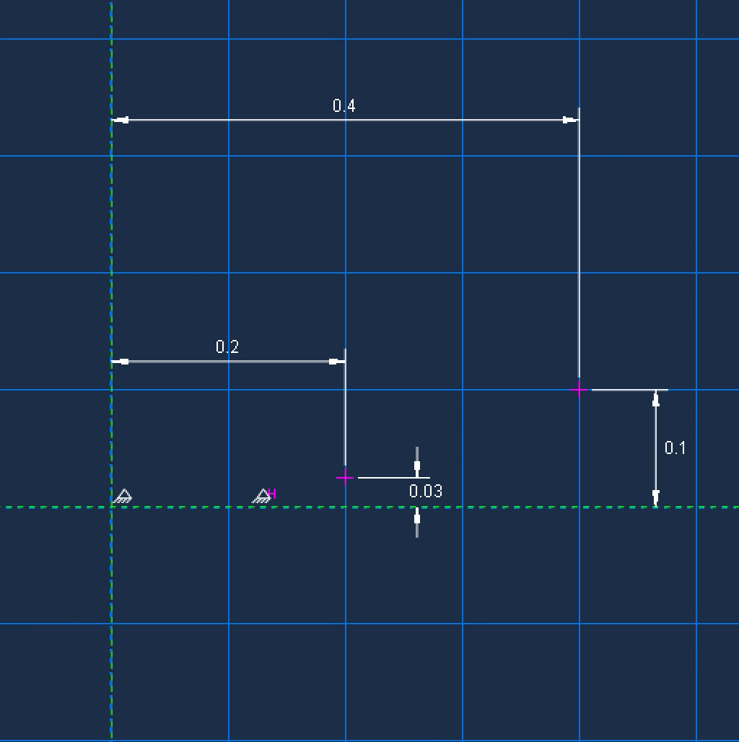
Question 6
Abaqus – Setup
  Aluminum Reflector – Al 6061-T6
  Steel beams – AISI 4130
  Shell thickness – 0.01 m
  Max diameter – 0.8 m
  Height – 0.1 m
  Supported by 4 steel beams – 90˚ midway thru height
    Need to find vertex of base attachment point
  Cross section – 0.01 m
  Damping of 3%
  Geometry of reflector shown to the right, using parabola equation

Slide 8
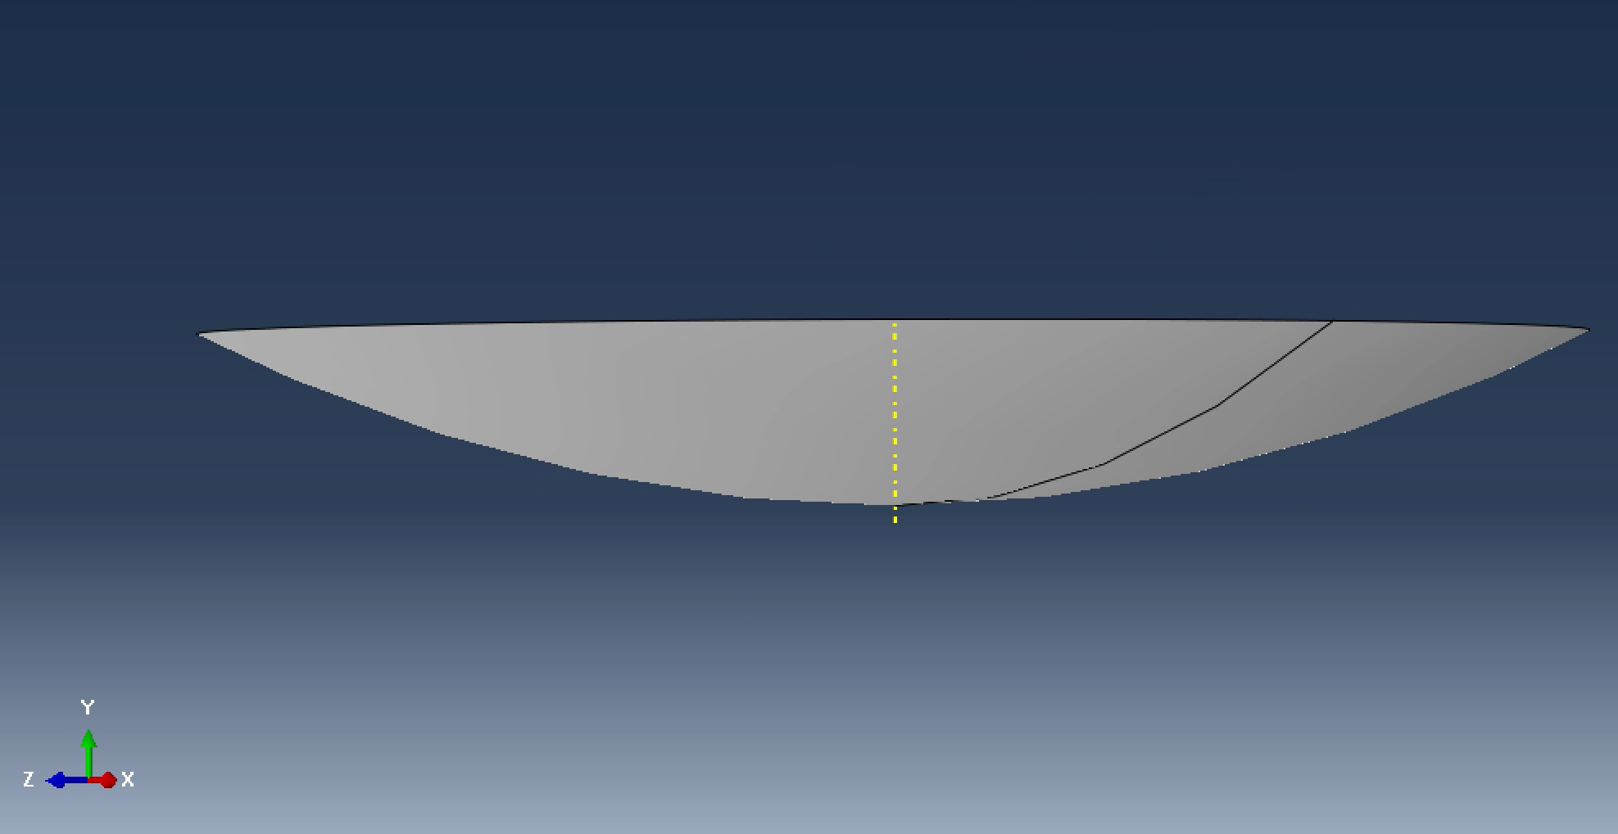
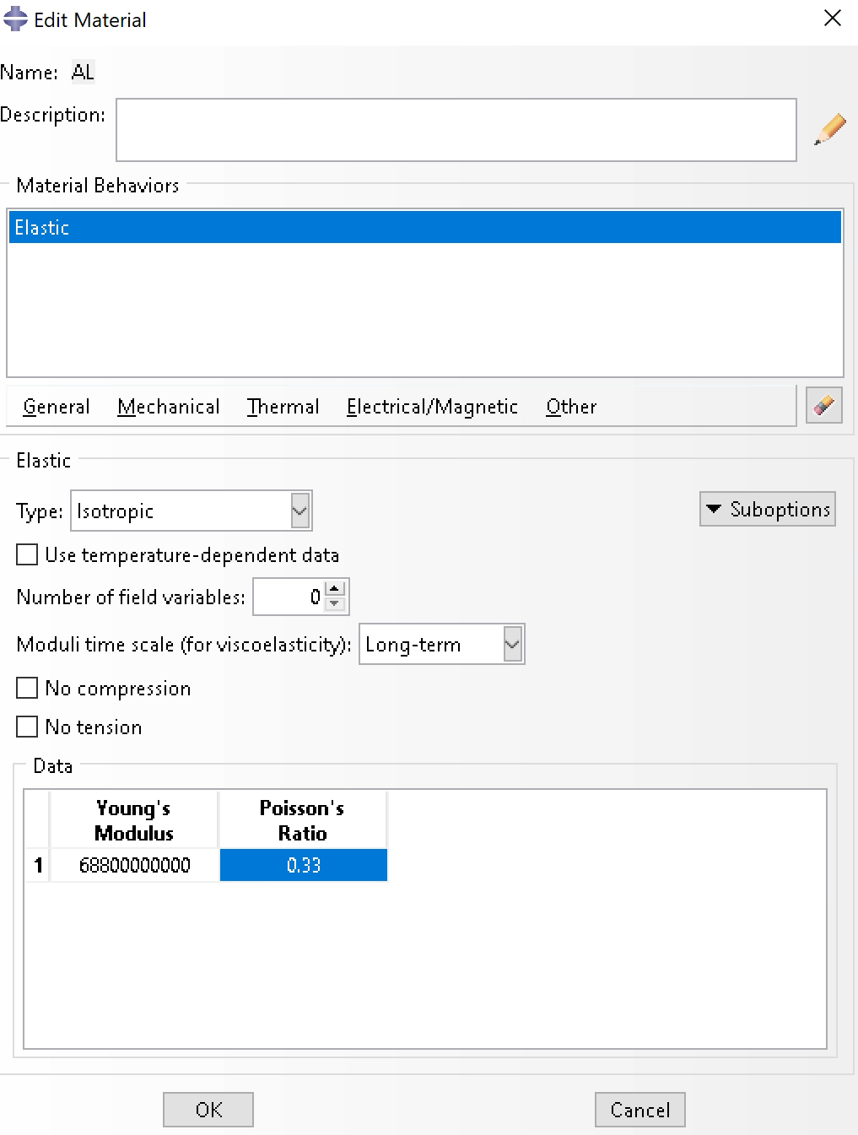
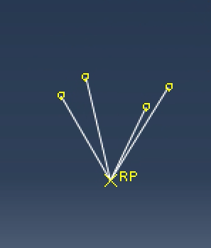
Question 6
Abaqus – Setup
Arc
  Max radius = 0.4 m
  Max height = 0.1m
Beams
  Vertex at origin
  4 points for wire schematic
    (0.2,0.219627,0)​
    (-0.2,0.219627,0)​
    (0,0.219627,0.2​)
    (0,0.219627,-0.2​)
Material properties​
  AL 6061​
    Density = 2700 kg/m^3​
    E = 68.8 Gpa =68.8 e9 Pa​
    V = 0.33​
  Steel - AISI 4130​
    Density = 8000 kg/m^3​
    E = 205 Gpa = 205 e9 Pa​
    V = 0.3​

Slide 9
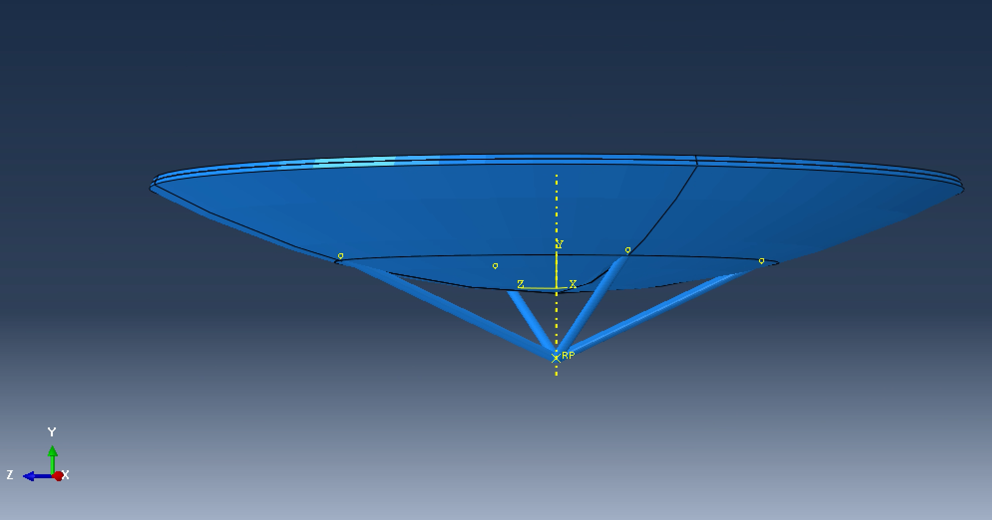
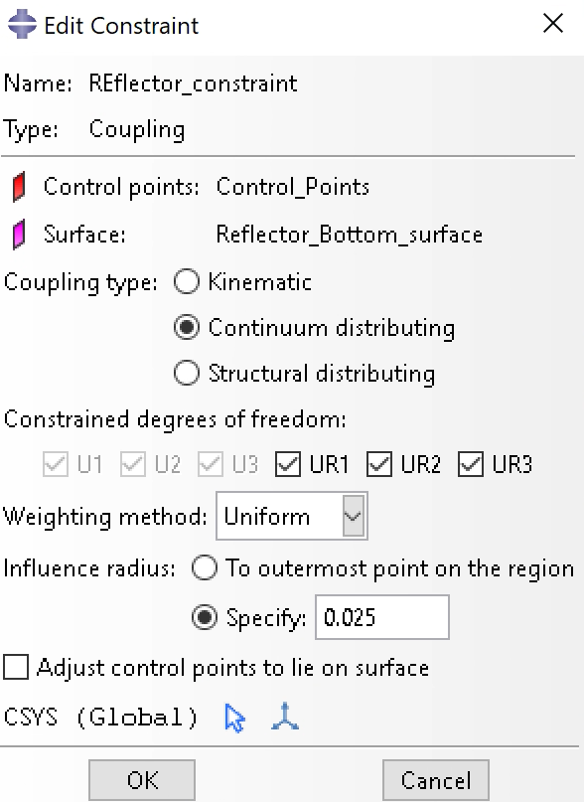
Question 6
Abaqus – Setup
  4 steel beams were translated by -.07 under the reflector
  Shell section, homogenous
  Thickness = 0.01m
  Beam radius = 0.005
    5x0.005 = 0.025

Slide 10
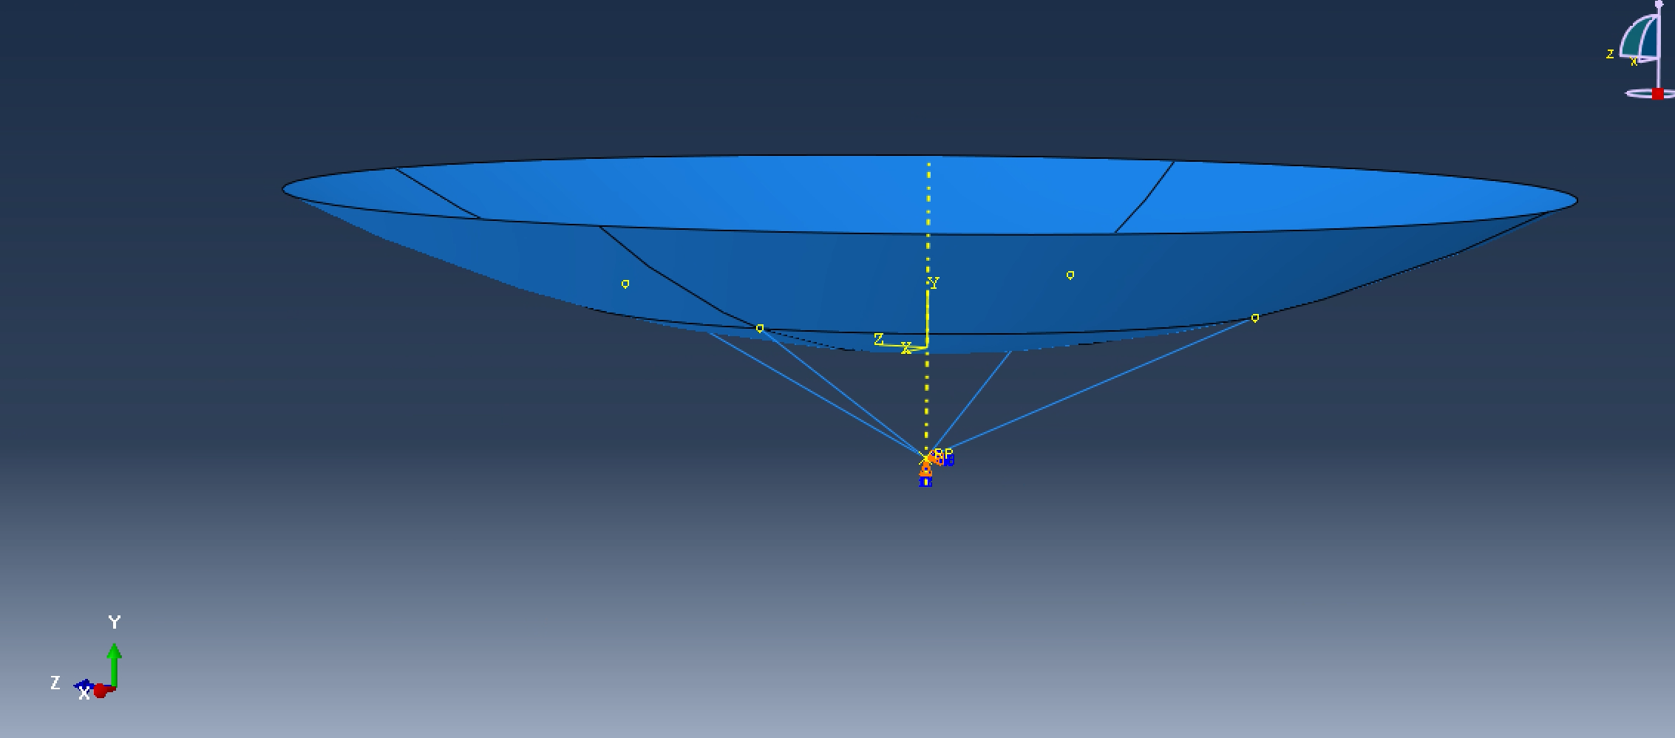
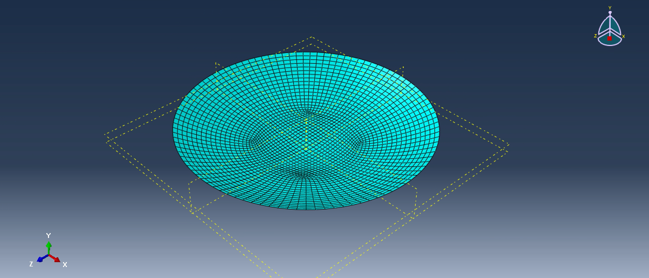
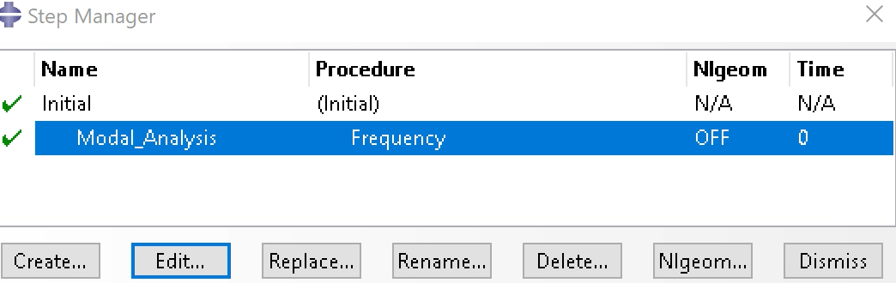
Question 6
Abaqus – Setup
  Modal analysis step was set
  Constraint was set in previous slide
  Final model shown to the right
  Mesh is shown for reflector
    Beams were also meshed

Slide 11
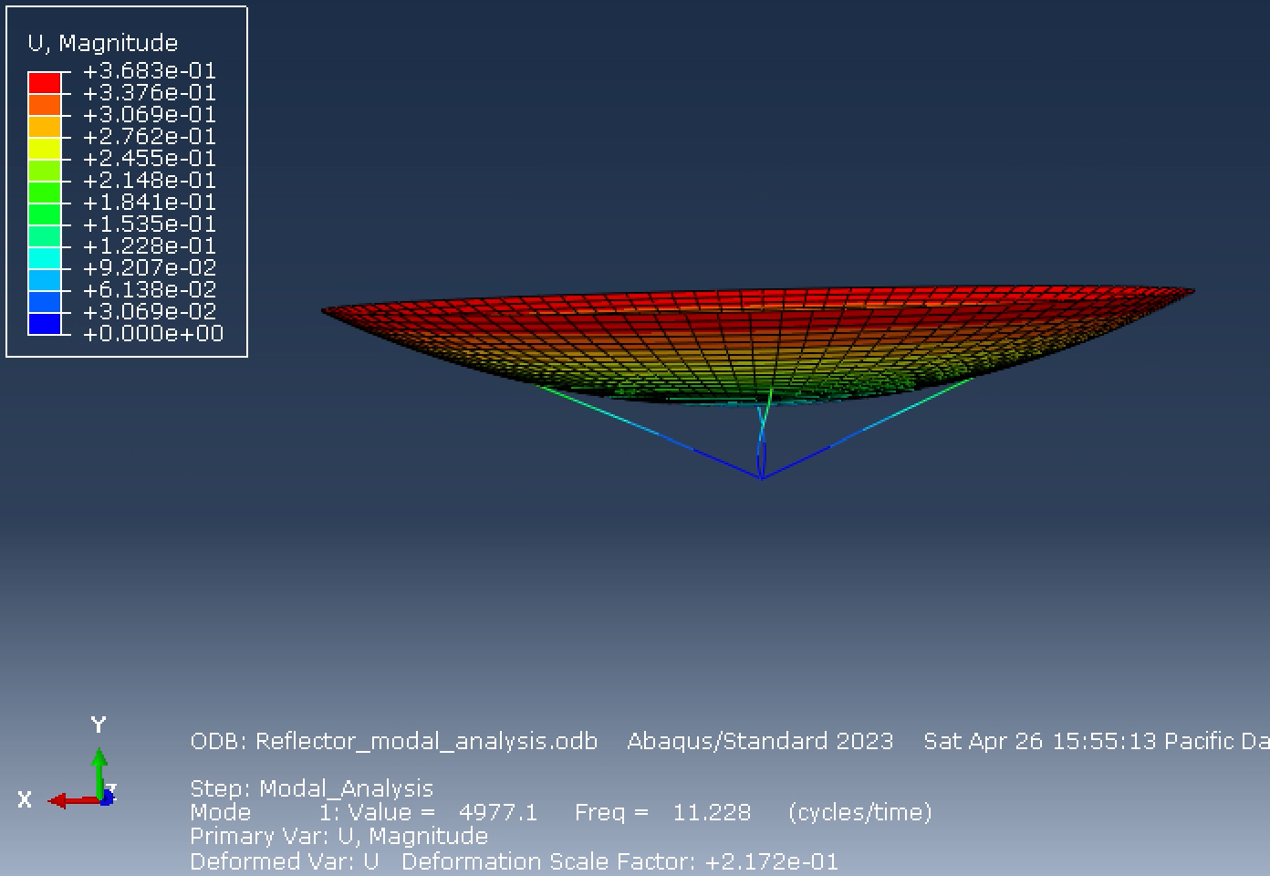
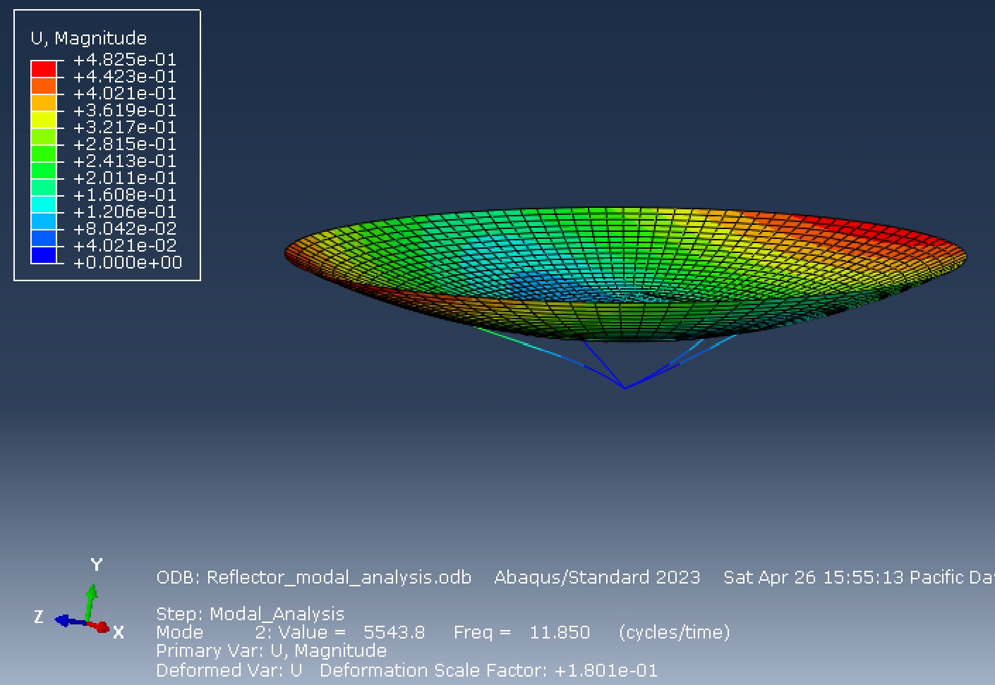
Question 6
Abaqus – Modal Analysis Results
  Modes 1 and 2
  Mode 1 - Some deformation, nothing incredible, slight twist to the side on beam
  Mode 2 – More pronounced, dish and beam bend to the side

Slide 12
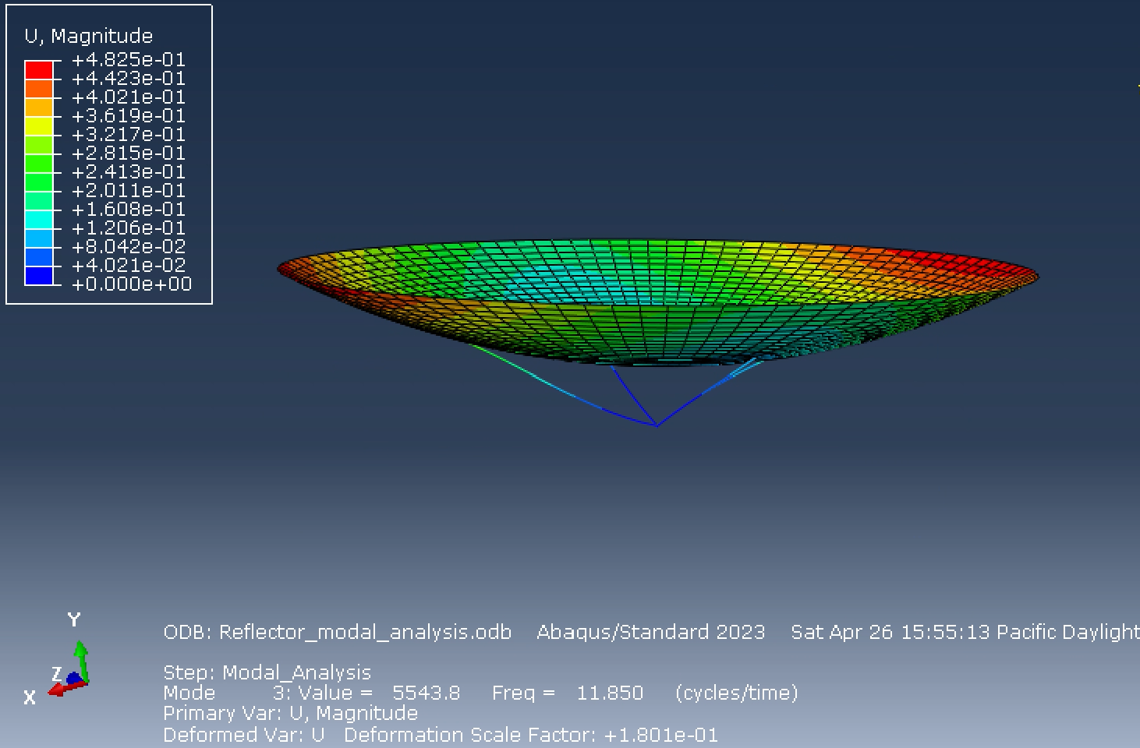
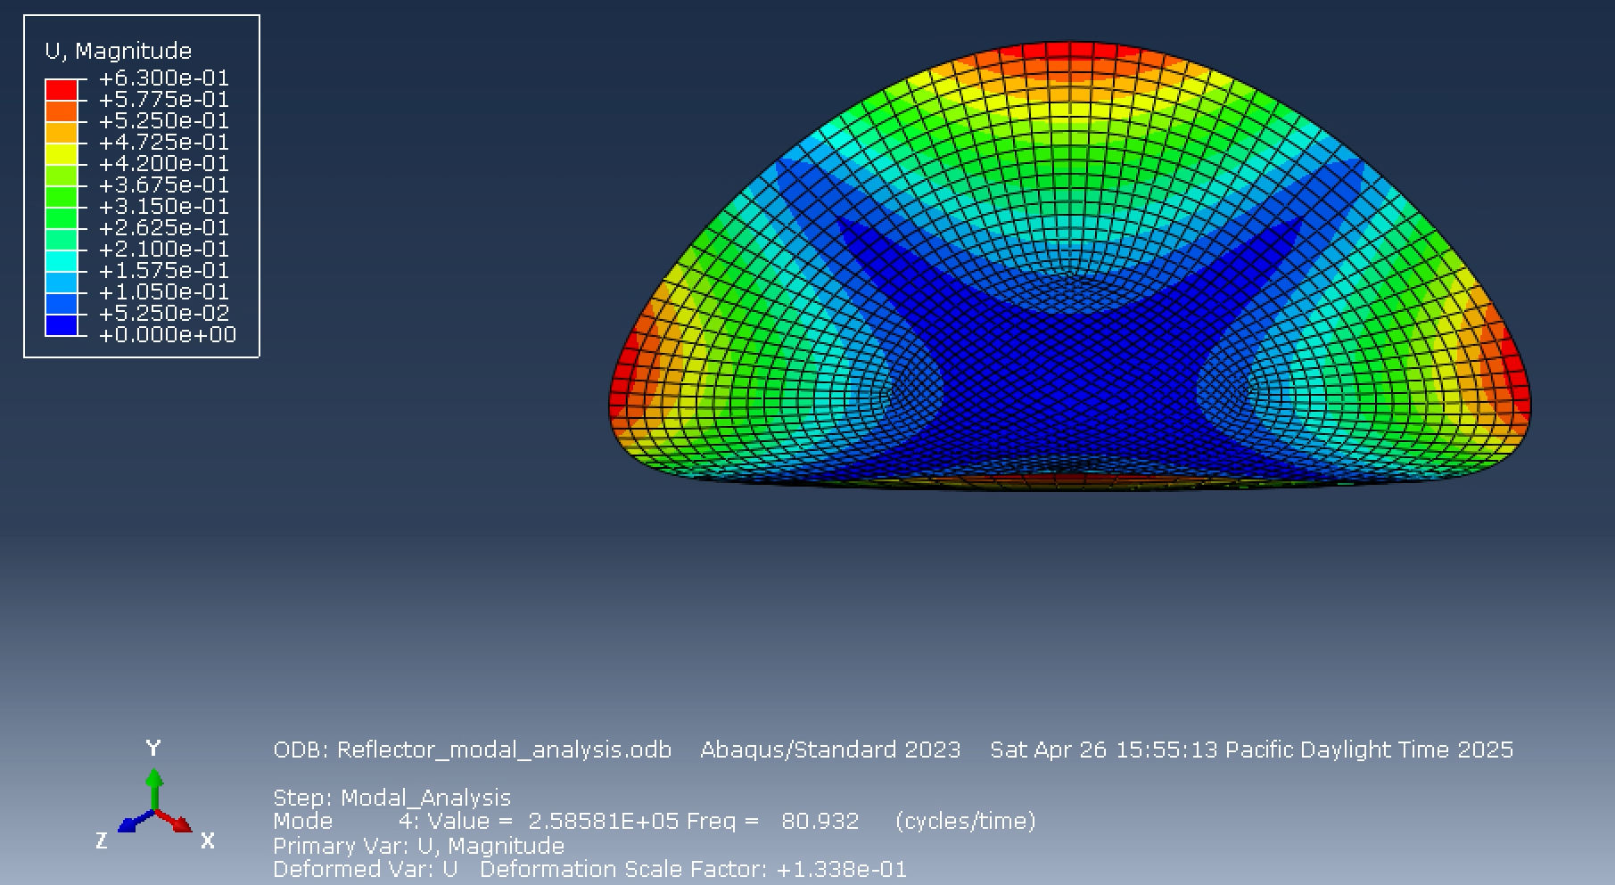
Question 6
Abaqus – Modal Analysis Results
  Modes 3 and 4
  Mode 3 – Bending direction of beam opposite of mode 2
  Mode 4 – Dish bends like a taco

Slide 13
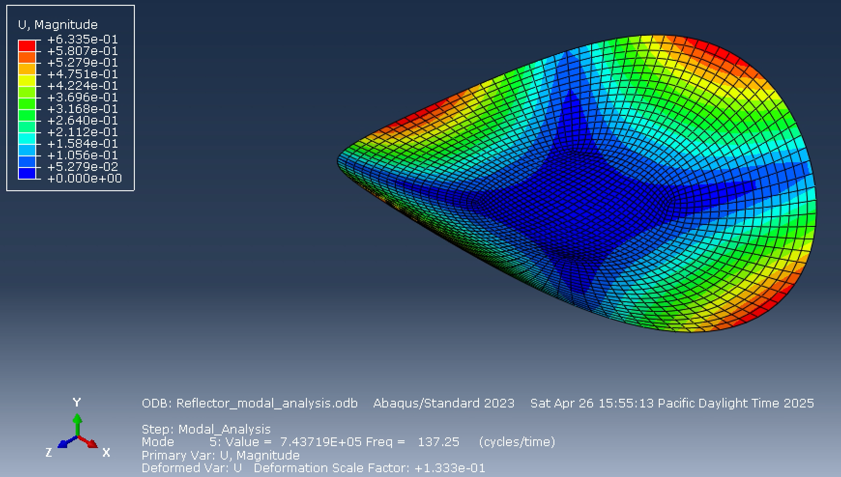
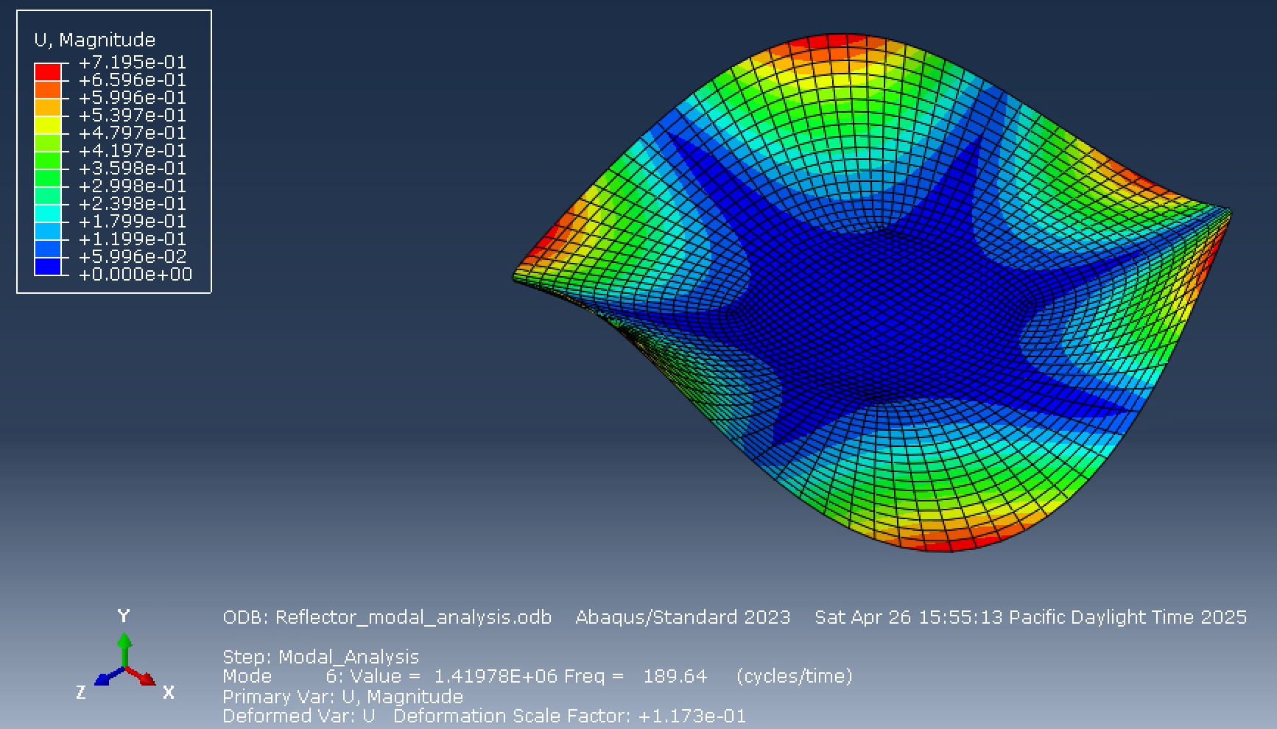
Question 6
Abaqus – Modal Analysis Results
  Modes 5 and 6
  Mode 5 – Dish bends like a taco opposite direction of mode 4
  Mode 6 – Dish bends at all ends

Slide 14
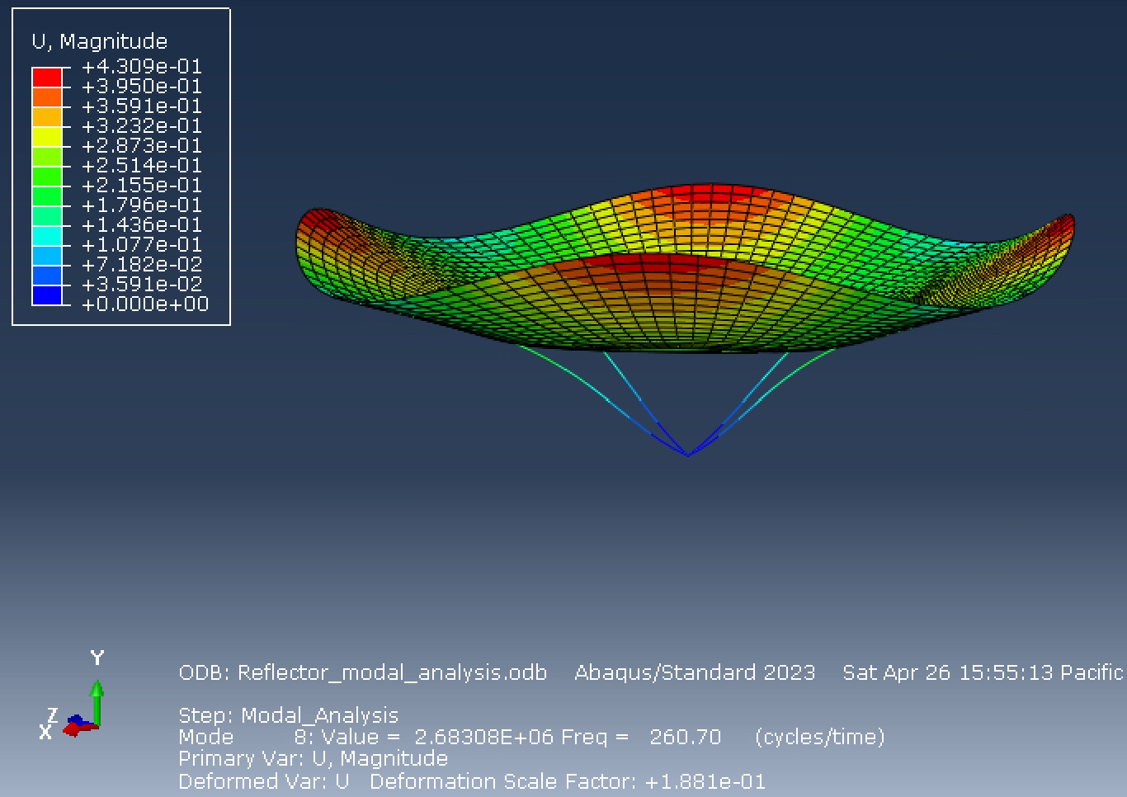
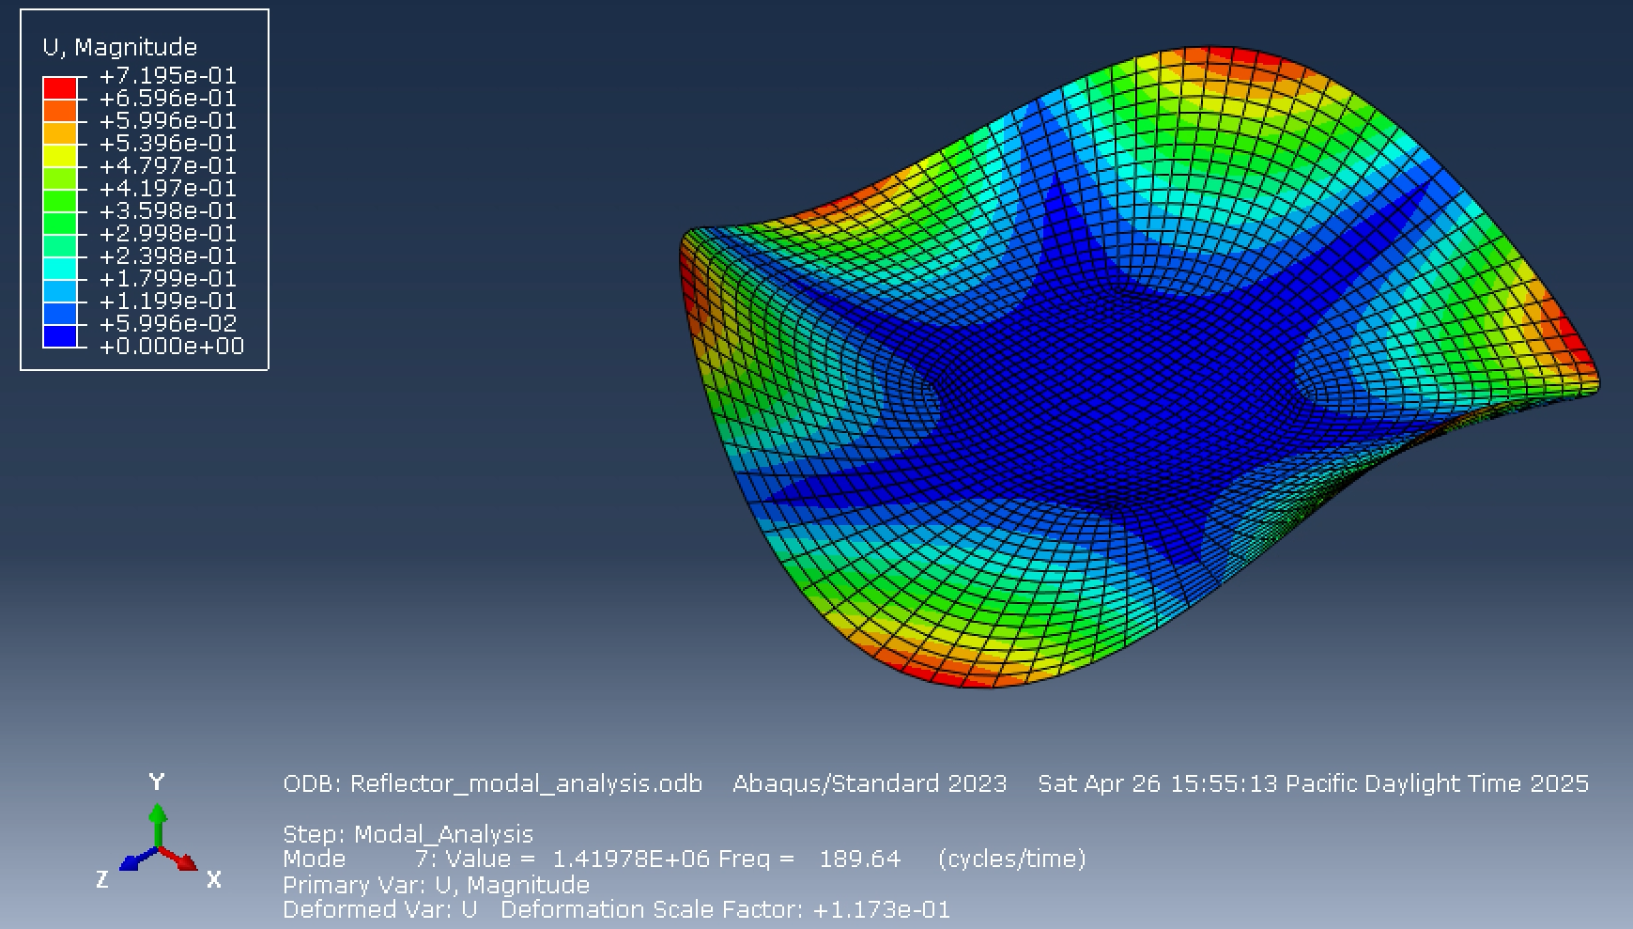
Question 6
Abaqus – Modal Analysis Results
  Modes 7 and 8
  Mode 7 – Same as mode 6 just in different direction
  Mode 8 – Compressed and bended upwards

Slide 15
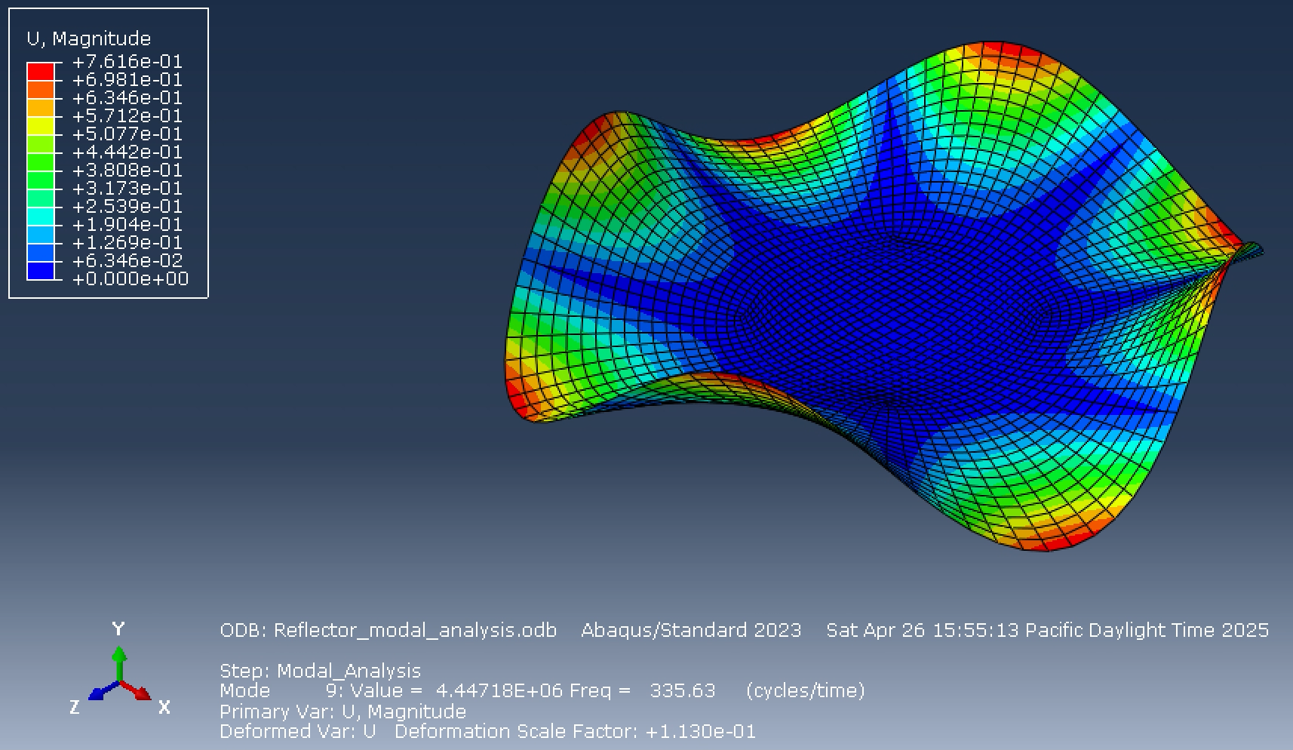
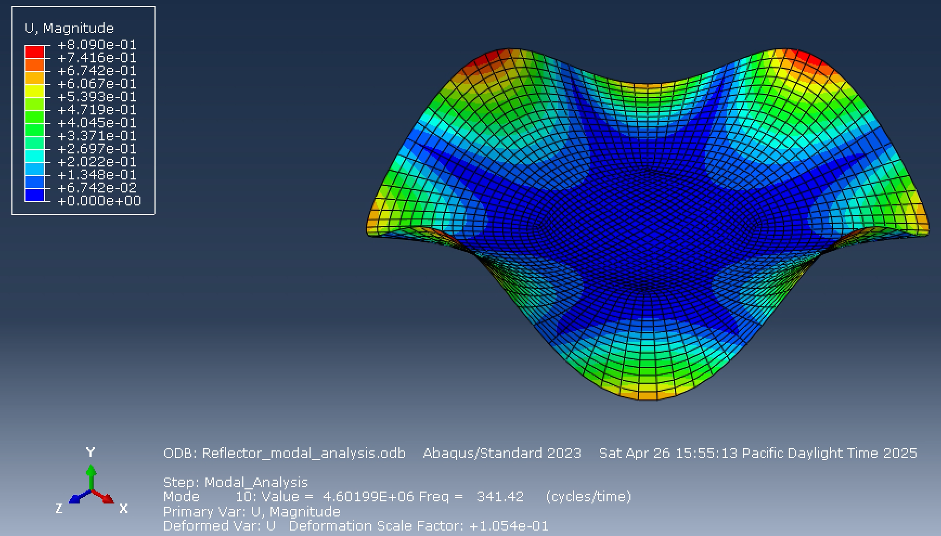
Question 6
Abaqus – Modal Analysis Results
  Modes 9 and 10
  Both Modes 9 and 10 have alternating ruffle patterns

Slide 16
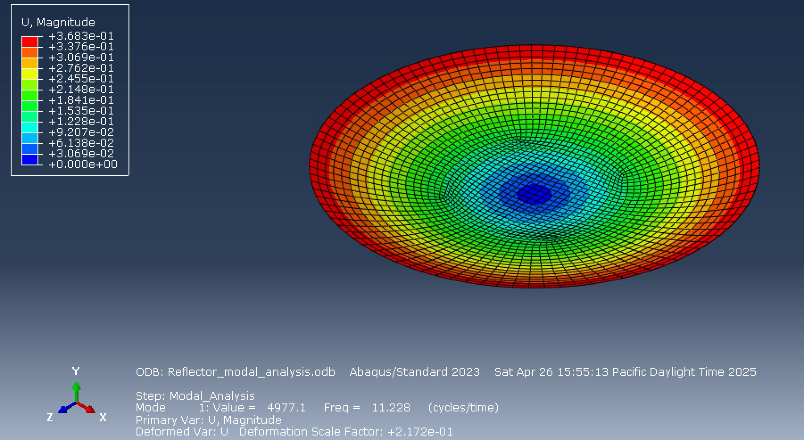
Question 6
Abaqus – Modal Analysis Results Conclusion
  Frequency range: 11.228 – 341.42 Hz
  First 7 modes are below 200 Hz
  Modes 1 and 10 are shown for full range of Hz

Slide 17
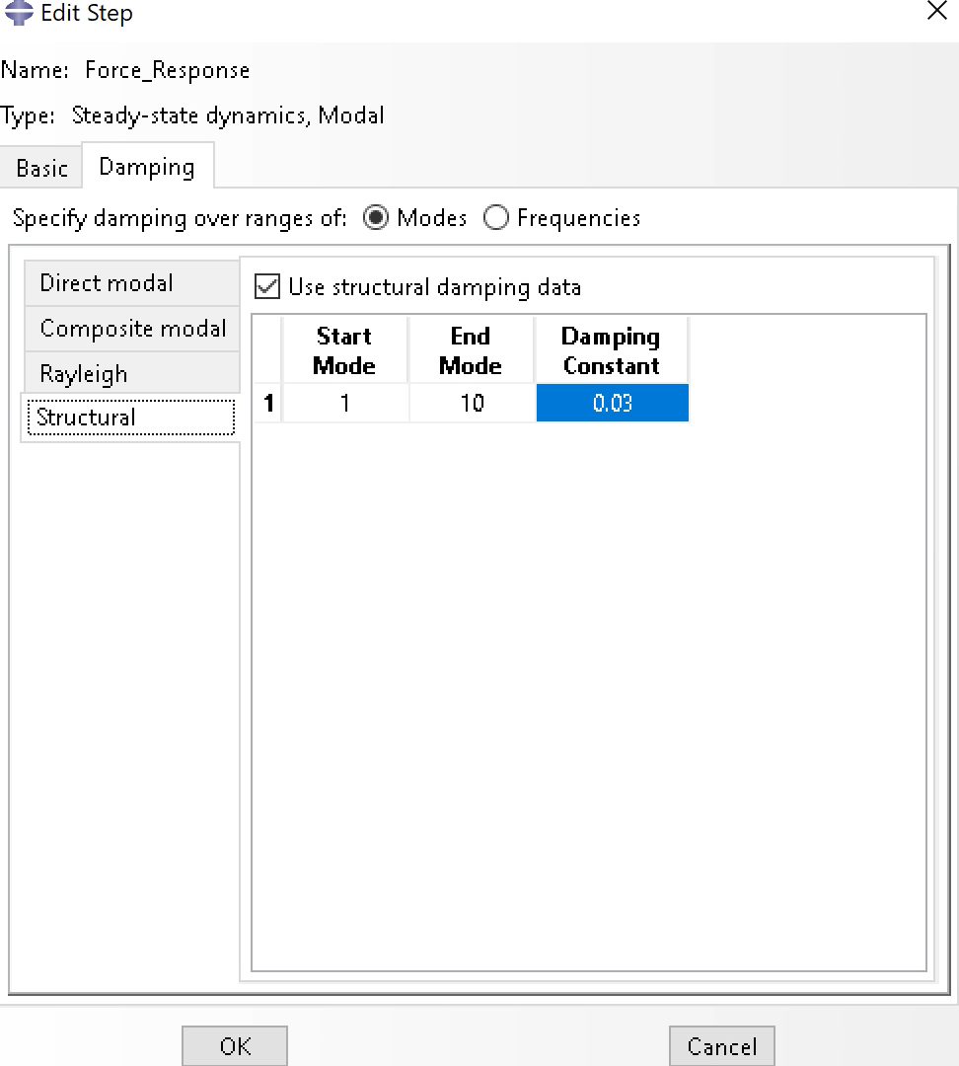
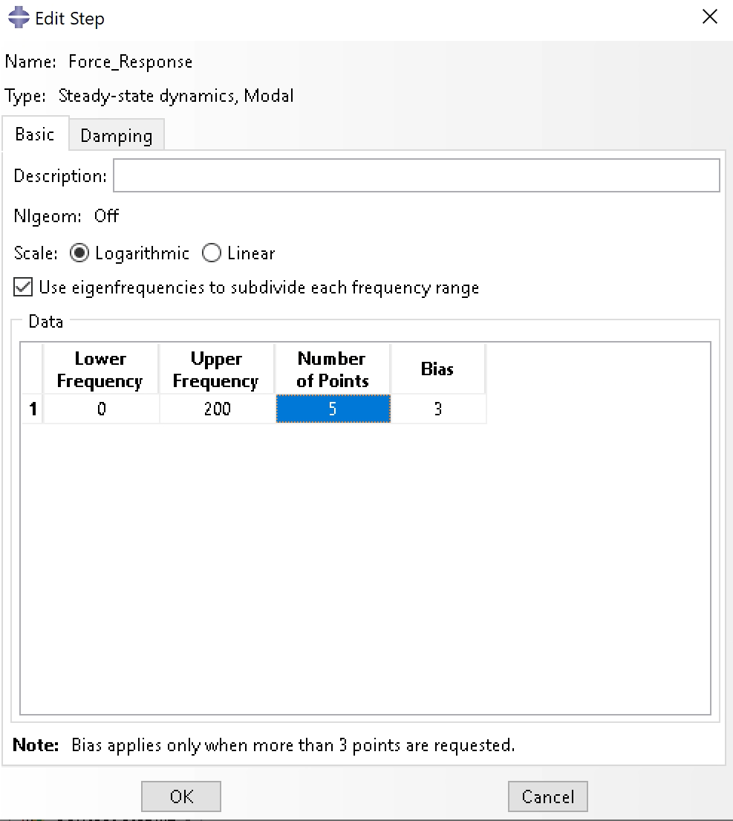
Question 6
Abaqus – Forces Response Setup
  5 points to gather deflection data​
    4 points around the perimeter of the dish​
    1 point in the center of the reflector
  Step setup​
    Lower frequency = 0​
    Upper frequency = 200​
  Apply structural dampening of 0.03 to all modes​
    1 through 10​
  Inertial load​
    Apply 3G to the X-direction for the lateral loading​
    3G = 9.81 x 3 = ​29.43

Slide 18
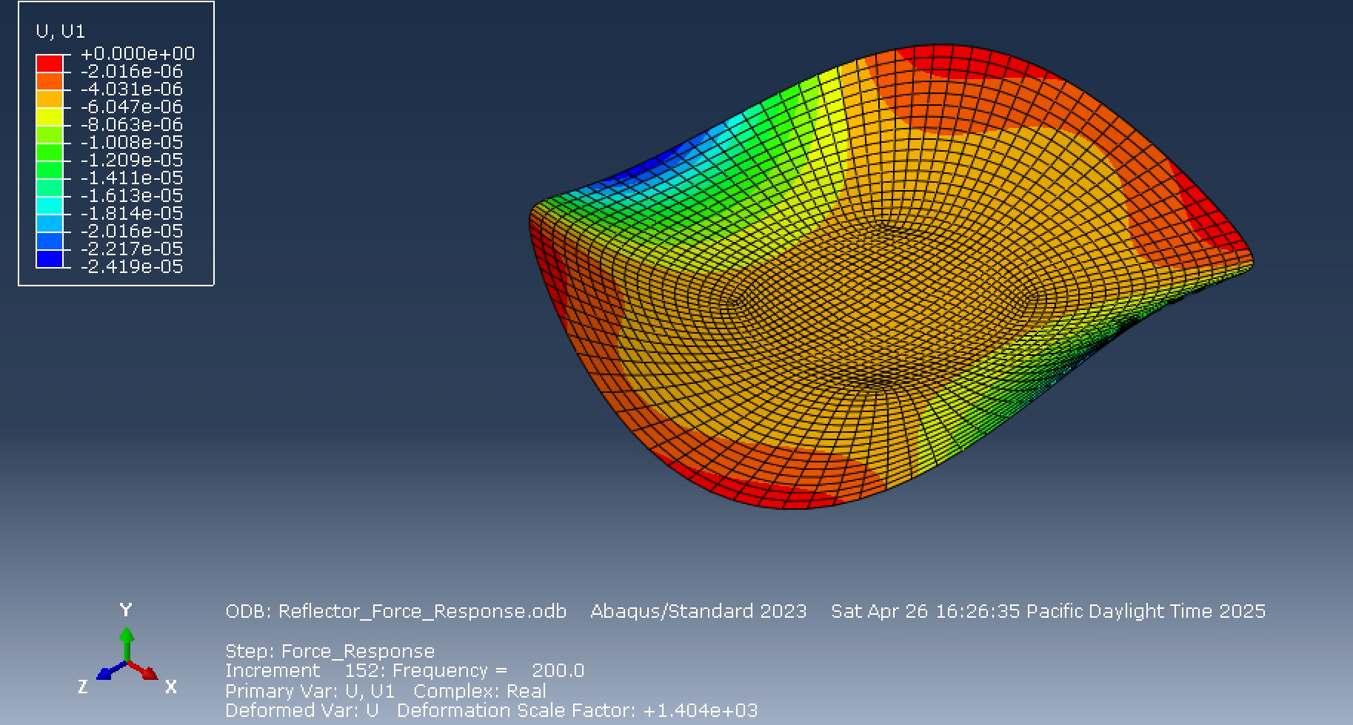
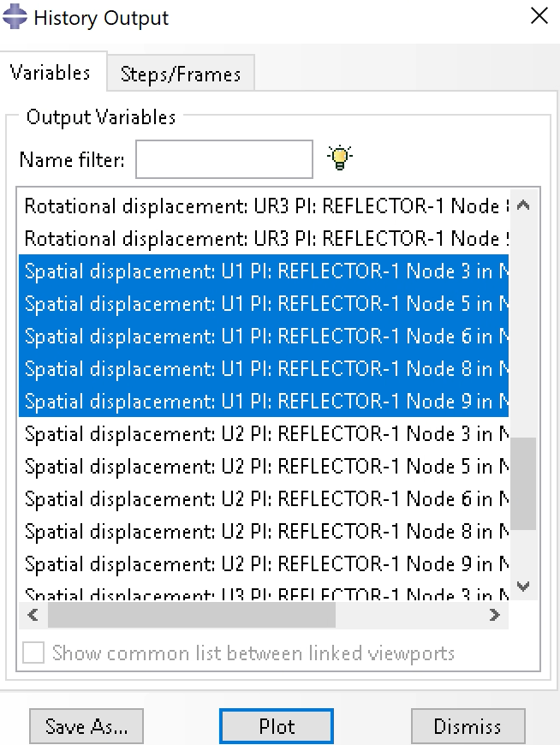
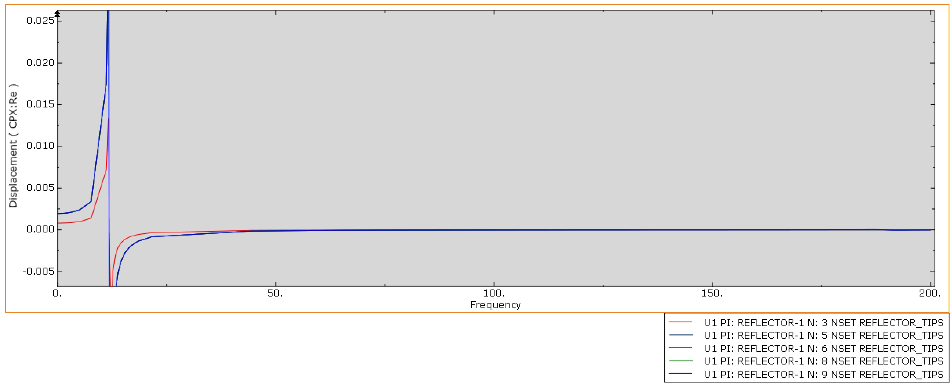
Question 6
Abaqus – Forces Response Results
  XY data plot of U1 displacement shown below
  Incrementation with 20 integration points ended at 152 to reach 200 Hz
  Natural frequency is around 12 hz

Slide 19
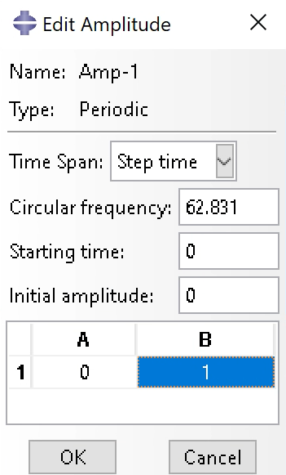
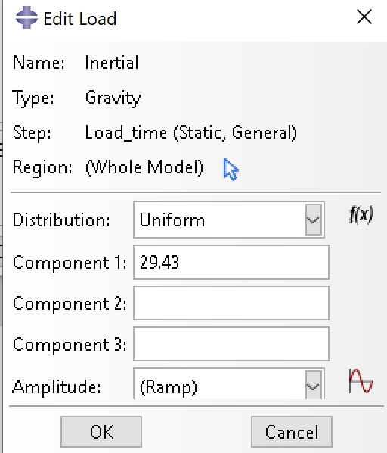
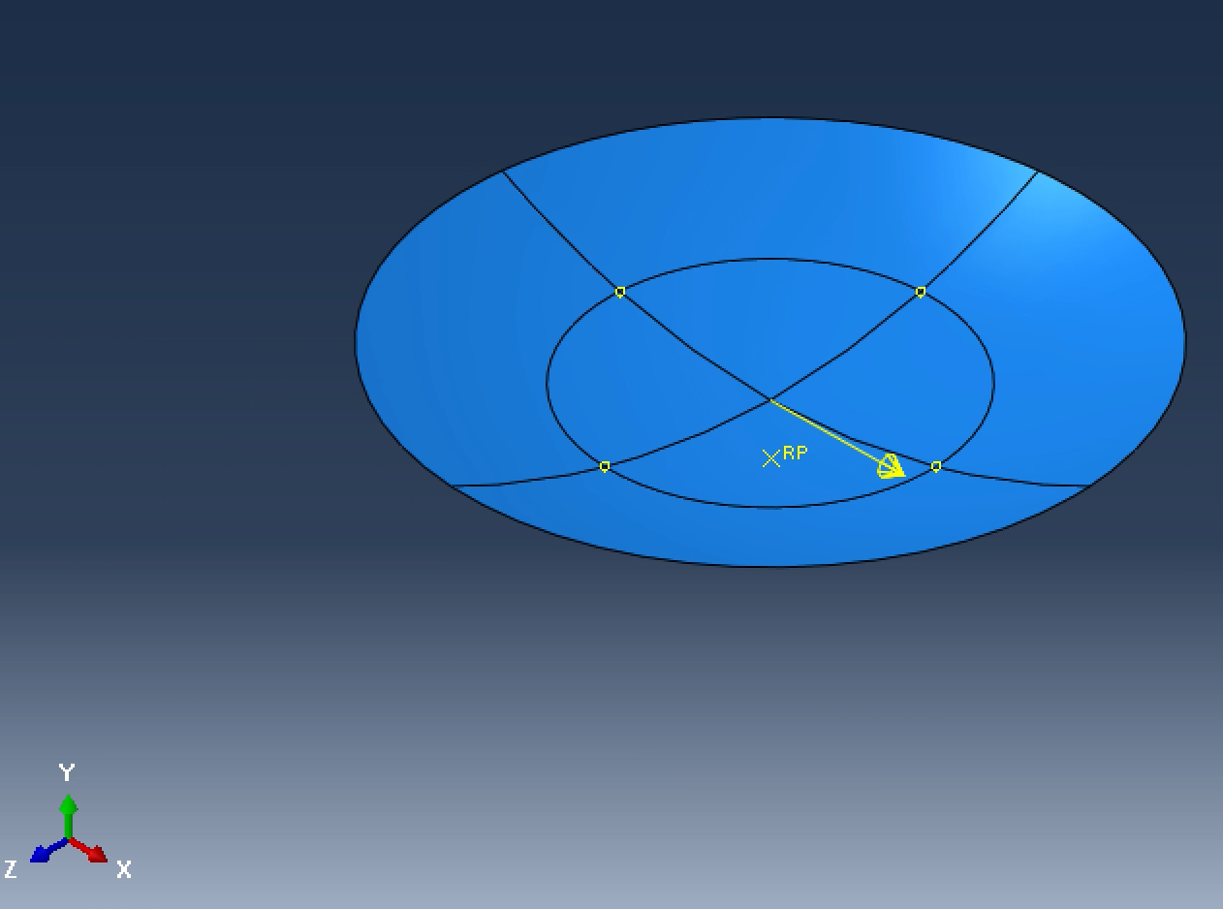
Question 6
Abaqus – Direct Time integration Setup
  Incrementation in the step is set to load step time period of 0.05 seconds
  Loading changed
    Initial step is set to gravity load (static, general) with periodic amplitude on the loading step​
    Set to 3G = 29.43 in component 1
  Amplitude is added - circular frequency​
    2pi rads in 0.1 seconds​
    Circular frequency = 2pi/0.1 = 62.831​​

Slide 20
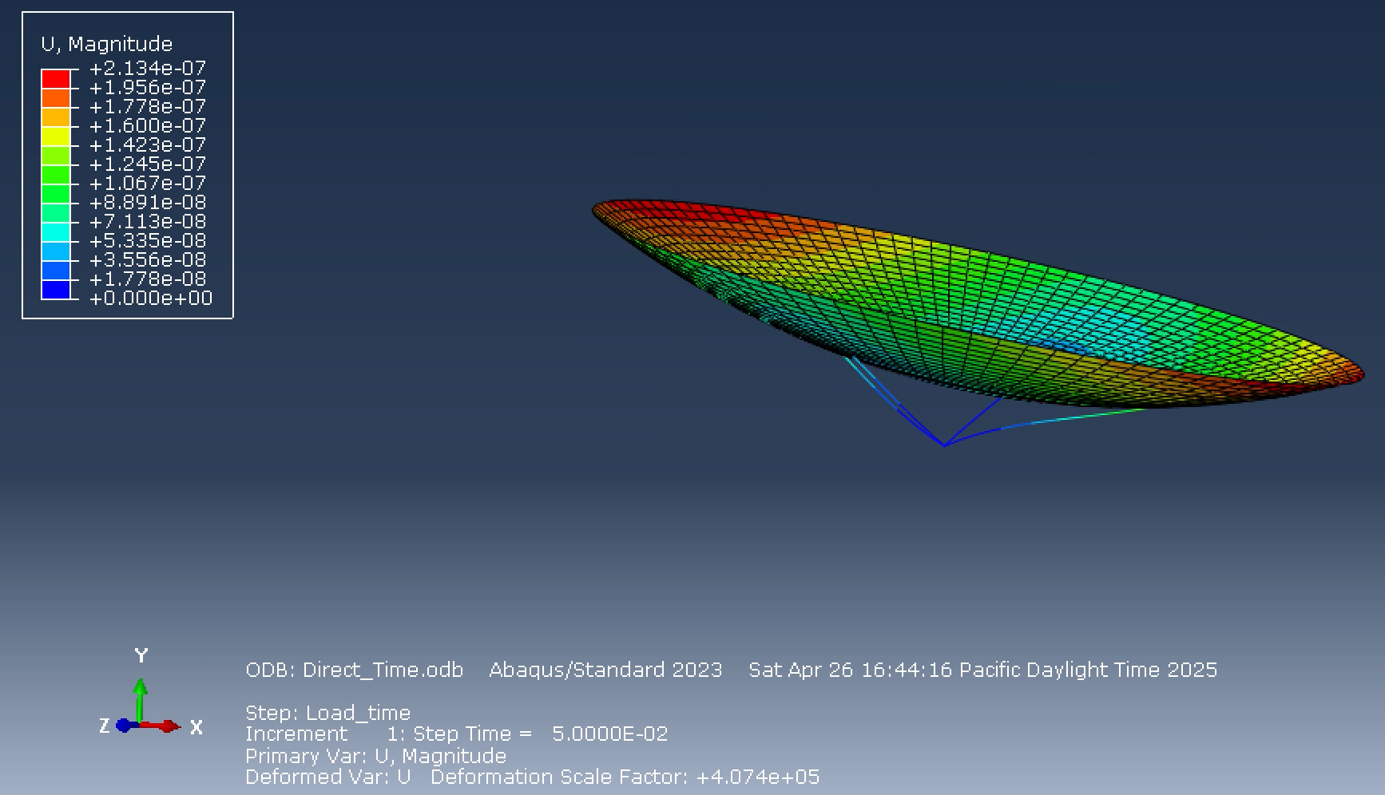
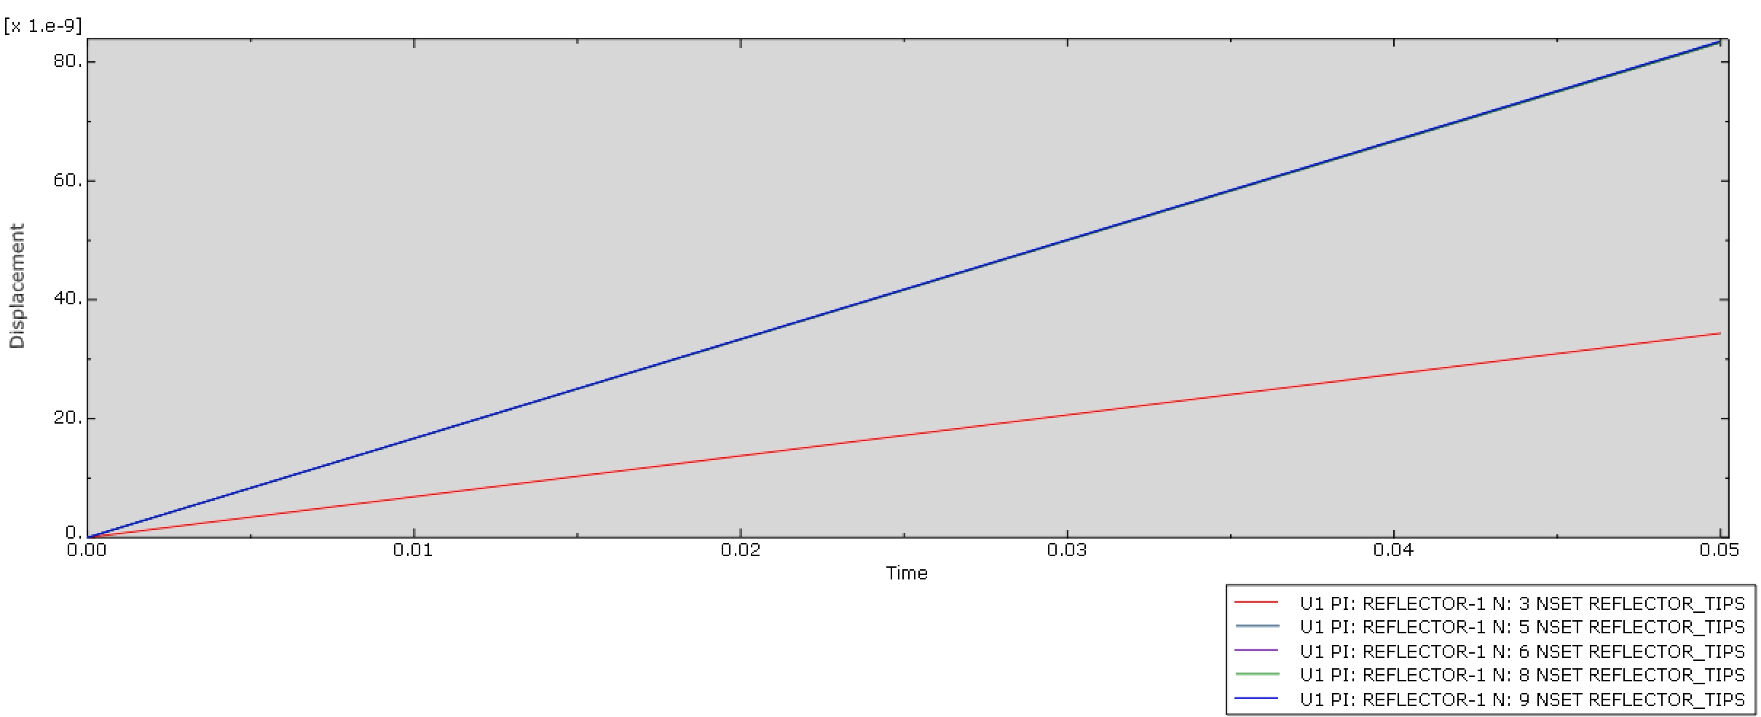
Question 6
Abaqus – Direct Time integration Results
  Similar to Tony’s results and Samy’s
  Little displacement over the time period during loading
  Similar to modes 2 and 3 at 0.05 time increment
    Frequency around 12 Hz

