Slide 1
Welds Project 10
Henry Glover

Slide 2
Question 1
Two types of welding processes
  Fusion welding
    Coalescence is achieved by melting two parts to be joined
    Sometimes with filler metal to fill the joint
      Arc welding
      Resistance spot welding
      Oxyfuel gas welding
  Solid State welding
    Heat/pressure used to achieve coalescence
    No melting of base materials
    No filler metal is added
      Forge welding
      Diffusion welding
      Friction welding
What types of welding processes exist
  Plasma Arc welding
    Constricted highly focused plasma arc is directed at weld area
    Tungsten electrode tube with high velocity argon focuses into an arc region to form a hot plasma arc stream
    Advantages
      Good arc stability and quality
      Better penetration
      Very fast
      Can be used to weld almost any metals
    Disadvantages
      High equipment cost
      Larger torch size, harder to reach some joint areas
  Arc welding
    Fusion welding process coalesces metals by heat from an electric arc
    Around 10,000F, can melt any metal
    Sometimes uses filler material to increase volume and strength of weld
    Pool of molten metal is formed near the electrode tip that is then moved along the joint to solidify
    Disadvantages
      Problems with manual welding – weld quality, repeatability, and productivity
      Generally slower and more costly than consumable electrode arc welding processes
    Advantages
      High quality of welds
      No spatter because no fille material through arc
      No flux - little to no post-weld cleaning

Slide 3
Question 1 Cont.
What types of welding processes exist
  Friction Stir welding
    Rotating tool is set along a joint line between two workpieces, generating friction heat and mechanically stirring the metal to form a weld
    Heat is garneted by separate tool, not part
    Good mechanical properties of weld, little distortion or shrinking, good weld appearance, no toxic fumes, no warping, no shielding issues
    Disadvantages
      Exit hole is produced when tool is taken out
      Heavy duty clamping needed
    Used to make heavy machinery/armament
  Friction welding
    Uses frictional heat combined with pressure
      No melting occurs, no filler metal, no flux, no shielding gases
      Has a narrow HAZ
    Used to join dissimilar metals
    Used in commercial process, amenable to automation
  Electron Beam welding
    Fusion welding process where heat for welding is provided by a high intensity stream of electrons
      Concentrated electron beam gun operates at high voltage (10-150Kv)
      Beam current are low (mm)
    Advantages
      Has high quality welds with deep narrow profiles
      Limited heat affected zone with low thermal distortion
      No flux or shield gases required
    Disadvantages
      Expensive
      Precise alignment and joint preparation
      Vacuum chamber required
      Can be unsafe
  Resistance welding
    Fusion welding processes that use heat and pressure
    Heat is generated by electrical resistance to current flow at junction
    Advantages
      No filler metal needed
      High production rates
      Can be automated
      Not a lot of skill needed
      Can be repeated and is reliable
    Disadvantages
      High initial cost
      Limited to lap joints
      Low strength sometimes

Slide 4
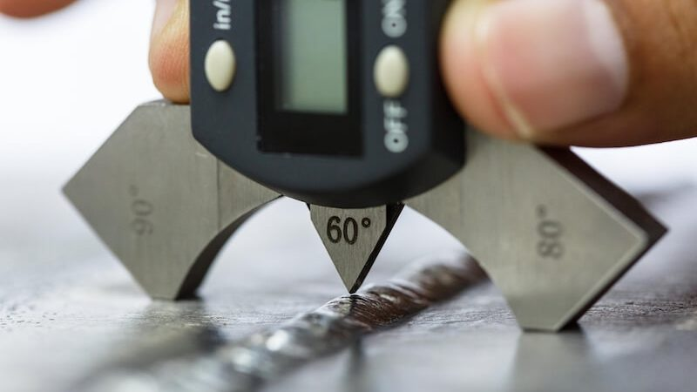
Question 2
Weld confidence and quality control
  Strength of welded joint must be checked for failure in parent material and in weld
  Weld strength is dependent on electrode material
    Weld material is often stronger than parent material
    Parent material experiences heat effects near weld
  Acceptable weld joint needs to be absent of defects and is strong
  Typically analyzed using shear force on the weld
  NDE methods, proof testing, coupon testing
  Visual inspection
    Conformance to dimensions, warpage, cracks, cavities, incomplete fusion, other surface defects
    Issue: Only surface defects are detectable and up to the standards of the inspector
  Nondestructive evaluation (NDE)
    Perform before and after
    Ultrasonic testing, radiographic testing, dye-penentrant and fluorescent penetrant tests, magnetic particle testing
  Destructive testing
    Mechanical tests - tension shear test, fillet break test, tension-shear of spot weld, peel test for spot weld
    Coupon testing
  Metallurgical tests
    Preparation of metallurgical specimens of weldment
    Used to examine metallic structures, defects, analyze heat affected zone (HAZ)
https://weldguru.com/weld-quality-testing/

Slide 5
Question 3
Welding process variability
  Material matters, effects weldability
    Some metal combinations can be readily welded by one process but are difficult to weld by others
    Some metals melt too easily
    Metals with high thermal conductivity transfer heat away from weld – can cause problems
    High thermal expansion and contraction in metal causes distortion issues
    Dissimilar metals can cause problems in welding
  Filler metal
    Needs to be compatible with base metal
  Surface conditions
    Moisture can result in porosity in fusion zone
    Oxides and other films on metal surfaces can prevent adequate contact and fusion
  Welding can be a manual process
    Introduces variability in technician performance
  Other non-material factors
    Torch speed
    Welding sequence/pattern
    Residual stress caused by inadequate weld or coalescence
  Defects are hard to see
    Cracks, porosity, voids, cavities that are not visible on the surface

Slide 6
Question 4
Weld defect types
  Cracks
    Sudden failure at any stress level depending on crack size/propagation
    Caused by high stress concentrations during thermal cycling, hydrogen embrittlement, FOD, or improper technique
    Surface or internal
  Incorrect geometry conformance
    Poor technique leading to improper geometry/welds
  Overlap
    molten weld pool flows beyond the weld toe without fusion, leads to weak bonding
  Warping and distortion
    Caused by uneven heating or cooling
    Leads to thermal stresses which can cause dimensional inaccuracies
  Incomplete fusion
    Inadequate heat or poor technique, preventing adequate bonding between weld metal and base metal
    Causes weak zones in the joint
  Large heat affected zone (HAZ)
    Not a defect but, can lead to changes in material properties
    Increases in residual stresses
    Reduced material characteristics – metal can be more susceptible to corrosion
  Large residual stress concentrations
    Effects strength of joint
    Can be detrimental to structure
  Cavities
    Porosity – entrapment of gas bubbles during solidification, reduces strength and can lead to crack initiation
    Voids
Weld defect types
  Foreign object debris
    Metal shavings, dust, flux from pervious welds, environmental contaminations, work items (gloves, napkins, etc.…)
    Can lead to premature cracks, interrupts the metallurgical bonds, and can reduce mechanical properties
  Incorrect surface prep on base material
    Failure to properly clean, align or prepare the surfaces to be welded
    Can cause defects such as cracks, porosity, improper fusion, distortion, stress concentrations, etc….
  Spatter
    Molten material is ejected from weld pool caused by arc instability
    Can lead to surface imperfections

Slide 7
Question 5
Should we add more weld passes?
  NO
  Adding more weld passes does not make the weld stronger it can (most likely) add more stress concentrations on the welded section
  More weld passes are sometimes used for thick materials but in general it does not work like this
  More weld passes can cause
    Larger heat affected zone
    More distortion or warping
    Residual stress concentrations when overlapping
    Reduce mechanical and fatigue life properties

Slide 8
Question 6
Best approach to substantiate a weld
  Analysis and testing needed to make sure structure is airworthy
  This is done when a repair occurs too
  Visual inspection
    Conformance to dimensions, warpage, cracks, cavities, incomplete fusion, other surface defects
    Issue: Only surface defects are detectable and up to the standards of the inspector
  Nondestructive evaluation (NDE)
    Perform before and after
    Ultrasonic testing, radiographic testing, dye-penentrant and fluorescent penetrant tests, magnetic particle testing
  Destructive testing
    Mechanical tests - tension shear test, fillet break test, tension-shear of spot weld, peel test for spot weld
    Coupon testing

Slide 9
Question 7
Damage that can occur in composites
  Matrix cracking
    Cracks in resin than reduce stiffness – leads to delamination
  Delamination
    Separation between plies
  Fiber breakage
    Caused by excessive loading or impact – reduces strength properties
  Facesheet debonding
    Shear load failure leads to core – facesheet debonding
  Thermal damage
    Extreme thermal cycling leads to matrix failure, debonding, or delamination
  Moisture ingress
    Moisture get trapped inside composite – leads to matrix failure or swelling
  FOD (impact damage)
    Sometimes hard to detect
    Compromises composite structure mechanical properties
Repairs
  Patch repair
    Circular or square patch where damaged area is layered with new plies following the original layup
  Sanded repairs
    Good for surface only damage
    Damaged area is sanded down and ply is repaired and cured
    Tapered or stepped hole on each ply
  Bolted repairs
    Reinforcing plate to damaged area is placed
    ​Fills the damaged area and adds a bolted section for support​
    Very strong but heavy
  Core replacement
    Damaged cores are removed and replaced when debonding or core crushing is detected
  Resin injection
    For minor repairs, epoxy is injected into cracks or delamination's

Slide 10
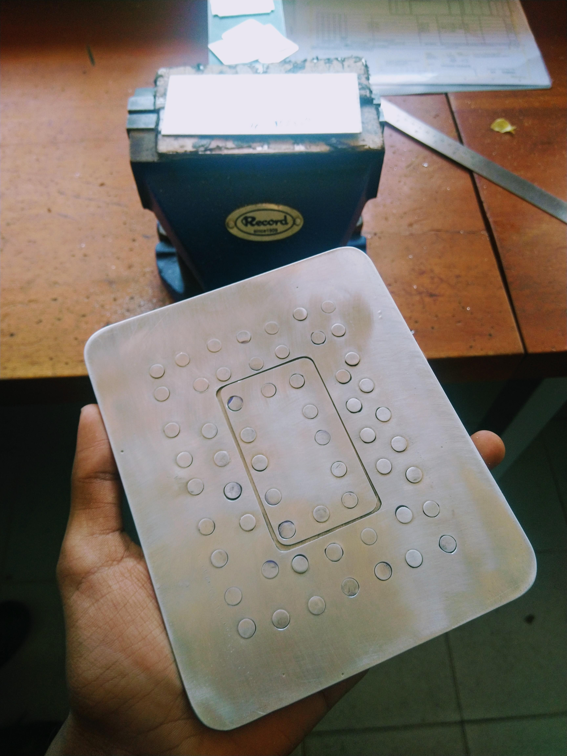
Question 8
Damage that can occur in metals
  Corrosion – loss of metal from the surface by chemical action
    Repair
      Mitigate corrosion root cause, remove corroded regions by removing material, and analyze modified structures
  Dent – indentation of metal
    Repair
      Ensure structural integrity remains, analyize for potential buckling and plastic deformation, potentially reinforce structure
  Galling – break down or build up of metal surfaces due to excessive friction between two parts having relative motion
    Repair
      Sand material to smoothen stress risers and determine whether the galling can lead to crack initiation points
  Gouge – breakdown of a meatal surface from contact with foreign material under heavy pressure
    Repair
      Sanding down material and analyzing structure treating the “gouge” as a flaw
  Nick – local break or notch on edge
Repairs
  Doubler and filler method – damaged area is cut to a smooth reactangle with corner radii, doubler is riveted in place, filler is riveted into the doubler to seal the damaged area
  Riveted/bolted reenforcing patch
  Stop-drilling cracks to limit propagation
  Doublers reinforced with metallic patches
  Reinforcing damage with corrugated panels and self plugging rivets
https://www.reddit.com/r/aviationmaintenance/comments/c0eu0q/my_first_ever_flush_repair_project_as_a_trainee/?rdt=56519 - IMAGE

Slide 11
Question 9
Repair techniques are validated
  Repair validation is supported through testing
  Testing should demonstrate that methods and techniques of repair restore the structure to an airworthy condition
  The repair must fulfill the same requirements as the parent structure
  Representative damage sizes are introduced in full scale test specimens
  Metal repair analysis considers
    Flaw assessment
    Fatigue assessment
    Bolt analysis
    Skin analysis
    Demonstrates that repair restores strength to qualified config
    Consider all new failure modes that could have been introduced during repair

Slide 12
Question 10
Additive manufacturing types
  Power bed fusion – Selective laser Melting
    Powdered material is consolidated by melting it together using a laser or electron beam
    The powder surrounding the consolidated part acts as support material for the features
  Direct energy deposition
    Powder or wire fed into a melt pool, then adhered to the underlying part or layers using energy source
    Automated build-up welding
  Sheet lamination
    Sheets of material are stacked and laminated together to form an object
    Lamination method can be adhesives, chemical (plastics), ultrasonic welding, or brazing (metals)
    Un-needed sections are cut out layer by layer and removed after the object is completed

Slide 13
Question 11
Additive manufacturing defects
  Manufacturing sensitive
  Surface finish and print direction can dictate part strength
    Poor surface finish leads poor fatigue performance or premature wear
  Warping/distortion
    Rapid thermal cycles – cooling or heating
    Can happen during or after printing
  Material variability from one machine to another
    Dimensional inaccuracies – leads to uneven layers or bonding issues
  Porosity and voids
    Caused by incomplete melting, poor material flow, trapped gasses – reduced strength and fatigue life
  Cracks
    Caused by high thermal stresses or residual stresses
  Delamination
    Improper fusion between layers

Slide 14
Question 12
Key Points AIAA paper
  Space requirements for additive manufacturing parts are no less than those for traditional manufacturing methods
  Qualification verifies both the design and the manufacturing process – repeatability can be established
  The manufacturing process between production and qualification hardware must be consistent

Slide 15
Question 13
Why is optimization useful and how can it be used with Additive manufacturing
  Optimization lets us design a part where only the load bearing sections of the parts can be kept​
    The non load bearing parts can be removed to reduce weight​
  Often the load paths are complex, hard to build using traditional methods​
    AM parts allow us to build that complex shape​
  Optimization + AM allows us to significantly reduce material in a given part​
    Ability to take off non load bearing sections​
  This approach allows the following​
    Given a structure performance requirement, we can design a part that has significantly lower weight that meets the requirement compared to traditional methods

Slide 16
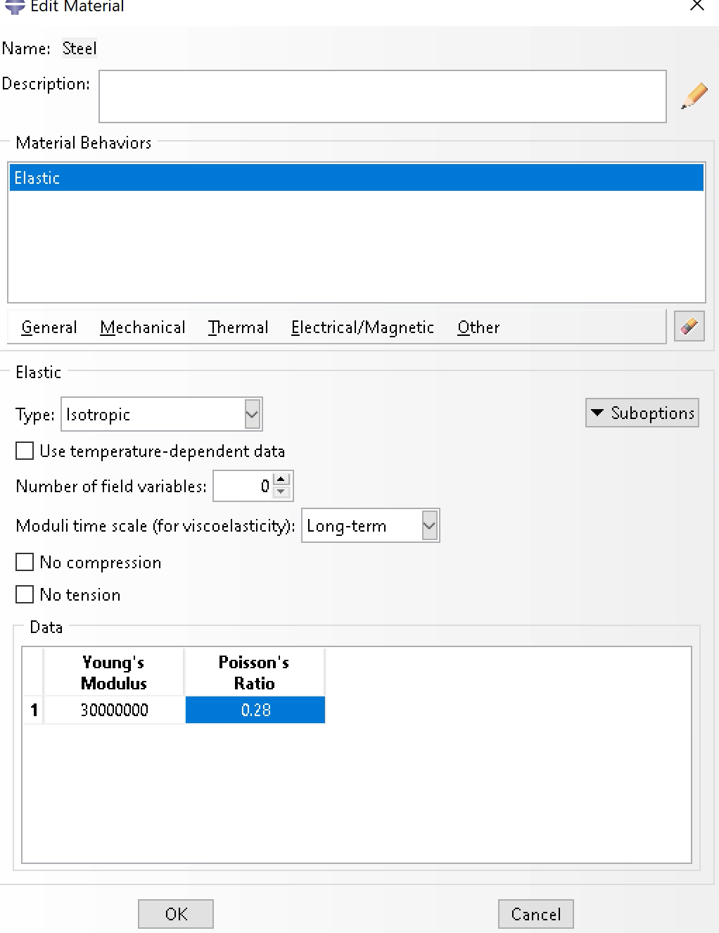
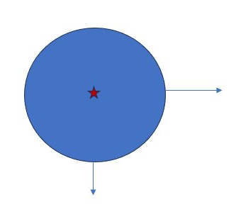
Abaqus
Abaqus
  Disk optimization
  Model this using 2d- planar shell elements
Material Properties
  E = 30 Msi = 30 e6 psi
  Assuming steel because E= 30 Msi
    V = 0.28
  Strength = 120 ksi = 120 e3 psi
    Testing to see how close we can get to this value
    Assuming F.S. is applied
Model
  Center is encastrated
  Disk radius = 5 in.
  2-point loads
    1000 Ibs. to right
    -500 Ibs. on bottom

Slide 17
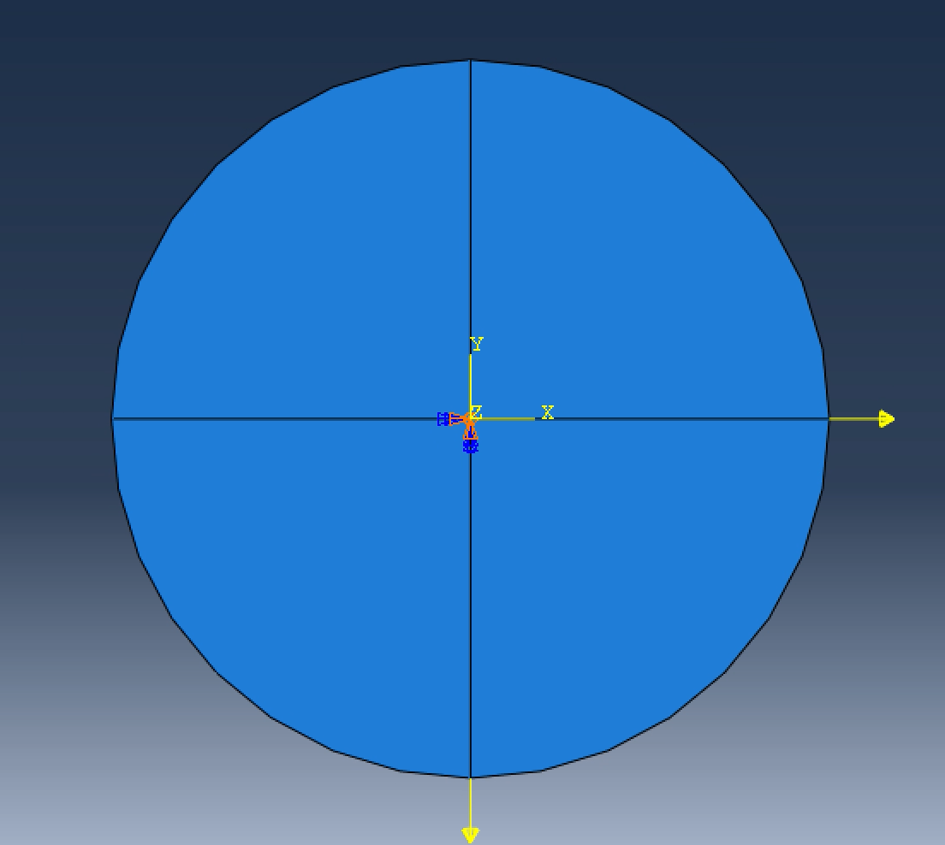
Abaqus
Abaqus – Setup
  First partition is setup
  Load are applied
  Center in constrained
  This is the setup for our first results

Slide 18
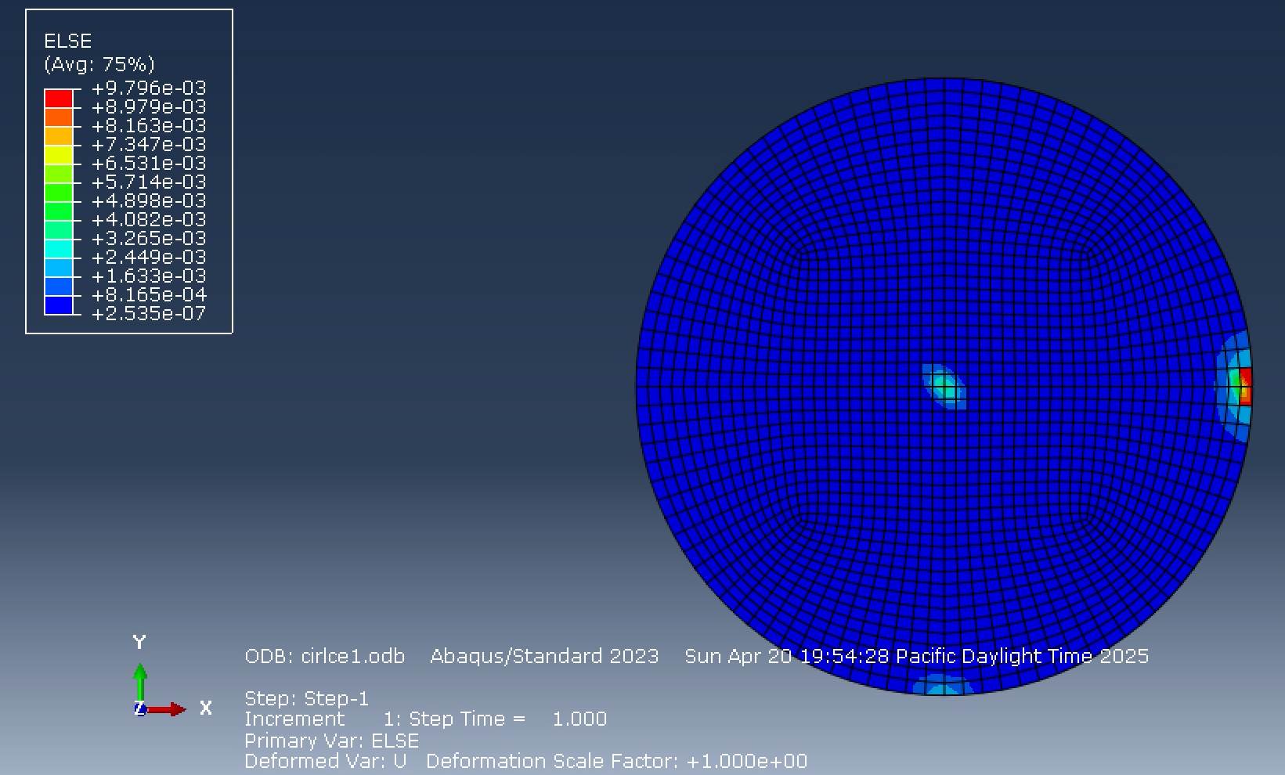
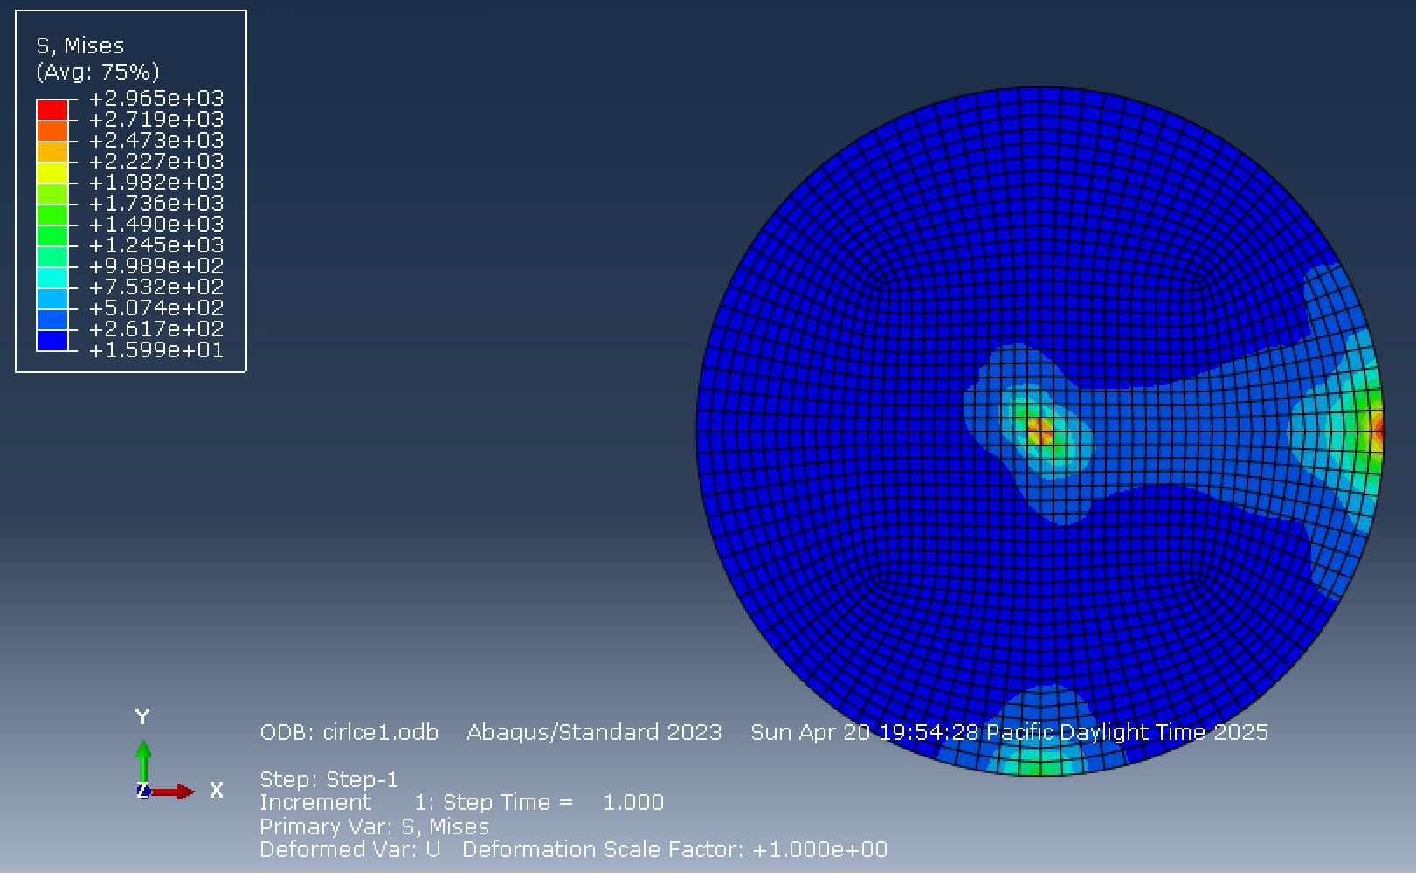
Abaqus
Abaqus – Results 1
  ELSE and S, Mises plotted below
  Max stress is significantly below 120 Ksi, we are at 2.965 Ksi
  A lot more material to cut, this is our baseline
  Strain energy appears where load is applied

Slide 19
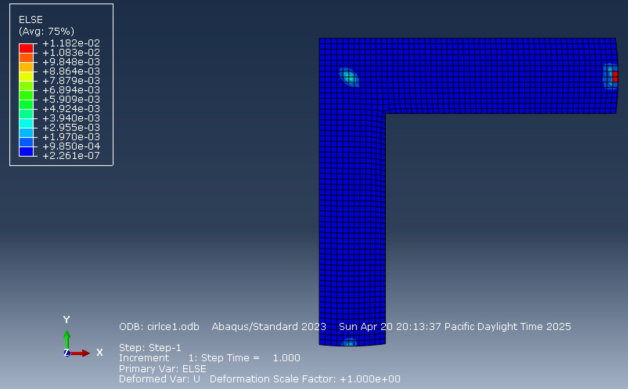
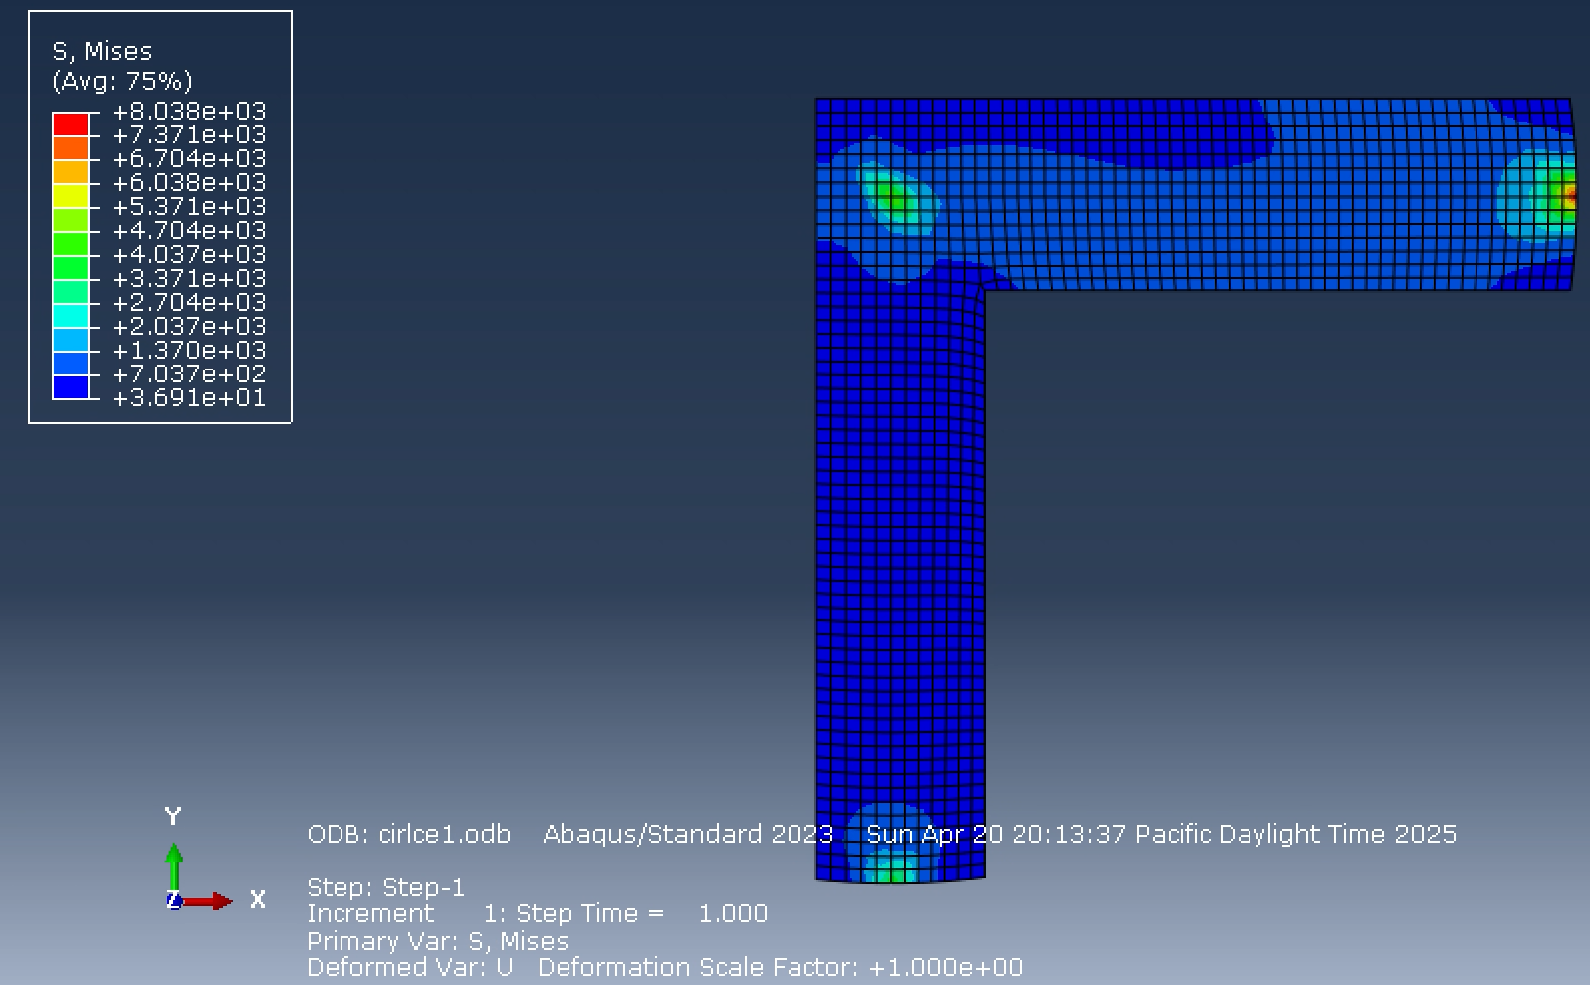
Abaqus
Abaqus – Results 2
  New partitions are made to cut out extra material
  We see, we are still at only 8.038 Ksi, still significantly below what we are allowed

Slide 20
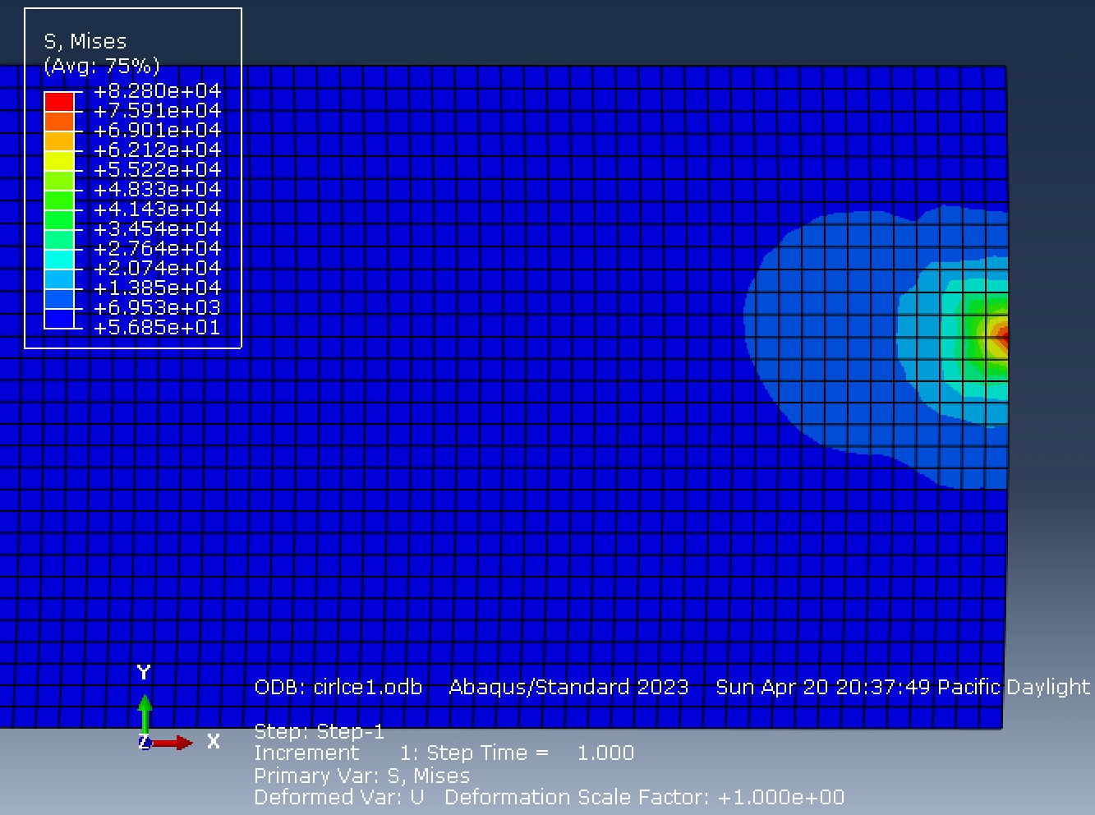
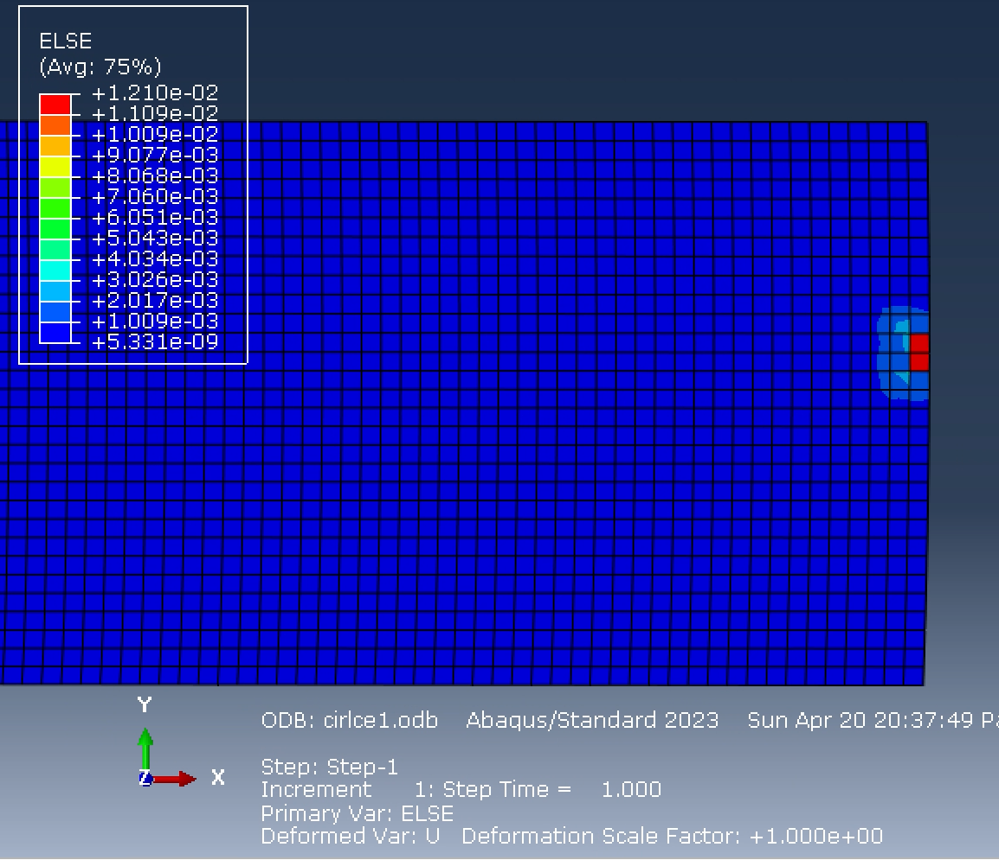
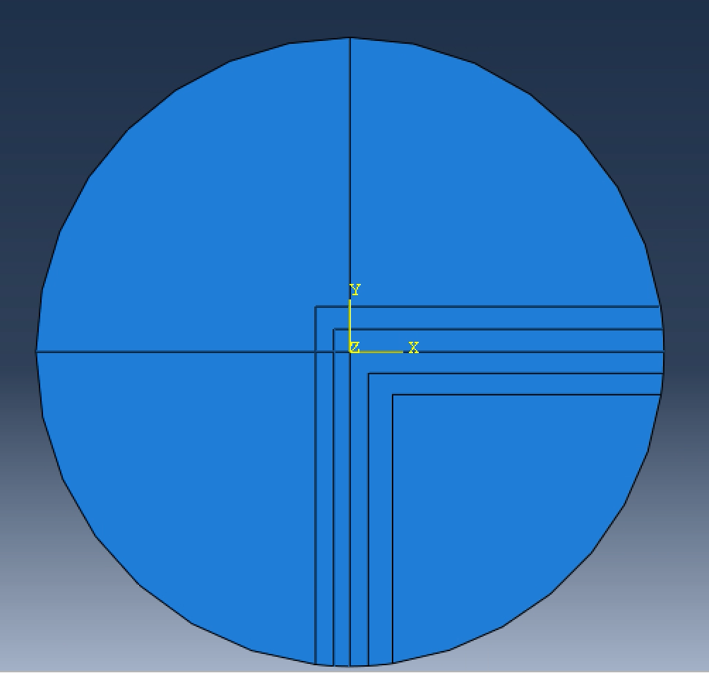
Abaqus
Abaqus – Results 3
  Material is partitioned further; we are getting closer to our allowable.
  Stress increases to 80.28 Ksi
  No significant change in strain energy at 0.01210 Psi

Slide 21
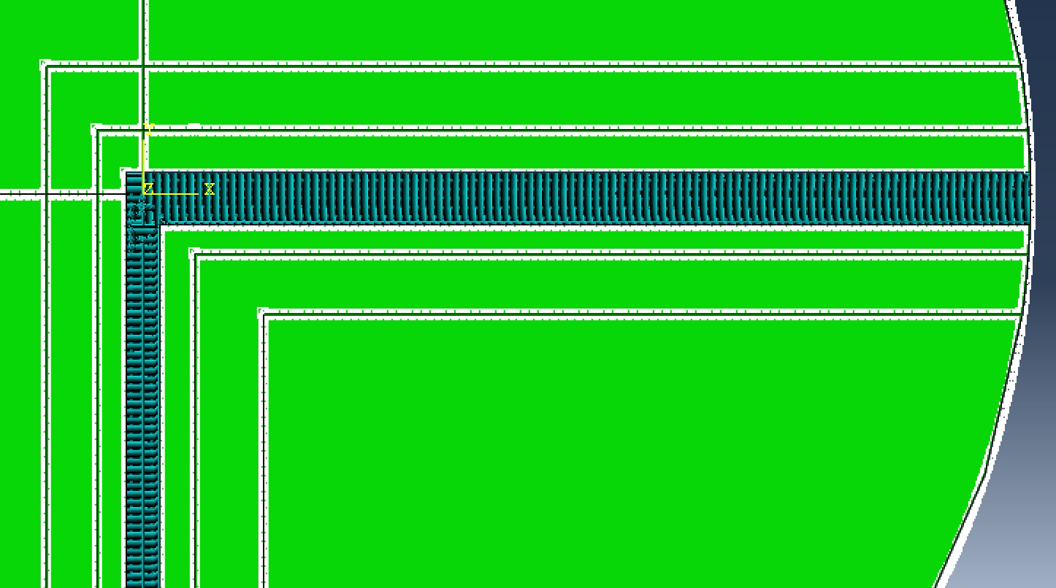
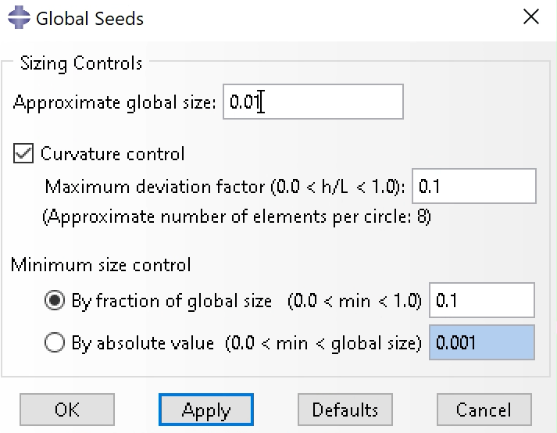
Abaqus
Abaqus – Final Setup
  Material is portioned for the last time
  Global mesh is set to 0.01

Slide 22
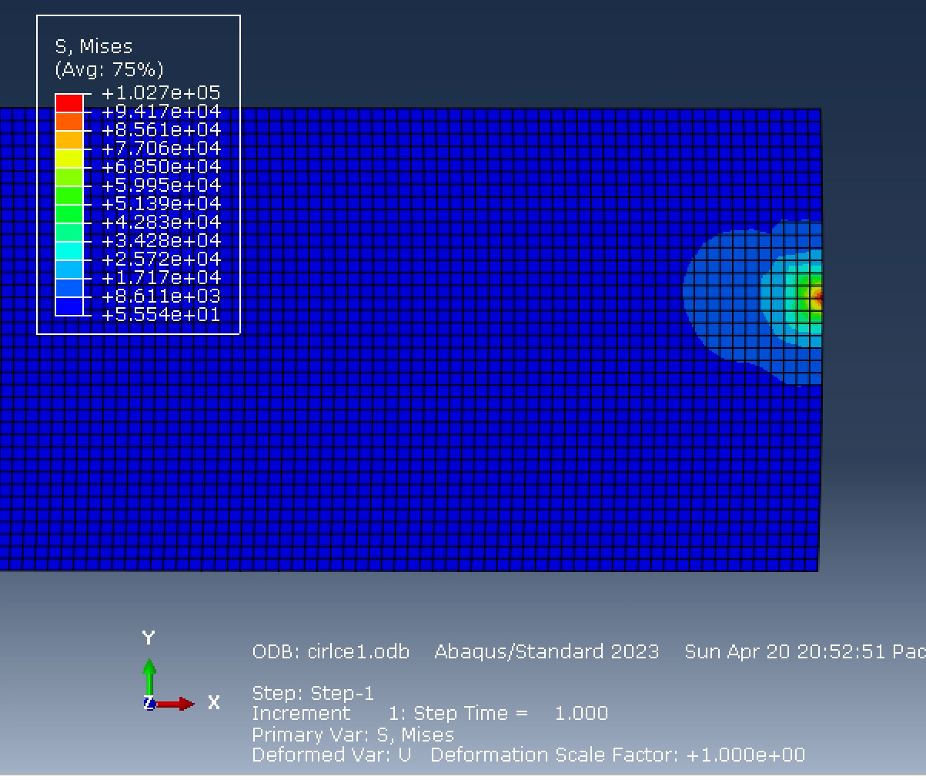
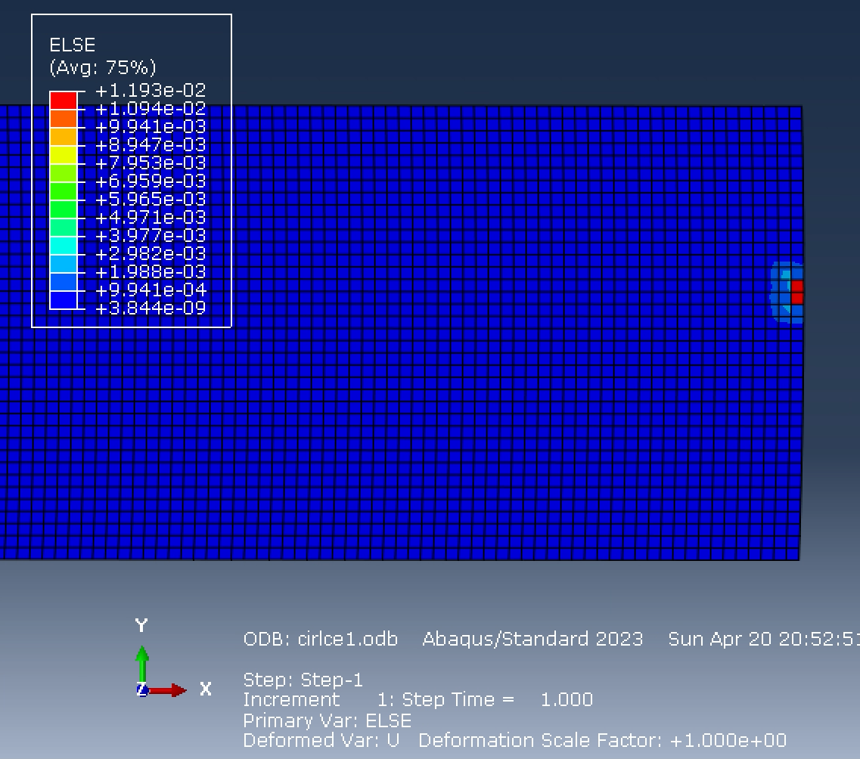
Abaqus
Abaqus – Results 4
  Get a stress value of 102.7 Ksi
  This is close enough to our 120 Ksi allowable
  This is where I am comfortable stopping removing more material
  Again, strain remains the same, unchanged

Slide 23
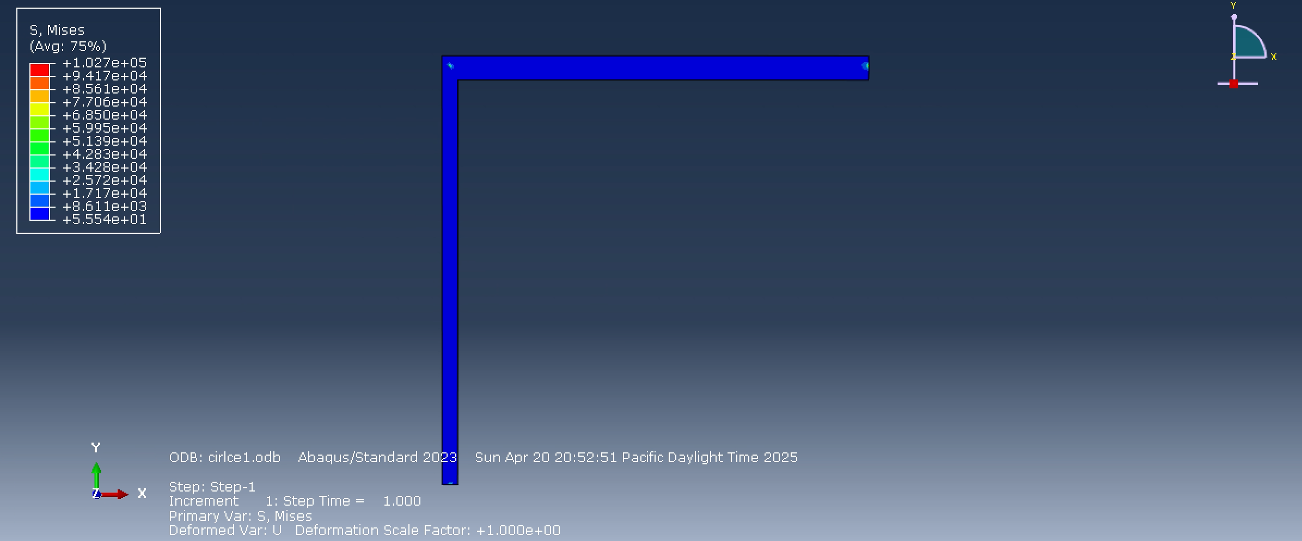
Abaqus
Abaqus – Conclusion
  Final part looks like the image below with a 102.7 Ksi stress
  We can still shave down more using an iterative optimization method, but comfortable stopping here
  Strain remained constant throughout different partitions localized where the loads and center constraint was placed

