Slide 1
AME 585 Fracture Project 7 Final
Taeklim Kim
Samy Ousman
Henry Glover

Slide 2
Question 1
NASA 5019A
Develop a Comprehensive Fracture Control Plan (FCP): Establishing and maintaining an FCP is crucial for human-rated spaceflight hardware to mitigate catastrophic failure risks due to flaws.
Classify Hardware Components Accurately: All parts should be evaluated and categorized as exempt, non-fracture critical (NFC), or fracture critical to determine appropriate control measures.
Implement Rigorous Verification Processes: Verification of fracture control requirements ensures that hardware meets safety and reliability standards.
Utilize Established Approaches for Specific Hardware Types: Applying proven methods for different hardware categories enhances reliability and safety.
Document Alternative Approaches Thoroughly: When deviating from standard practices, comprehensive documentation and approval are essential to maintain safety standards.
Ensure Material Traceability: Maintaining traceability of materials used in fracture-critical components is vital for quality assurance and safety.
Perform Detailed Failure Mode Evaluations: Identifying and assessing potential failure modes in hardware components help in implementing effective fracture control measures.
Apply Conservative Design Margins: Incorporating conservative design margins in fracture-critical components enhances safety and reliability.
Conduct Regular Training for Personnel: Ensuring that personnel involved in fracture control are adequately trained contributes to the effectiveness of the program.
Engage in Continuous Improvement: Regularly updating fracture control practices based on new findings and technological advancements fosters ongoing enhancement of safety measures.
NASA 5009
Establish Clear NDE Requirements: Defining specific NDE requirements for fracture-critical components ensures consistent application across programs.
Qualify NDE Procedures Rigorously: Qualification of NDE procedures is essential to validate their effectiveness in detecting critical flaws.
Determine Minimum Detectable Flaw Sizes: Establishing the smallest flaw size that NDE methods can reliably detect is crucial for accurate fracture analysis.
Apply Standard NDE Methods When Appropriate: Utilizing standard NDE methods with known capabilities simplifies the inspection process and ensures reliability.
Implement Special NDE for Complex Cases: For unique or complex components, special NDE procedures may be necessary to achieve the required detection capabilities.
Maintain Inspector Proficiency: Regular training and certification of NDE inspectors are vital to maintain high detection reliability.
Document NDE Results Systematically: Thorough documentation of NDE findings supports traceability and aids in the assessment of component integrity.
Integrate NDE into the Design Process: Incorporating NDE considerations early in the design phase facilitates the development of inspectable and reliable components.
Utilize Probability of Detection (POD) Curves: Employing POD curves helps in understanding the effectiveness of NDE methods and informs risk assessments.
Engage in Continuous NDE Technology Assessment: Regularly evaluating and adopting advancements in NDE technologies ensures the effectiveness of inspection processes.

Slide 3
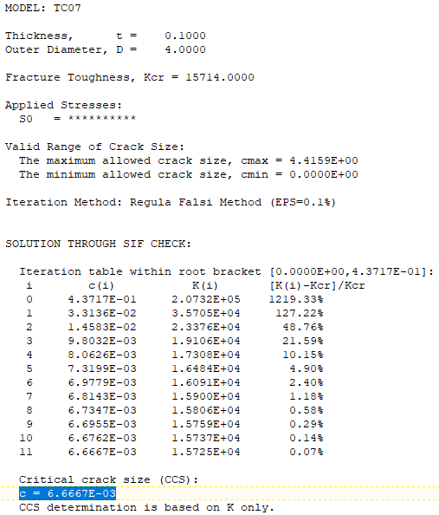
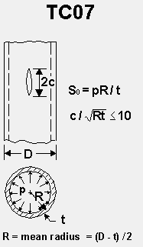
Question 2
Input
R = 2”; D = 4”
t = 0.1”
K_{IC} = 22000 (Al 2024-T3)
FS = 1.4
K_{IC} = 22000/1.4 = 15714
P = 5500 psi
σ_{hoop} = PR/t = 110,000 psi
Results
Crack = 2c = 0.0133”

Slide 4
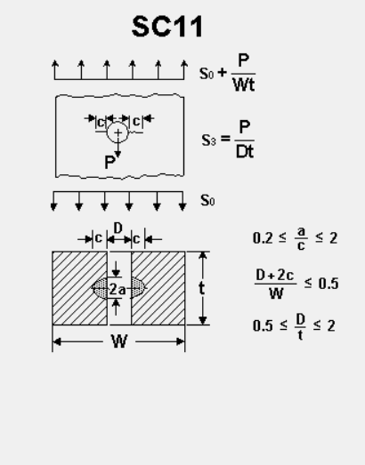
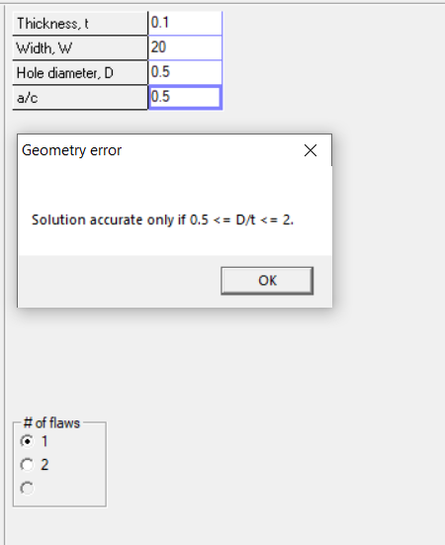
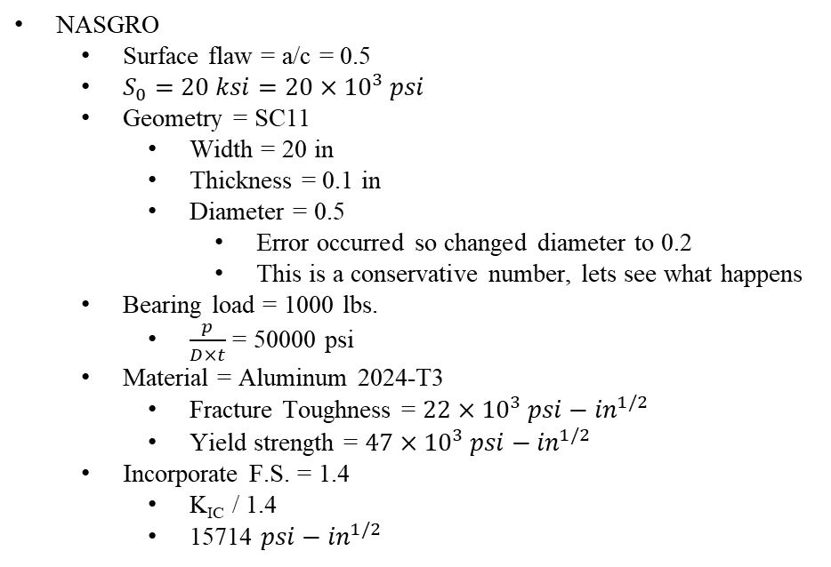
Question 3
NASGRO
Surface flaw = a/c = 0.5
$S_{0}=20 ksi=20×{10}^{3} psi$
Geometry = SC11
Width = 20 in
Thickness = 0.1 in
Diameter = 0.5
Error occurred so changed diameter to 0.2
This is a conservative number, lets see what happens
Bearing load = 1000 lbs.
$\frac{p}{D×t}$ = 50000 psi
Material = Aluminum 2024-T3
Fracture Toughness = $22×{10}^{3} psi−{in}^{1/2}$
Yield strength = $47×{10}^{3} psi−{in}^{1/2}$
Incorporate F.S. = 1.4
K_{IC} / 1.4
15714 $psi−{in}^{1/2}$

Slide 5
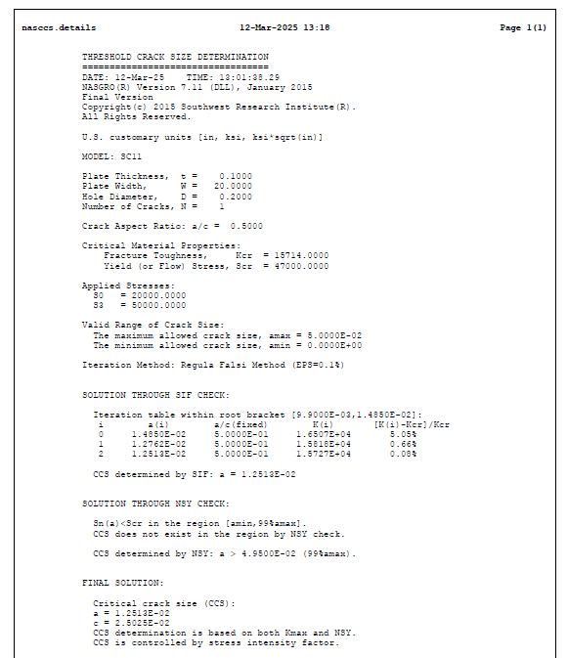
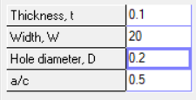
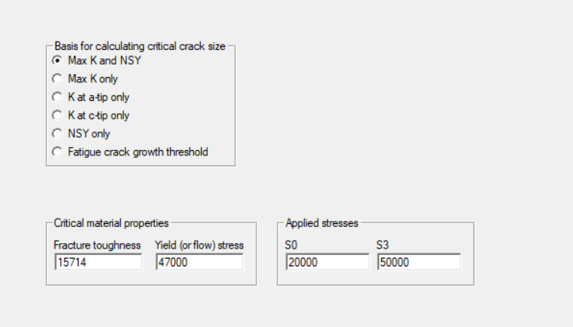
Question 3 (cont)
Results
The current flaw size in the problem is c = 0.5 in
Is the flaw safe for flying?
No
Critical flaw size is 0.025
The found flaw size is much larger than the critical crack size
No difference in using only fracture toughness and assuming no yielding

Slide 6
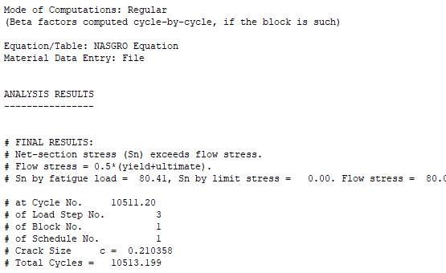
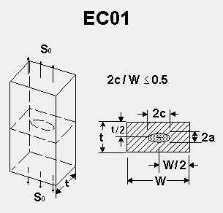
Question 4
Input
t = 0.1”
w = 0.56” (based on 2c/W < 0.5 calc)
Radiography NDE (X-ray 5009)
Proof factor = 1.5
K_{IC} = 25000 (Al 7075-T6)
S0 = 20 ksi
Results
Operating Cycles Capability = 10511 cycles

Slide 7
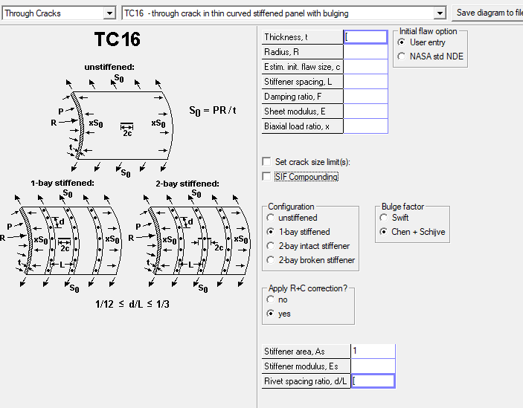
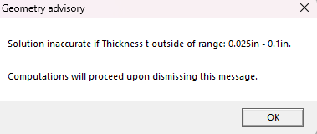
Question 5
Setup
TC16 geometry
Material = Al 7075-T6[12AB1]
Airplane skin
Flying at 40000 ft, cabin pressurized to 7000 ft
P = 11.34 – 2.72 = 8.62 psi
S₀ = PR/t = (8.62*75)/0.1 = 6.47 ksi
1-bay stiffened
Radius = 75 in
Thickness = 0.15 in
Adjusted to 0.1 in
Stiffener spacing = 24 in
Rivet spacing ratio = 2/24 = 0.0833
Dampening ratio = 0
Biaxial load ratio = 0.5
Requirement
3000 takeoff and landing = 3000 cycles
Assumptions
Stiffener is made of Al 7075-T6 as well
Elastic modulus = 10400 ksi
Units
NASGRO material library uses the following
Ksi for pressure
In for length
Adjustments
NASGRO warns of inaccuracy if thickness above 0.1 in
Thinner wall experiences worse fatigue, should envelop original dimensions

Slide 8
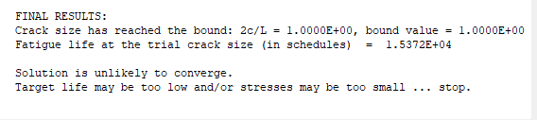
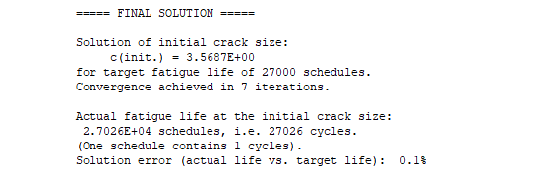
Question 5
Analysis
3000 cycles threw error that target life is too low
Setting more realistic target
Using southwest as example
Assume 3 flights/day, operating 300 days a year on average
Quick search of airliner service life = 30 years
3 flights = 3 cycles
3*300 = 900 cycle/year
900*30 = 27000 cycle/lifetime
27000 cycle results
C = 3.5687 in
Round to 3.56 in
Geometry shows that total crack length is 2c
2*3.56 = 7.12 in
Conclusion
3000 takeoff/landing cycle is way too little considering modern airliners
Using quick estimate using Southwest, critical flaw size for the expected flight cycles (27000 cycles) for of an airliner is 7.12 in
This is a conservative estimate due to reduction of thickness to avoid NASGRO inaccuracies
With crack that big, fatigue fracture should not be the dominant failure mode for the skin
3000 cycle result
27000 cycle result

Slide 9
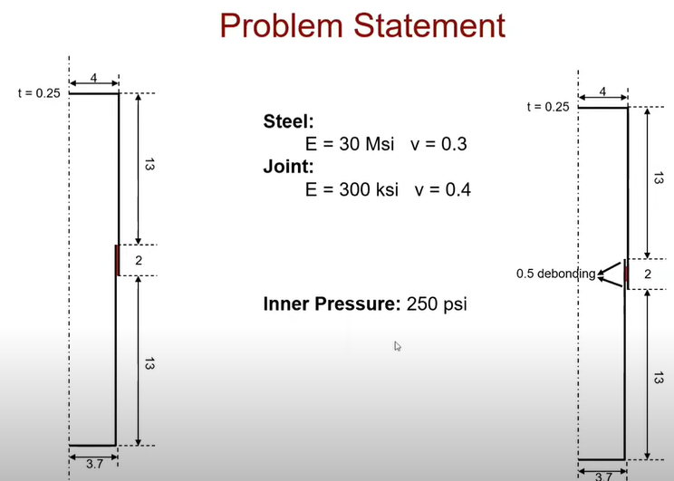
Question 6
Setup
Assume bond will fail before the metal
We can control bond overlap length and wall thickness
Wall thickness drives bond thickness
Bond thickness = 0.3
Length = overlap length
Thickness= bond thickness
Requirement
System must hold 400 psi internal pressure
Fatigue not considered for problem
Assumptions
Assume radius given is midpoint radius
Bond material property taken from diagram
E = 300 ksi
V = 0.4

Slide 10
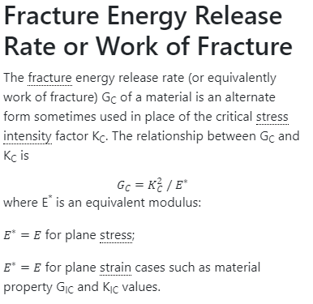
Question 6
Analysis
Debonding can be characterized as a crack on the bond ring
Crack is axial, on the edge of the cylinder
Question to ask is, at how much debonding does the bond fail?
This length should represent minimum overlap required, assuming perfect bond
Load on the bond can the characterized into the following
Hoop stress experienced by the bond
Shear experienced due to different hoop stresses between inner and outer cylinders
Peeling stress and axial stress not considered
Test #1
Debonding characterized as surface crack
Based on Al 7075-T6 yield strength, we set cylinder thickness to 0.022 in
Bond thickness = 0.3-0.022 = 0.278 in
Bond outer diameter = 4-(0.5*0.022) = 3.989 in
Bond hoop stress = (400*3.85)/0.278 = 5540 psi
Inner cylinder hoop stress = (400*3.7)/0.022 = 67273 psi
Outer cylinder hoop stress = (400*4)/0.022 = 72728 psi
Shear caused by cylinders = 5455 psi
Fracture toughness = K = sqrt(GE)
Sqrt(2*300e3) = 774.59 psi-in^{1/2}
a/c set to maximum allowed (1.2)
Deeper crack has higher stress concentration, which will drive catastrophic failure faster
Gives me shortest critical flaw size
Default units for NASGRO is Kips, in

Slide 11
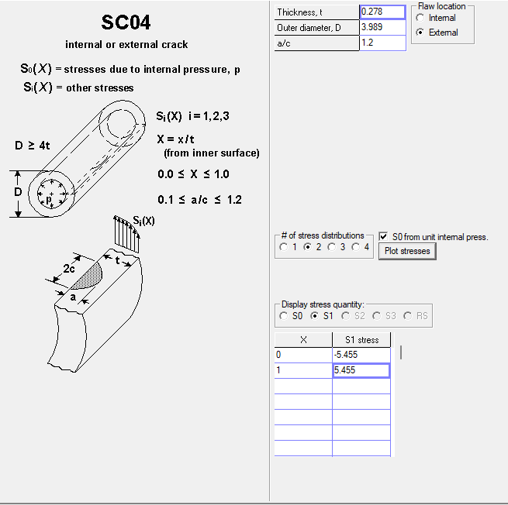
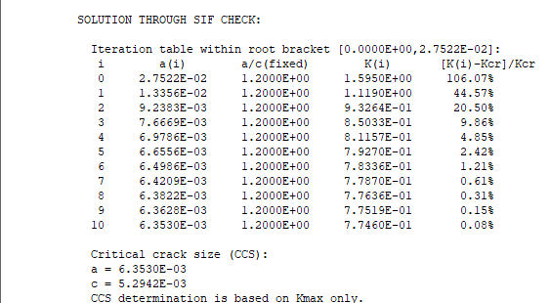
Question 6
Test #1
Using SC04 to map bond geometry, external flaw
Based on geometry, we can take the axial length of the critical crack size to be 2c = 2*5.294e-3 = 0.01 in
Current understanding is that this would be the minimum overlap required to avoid failure
Decreasing thickness of bond decreases bond’s ability to withstand fracture
Careful balance required for Aluminum thickness
Test Result Considerations
What critical flaw size do we say that the flaw is undetectable?
Crack is on the edge of bond, hidden inside outer cylinder
Most realistic NDE approach is RT or ultrasound
Assuming we can have the same fidelity for ultrasound as the standard NDE level as shown in NASA-STD-5009
a = 0.030 in
a/c = 0.2
Use these as minimum detectable flaw size
I assumed that the standard would hold for our case due to how thin the cylinders are, and with proper test setup can achieve the same fidelity as the standard written in early 2000s
Different approach is needed
Try modeling bond as a plate with surface crack or through crack
Plate can then be set with a width to specify the overlap length
Modelled using SC02 and TC12 for each cases

Slide 12
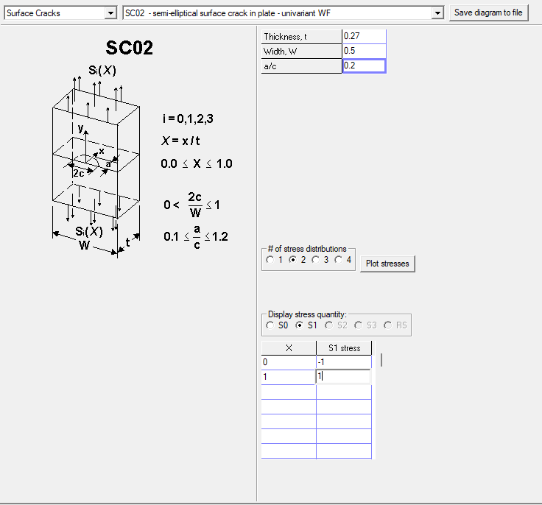
Question 6
Test #2
Using SC02 for critical flaw size
Al thickness = 0.03 in
Slight increase to ensure both cylinders stay in elastic region with some margin
Bond thickness = 0.27 in
a/c = 0.2; keep with NASA STD being referenced
Width: overlap length, variable we change to see what happens
See image to shear modelling
S0 represents hoop stress on the bond
S1 represents shear stress caused by cylinders
Bond hoop stress = (400*3.85)/0.27 = 5704 psi
Inner cylinder hoop stress = (400*3.7)/0.03 = 49334 psi
Outer cylinder hoop stress = (400*4)/0.03 = 53334 psi
Shear caused by cylinders = 4000 psi
Fracture toughness = K = sqrt(GE)
Sqrt(2*300e3) = 774.59 psi-in^{1/2}

Slide 13
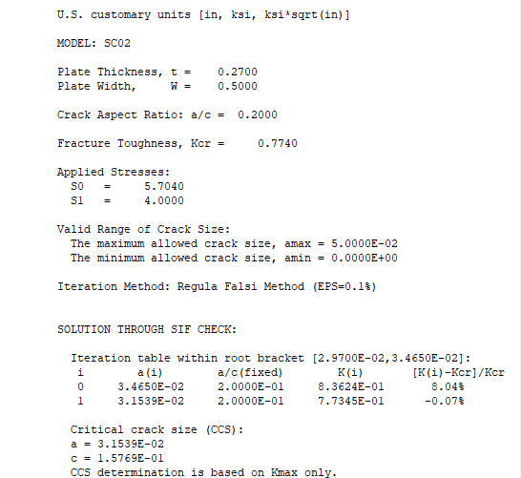
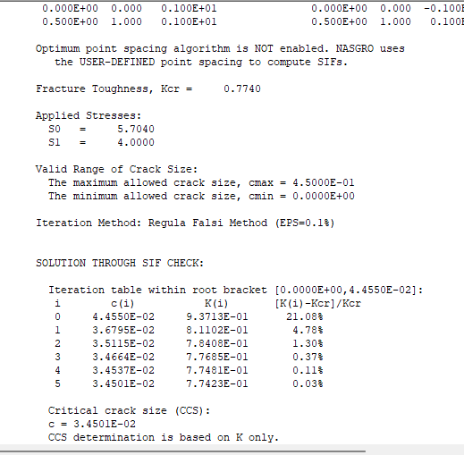
Question 6
Test 2 Results
We need to find a setup where the critical flaw size is greater than what’s detectable by NASA STD NDE ultrasound
a = 0.03 in = 3 e-2 in
a/c = 0.2
Keeping the a/c the same as the Standard, we approach the minimum detectable flaw size when the width = 0.5 in
Alternative modelling using TC12 also shows that critical flaw size stays above detection range
Through crack case examined to see if the bond itself would fail instead of delamination
Aluminum Recommendation
Al thickness = 0.03 in
Overlap length = 0.5 in
Further optimization may be possible, but at current level of analysis is deemed impractical
This will be the basis for the Abaqus setup
SC02 result (a = 3.15e-2)
TC12 result (c = 3.45e-2)

Slide 14
Question 6
Abaqus Setup
For the length and height of the model, we use the same one given in the image
Changes
Given the problem statement calls for a joint, I do not make this into a cylinder
Assuming infinite length for the purposes of the FEA
We add a level of conservatism since NASGRO has its limitations
Overlap length double to 1 in
Al thickness increased to 0.1 in
Overlap length and thicknesses will be dimensioned for quick testing of multiple constructions
Recall we defined the given radius as midpoint radius
Units
Length as in
Force as Ibs
Material Properties
Aluminum
E = 10400 ksi = 10400e3 psi
V = 0.33
Bond
E = 300e3 ksi = 300e6 psi
V = 0.4
Differences between video and problem
We don’t worry about debonding since we’re just asked to design something to survive 400 psi internal pressure
Notes regarding building model
Using sketch to partition is much faster and less clunky than datum planes

Slide 15
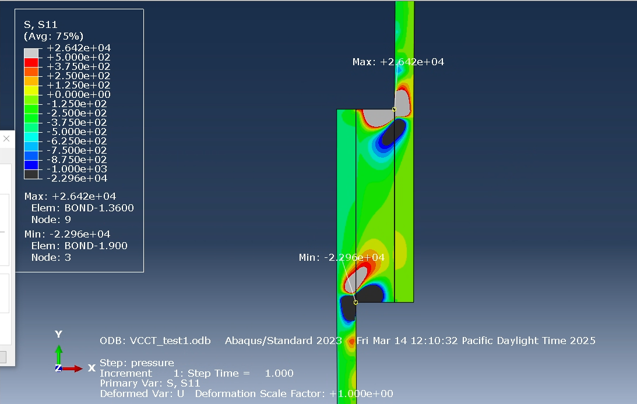
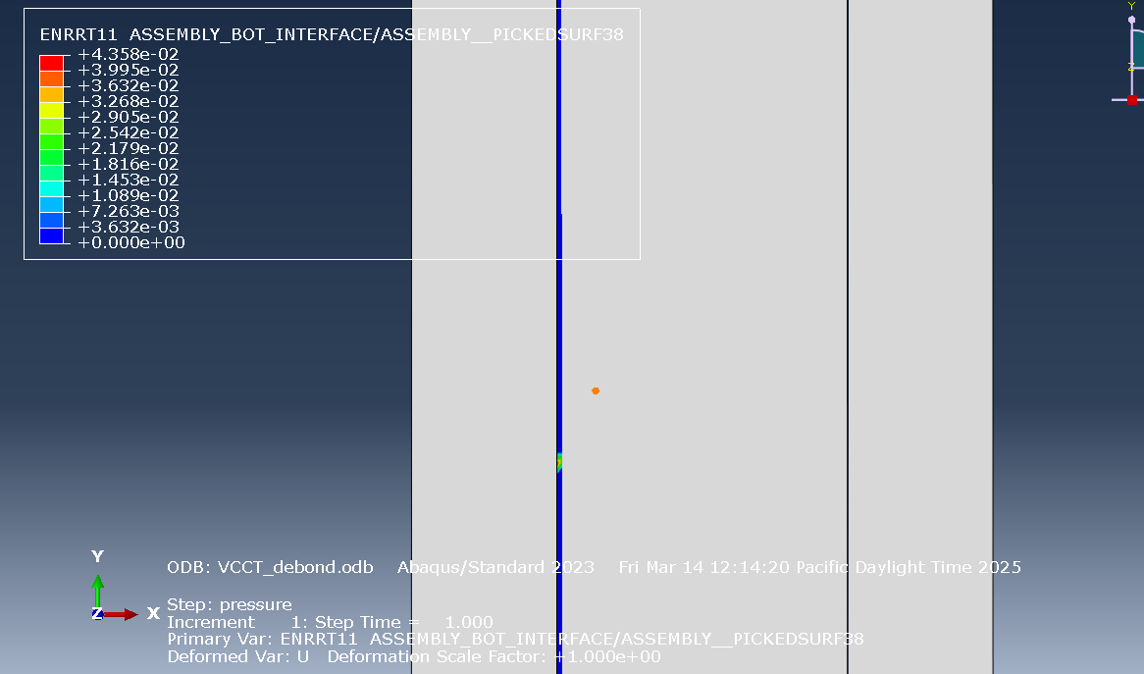
Question 6
Test #1 results
Stress concentration at the bond edge captured
Without debonding, Abaqus was reporting an ENRPT values of 0 across the board
Added the following debond to capture energy release rate
0.25 in debond from the top and the bottom, respectively
Test #1-debond results
ENRRT max detected around the end of the debond as expected

Slide 16
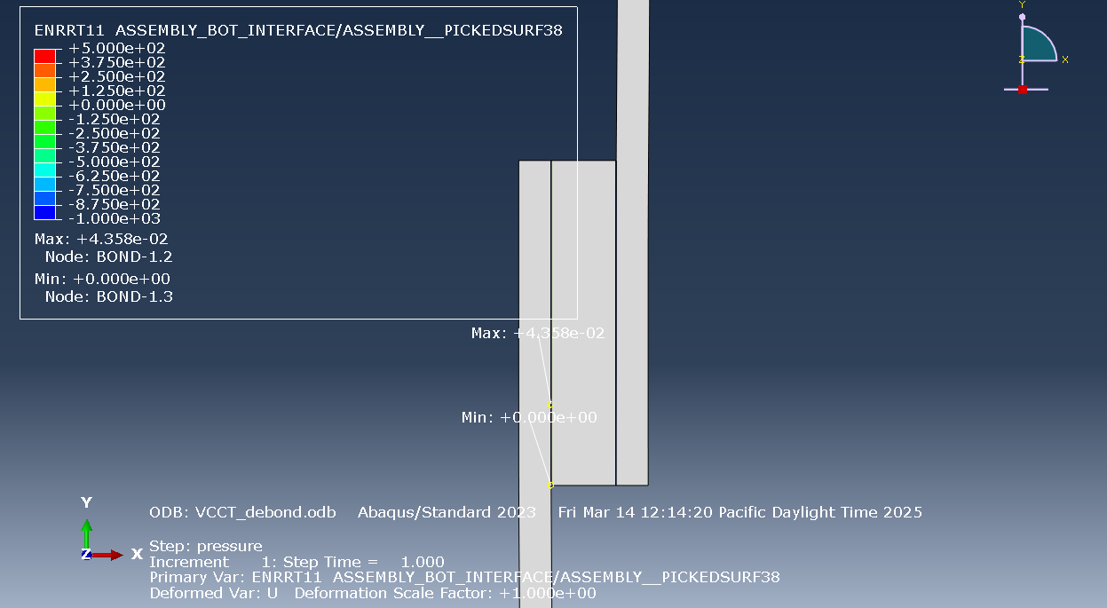
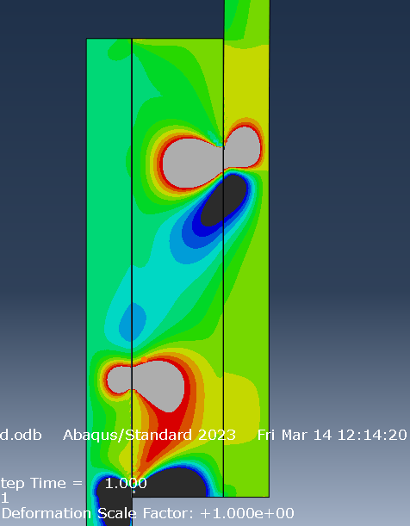
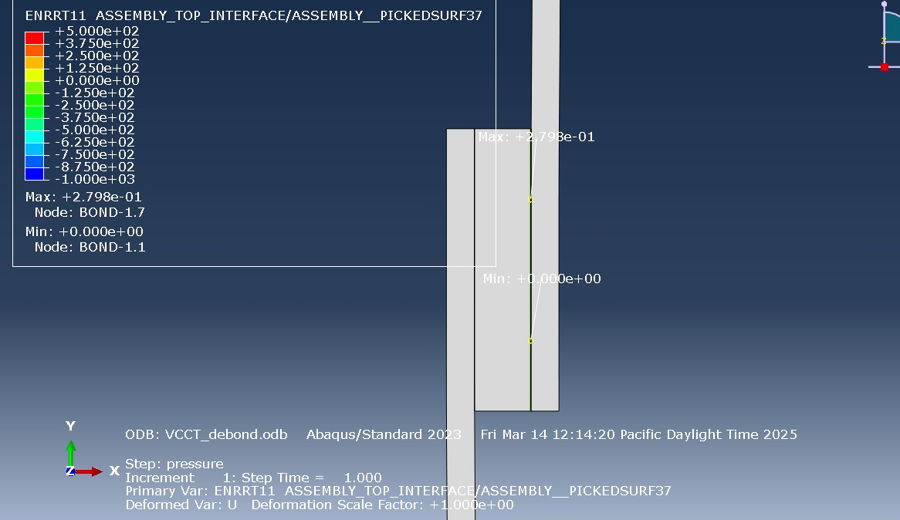
Question 6

Slide 17
Question 6
Analysis
G1 values for our debonded case are staying well below the bond limits
G1c = 2
As shown in the max value pointed in abaqus, the max G1 noticed is 2.798 e-1 on the outer layer
This shows that our current configuration will work under 400 psi internal pressure, even with internal pressure
Additional cases to consider
Original geometry found using NASGRO
Replace material with steel
Original Geometry case
Al thickness = 0.03 in
Overlap = 0.5 in
For debond purposes, take off ¼ of the overlap on top and bottom respectively
Steel case
Steel material properties
E = 30 Msi = 30e6 psi
V = 0.3

Slide 18
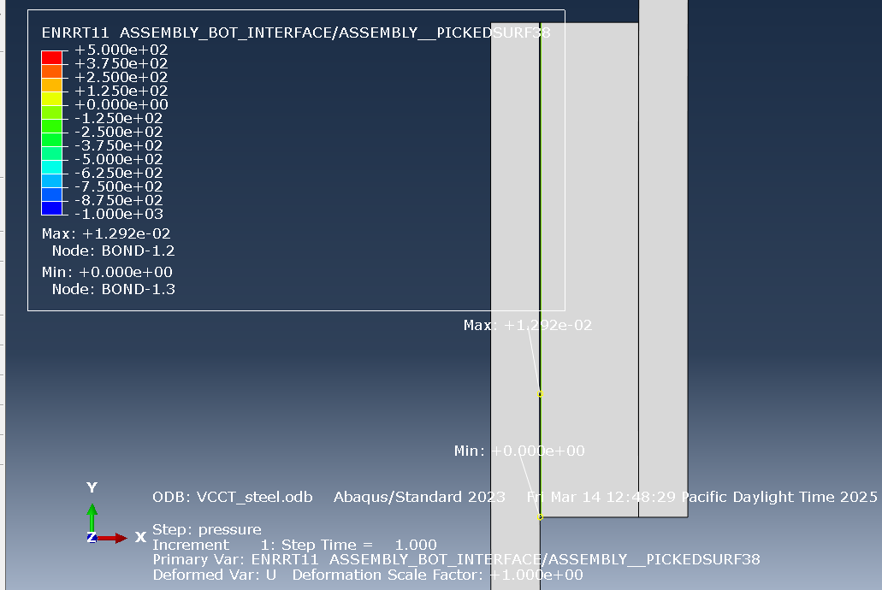
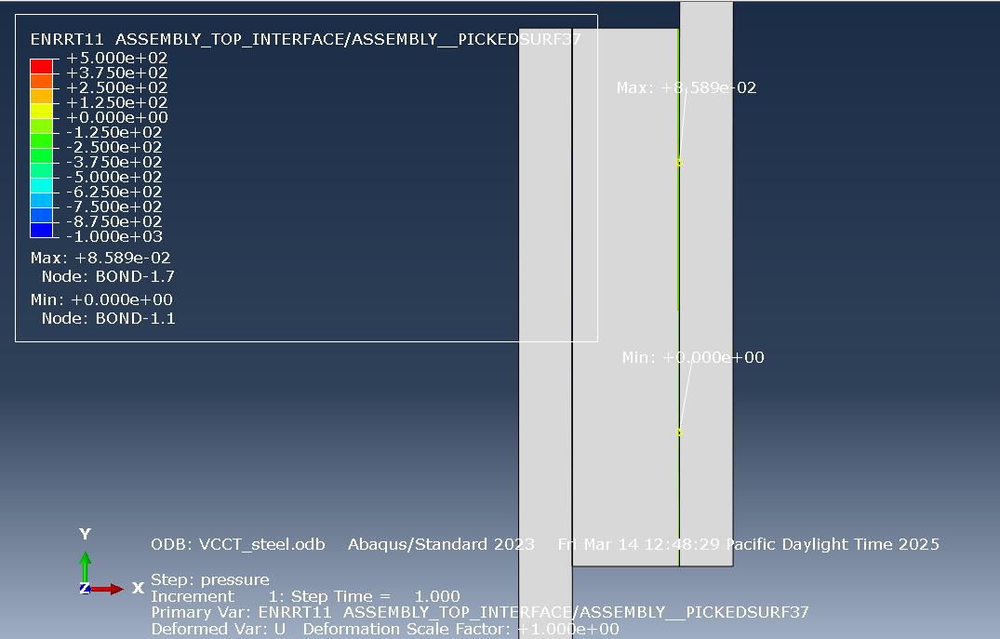
Question 6
Change Material to Steel
G1 max = 8.859e-2
G1 max decreased from the identical setup using Aluminum
Stiffer material decreased the strain of the cylinders, putting less stresses on the bond

Slide 19
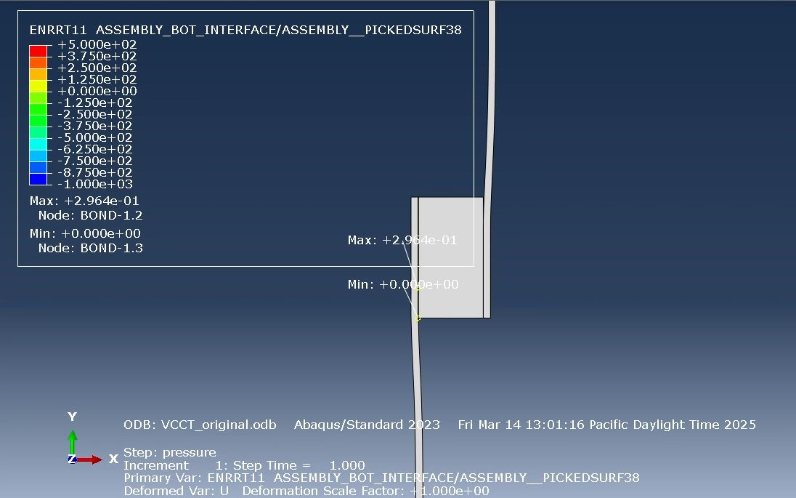
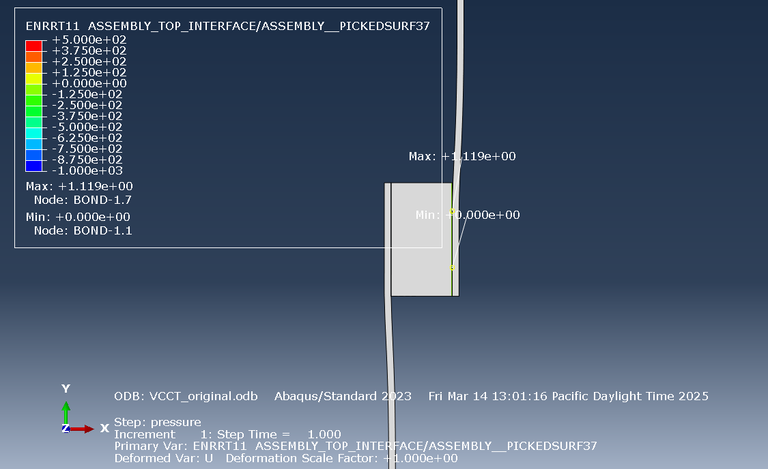
Question 6
NASGRO Approach Geometry
G1 max = 1.119
Definite increase from the thicker geometry tested, but still under the G1c of 2

Slide 20
Question 6
Conclusions
NASGRO approach seems to be a valid starting point for modelling a joint for this specific case
Caveats to FEA results
Unlike the example images shown, I modelled this joint as connection of 2 long pipes, thus there is no top and bottom of the cylinder that would cause additional shear in the joint
This modelling was done since it was assumed that the shear caused by the different expansion of the cylinders would be the main contributor to fracture
Overall recommendation
From rough understanding of fatigue fracture, the more conservative geometry is recommended for this joint
Al thickness = 0.1 in
Overlap = 1 in
Switching to steel should improve fracture toughness, but this decision must be put against other factors for the joint that are not listed in the problem
Weight margins
Costs
Material availability
Fluid to be transported
NASGRO approach does provide a rough starting point for this joint design
However FEA is recommended for proper analysis

Slide 21
AME 585 Fracture Project Individual Draft
1st Lt Kim, Taeklim

Slide 22
Question 1
NASA 5019A
Fracture control standards for human spaceflight; anything human involved comes with more stringent requirements
1st point made regards to fracture, like all other potential failures, is setup of proper issue containment and mitigation plan
NFC parts based on NASA testing; these are parts where other failure modes take them out before fracture
Pressure vessels always fracture critical
General metaling loading FOS
4x service life factor
1.4 FOS on single loading event
NASGRO guidelines
Choose B_{k} as zero or value so that K_{c} at part thickness is less than or equal to K_{1C}
If we need to set B_{k} as something else, further understanding of constraints required
Determining flaw size using process control is unusual, need to be approved by RFCB
flaw size determination is based on 90/95 flaw detection capability
NDE should take the conservative estimates if unclear
Work experience tells me NDE can be often unclear
NASA 5009
All detected cracks, crack-like flaws to be rejected
Accepting these flaws needs to undergo full engineering review
NDE methods must be certified using known flaw specimens
Standard flaw size tables provided based on shuttle test data
Used as minimum detectable flaw siz
Eddy current doesn’t work on composites
Special NDE called when standard methods can’t be applied properly (complex geometry) or critical flaw size is smaller than standard flaw size
PT, RT, ultrasound, and Eddy current for NDE
Special NDE also needs to certify that NDE method used can achieve 90/95 flaw detection capability
2 methods of certifying minimum detectable flaw size
Point estimate
POD

Slide 23
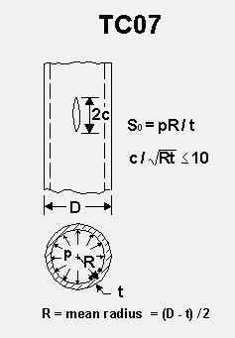
Question 2
NASGRO Setup
Geometry = TC07
Use case: pipe under pressure
Pressure = 5550 psi
Radius = 2 in
Thickness = 0.1 in
Material = Al 2024-T3
FoS = 1.4
Apply to K_{1C}
Objective: find acceptable flaw size
Need to find critical flaw size where failure occurs
NASCCS used for this
Fatigue not considered since we’re not solving for service life in this problem
Al 2024-T3
Fracture toughness (K_{1C}) = 22e3 psi-in^{1/2}
Applying FOS of 1.4 = 15714 psi-in^{1/2}
Yield Strength = 47e3 psi
S₀ = pR/t
(5550*1.95)/0.1
108225 psi
Units
Length as in
Force as Ibs
Pressure as psi
Fracture toughness as psi-in^{1/2}

Slide 24
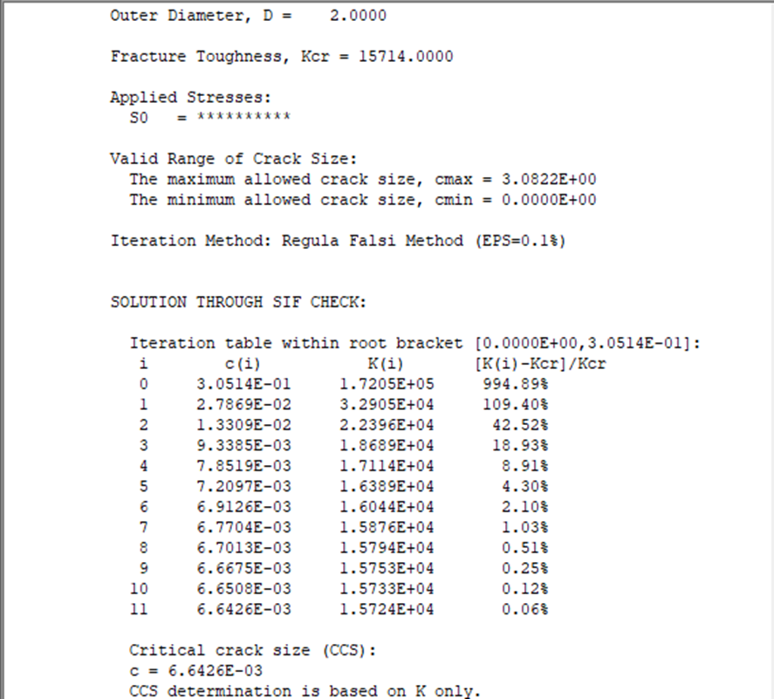
Question 2
Analysis
Overall stress induced on pipe over Al alloy yield stress, failure via yielding expected to occur before fracture
If we are only considering the adjusted fracture toughness, then maximum acceptable flaw size is 6.642 e-3 in * 2 (flaw size is 2c)
0.012 in max flaw size allowed

Slide 25
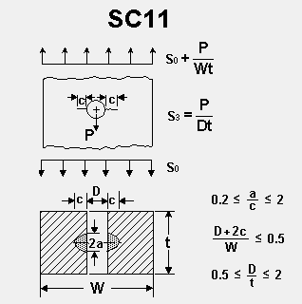
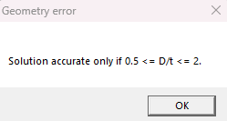
Question 3
Setup
Surface flaw = a/c = 0.5
C = 0.5
Geometry SC11
Plate
Width = 20 in
Thickness = 0.1 in
Hole diameter = 0.5 in
Change diameter to 0.2 in to fit in NASGRO
Hand calcs show smaller hole results in greater stress concentration, smaller hole should work as an enveloping case against larger hole
S₀ = 20ksi = 20e3 psi
S₃ = P/Dt
1000/(0.5*0.1) = 20000 psi
1000/(0.2*0.1) = 50000 psi
Using the adjusted diameter S₃ for conservatism
Material = Al 2024-T3
Fracture toughness (K_{1C}) = 22e3 psi-in^{1/2}
Applying FOS of 1.4 = 15714 psi-in^{1/2}
Yield Strength = 47e3 psi
Hand calculations show that yielding will not occur, but NASGRO limitations would artificially show yielding
Critical flaw size will only be based on fracture toughness due to this
Units
Length as in
Force as Ibs
Pressure as psi
Fracture toughness as psi-in^{1/2}

Slide 26
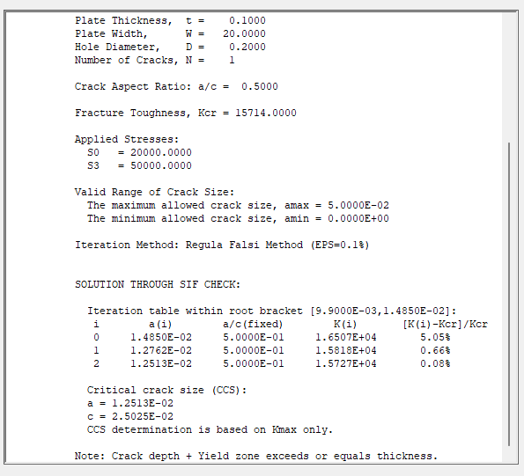
Question 3
Analysis
Geometry changed to fit in NASGRO, following most conservative approach
Hand stress calculation show that original part will not yield during operation
Decreasing diameter is more conservative than increasing thickness in terms of preserving stress
Decreasing the diameter results in artificial yielding in analysis, hence only using fracture toughness and forcing NASGRO to assume no yielding
Current flaw size showing c = 0.5 in
Bigger than critical flaw size for c = 0.025 in
Considering the found flaw size is 20x the critical flaw size, part should be deemed unsafe for flight
Even with the conservative adjustments made to fit in NASGRO, a 20x difference clearly indicates fracture failure occurring

Slide 27
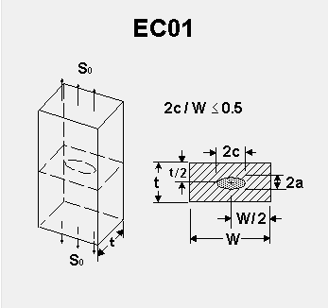
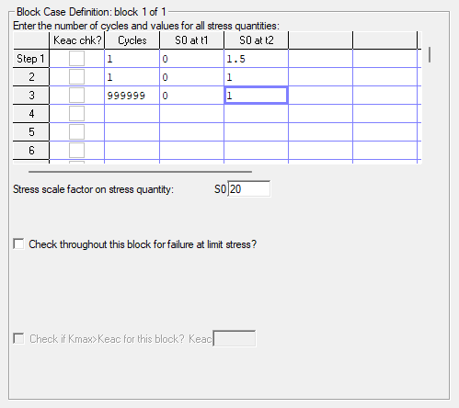
Question 4
Setup
EC01 geometry
Material = AL 7075-T6[12AB1]
NASGRO library contains this material
Flaw size: min detectable flaw size per NASA 5009, RT
Testing
Proof at 1.5 * MEOP = 30 ksi
Leak test at 20 ksi
Assume leak test is done at MEOP
Thickness = 0.1 in
Width not provided
NASA data shows 2c = 0.14 in
NASGRO limitation: 2c/W <= 0.5
W >= 4c
Fatigue fracture gets worse with smaller width
W = 4c = 4*0.14 = 0.56 in
We assume worst case allowed in NASGRO for conservative approach
Cycles
Added arbitrary service cycle to see where fatigue fracture happens
Assumed that valve fails before 10⁶ cycles
Assumed that valve will cycle from ambient to MEOP
This approach should envelop worst case scenario for valve during use

Slide 28
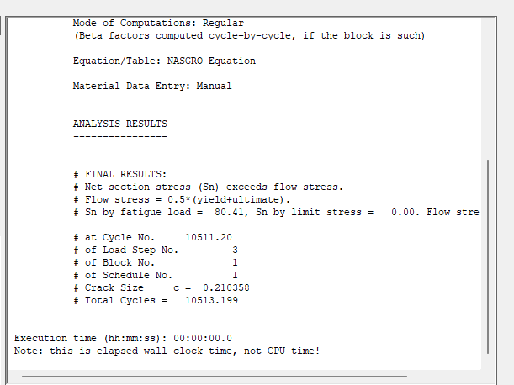
Question 4
Analysis
NASGRO predicts failure during cycle # 10511
Valve service life is at 10000 cycles
This does not consider operating environment, which may negatively impact service life
This does not consider bigger flaw sizes caused in manufacturing/install/handling
FOS considerations
FOS should envelop human error and operating environment
4x life usually recommended for part cycle life
Adjusted valve service life
10000/4 = 2500
Adjusted service life recommendation = 2500 cycles

Slide 29
Question 5
Setup
TC16 geometry
Material = Al 7075-T6[12AB1]
Airplane skin
Flying at 40000 ft, cabin pressurized to 7000 ft
P = 11.34 – 2.72 = 8.62 psi
S₀ = PR/t = (8.62*75)/0.1 = 6.47 ksi
1-bay stiffened
Radius = 75 in
Thickness = 0.15 in
Adjusted to 0.1 in
Stiffener spacing = 24 in
Rivet spacing ratio = 2/24 = 0.0833
Dampening ratio = 0
Biaxial load ratio = 0.5
Requirement
3000 takeoff and landing = 3000 cycles
Assumptions
Stiffener is made of Al 7075-T6 as well
Elastic modulus = 10400 ksi
Units
NASGRO material library uses the following
Ksi for pressure
In for length
Adjustments
NASGRO warns of inaccuracy if thickness above 0.1 in
Thinner wall experiences worse fatigue, should envelop original dimensions

Slide 30
Question 5
Analysis
3000 cycles threw error that target life is too low
Setting more realistic target
Using southwest as example
Assume 3 flights/day, operating 300 days a year on average
Quick search of airliner service life = 30 years
3 flights = 3 cycles
3*300 = 900 cycle/year
900*30 = 27000 cycle/lifetime
27000 cycle results
C = 3.5687 in
Round to 3.56 in
Geometry shows that total crack length is 2c
2*3.56 = 7.12 in
Conclusion
3000 takeoff/landing cycle is way too little considering modern airliners
Using quick estimate using Southwest, critical flaw size for the expected flight cycles (27000 cycles) for of an airliner is 7.12 in
This is a conservative estimate due to reduction of thickness to avoid NASGRO inaccuracies
With crack that big, fatigue fracture should not be the dominant failure mode for the skin
3000 cycle result
27000 cycle result

Slide 31
Question 6
Setup
Assume bond will fail before the metal
We can control bond overlap length and wall thickness
Wall thickness drives bond thickness
Bond thickness = 0.3
Length = overlap length
Thickness= bond thickness
Requirement
System must hold 400 psi internal pressure
Fatigue not considered for problem
Assumptions
Assume radius given is midpoint radius
Bond material property taken from diagram
E = 300 ksi
V = 0.4

Slide 32
Question 6
Analysis
Debonding can be characterized as a crack on the bond ring
Crack is axial, on the edge of the cylinder
Question to ask is, at how much debonding does the bond fail?
This length should represent minimum overlap required, assuming perfect bond
Load on the bond can the characterized into the following
Hoop stress experienced by the bond
Shear experienced due to different hoop stresses between inner and outer cylinders
Peeling stress and axial stress not considered
Test #1
Debonding characterized as surface crack
Based on Al 7075-T6 yield strength, we set cylinder thickness to 0.022 in
Bond thickness = 0.3-0.022 = 0.278 in
Bond outer diameter = 4-(0.5*0.022) = 3.989 in
Bond hoop stress = (400*3.85)/0.278 = 5540 psi
Inner cylinder hoop stress = (400*3.7)/0.022 = 67273 psi
Outer cylinder hoop stress = (400*4)/0.022 = 72728 psi
Shear caused by cylinders = 5455 psi
Fracture toughness = K = sqrt(GE)
Sqrt(2*300e3) = 774.59 psi-in^{1/2}
a/c set to maximum allowed (1.2)
Deeper crack has higher stress concentration, which will drive catastrophic failure faster
Gives me shortest critical flaw size
Default units for NASGRO is Kips, in

Slide 33
Question 6
Test #1
Using SC04 to map bond geometry, external flaw
Based on geometry, we can take the axial length of the critical crack size to be 2c = 2*5.294e-3 = 0.01 in
Current understanding is that this would be the minimum overlap required to avoid failure
Decreasing thickness of bond decreases bond’s ability to withstand fracture
Careful balance required for Aluminum thickness
Test Result Considerations
What critical flaw size do we say that the flaw is undetectable?
Crack is on the edge of bond, hidden inside outer cylinder
Most realistic NDE approach is RT or ultrasound
Assuming we can have the same fidelity for ultrasound as the standard NDE level as shown in NASA-STD-5009
a = 0.030 in
a/c = 0.2
Use these as minimum detectable flaw size
I assumed that the standard would hold for our case due to how thin the cylinders are, and with proper test setup can achieve the same fidelity as the standard written in early 2000s
Different approach is needed
Try modeling bond as a plate with surface crack or through crack
Plate can then be set with a width to specify the overlap length
Modelled using SC02 and TC12 for each cases

Slide 34
Question 6
Test #2
Using SC02 for critical flaw size
Al thickness = 0.03 in
Slight increase to ensure both cylinders stay in elastic region with some margin
Bond thickness = 0.27 in
a/c = 0.2; keep with NASA STD being referenced
Width: overlap length, variable we change to see what happens
See image to shear modelling
S0 represents hoop stress on the bond
S1 represents shear stress caused by cylinders
Bond hoop stress = (400*3.85)/0.27 = 5704 psi
Inner cylinder hoop stress = (400*3.7)/0.03 = 49334 psi
Outer cylinder hoop stress = (400*4)/0.03 = 53334 psi
Shear caused by cylinders = 4000 psi
Fracture toughness = K = sqrt(GE)
Sqrt(2*300e3) = 774.59 psi-in^{1/2}

Slide 35
Question 6
Test 2 Results
We need to find a setup where the critical flaw size is greater than what’s detectable by NASA STD NDE ultrasound
a = 0.03 in = 3 e-2 in
a/c = 0.2
Keeping the a/c the same as the Standard, we approach the minimum detectable flaw size when the width = 0.5 in
Alternative modelling using TC12 also shows that critical flaw size stays above detection range
Through crack case examined to see if the bond itself would fail instead of delamination
Aluminum Recommendation
Al thickness = 0.03 in
Overlap length = 0.5 in
Further optimization may be possible, but at current level of analysis is deemed impractical
This will be the basis for the Abaqus setup
SC02 result (a = 3.15e-2)
TC12 result (c = 3.45e-2)

Slide 36
Question 6
Abaqus Setup
For the length and height of the model, we use the same one given in the image
Changes
Given the problem statement calls for a joint, I do not make this into a cylinder
Assuming infinite length for the purposes of the FEA
We add a level of conservatism since NASGRO has its limitations
Overlap length double to 1 in
Al thickness increased to 0.1 in
Overlap length and thicknesses will be dimensioned for quick testing of multiple constructions
Recall we defined the given radius as midpoint radius
Units
Length as in
Force as Ibs
Material Properties
Aluminum
E = 10400 ksi = 10400e3 psi
V = 0.33
Bond
E = 300e3 ksi = 300e6 psi
V = 0.4
Differences between video and problem
We don’t worry about debonding since we’re just asked to design something to survive 400 psi internal pressure
Notes regarding building model
Using sketch to partition is much faster and less clunky than datum planes

Slide 37
Question 6
Test #1 results
Stress concentration at the bond edge captured
Without debonding, Abaqus was reporting an ENRPT values of 0 across the board
Added the following debond to capture energy release rate
0.25 in debond from the top and the bottom, respectively
Test #1-debond results
ENRRT max detected around the end of the debond as expected

Slide 38
Question 6

Slide 39
Question 6
Analysis
G1 values for our debonded case are staying well below the bond limits
G1c = 2
As shown in the max value pointed in abaqus, the max G1 noticed is 2.798 e-1 on the outer layer
This shows that our current configuration will work under 400 psi internal pressure, even with internal pressure
Additional cases to consider
Original geometry found using NASGRO
Replace material with steel
Original Geometry case
Al thickness = 0.03 in
Overlap = 0.5 in
For debond purposes, take off ¼ of the overlap on top and bottom respectively
Steel case
Steel material properties
E = 30 Msi = 30e6 psi
V = 0.3

Slide 40
Question 6
Change Material to Steel
G1 max = 8.859e-2
G1 max decreased from the identical setup using Aluminum
Stiffer material decreased the strain of the cylinders, putting less stresses on the bond

Slide 41
Question 6
NASGRO Approach Geometry
G1 max = 1.119
Definite increase from the thicker geometry tested, but still under the G1c of 2

Slide 42
Question 6
Conclusions
NASGRO approach seems to be a valid starting point for modelling a joint for this specific case
Caveats to FEA results
Unlike the example images shown, I modelled this joint as connection of 2 long pipes, thus there is no top and bottom of the cylinder that would cause additional shear in the joint
This modelling was done since it was assumed that the shear caused by the different expansion of the cylinders would be the main contributor to fracture
Overall recommendation
From rough understanding of fatigue fracture, the more conservative geometry is recommended for this joint
Al thickness = 0.1 in
Overlap = 1 in
Switching to steel should improve fracture toughness, but this decision must be put against other factors for the joint that are not listed in the problem
Weight margins
Costs
Material availability
Fluid to be transported
NASGRO approach does provide a rough starting point for this joint design
However FEA is recommended for proper analysis

Slide 43
AME 585 Project 7
Samy Ousman

Slide 44
Question 1
NASA 5019A
Develop a Comprehensive Fracture Control Plan (FCP): Establishing and maintaining an FCP is crucial for human-rated spaceflight hardware to mitigate catastrophic failure risks due to flaws.
Classify Hardware Components Accurately: All parts should be evaluated and categorized as exempt, non-fracture critical (NFC), or fracture critical to determine appropriate control measures.
Implement Rigorous Verification Processes: Verification of fracture control requirements ensures that hardware meets safety and reliability standards.
Utilize Established Approaches for Specific Hardware Types: Applying proven methods for different hardware categories enhances reliability and safety.
Document Alternative Approaches Thoroughly: When deviating from standard practices, comprehensive documentation and approval are essential to maintain safety standards.
Ensure Material Traceability: Maintaining traceability of materials used in fracture-critical components is vital for quality assurance and safety.
Perform Detailed Failure Mode Evaluations: Identifying and assessing potential failure modes in hardware components help in implementing effective fracture control measures.
Apply Conservative Design Margins: Incorporating conservative design margins in fracture-critical components enhances safety and reliability.
Conduct Regular Training for Personnel: Ensuring that personnel involved in fracture control are adequately trained contributes to the effectiveness of the program.
Engage in Continuous Improvement: Regularly updating fracture control practices based on new findings and technological advancements fosters ongoing enhancement of safety measures.
NASA 5009
Establish Clear NDE Requirements: Defining specific NDE requirements for fracture-critical components ensures consistent application across programs.
Qualify NDE Procedures Rigorously: Qualification of NDE procedures is essential to validate their effectiveness in detecting critical flaws.
Determine Minimum Detectable Flaw Sizes: Establishing the smallest flaw size that NDE methods can reliably detect is crucial for accurate fracture analysis.
Apply Standard NDE Methods When Appropriate: Utilizing standard NDE methods with known capabilities simplifies the inspection process and ensures reliability.
Implement Special NDE for Complex Cases: For unique or complex components, special NDE procedures may be necessary to achieve the required detection capabilities.
Maintain Inspector Proficiency: Regular training and certification of NDE inspectors are vital to maintain high detection reliability.
Document NDE Results Systematically: Thorough documentation of NDE findings supports traceability and aids in the assessment of component integrity.
Integrate NDE into the Design Process: Incorporating NDE considerations early in the design phase facilitates the development of inspectable and reliable components.
Utilize Probability of Detection (POD) Curves: Employing POD curves helps in understanding the effectiveness of NDE methods and informs risk assessments.
Engage in Continuous NDE Technology Assessment: Regularly evaluating and adopting advancements in NDE technologies ensures the effectiveness of inspection processes.

Slide 45
Question 2
Input
R = 2”; D = 4”
t = 0.1”
K_{IC} = 22000 (Al 2024-T3)
FS = 1.4
K_{IC} = 22000/1.4 = 15714
P = 5500 psi
σ_{hoop} = PR/t = 110,000 psi
Results
Crack = 2c = 0.0133”

Slide 46
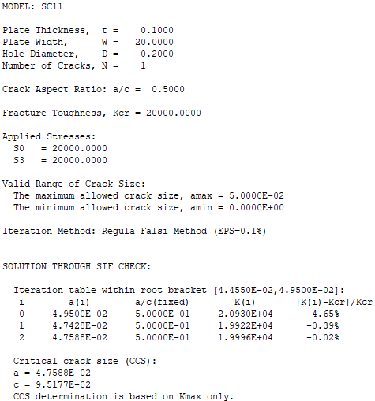
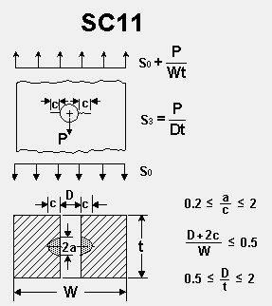
Question 3
NDE
a/c = 0.5 (c = 0.5”)
a = 0.25” acceptable?
Input
t = 0.1”
w = 20”
D = .2” (0.5 < D/t <2)
a/c = 0.5
K_{IC} = 22000 (Al 2024-T3)
P = 5500 psi
S0 = 20 ksi
P = 1000 lb
S3 = P/Dt = 20 ksi
Results
Critical Crack Size = c = 0.1” > 0.5”
Unsafe for flight conditions

Slide 47
Question 4
Input
t = 0.1”
w = 0.56” (based on 2c/W < 0.5 calc)
Radiography NDE (X-ray 5009)
Proof factor = 1.5
K_{IC} = 25000 (Al 7075-T6)
S0 = 20 ksi
Results
Operating Cycles Capability = 10511 cycles

Slide 48
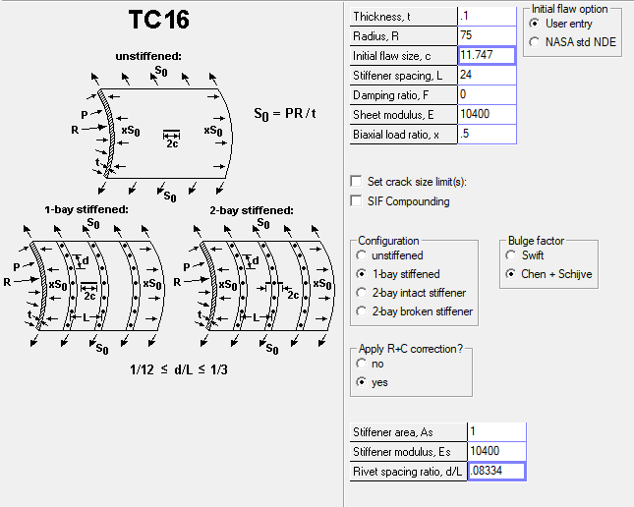
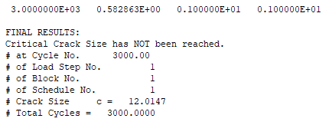
Question 5
Input
S0 = PR/t = (8.62*75)/.1 = 6.47 ksi
K_{IC} = 25000 (Al 7075-T6)
E = 10400 ksi
Results
Critical Crack Size = 2c = 24.03” (anything above this value will decrease capability below 300 cycles)

Slide 49
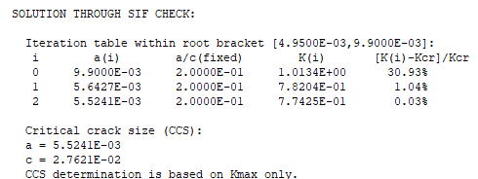
Question 6
From NASGRO
t = 0.27”

Slide 50
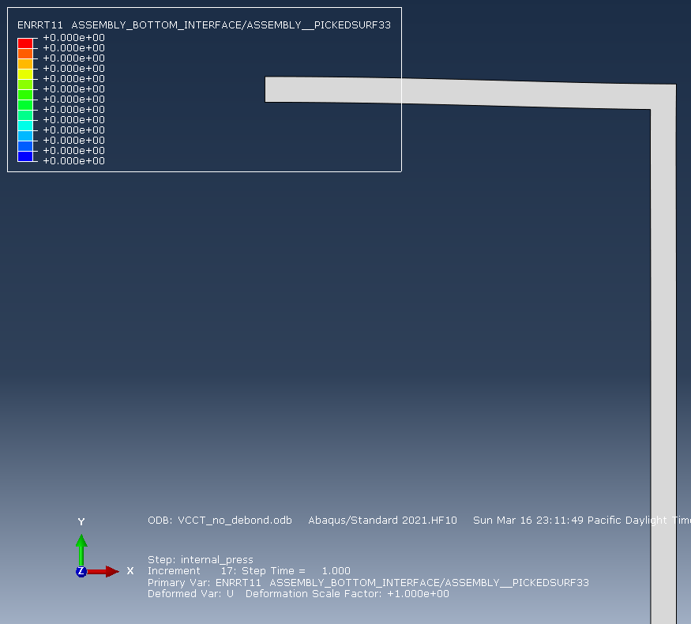
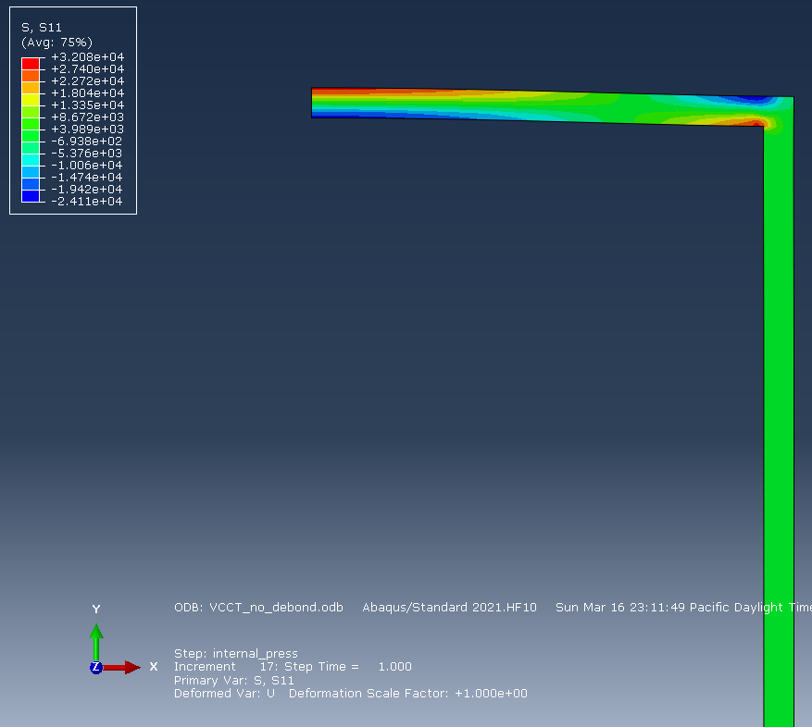
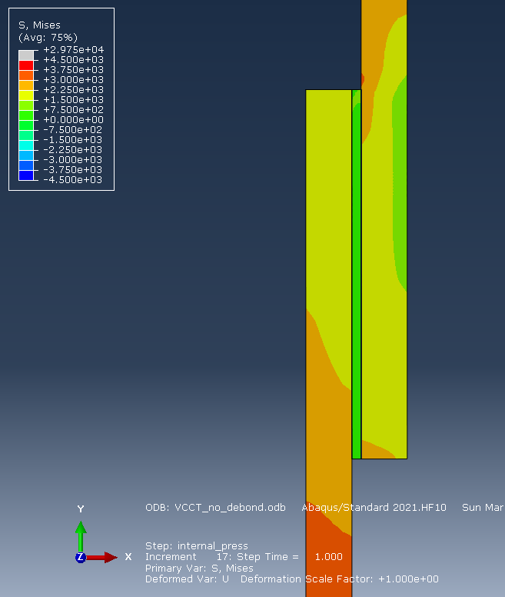
Question 6: Aluminum 7075-T6
Results (No Bonding)
Stress = 32.1 ksi
ENPRT = 0

Slide 51
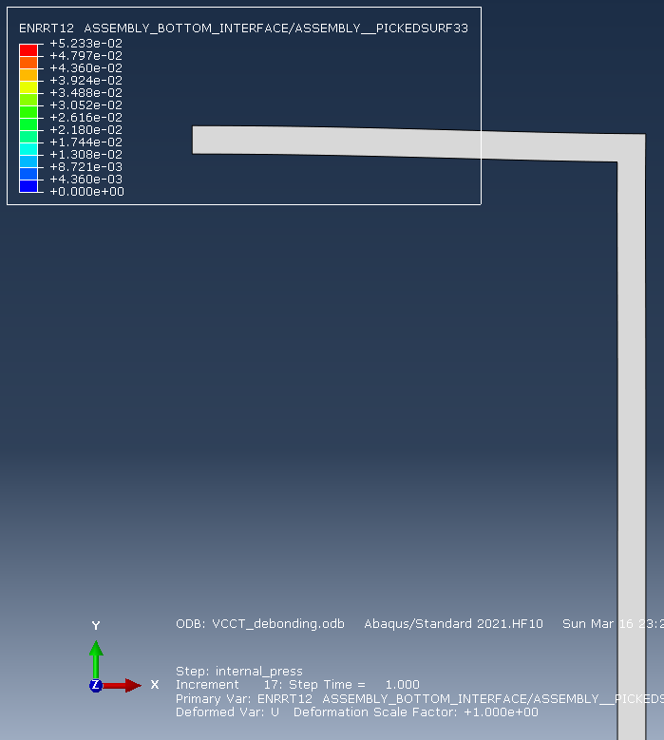
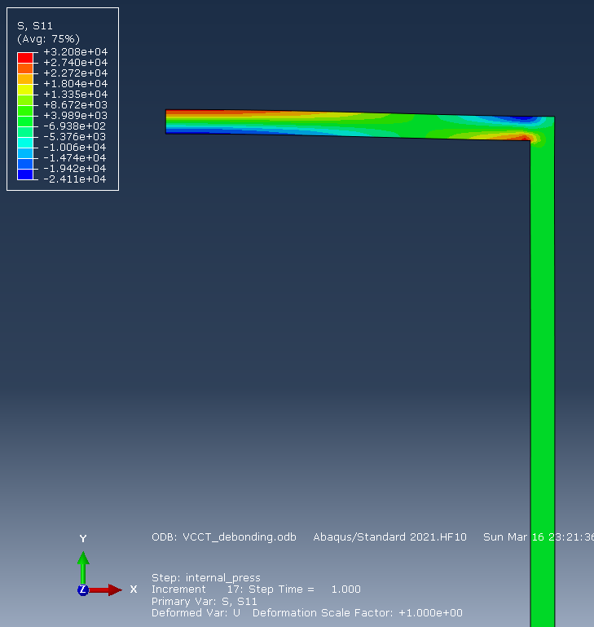
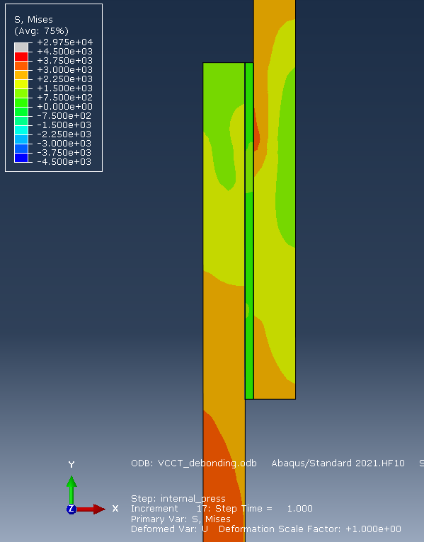
Question 6: Aluminum 7075-T6
Results (Debond)
Stress = 32.1 ksi
ENPRT = 5.23E-2

Slide 52
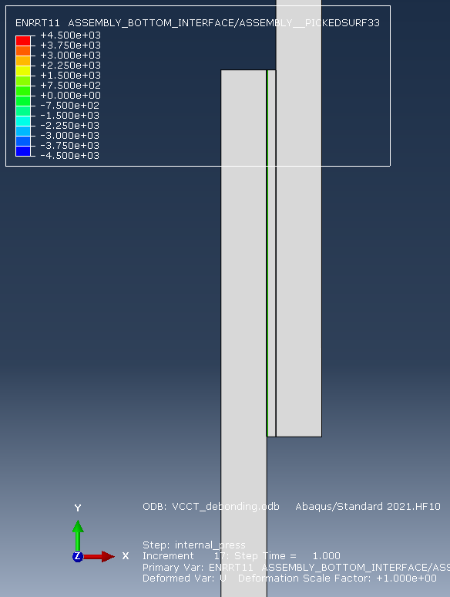

Question 6: Steel
Results (Debond)
Stress = 29.8 ksi
ENPRT = 4.5E3

Slide 53
AME 585
Project 7
Henry Glover
3/14/2025

Slide 54
#1
NASA 5019
A fracture control plan needs to be developed and maintained for human rated spaceflight hardware that
Addresses hazard, the parts in the program-specific flight hardware
Meets the requirements of the NASA technical slandered
Specifics fracture controls to mitigate risk of catastrophic failure
Has approval by the RFCB
If part failure does not result in a credible catastrophic hazard, then it is classified as non-fracture critical
For pressurized components perform proof tests to a minimum of 1.5 times the MDP during individual acceptance
For rotating hardware, it is proofed by a spin test to a minimum rotational energy factor of 1.05
A loading spectra is needed for the damager tolerance life analysis
Assume that initial flaw in a part is the size and shape that is not screened by NDE, proof test, or process control and it is in the worst location and orientation
If fatigue crack growth is minimal or the service life is a single event, the analysis must ensure a factor of safety of 1.4 on the critical stress intensity factor
Develop an impact damage mitigation plan to define, document, implement, and prescribe impact protection and detection strategies for flight hardware to mitigate identified damage threats
For proof testing composite or bonded hardware a flight article needs to be 1.2 times the limit load under the appropriate environment conditions or by adjusting the test loads using coupon or hardware element tests verified ECF
All parts go through a fracture control classification process for all mission phases to determine which parts are fracture critical. Parts are classified as:
Exempt
NFC – Not fracture critical
Fracture critical

Slide 55
#1 Cont.
NASA 5009
NDE inspection is conducted by certified inspectors who have a clear criteria defined for each type of part and NDE methods need to be selected for the entirety of the component's life cycles including – manufacturing, transportation, maintance, and operations
All detected crack or crack-like flaws can be cause for rejection
NDE inspection zones need to be clearly identified in drawings and subsequently updated
NDE capability demonstration specimens must be used to assess detection capability for Special NDE applications, represent the inspected material and flaw characteristics, and be documented in NDE procedures and personnel qualifications, with specimens sourced or created as needed
Nondestructive inspections of fracture-critical hardware must detect initial crack sizes from damage tolerance analyses with 90% probability at 95% confidence
Liquid penetrant testing (fluorescent penetrant), eddy current, magnetic particle inspections, UT, RT, and other NDE need to be in accordance with the standard practices and specification sheets (ASTM, SAE, etc.)
All deviations from the standard NDE need to be approved by the qualified and approved NDE engineering organization, the RFCB, and the Technical Authority
Special NDE is require with approval when the damage tolerance analysis requires smaller flaw sizes than those given for standard NDE
The Point Estimate Method assumes flaw detection capability increases with flaw size near the test flaw and requires few flaws, making the minimum detectable flaw size potentially non-determinant
NDE needs a summary report with the supporting data

Slide 56


#2
NASGRO
Geometry = TC07
Radius = 2 in
Diameter = 2 x R = 4
Thickness = 0.1 in
Material = Aluminum 2024-T3
Fracture Toughness = $22×{10}^{3} psi−{in}^{1/2}$
Yield strength = $47×{10}^{3} psi−{in}^{1/2}$
Through crack in a pipe
Crack propagation analysis
NASCCS
Pressure = 5,550 psi
Incorporate F.S. = 1.4
K_{IC} / 1.4
15714 $psi−{in}^{1/2}$
$R=\frac{D−t}{2}$ = 1.95
$S_{0}=\frac{pR}{t}=$ 108225 psi
Is the acceptable flaw size inspectable by dye penetrant?
Need to find critical crack size
Aluminum Properties - https://www.makeitfrom.com/material-properties/2024-T3-Aluminum

Slide 57


#2 Cont..
Results
Max acceptable flaw size = $6.6667×{10}^{−3} in$
0.0067
2C = 0.0134 in
This was calculated using an outer diameter of 4 in.

Slide 58
Question 3
NASGRO
Surface flaw = a/c = 0.5
$S_{0}=20 ksi=20×{10}^{3} psi$
Geometry = SC11
Width = 20 in
Thickness = 0.1 in
Diameter = 0.5
Error occurred so changed diameter to 0.2
This is a conservative number, lets see what happens
Bearing load = 1000 lbs.
$\frac{p}{D×t}$ = 50000 psi
Material = Aluminum 2024-T3
Fracture Toughness = $22×{10}^{3} psi−{in}^{1/2}$
Yield strength = $47×{10}^{3} psi−{in}^{1/2}$
Incorporate F.S. = 1.4
K_{IC} / 1.4
15714 $psi−{in}^{1/2}$

Slide 59
Question 3 (cont)
Results
The current flaw size in the problem is c = 0.5 in
Is the flaw safe for flying?
No
Critical flaw size is 0.025
The found flaw size is much larger than the critical crack size
No difference in using only fracture toughness and assuming no yielding

Slide 60




#4
AL 7075-T6 [12AB1]
Thickness = 0.1 in
Width
2c/W <= 0.5
c = 0.07
2c = 0.14
W >= 4c
W = 0.56
Pressure = 20 Ksi
Use X-ray 5009 flaw size
Assumptions
EC01 is the right geometry
Proof factor = 1.5
30 Ksi
Proof test completed once
Leak test at 20 Ksi
Cycles set to infinity to see when the valve will fail

Slide 61

#4 Cont.
Results
Failure at cycle 10511
Based on FOS of 4x, valve service life should be at 2500 cycles
This doesn’t not account for temperature fluctuations, manufacturing variability, handling, or environmental loads on the valve

Slide 62

#5
TC16
Assumptions
Flying at = 40,000 ft
Cabin pressure = 7,000 ft
P = 11.34 - 2.72 = 8.62 psi
S₀ = PR/t = 6.47
Al 7075-T6[12AB1]
E = 10400
1-bay stiffened
Area =1 in²
Rivet every 2 in
Length between stiffeners = 24 in
Radius = 75 in
Thickness = 0.15
NASGRO adjusted to 0.1 thickness
Biaxial load ratio = 0.5
Dampening ratio = 0

Slide 63

#5 Cont.
Results
Iterate crack size, until a finite life solution
3.35 crack size
2 x 3.35 = 6.7 in
Conservative estimate of 6.7 in of a critical crack size

Slide 64

#6
Tubular joint under pressure
Fracture toughness = 2 lb/in
Aluminum 7075
Cannot rupture at an internal pressure of 400 Psi
Bond thickness = 0.27
Bond hoop stress = (400*3.85)/0.27 = 5704 psi​
Inner cylinder hoop stress = (400*3.7)/0.03 = 49334 psi​
Outer cylinder hoop stress = (400*4)/0.03 = 53334 psi​
Shear caused by cylinders = 4000 psi​
Fracture toughness = K = sqrt(GE)​
Sqrt(2*300e3) = 774.59 psi-in1/2​

Slide 65

#6 Cont.
Results using SC02
a = 3.8157e-3

Slide 66


#6 Cont.
Abaqus setup
Joint thickness = 0.25
Upper and lower bounds were kept the same from the video
Partitions were created to discretize mesh

Slide 67


#6 Cont.
Mesh was changed to structures
Mesh seeds were set

Slide 68


#6 Cont.
Load of 250 Psi was placed
Mesh for the joint was set

Slide 69


#6 Cont.
Result with no debonding showed 0 ENRPT11
Deformation was located on the y-constraint

Slide 70


#6 Cont.
To add debonding, the structure was altered

Slide 71


#6 Cont.
Aluminum structure with debonding

Slide 72


#6 Cont.
Steel structure with debonding

