Slide 1

CE 502 - Construction Accounting, Fiance and Strategy
Professor Ed Reynolds
Presented by Team 2: Shahrzad Ghorbannia, Henry Glover, Gabriel Garfias, Eli Naderikooshesh, Sihan Chen

Slide 2
Company Overview
By Shahrzad

Slide 3
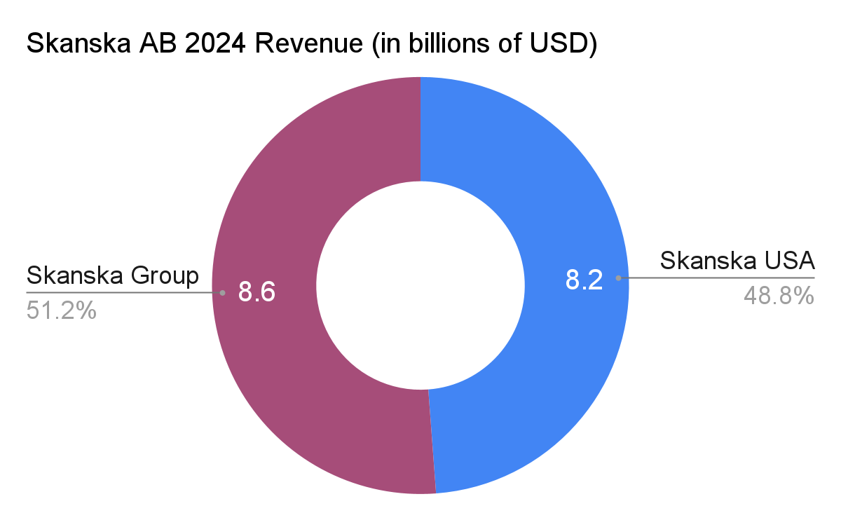
Company Overview
Parent company: Skanska AB (Sweden)
U.S. operations: Skanska USA
Workforce: 6,300+ employees in U.S. (Global total ~26,300)

Slide 4
Company Overview - 4 USA Substantial Company
Skanska AB
Skanska Financial Services AB
Skanska Kraft AB
Skanska USA
Skanska USA Building Inc
Skanska USA Civil Inc
Skanska USA Commercial Development Inc
Skanska Infrastructure Development Inc
Notes:
Skanska Kraft AB’s focus is corporate ownership/structure—not operations. It’s a holding company used to own and manage Skanska Group subsidiaries, which helps with things like legal structure, financing/dividends, and governance across different countries/business units
shares-and-participations-in-subsidiaries-2022.pdf

Slide 5
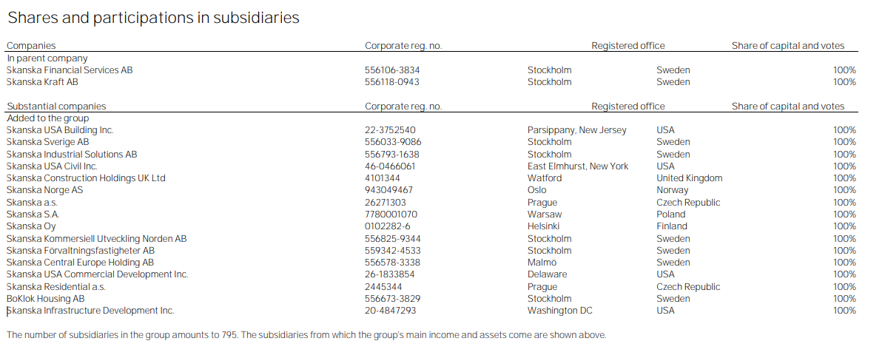
Total Subsidiaries - 16 Substantial Companies - 795 Subsidiaries
Notes:
shares-and-participations-in-subsidiaries-2022.pdf

Slide 6
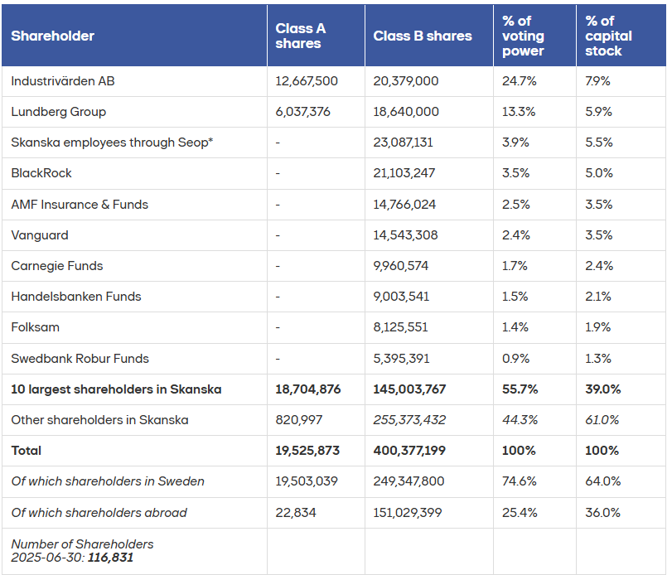
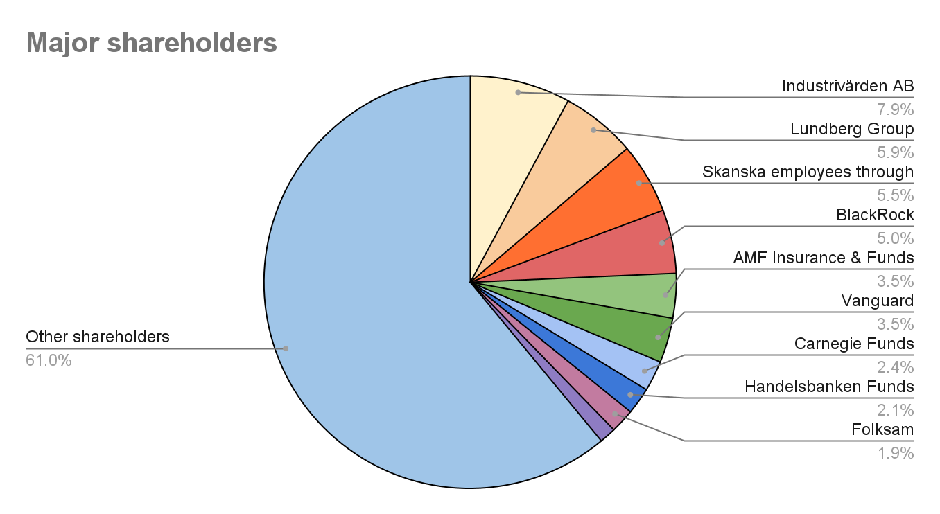
Skanska’s Shareholder Split
Notes:
Industrivärden (Industrivärden AB) - A Swedish holding company that practices “active ownership”—it invests long-term and influences strategy and governance in its portfolio companies (board work, ownership agenda, setting expectations, etc.)
Lundbergs = L E Lundbergföretagen AB, a Swedish investment and real-estate holding company that owns stakes in several large Nordic companies (including Skanska)
Source: Monitor by Modular Finance AB. Compiled and processed data from various sources, including Euroclear, Morningstar and the Swedish Financial Supervisory Authority
* Skanska employer ownership program is a stock purchase program within Skanska. This should not be treated as a unified ownership group. It includes matching and performance shares to be delivered to the participants in the future.

Slide 7
Analyzing the External Environment
By Henry

Slide 8
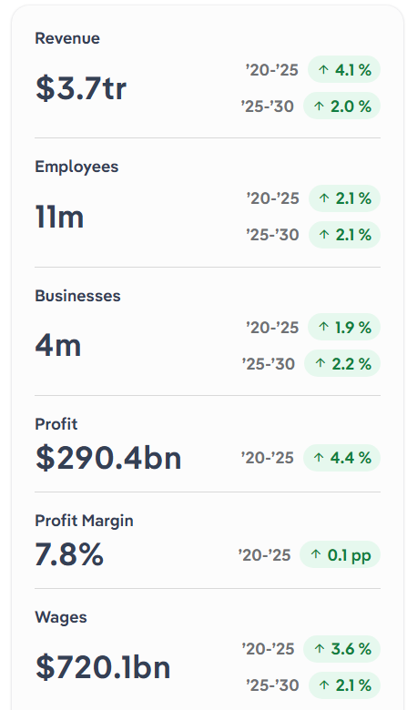
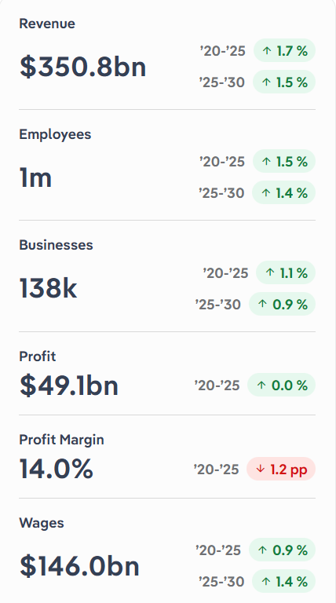
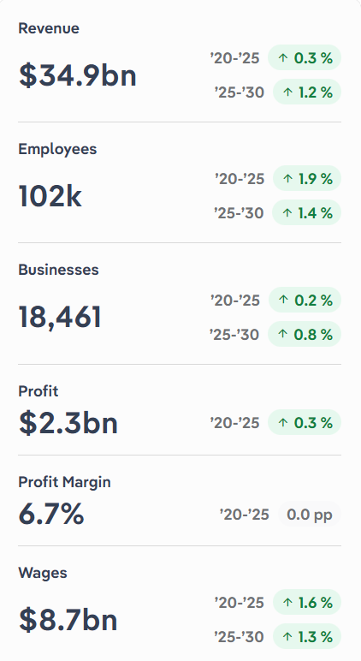
U.S. Analysis
U.S. Construction
U.S. Engineering Services
U.S. Heavy Construction
Key Takeaways on Performance
Office construction collapse + residential swings reshape the market
Material inflation + interest-rate volatility dominate industry performance
Federal infrastructure funding is a primary driver (IIJA, IRA, CHIPS).
Volatile material costs + skilled-labor shortages pressure profitability.
Technology integration (BIM, 3D printing, cloud) boosts efficiency.
Government funding + interest-rate cycles create revenue volatility.
Notes:
1- Remote work caused a long-term crash in demand for office buildings (vacancies at 17.6%, office construction down 66% vs. 2020).
COVID-era low rates created a temporary boom in residential construction, but high mortgage rates later suppressed activity.
2-Construction material prices surged 51% (2020–22)
Interest rate hikes sharply reduced construction investment, particularly residential, but expected 2025 cuts may revive spending.
3- The IIJA, IRA, and CHIPS Acts supply massive public funding (⅔ of revenue), driving demand for rail, ports, tunnels, transit, and green infrastructure.
The 2025 federal pause on certain IRA/IIJA climate-related funds introduces major uncertainty for contractors.
4- Wild swings in materials prices (oil, steel, concrete) and supply-chain disruptions cut into profit margins until stabilizing in 2023–25.
Federally funded projects require specialized workers, intensifying labor shortages and pushing wages upward.
5- BIM, LiDAR, and cloud tools reduce errors, accelerate timelines, and improve coordination across engineering teams.
Prefabrication and 3D printing reduce waste, cut costs, and enable faster design + construction cycles.
6- Engineering services benefited heavily from IIJA, IRA, and CHIPS funding (34% of revenue from government contracts).
High 2022–23 interest rates reduced project spending, but falling rates in 2024 triggered a 5.3% revenue rebound and renewed demand heading into 2025.

Slide 9
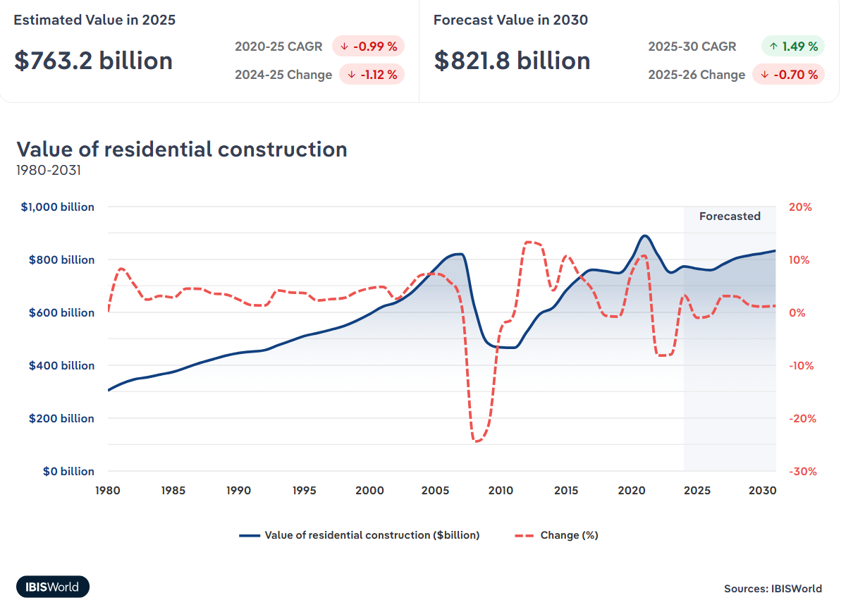
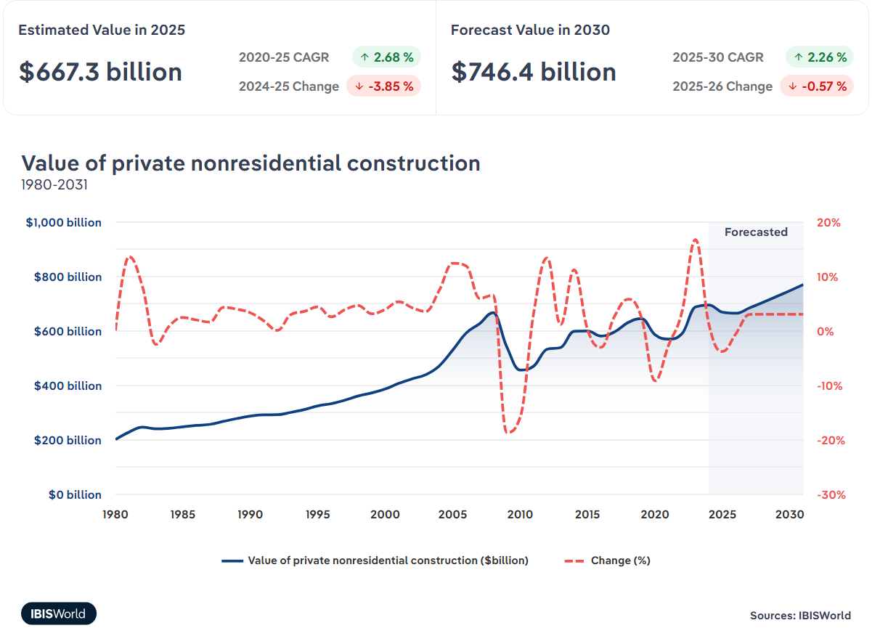
U.S. Analysis
Construction is cyclical, responds strongly to economy (2008, Covid, Inflation).
2022-2024 inflation + high interest rates
Residential sensitive to mortgage rates, nonresidential is driven by investment, federal activity, commercial real estate
Modest forecasted growth through 2030 suggests market stability

Slide 10
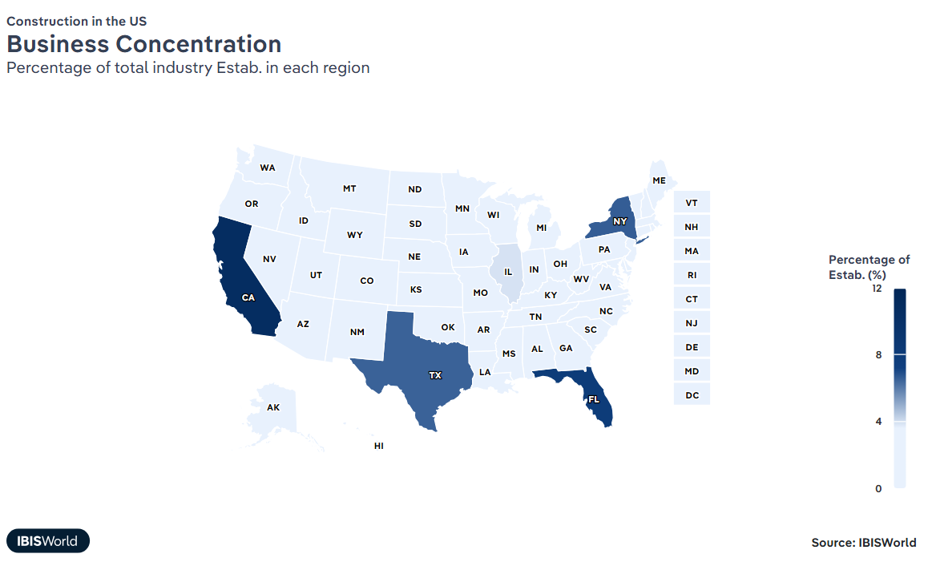
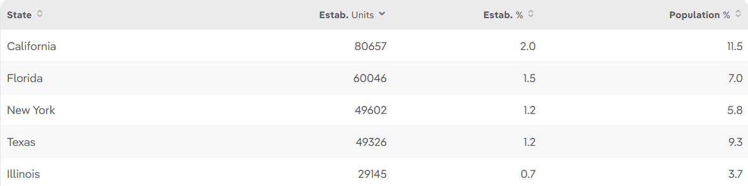
U.S. Analysis - Where is the action?
Notes:
Term
Meaning
Established Units
The raw number of businesses in that state
Established %
The state’s share of all U.S. businesses in that industry

Slide 11
U.S. Economic Characteristics
Construction in the U.S.
Even the largest contractors hold small national market shares due to the industry’s size.
Most construction firms operate regionally, limiting national dominance.
Geographic expansion is difficult because of logistical and operational challenges.
Heavy Engineering Construction
Large firms secure most government contracts and grants, sidelining smaller companies.
Big contractors rely on subcontractors to cover regional needs and maintain efficiency.
Major firms gain market share by expanding across multiple regions, often through acquisitions.
Major private-sector bids depend heavily on reputation and past performance.
Engineering Services
High start-up barriers: expensive entry, complex regulations, and heavy compliance requirements.
Strong competition for specialized engineering talent, making differentiation difficult.
Firms must stand out through expertise, innovation, and strong branding to compete with established players.
Crowded market makes it hard for new entrants to gain loyal clients without proven capabilities.

Slide 12
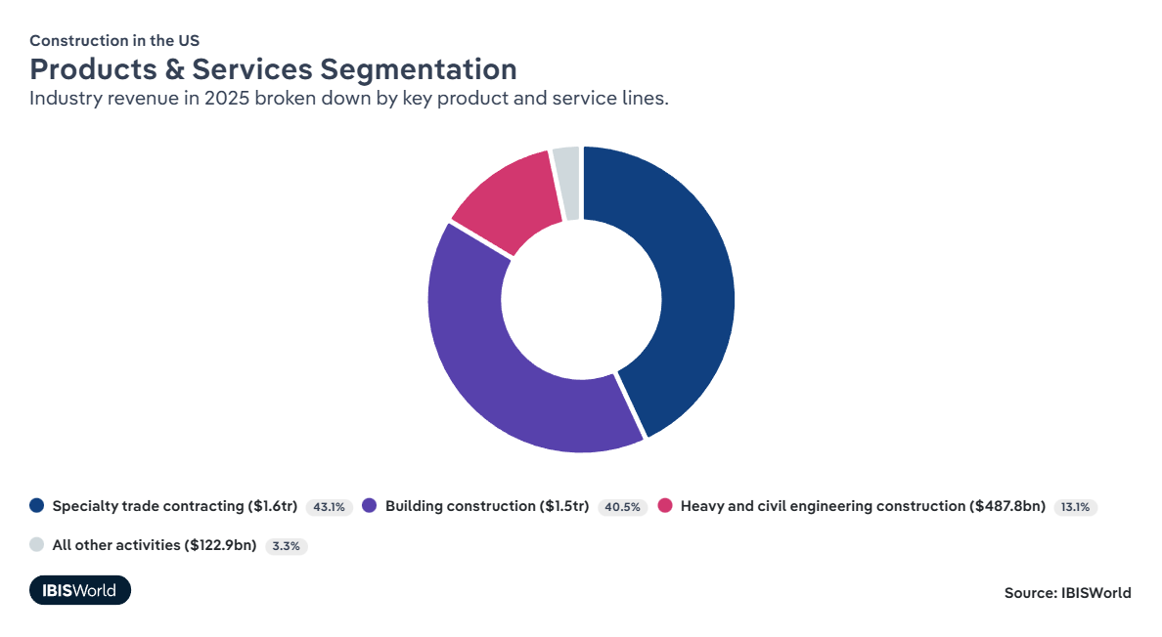
U.S. Analysis - Markets
Notes:
businesses that focus on one specific trade or specialized part of a construction project—rather than building entire structures.

Slide 13
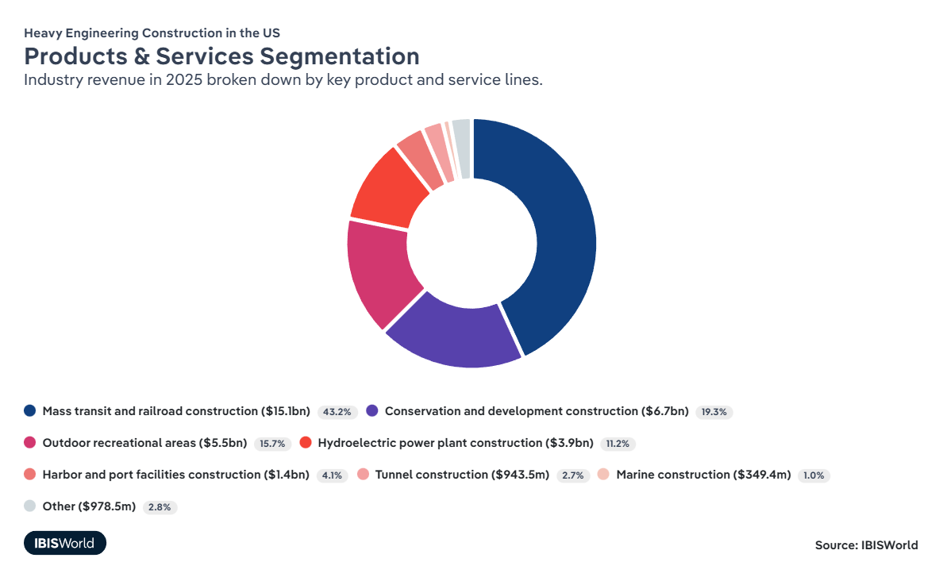
U.S. Analysis - Markets
Notes:
large-scale projects that protect, restore, or manage land, water, and natural resources.

Slide 14
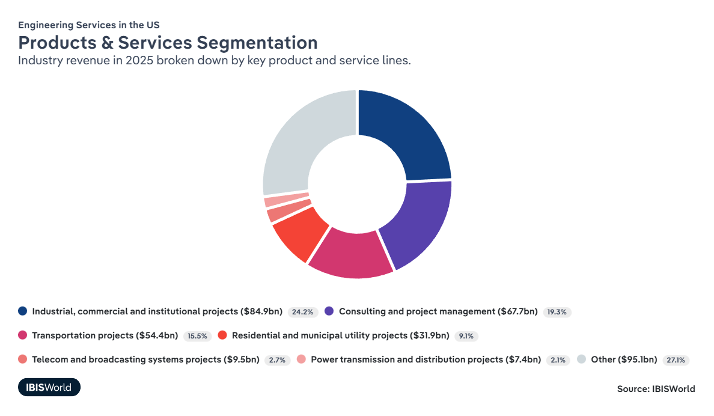
U.S. Analysis - Markets

Slide 15
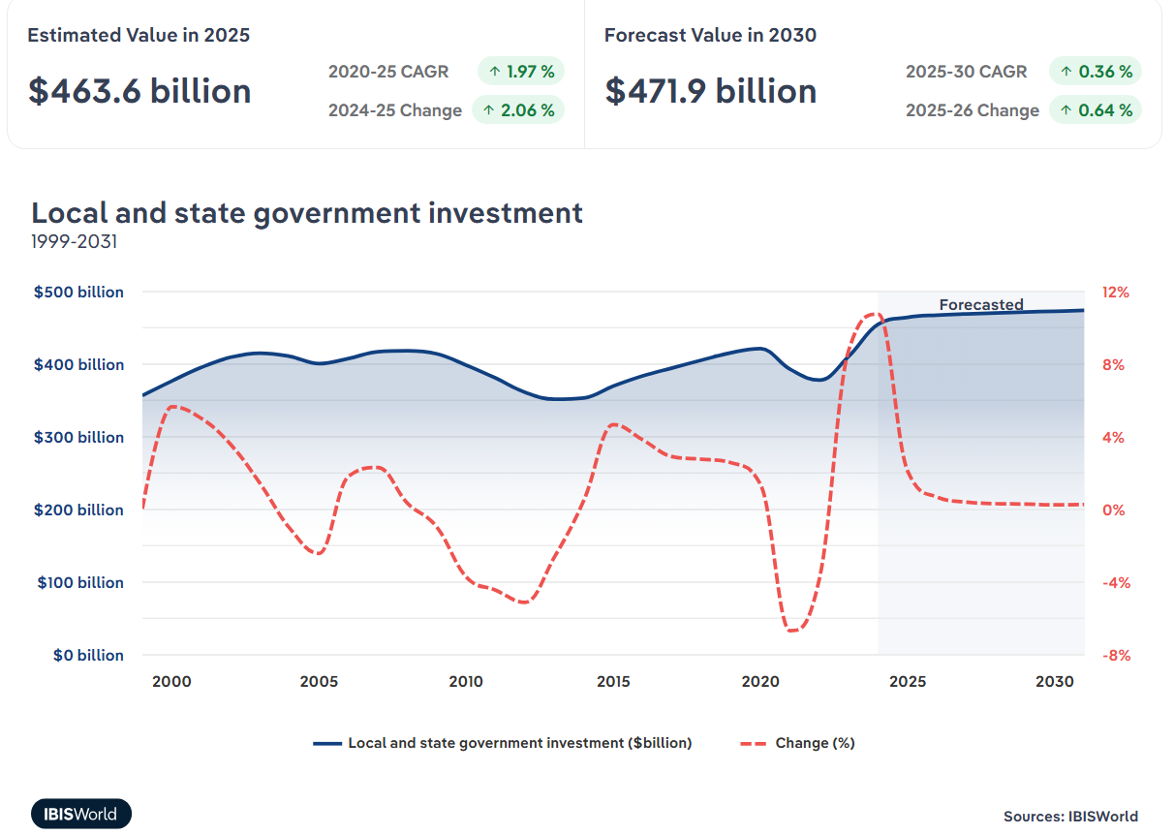
U.S. Driving Forces
Trump administration's policies have and will impact the construction sector.
→ Potential deportations and tariffs would increase labor and materials costs, respectively.
Cost of construction material has risen due to supply chain issues, Industry operating environment has become more uncertain.

Slide 16
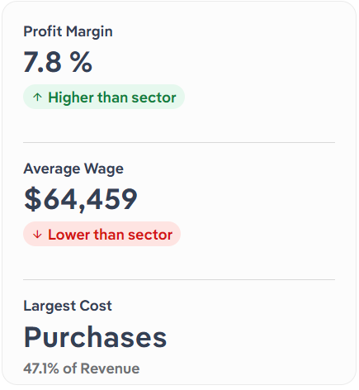
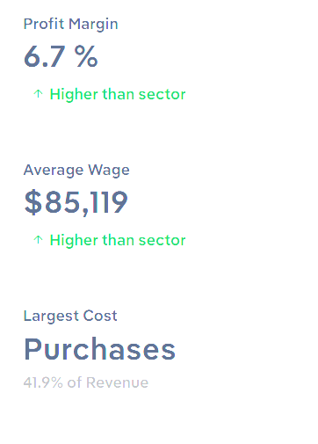
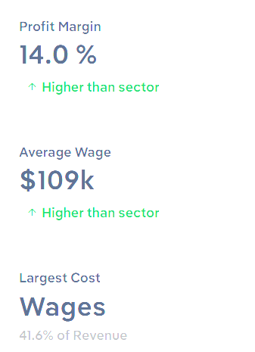
U.S. Driving Forces - Financial
→ Overall construction market - Most of sectors cost are the costs of the subs.
Heavy engineering construction
Input cost inflation squeezed margins: High steel and oil prices raised project costs and reduced profit levels.
Recent easing of material costs has helped stabilize profitability.
Rising wage pressure due to demand for highly skilled, specialized labor.
To control labor costs, many firms increasingly rely on subcontractors who offer more flexible and affordable labor options.
Engineering services
Intense competition for top engineering talent drives wages upward, raising labor expenses across the sector.
Firms must offer premium compensation packages to attract and retain skilled engineers.
Digital transformation boosts profitability: Investments in BIM, cloud collaboration, and automation increase efficiency and reduce rework.
Operational efficiencies from technology (automation, data tools) improve margins despite upfront costs.

Slide 17
U.S. Driving Forces
Construction in the U.S.
Highly regulated sector with rules varying by state, local, and federal levels.
COVID-19 increased industry volatility, disrupting demand and supply chains.
PPP loans and government relief programs provided temporary financial support during the pandemic.
Local permitting, zoning, and environmental regulations create complex compliance requirements.
Heavy engineering Construction
Strongly influenced by federal spending, especially the IIJA and IRA.
2025 political shifts (Trump administration) introduced uncertainty by pausing some funding.
Projects involve critical infrastructure (rail, ports, tunnels) with strict engineering and safety standards.
High regulatory burden and technical requirements create significant barriers to entry.
Heavy reliance on public-sector contracts, making the sector sensitive to government priorities.
Engineering services
State and local government investment drives demand for engineering firms through new infrastructure and utility projects.
Strict occupational health and safety regulations guide workplace practices and legal compliance.
Demand tied to growth in private nonresidential and utilities construction, which requires engineering for planning, design, and safety.
Regulatory pressures (environmental, safety, reporting) shape firm operations and expertise requirements.

Slide 18
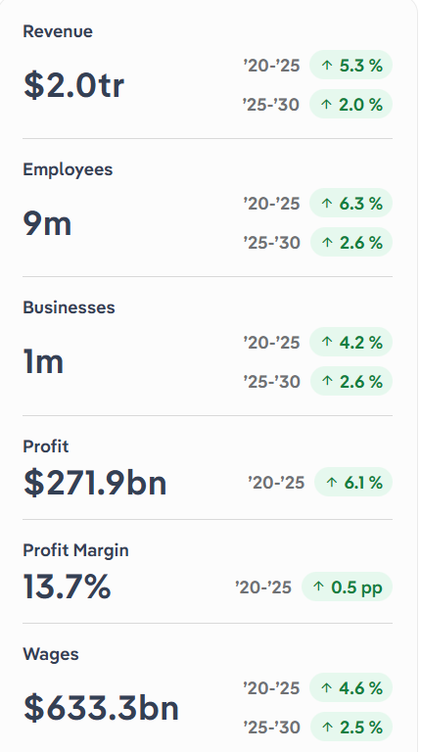
Global Analysis
Global Engineering Services
Driving Forces
Global infrastructure investment
Public sector remains strong despite inflation
EU Green Deal, 2T invested, (renewable energy transition)
Transportation infastrue big market share
Government funded mega projects sustain the project pipeline
Economic Characteristics
Strong labor costs
High wages
Large budgets, significant equipment and material expenses
Efficiency is a key to profitability (resource management, cost efficiency)
Digital tools, AI, computers increase efficiency and margins
External Environment
VERY regulated with lots of requirements
No unified global standards
Compliance burdens based on project
Sustainability regulations pushing firms to renewable and low carbon project expertise

Slide 19
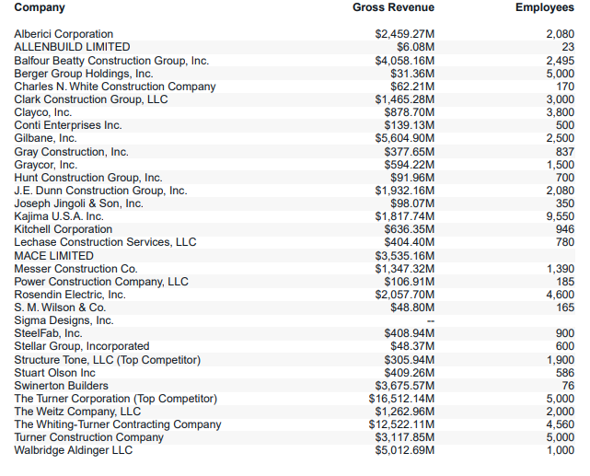
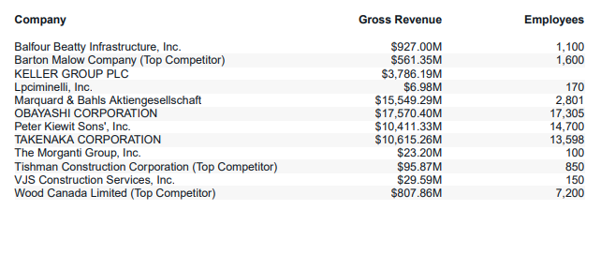
Competitors
Skanska USA Heavy Civil
Skanska USA Building
Displays Skanska position in industry.
Identifies top rivals.
Benchmark for revenue scale, workforce size, and project capacity.
Supports strategic decisions related to market focus.
Notes:
https://www.proquest.com/marketresearch/docview/1860784084/83BDDC151FC846C0PQ/2?accountid=14749&sourcetype=Reports https://www.proquest.com/marketresearch/docview/1860784363/83BDDC151FC846C0PQ/1?accountid=14749&sourcetype=Reports

Slide 20
How to Be Successful
Keys to Succeed:
Establish long-term working relationships with raw material suppliers
Demonstrate strong management capabilities
Secure a skilled workforce and ensure consistent labor availability
Invest in new technologies to enhance efficiency and quality
Allocate services to areas with the greatest demand
Provide appropriate facilities and infrastructure
Develop a strong industry reputation
Understand the economics of scaling operations
Leverage the company’s core expertise

Slide 21
External Analysis
By Eli

Slide 22
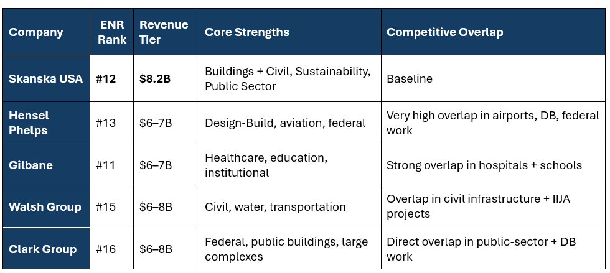
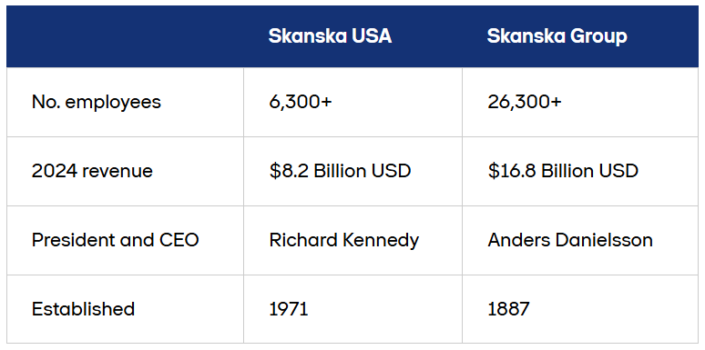
Competitive Analysis
Notes:
For our competitive analysis we choose four competitors in skanska’s revenue range , hensel phelps,gilbane walsh and clark, Each one has specialty.
Hensel Phelps is strong in design-build, airports, and federal projects, so Skanska competes heavily in those areas with them.
Gilbane specializes in healthcare and education, which creates overlap with Skanska’s building projects.
Walsh is strong in civil work, water treatment, and transportation, which overlaps with Skanska’s civil division, especially with the new federal IIJA funding.
Clark is a major federal and public-sector builder and is also strong in design-build, creating direct competition with Skanska in those markets.
Overall, Skanska is balanced across both buildings and civil work and has a strong sustainability reputation, but these four competitors each have a specialty area where they perform very strongly.
Source

Slide 23
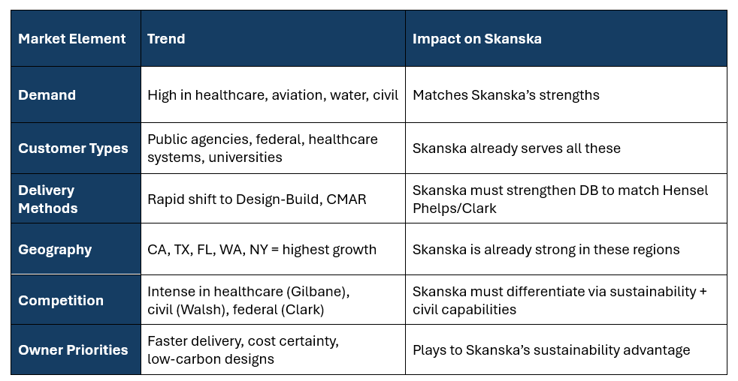
Market Analysis
Notes:
This table explains the current market conditions and how they affect Skanska
The strongest markets right now are healthcare, education, water, airport, and transportation with matches skanska.
Our main customer groups are public agencies, federal clients, healthcare systems, and universities which already Skanska works with them
Skanska mainly do CMGC but needs to diversify more CMAR to compete with other firms like Hensel Phelps and Clark.
A lot of new projects are happening is in California, Texas, Florida, Washington, and New York areas where Skanska already works.
Competition is intense: Gilbane in healthcare, Walsh in civil work, and Clark in federal projects.
In general Skanska is in a good -positioned but must continue focusing on speed, cost control, and sustainability to stay competitive.

Slide 24
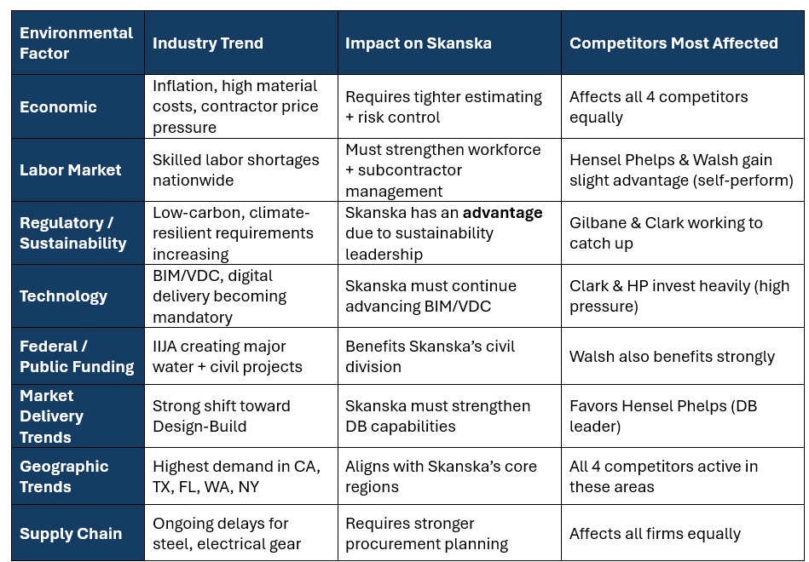
Environmental Trend Analysis Impacting the U.S. Construction
Notes:
Here we have enviromental factors as Economic, Labor market, sustainability, technology, federal funding, market delivery trends, geographic trends and supply chains.
We start with economy, Prices are higher for materials and labor, so Skanska and all competitors must estimate carefully and manage financial risk.
There’s a nationwide labor shortage. Skanska must manage its workforce . Companies that self-perform, like Hensel Phelps and Walsh, they handle this slightly better.
Sustainability rules are increasing, which actually helps Skanska because it’s already a leader in this area.
Technology expectations like BIM and VDC are rising fast. Competitors like Clark and Hensel Phelps invest heavily, so Skanska needs to keep up
The federal government is spending billions on civil and water projects. That helps Skanska and Walsh because both are strong in civil work
Design-Build is growing fast. Hensel Phelps is the leader, so Skanska needs to keep improving in DB
Construction demand is highest in California, Texas, Florida, Washington, and New York. Skanska already has strong operations in all of these regions
Material delays are still common, especially for steel and electrical equipment. All companies deal with this, so Skanska must plan ahead

Slide 25
Financial Analysis (‘20-’24)
By Gabe

Slide 26
Abstract
Overall, Skanska is responsibly managed:
Does not recklessly seek out debt
Prioritizes high inventory turnover
Receivables period is still within reason
Utilizes its assets well
However:
Since the pandemic, Skanska has struggled to regain its footing

Slide 27
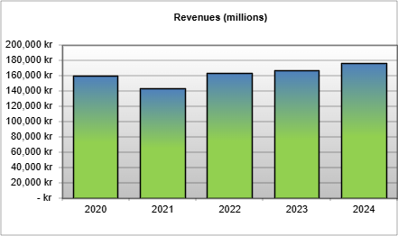
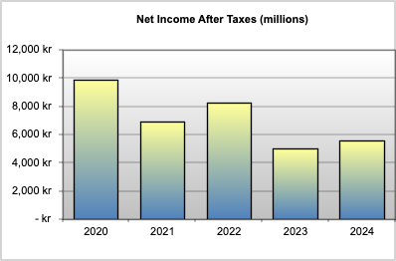
Income Statement Trend
Revenue: Recovering from 2021 pandemic dip
(+13% in 2022, +5% in 2024)
COGS: Averaged 90% of sales, indicating a high-cost operating model
Operating Income: Margins declined from 10.5% (2020) to 8.2% (2024)
Net Income: Fell from 6.2% (2020) to 3.2% (2024)
Causes: FER, project development market not recovering as expected, A/R collection period grew

Slide 28
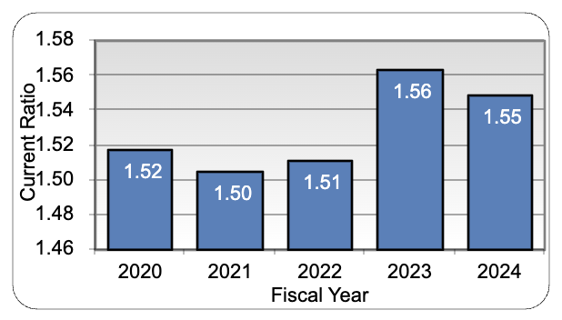
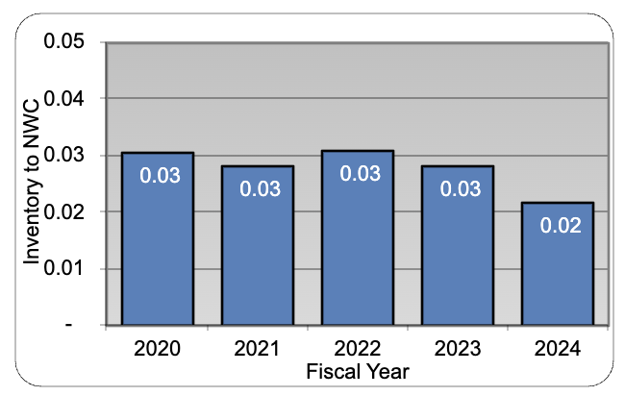
Key Liquidity Metrics
Current Ratio
Inventory to Net Working Capital
Key Takeaway: Great ability to retain liquidity despite financial downturn

Slide 29
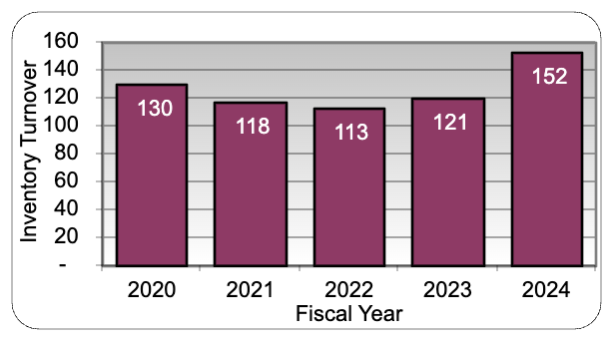
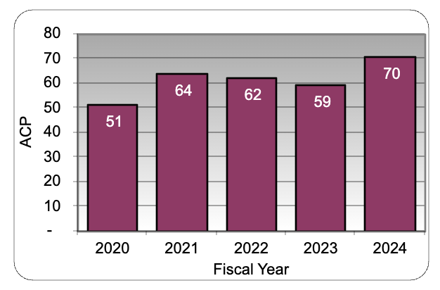
Key Activity Metrics
Inventory Turnover
A/R Collection Period
Key Takeaway: When assets go down, cash comes in. When they go up, cash is used.

Slide 30
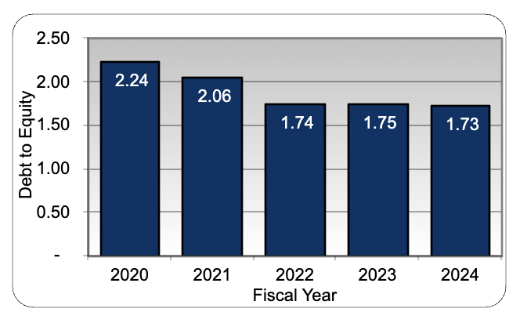
Key Leverage Metric
Debt to Equity
Key Takeaway: Concerted effort to decrease leverage is noticeable and may point to an ambitious push in the future, as they’ll need lender credit

Slide 31
Assessing Skanska’s Strategy
By Sihan

Slide 32
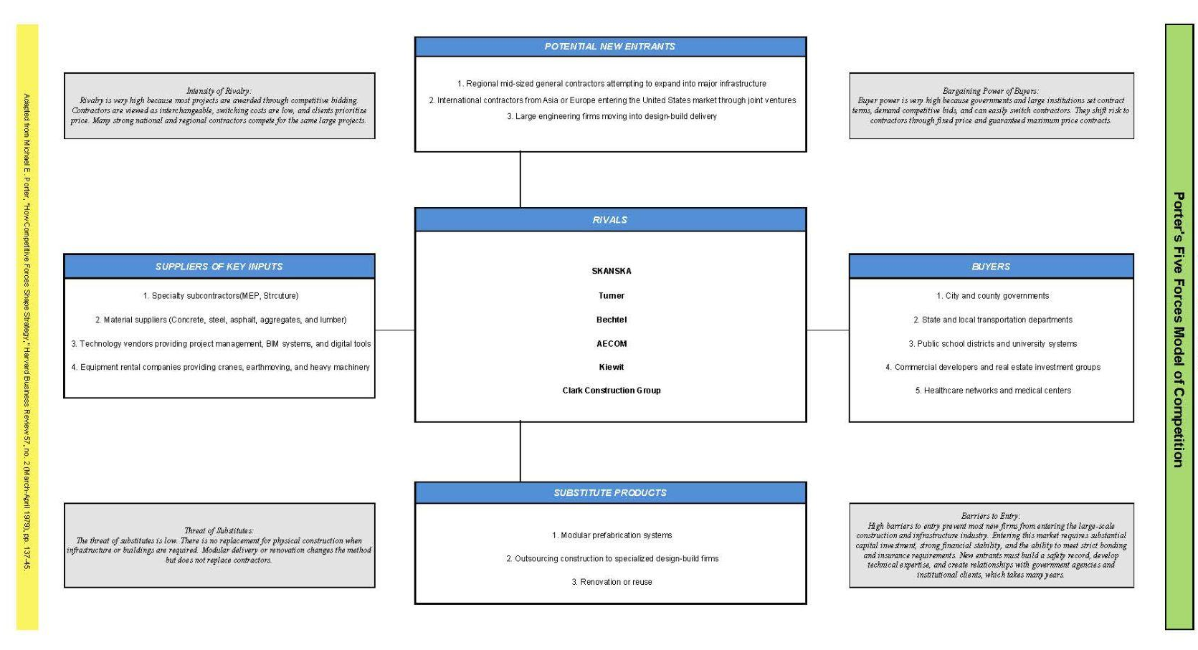
Porter Five Forces Summary
Notes:
The combined pressures create an industry that is difficult, low margin, and risk-heavy. Despite this, Skanska maintains a competitive position due to:
• Scale and technical expertise
• Strong brand reputation in safety and sustainability
• Deep government relationships
• Financial capacity to handle bonding and large project risk

Slide 33
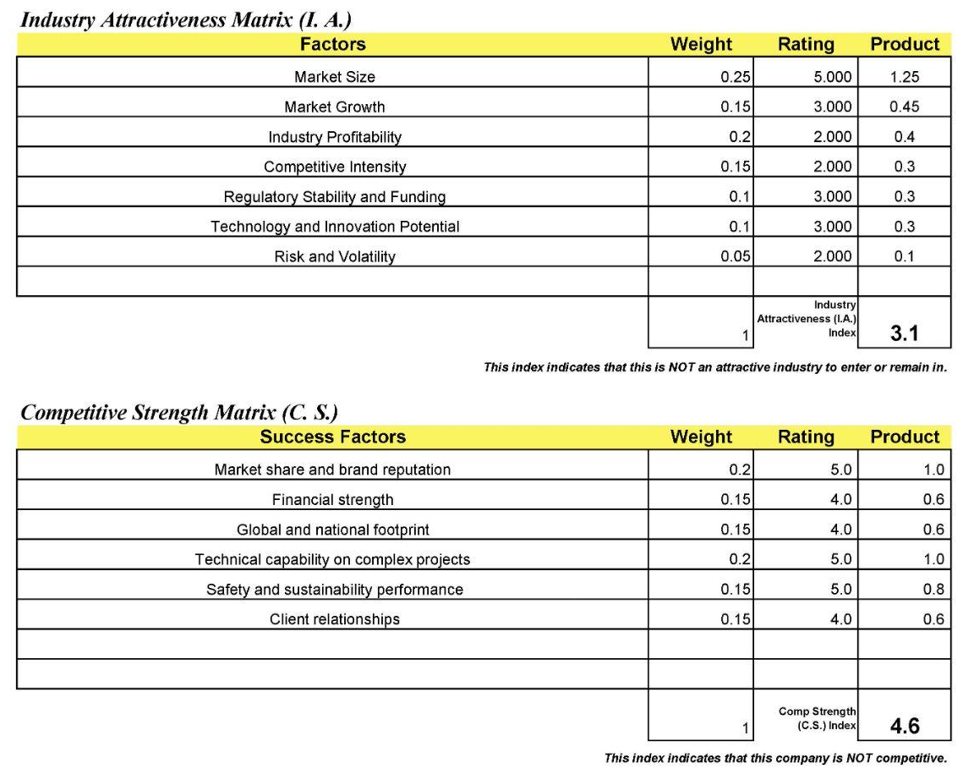
GE MATRIX
Industry Attractiveness Score: 3.1
Competitive Strength Score: 4.6
These values place Skanska in a low attractiveness but high strength position, which implies a very specific strategic meaning.

Slide 34
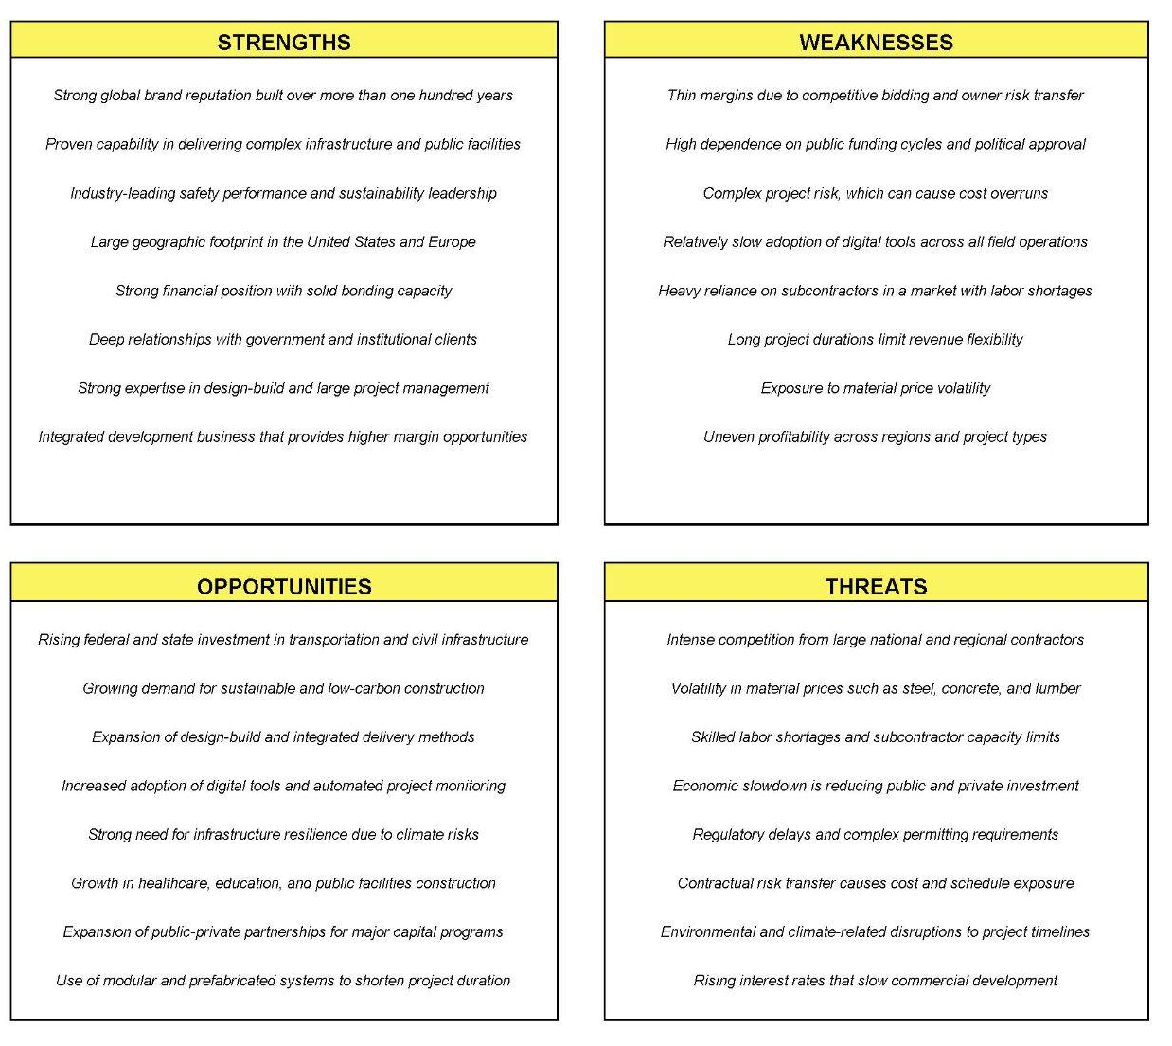
SWOT Analysis
The strategic takeaway:
Skanska should continue selective bidding, invest in digital and sustainability, and avoid exposure to high-risk fixed-price megaprojects while expanding in high-value segments like healthcare, transportation, and resilient infrastructure.

Slide 35
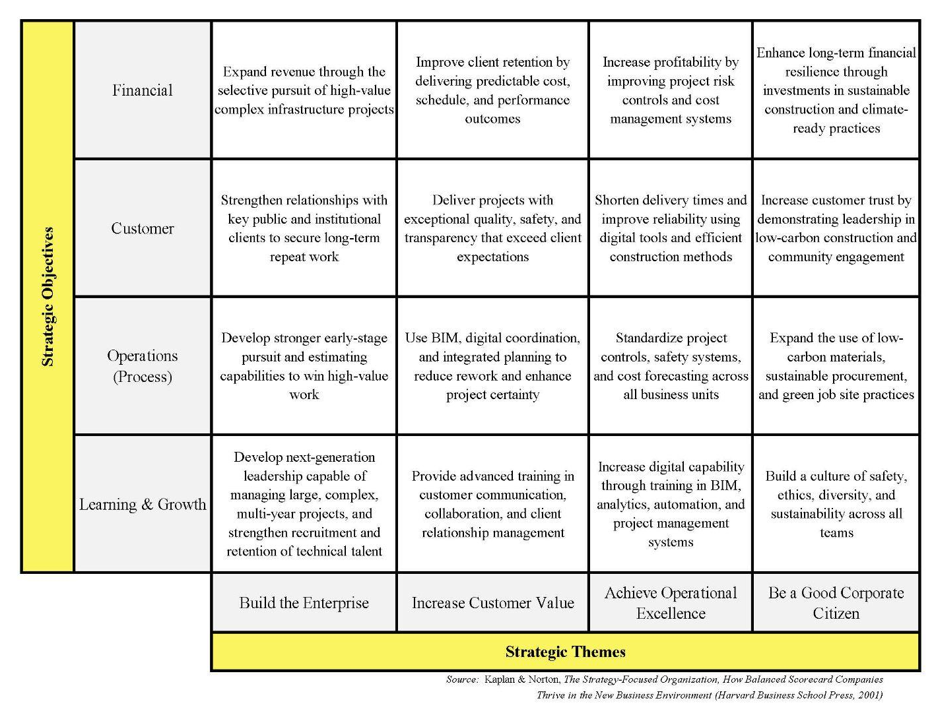
Strategy Map
Skanska’s Strategy Map shows a textbook example of a well-structured, integrated strategy for a major infrastructure contractor.
The map shows a clear cause-and-effect chain:
Invest in people and digital capability → Improve operations → Deliver predictable, low-carbon, high-quality work → Increase client trust and retention → Improve financial performance.
Strategic Objectives | Financial | Expand revenue through the selective pursuit of high-value complex infrastructure projects | Improve client retention by delivering predictable cost, schedule, and performance outcomes | Increase rofitability by improving project risk controls and cost management systems | Enhance long-term financial resilience through investments in sustainable construction and climate-ready practices
 | Customer | Strengthen relationships with key public and institutional clients to secure long-term repeat work | Deliver projects with exceptional quality, safety, and transparency that exceed client expectations | Shorten delivery times and improve reliability using digital tools and efficient construction methods | Increase customer trust by demonstrating leadership in low-carbon construction and community engagement
 | Operations (Process) | Develop stronger early-stage pursuit and estimating capabilities to win high-value work | Use BIM, digital coordination, and integrated planning to reduce rework and enhance project certainty | Standardize project controls, safety systems, and cost forecasting across all business units | Expand the use of low-carbon materials, sustainable procurement, and green job site practices
 | Learning & Growth | Develop next-generation leadership capable of managing large, complex, multi-year projects, and strengthen recruitment and retention of technical talent | Provide advanced training in customer communication, collaboration, and client relationship management | Increase digital capability through training in BIM, analytics, automation, and project management systems | Build a culture of safety, ethics, diversity, and sustainability across all teams
 |  | Build the Enterprise | Increase Customer Value | Achieve Operational Excellence | Be a Good Corporate Citizen
 |  | Strategic Themes

Slide 36
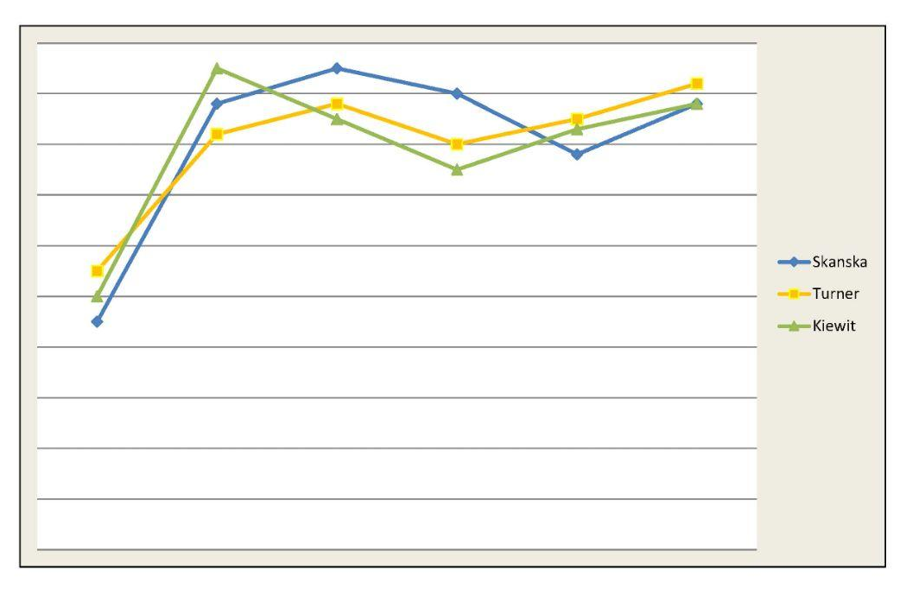
Strategy Canvas
This takes the form of a graphical two-dimensional representation:
The x-axis comprises a list of the factors the industry currently competes on, such as price, technical capability, safety performance, sustainability leadership, etc., and the y-axis represents the offering level that buyers receive across all these competing factors (no scale is possible since the levels pertain to many factors, but the range is from low to high).

Slide 37
Strategic Alternatives for Skanska
Based on Abraham Metrics and Skanska's historical performance, the best alternative for Skanska is green leadership and future-proof construction.
Reasons:
Aligns with Skanska's values of safety, sustainability, and ethics.
Global governments are investing in net-zero infrastructure that will last for decades.
Creates strong differentiation from competitors like Turner, Bechtel, and AECOM.
Positions Skanska to win high-value public sector work where sustainability scoring is required.
Reduces long-term operational costs through energy and material efficiency.
Strengthens brand reputation, which improves hiring, partnership, and client trust.
Gives Skanska a strategic identity that cannot be easily copied.

Slide 38
Should You Invest In Skanska?
By Gabe

Slide 39
2025 Third Quarter Report Summary
FER: 1 USD = 10 SEK

Slide 40
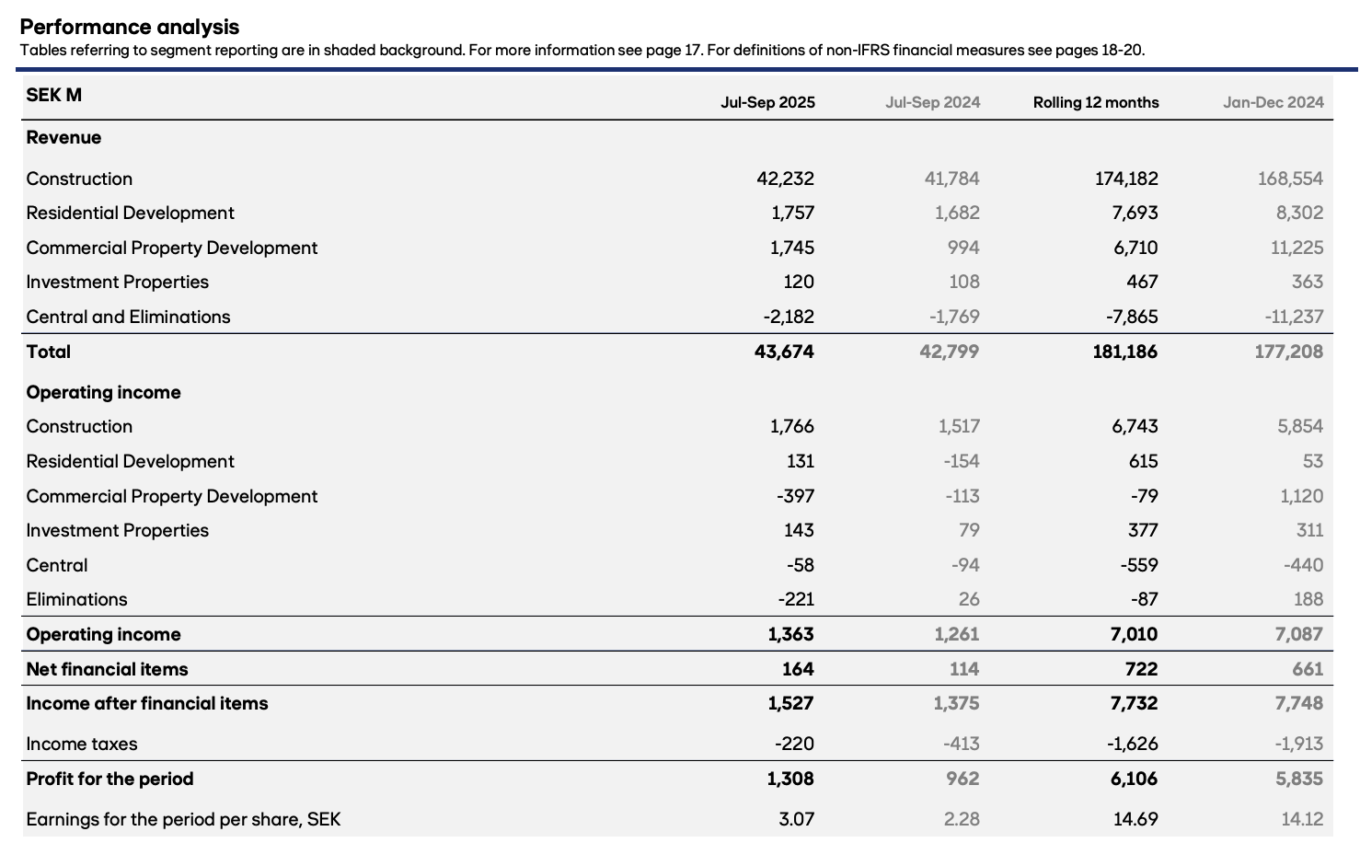
3Q Performance Analysis
→ Revenue up by 1 MSEK
→ Profit gain of 0.4 MSEK
→ EPS increased 50%
Source: Skanska 2025 3rd Quarter Report

Slide 41
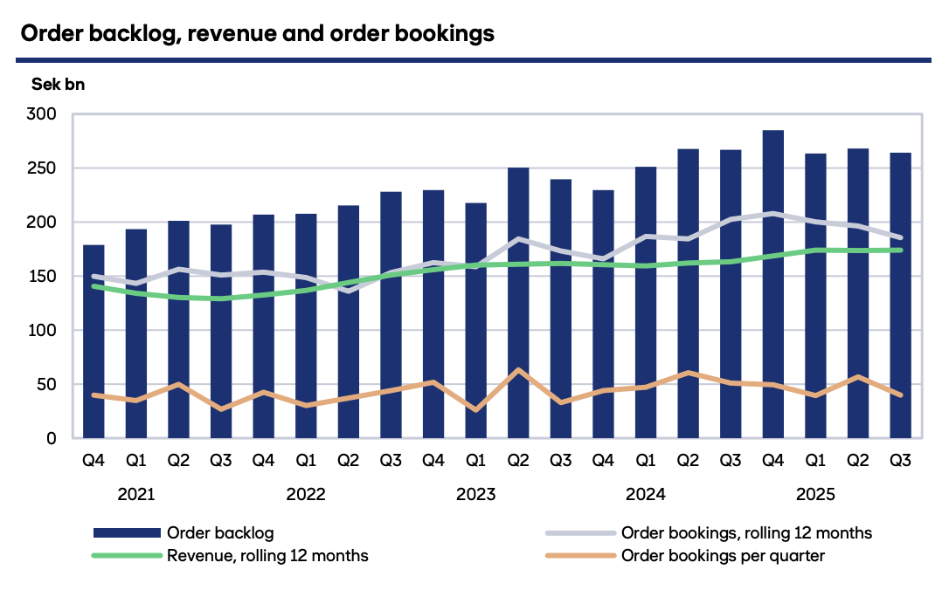
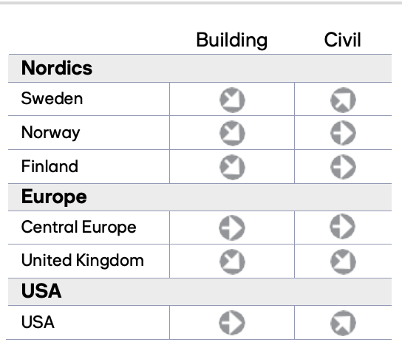
Order Backlog
→ Order backlog of 264 BSEK
→ Order bookings of 40 BSEK
Source: Skanska 2025 3rd Quarter Report

Slide 42
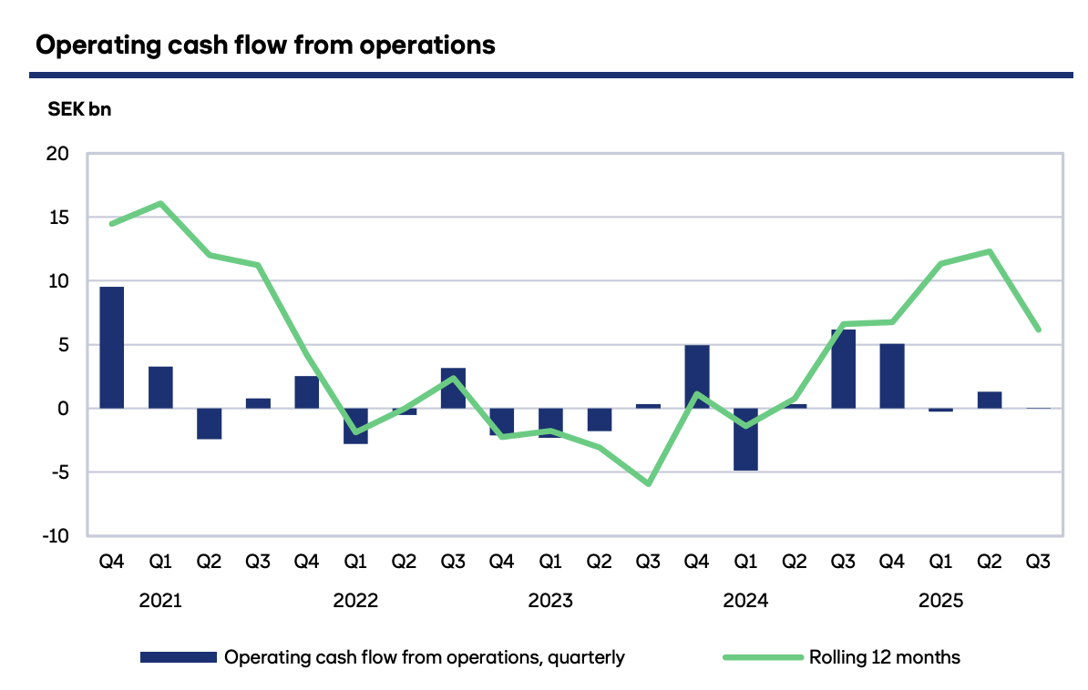
Operating Cash Flow
→ Cash flow came out to net zero
→ Causes: changes in working capital and investments in project development
Source: Skanska 2025 3rd Quarter Report

Slide 43
Stock Exchange: NASDAQ Stockholm
Ticker: SKA-B

Slide 44
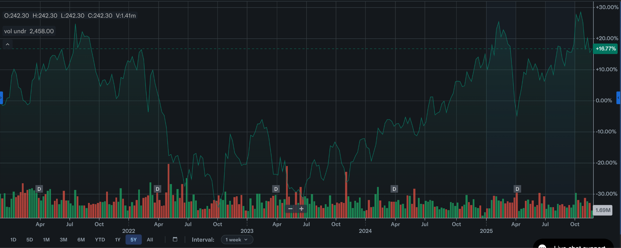
Price of Stock Over Last 5 Years
→ Current Price: 242 SEK
→ 5 Year Growth: +16%
→ Downtrend in 2023
(5 year low in NIAT)
→ Strong uptrend since start of 2024 (real estate market slowly returning to baseline)
→ Trailing P/E Ratio: 16
Source: Yahoo Finance

Slide 45
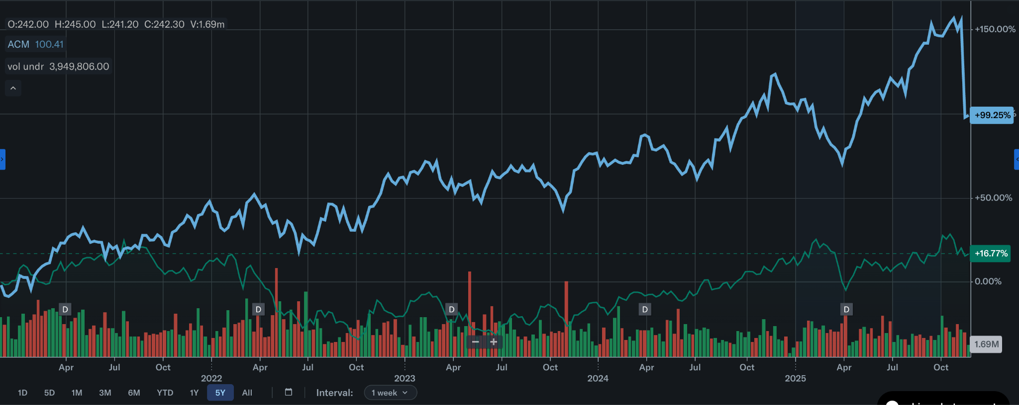
AECOM vs. Skanska
→ Strong growth from AECOM
→ 5 Year Growth: +100%
→ Why buy SKA-B over ACM? Cheaper
Source: Yahoo Finance

Slide 46
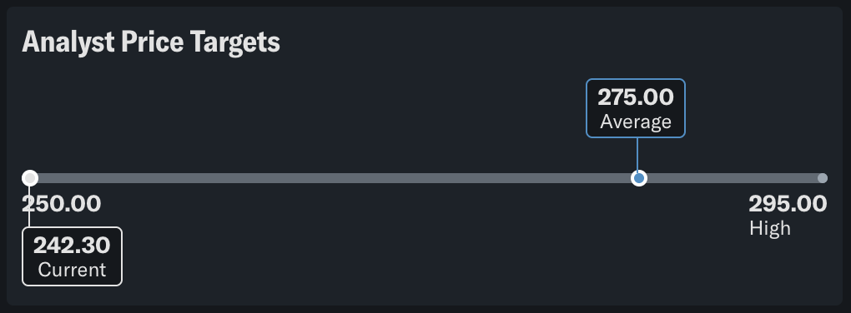
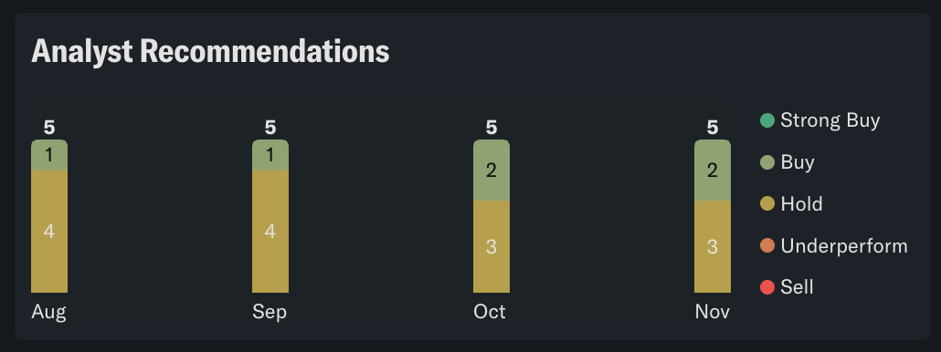
Analysts’ Recommendations
→ Analysts forecast stock price will grow by 23 SEK in the next 12 months
→ 2 out of 5 analysts recommend buying
Source: Yahoo Finance

Slide 47

Growth of Your Investment
→AROI = 3.3% (last 5 years)
Assume you bought 100 shares of SKA-B at 250 SEK each
That would be $2500 (the cost of 1 unit at USC)
In 10 years, that would be worth $3,460 in FV or $2,574 in PV
So you could buy one unit of CE 502 and fill up your car

Slide 48

So should you buy?
→No
Invest in Nvidia, whose 10 year annualized return is 71%
But if you want to invest in a construction company, invest in one that builds nuclear facilities

Slide 49
Thanks for listening to our presentation
Questions?
Presented by Team 2: Shahrzad Ghorbannia, Henry Glover, Gabriel Garfias, Eli Naderikooshesh, Sihan Chen

