Slide 1
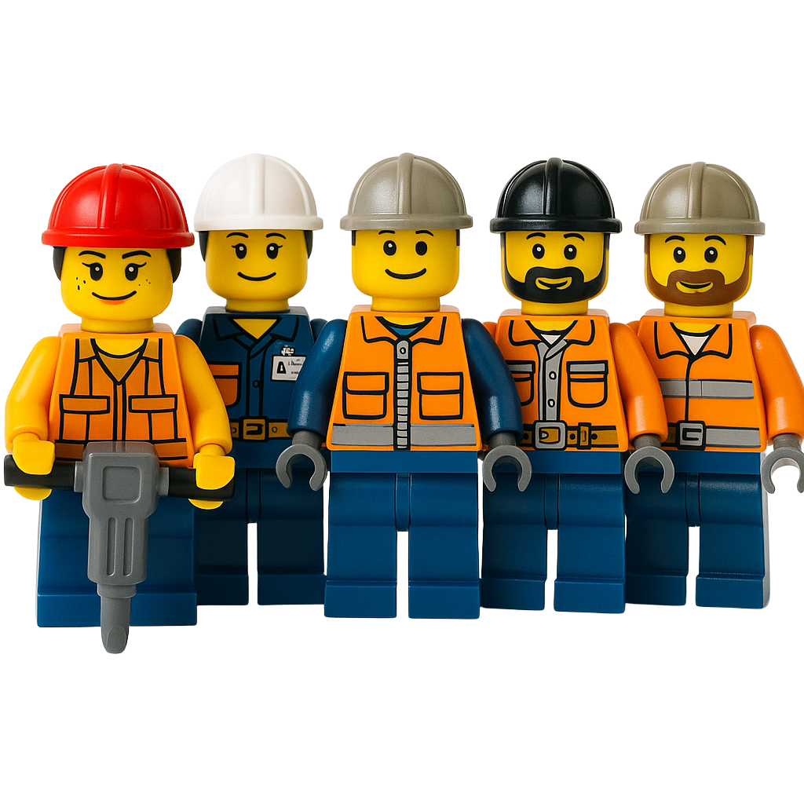
Company Failure Analysis - Lego
CE 502 - Construction Accounting, Fiance and Strategy
Professor Ed Reynolds
Presented by Team 2: Shahrzad Ghorbannia, Gabriel Garfias,
Eli Naderikooshesh, Henry Glover, Sihan Chen

Slide 2
Agenda
What business was LEGO originally in, and what made it successful? Slide 3
How did LEGO build its reputation in the toy market? Slide 2
How did LEGO drift away from its core business? Slide 4
What new directions did it pursue in the 1990s and early 2000s? Slide 4
What problems pushed LEGO close to failure? Slides 8-11
Why weren’t their new strategies working? Slide 12
What lessons and changes came from LEGO’s turnaround?
How did LEGO recover in the mid-2000s?
How is LEGO doing now?
Notes:
Shahrzad: We’ll cover: LEGO’s origins and reputation, how it drifted in the late ’90s/early 2000s, what pushed it close to failure, why fixes didn’t work at first, and how lego learned from these mistakes and where LEGO stands now.”

Slide 3
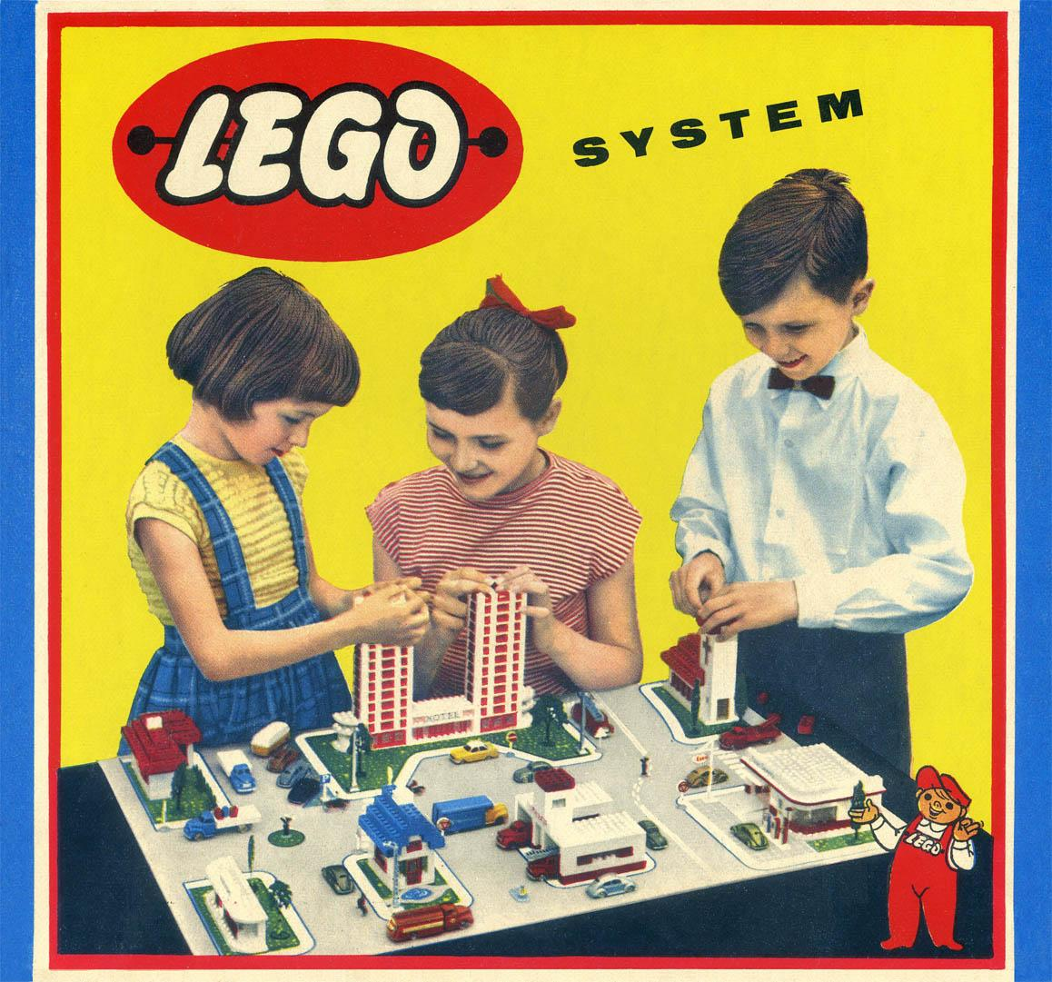
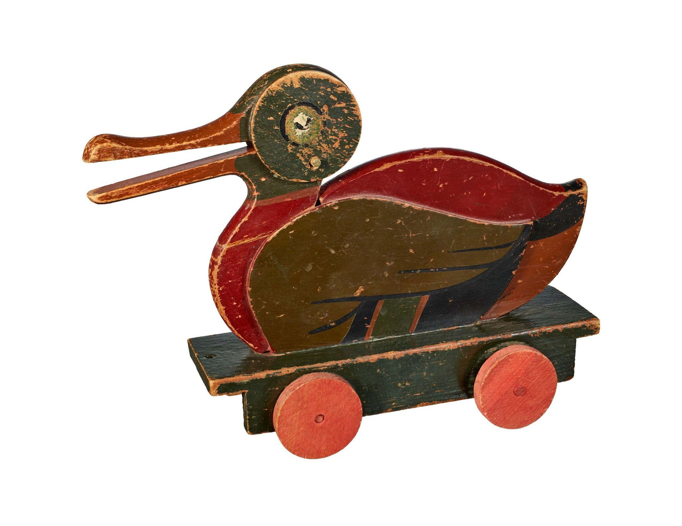
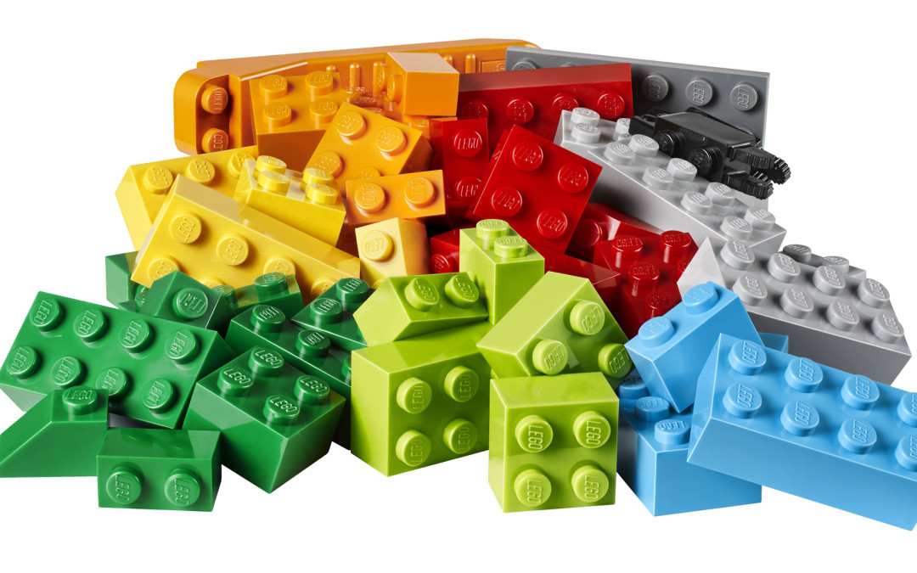
1 - Business Description
What business was LEGO originally in,
and what made it successful?
(Shahrzad)
Company Origin
Began (1932) as a Danish wooden-toy workshop
Started making wooden toys (yo-yos, trucks, animals), they focused on craftsmanship and high-quality
Name from “Leg Godt” = “play well.”
Introduction of Plastic
In 1947, the founder purchased a plastic injection molding machine
In 1949, the company began producing interlocking plastic bricks
1958, patented the lego brick and its interlocking mechanism
‹#›
Notes:
“LEGO starts in 1932 as a Danish wooden-toy shop focused on craftsmanship. Name means ‘play well.’”
“Pivots to plastic: 1947 injection molding; 1949 interlocking bricks; 1958 patents the modern stud-and-tube locking system.”
“The success formula: quality manufacturing + universal interlock across sets → endless rebuildability and loyalty.”

Slide 4
1.1 - Core Values of LEGO
How did LEGO build its reputation in the toy market?
(Shahrzad)
Quality + Consistency
Bricks engineered to interlock across sets and decades (“System of Play”).
Creativity First
Open-ended building
→ imagine, build, rebuild.
Learning Through Play
Durable, educational design made LEGO more than a toy.
Proof of Trust
Long-term revenue growth shows sustained consumer confidence.
Notes:
“Four pillars drove reputation:”
“Quality & consistency—bricks click across decades; a true ‘System of Play.’”
“Creativity first—open-ended building encourages imagination.”
“Learning through play—more than a toy; it teaches problem solving.”
“Proof in the market—long, steady demand shows trust in the product.”

Slide 5
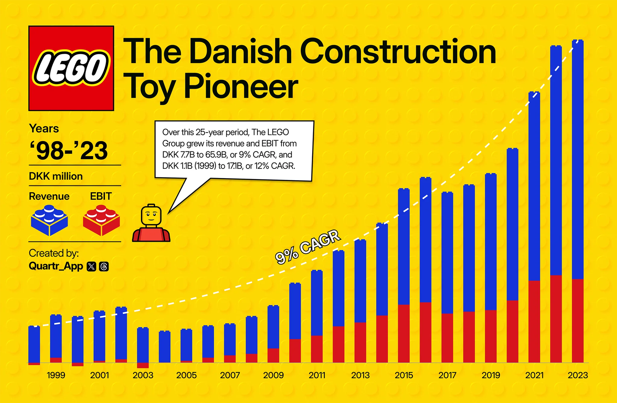
1.1 - Long term Performance (Shahrzad)
Privately held (never publicly traded, Transparency gives insight into financials & strategy despite private status
Revenue CAGR ≈ 9% over ~25 years
Indicates consistent, well-run operations and brand resilience-
CAGR = Compound Annual Growth Rate
Notes:
LEGO’s New Directions (1990s–Early 2000s)
Digital/Gaming push (1996–2002): Launched LEGO Media; hit PC titles like LEGO Island (1997), LEGO Racers (1999), LEGO Creator (1998), LEGO Chess (1998).
Filmmaking kits: LEGO Studio (2000) and the Steven Spielberg MovieMaker Set (2000) with USB camera & stop-motion software.
Big IP licensing: First major deal—Star Wars (1999); then Harry Potter (2001), Spider-Man (2002), Disney tie-ins, NBA (2003) with first natural-skin-tone minifigs.
Early childhood focus: Merged DUPLO and LEGO Baby into LEGO Explore (2002).
Theme parks expansion: Operating LEGOLAND parks—Windsor (1996), California (1999), Deutschland (2002).
Lifestyle/apparel: Licensed LEGO Wear (kids’ clothing) in Europe.
So what? LEGO diversified beyond bricks—into games, film-making tools, licensed IP, parks, preschool, and apparel—to grow the brand and reach new audiences.

Slide 6
2 - How did LEGO drift away from its core business?
(Shahrzad)
Digital & Interactive
Licensed Partnerships
LEGO Media (’96), PC games (Island, Racers, Creator, Chess), LEGO Studio & Spielberg MovieMaker (’00).
Moved beyond core brick expertise into software/hardware where LEGO lacked advantage.
Partnerships with Star Wars, Harry Potter, Spider-Man, Disney, NBA.
License-first mindset; exploding different types of experimental lines resulted in too many SKUs/colors/molds and
more big specialized pieces → higher costs, less creativity/replay value.
Theme Parks
Preschool Expansions
LEGOLAND expansion: Windsor (’96), California (’99), Deutschland (’02).
Capital-intensive operations far from toy manufacturing strengths; management distraction and margin pressure.
Streamlined preschool toys
(DUPLO & Baby → LEGO Explore, 2002)
with a learning-through-play focus,
and extended the brand into everyday kids’ apparel via LEGO Wear
Scattered bets in non-brick, lower-margin categories (apparel, non-system toys) diluted focus and operational discipline.
Notes:
“Late ’90s/early 2000s, LEGO spreads into areas far from its core brick system:”
“Digital/interactive (PC games, MovieMaker kits) without clear hardware/software advantage.”
“License-first mindset (Star Wars, Harry Potter, NBA, Disney) → explosion of SKUs, colors, unique molds; costs up, replay value down.”
“Theme parks—capital intensive, operational distraction.”
“Preschool/apparel expansions—non-system, lower-margin categories dilute focus.”

Slide 7
3 - What Problems pushed LEGO close to Failure?(Gabe)
1. “Kids were getting older younger”
- David Robertson
2. Too Innovative
3. Shift in Bargaining Power
4. Decline of the dollar
Due to the rise of the consumer-electronics market, kids were no longer interested in play material toy products.
LEGO’s extensive product portfolio cannibalised on the sales of its core products.
Toys were now being bought in larger stores, like Walmart. Sales at smaller retail stores began to fade, allowing larger ones to demand lower prices, exclusive products, and higher profit margins.
The foreign exchange rate between the dollar and krone had declined, resulting in less earnings.

Slide 8
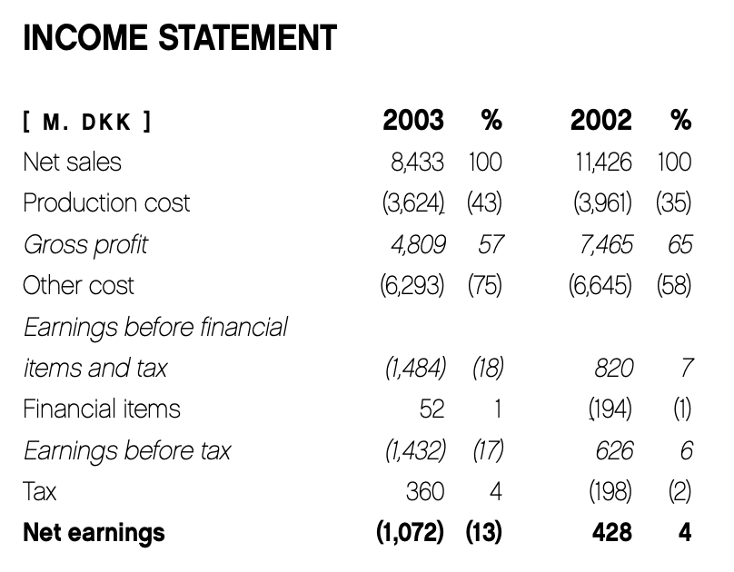
Key Points
Net sales declined
by 3 billion krone between ‘03 and ‘02
Net earnings was a loss of 1.072 billion krone in ‘03
(Annual Report 2003 LEGO Company)

Slide 9
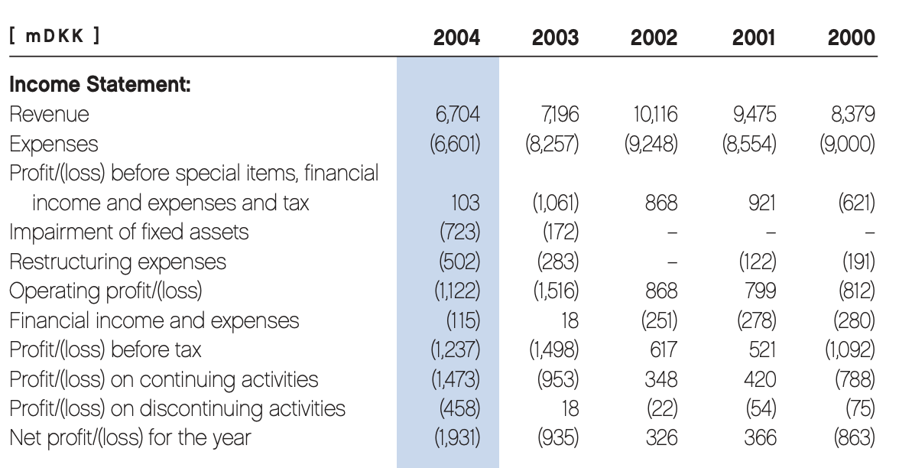
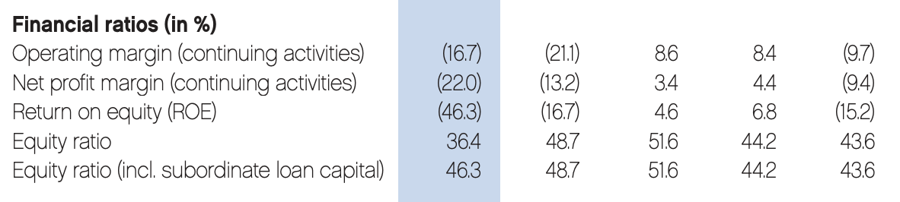
Key Points
Net loss had grown by about 1 billion krone from ‘03 to ‘04
Net profit margin grew to -22% in ‘04
(Annual Report 2004 LEGO Group)

Slide 10
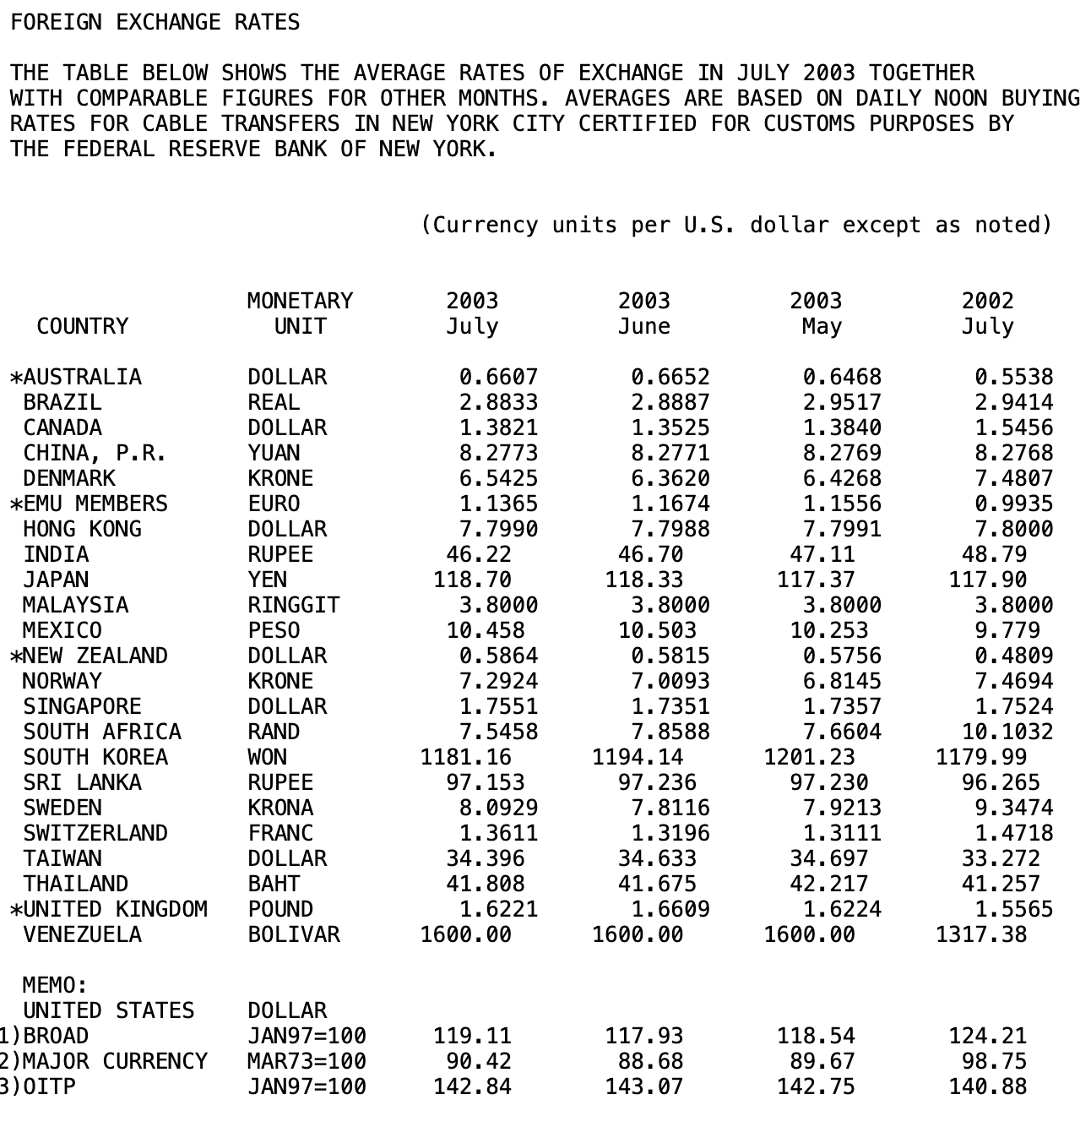
Key Points
1 dollar was now worth 6.54 krone in ‘03, instead of 7.48 krone in ‘02
(Federal Reserve Statistical Release)

Slide 11
3.1 - Why Weren’t New Strategies Working? (Gabe)
1. LEGO aimed to boost sales with the creation of movie tie-in products
2. Failed to remember their customer base
Products linked to popular franchises like Star Wars and Harry Potter were short term solutions. Movie tie-in products relied heavily on the release of new movies, so sales quickly faded after release.
LEGO’s customers weren’t into their auxiliary ventures. LEGO tried so hard to anticipate their customers’ demands that the company forgot to simply ask them what they wanted to see.

Slide 12
4- What lessons and changes came from LEGO’s turnaround?
(Shahrzad)
Focus Beats Sprawl
Standardization
- Growth has to reinforce the core value proposition: open-ended building with a compatible “system of play.”
- Discipline cash, cost, and unit economics before growth.
- Shed the capital burden (Side business.
- Too many SKUs/unique parts bloat cost, slow design, and fragmented supply chains.
- Standardization multiplies speed and margin.
Protect Brand Identity
Targeted Customer
- Pair licensed blockbusters with strong originals (City, Technic, BIONICLE) to reduce volatility and protect brand identity.
- Digital, film, and robotics worked when they extended brick play (Mindstorms, LEGO games/movies), not when they tried to replace it (Action-figure detours).
- Adult Fan of LEGO (AFOL) engagement and LEGO Ideas (fan-designed sets) improved hit rate, de-risked bets, and deepened loyalty.
Notes:
Slide 12 — Lessons from the Turnaround
“Focus beats sprawl—growth must reinforce the System of Play; shed side businesses.”
“Standardize—fewer SKUs/unique elements → faster design cycles, cheaper supply chains.”
“Protect brand identity—balance licenses with strong original IP to reduce volatility.”
“Target the right customers—activate AFOLs and co-create to raise hit rates.”

Slide 13
4.1- How did LEGO recover in the mid-2000s?
(Shahrzad)
Refocus the Core
Simplify the System
In 2004, Lego shifted its strategy, which abandoned many side businesses (clothing, media spinoffs, even LEGOLAND parks) and re-centered on the core LEGO brick-based play system.
- Stabilize Cash
LEGO reduced its unique element library by approximately 50%. Standardization reduced costs, simplified design, and improved supply chains. Factories were restructured for efficiency, with some production outsourced to partners.
- Stabilize Cash + Standardize to scale
Portfolio Discipline
Community & Channels
LEGO doubled down on Star Wars and
Harry Potter, but also balanced them with strong original IP (Technic, City, BIONICLE).
LEGO implemented a more disciplined approach, tracking sell-through rates, profitability per theme, and dropping underperformers faster.
- Govern innovation
LEGO began collaborating with fan communities (Engage AFOLs, Supporting Mindstorms hacks, later launching LEGO Ideas for user-submitted sets).
- Community as an R&D force

Slide 14
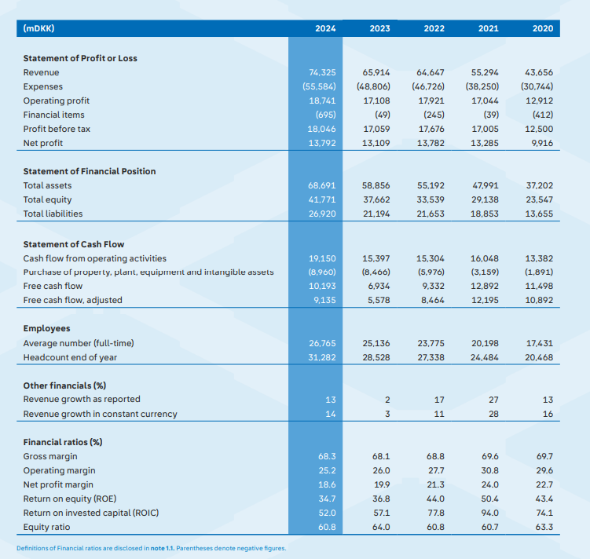
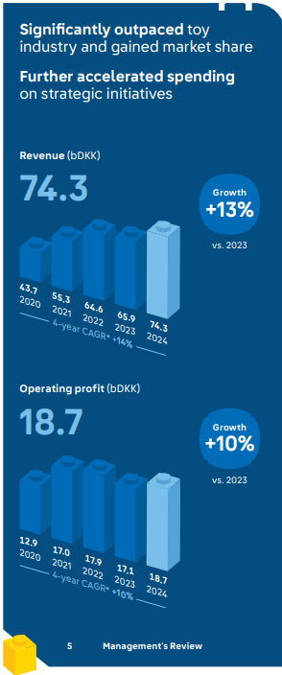
4.2 How is LEGO doing now? (Gabe)
LEGO is in a strong position
10.193 Billion in free cash flow (2024)
Revenue and profits at historic highs
Up 13% from 2023
12% Increase in consumer sales
Growth in all major metrics
Investments in sustainability and expansion
½ material purchased were from sustainable sources
New regional distribution centers (Belgium and Vietnam)
New factories (Vietnam and U.S.)
Existing factory expansion (China, Hungary, Mexico)
Lots of product innovation
840 products, 46% were new in 2024

Slide 15

Any questions?
Thanks for Listening to our presentation!
Notes:
The LEGO example highlights the risk of losing focus by diversifying too much. Applying this to construction means avoiding the trap of being a jack-of-all-trades. Instead of taking on projects that require you to completely reinvent your processes, you should expand into areas where you can reuse a significant portion of your existing playbook.
This "system of build" includes your core crews, trusted vendors, and established control methods. By focusing on projects where at least 70% of this system is reusable, you can ensure that each new project strengthens what you already do well. This approach minimizes the need for new processes, reduces errors like RFIs and rework, keeps schedules on track, and protects your profit margins.
In essence, the strategy is to grow by replication, not reinvention. You should only pursue work where your proven system gives you a competitive advantage.

